Slide 1
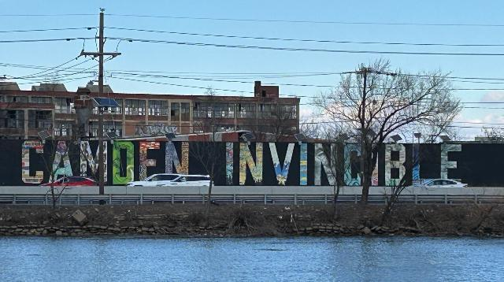
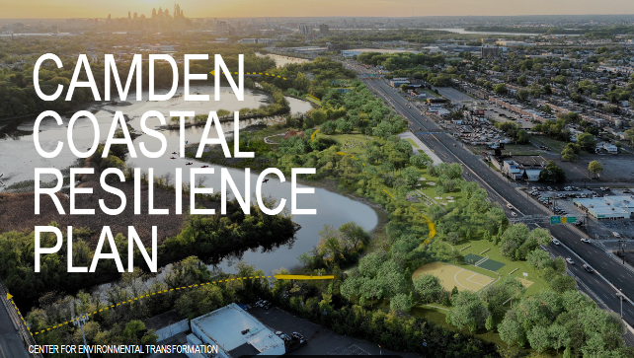
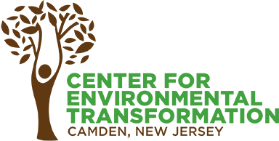



Development of the 2025 Camden Coastal Resilience Plan
Jon Compton, AJ Riggs, Anushka Samant, Ellen Neises, Ellen Kohler, Brianne Callahan, John Henderson, Ahmad Payab, Nirajan Adhikari, and Franco Montalto*

Slide 2
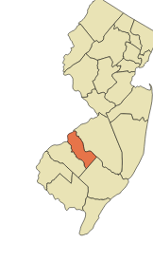
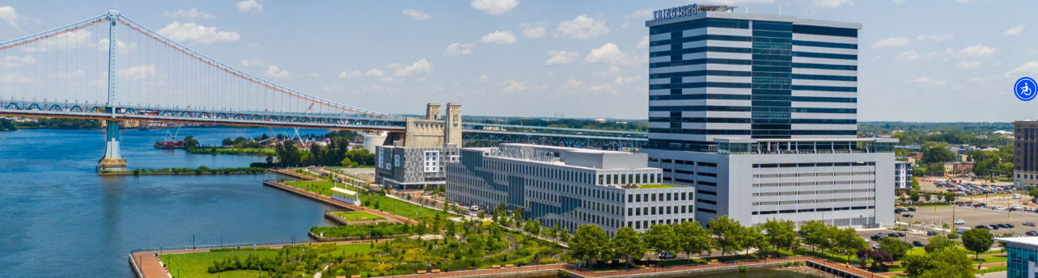
Overview of presentation
Project origin and process
The focus on flood mitigation
Five resilience strategies
Four early investments

Slide 3
Project Origin and Team
Project lead:
The Center for Environmental Transformation (CFET)
Funding:
National Fish and Wildlife Foundation (NFWF) Community Capacity Building and Planning Grant (Phase 1)
Project Team:
PennPraxis, eDesign Dynamics, the Penn Water Center, and Drexel University (through CCMUA)

Slide 4
Strategic Alignment
NFWF goals
Community resilience
Nature-based solutions
Increase in (contiguous) habitat with connected corridors
NFWF positioning - prepare for future phases of the NFWF grant program:
Phase 2: Site assessment and preliminary design
Phase 3: Final design and permitting
Phase 4: Restoration implementation
Neighborhood, City, and State Priorities and Plans
There are and have been many!
CCMUA goals
85% reduction in CSOs to the Cooper River

Slide 5
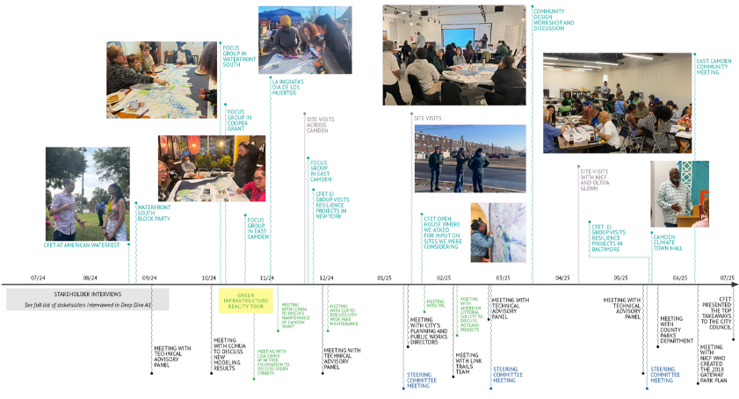
Our 18-month process
Stakeholder interviews
Formation of a Technical Advisory Panel (decision-makers and professionals in the space)
Formation of a Project Steering Committee (neighborhood orgs and community leaders)
Focus group meetings
One-on-one meetings with key stakeholder groups
Onboarding of community ambassadors
Community meetings and workshops
Site visits across Camden
Site visits to other cities

Slide 6
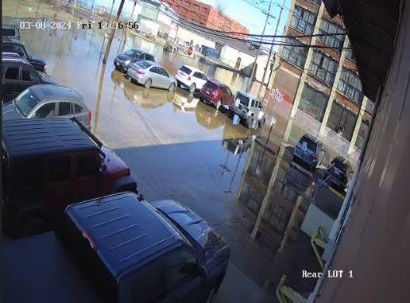
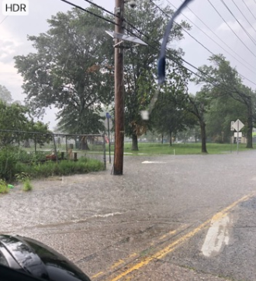
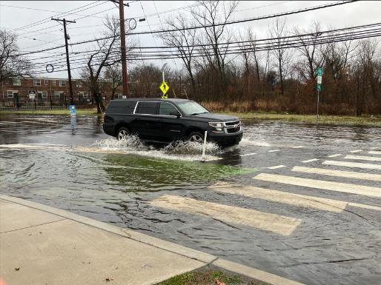
Flooding – the top priority for residents, the City, and the county

Slide 7
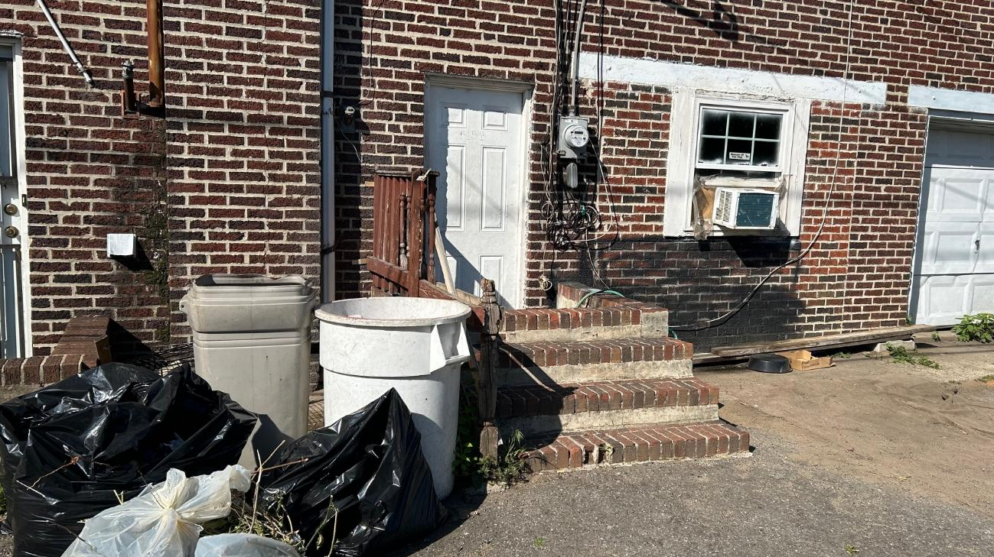

Slide 8
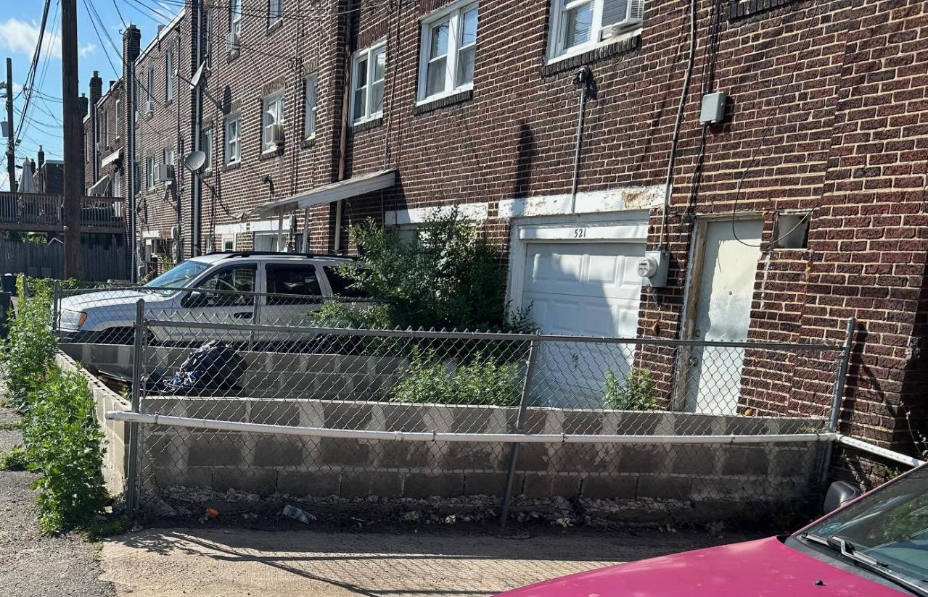

Slide 9
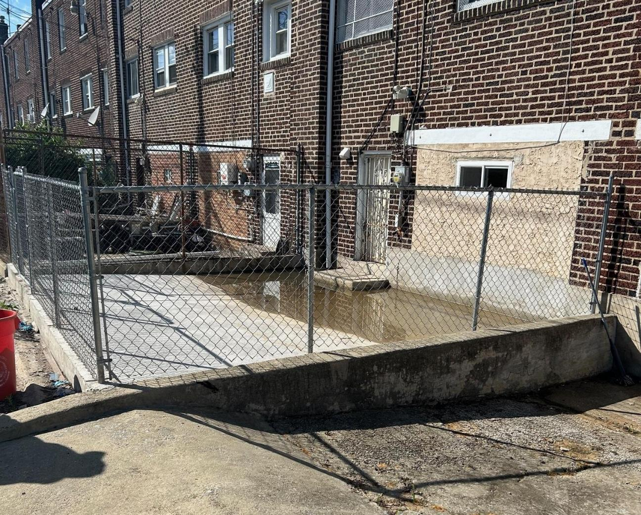

Slide 10
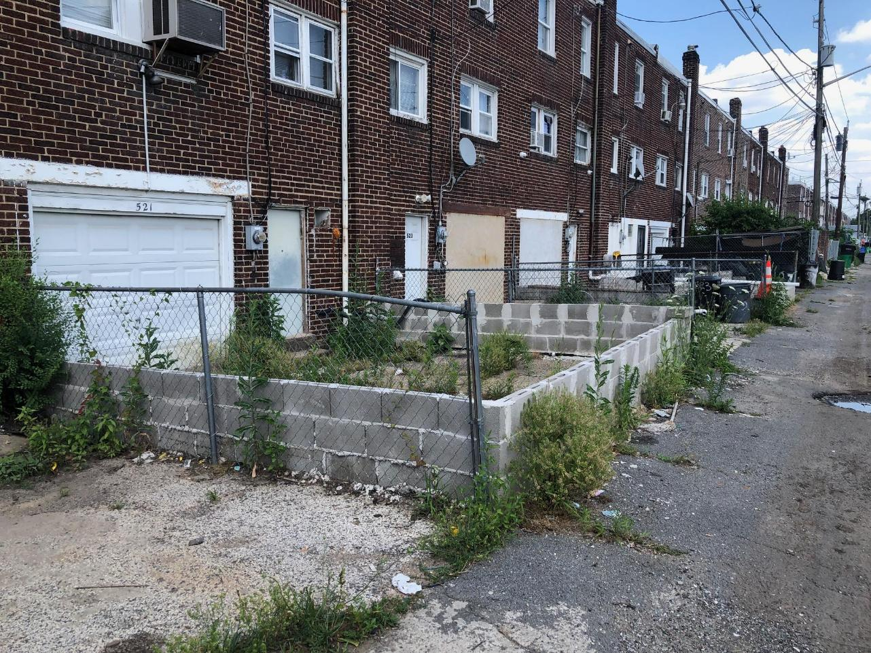

Slide 11
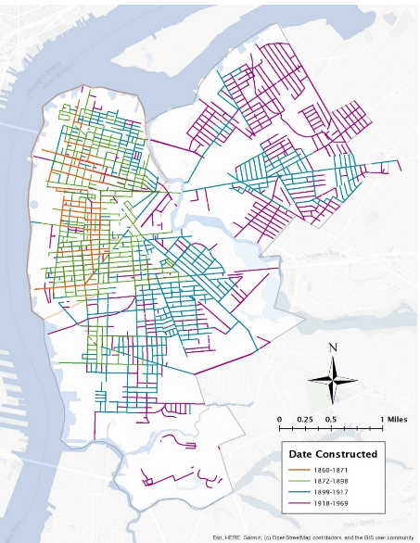
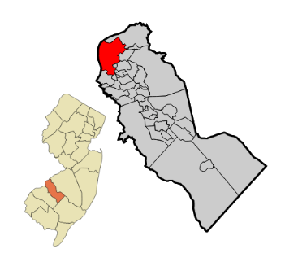
Leveraging CCMUA’s LTCP Process
Currently developing alternatives for its LTCP and is committed to reducing both CSOs into the Cooper and Delaware River and flooding

Slide 12
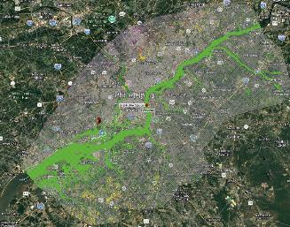
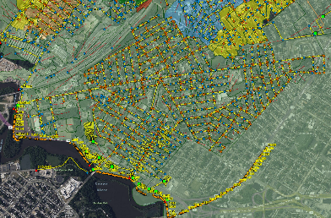
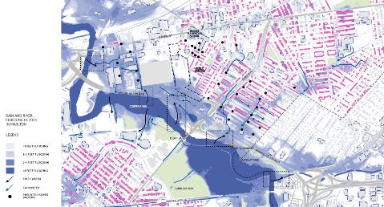
Understanding flooding in a coastal CSO city
Regional modeling 🡪 2D HEC-RAS
Localized site investigations 🡪 Scalgo
Detailed H&H Modeling 🡪 1D-2D integrated all pipes PCSWMM model

Slide 13
Key Findings

Slide 14
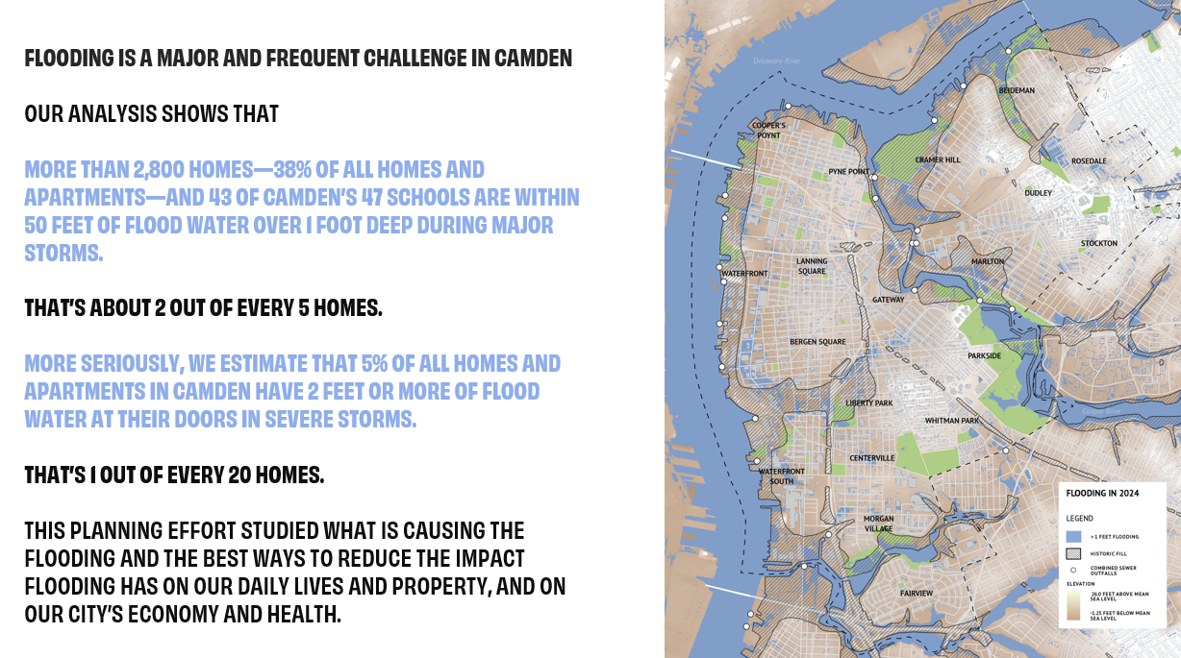

Slide 15
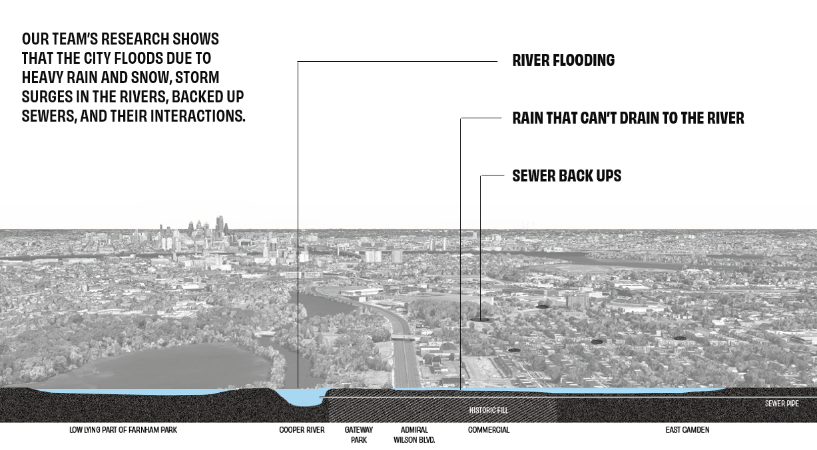

Slide 16
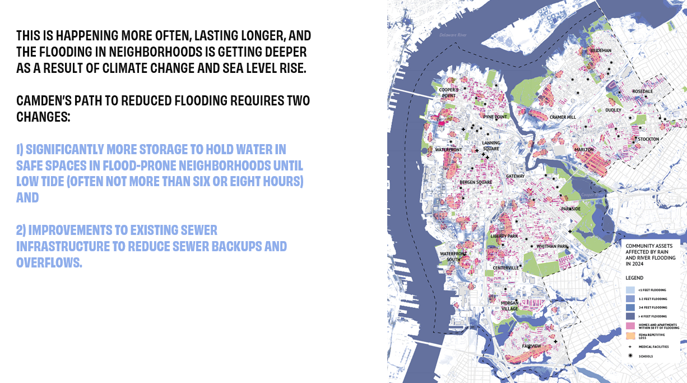

Slide 17
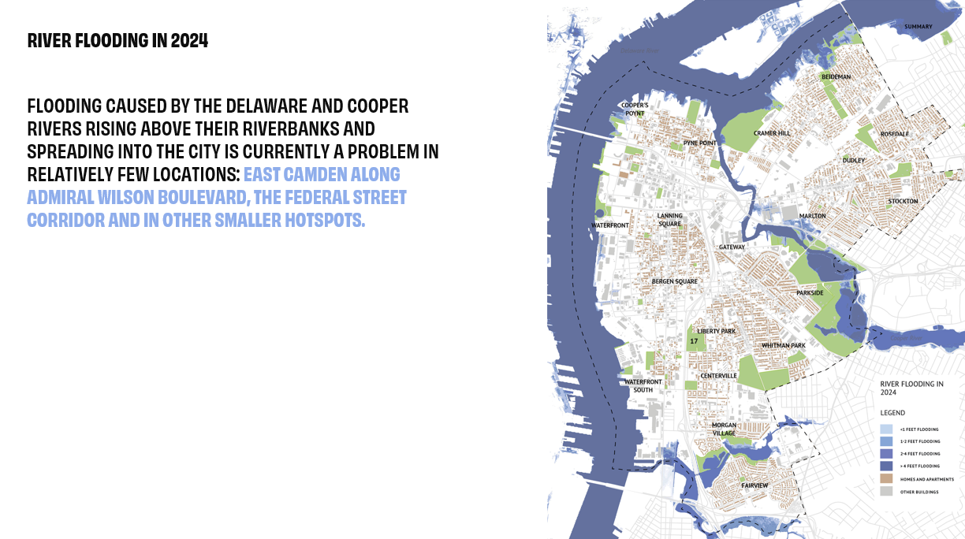

Slide 18
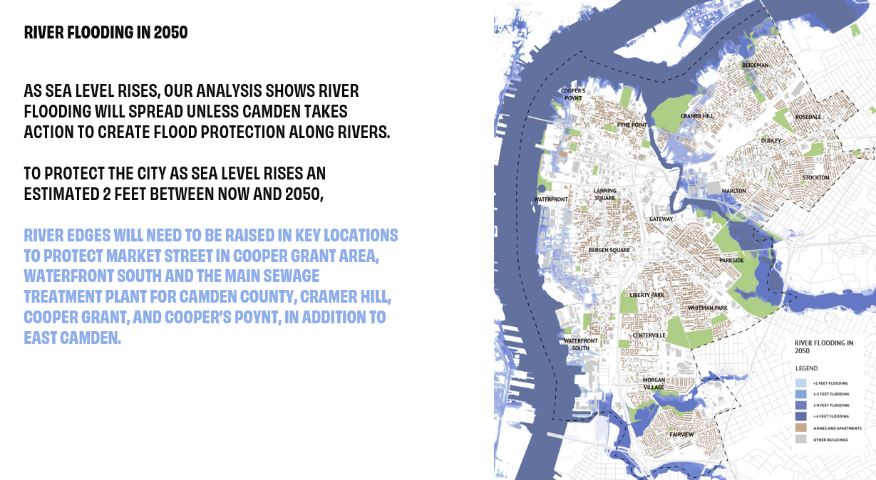

Slide 19
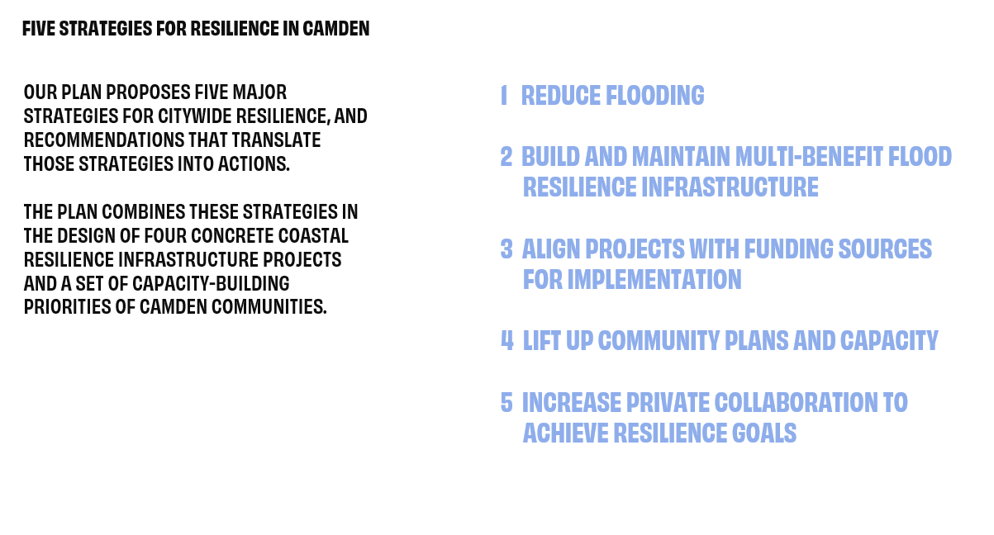

Slide 20
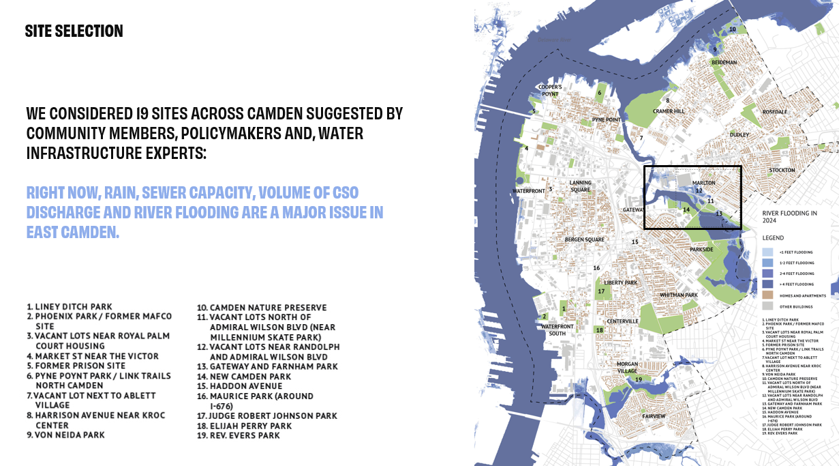

Slide 21
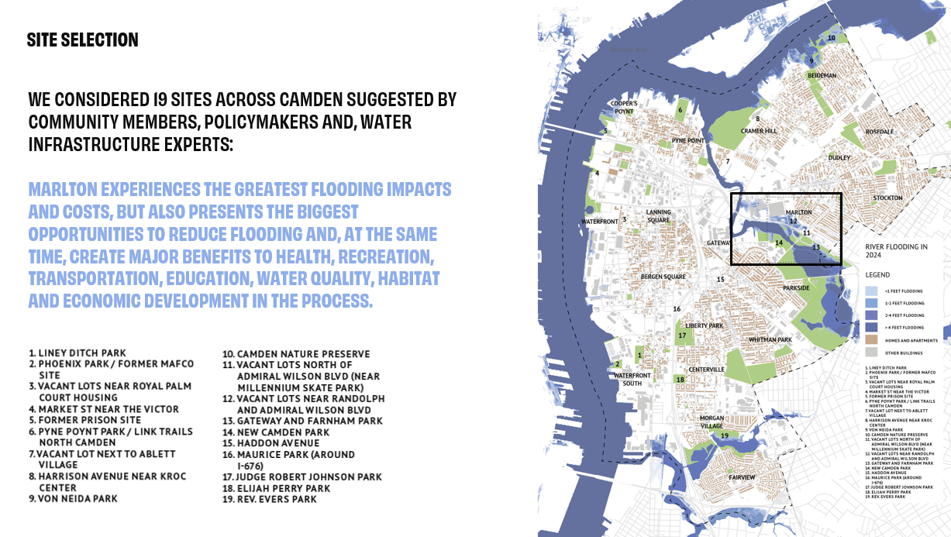

Slide 22
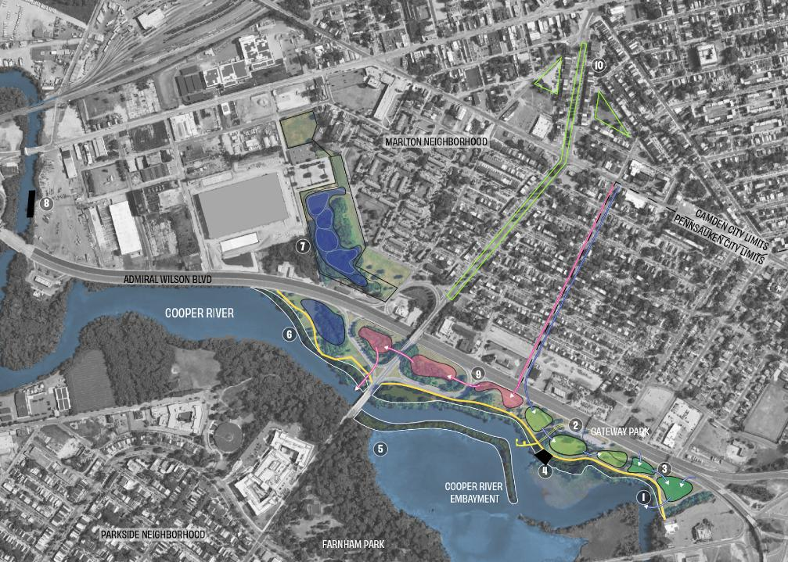
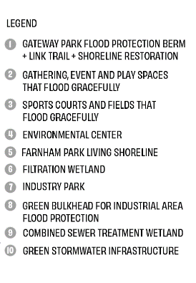
10 PROJECTS THAT REDUCE FLOODING

Slide 23
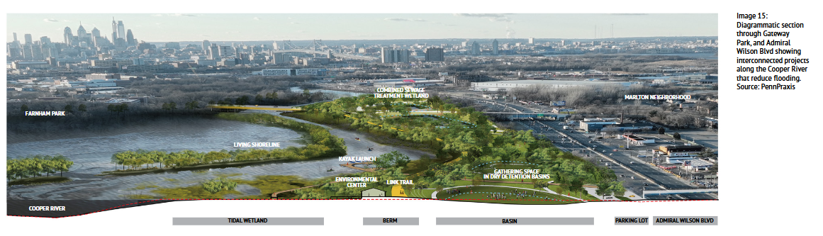

Slide 24
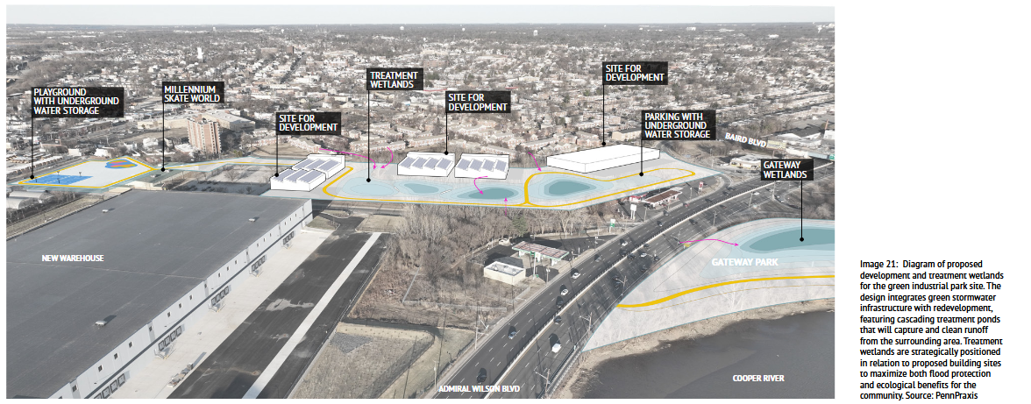

Slide 25
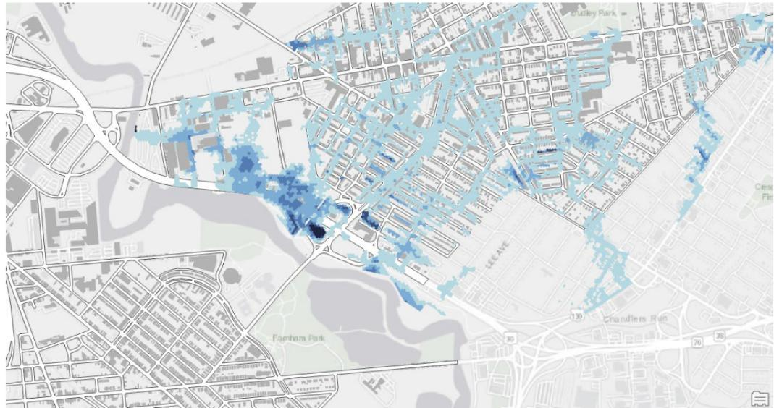
Simulated flooding resulting from January 2024 flood event

Slide 26
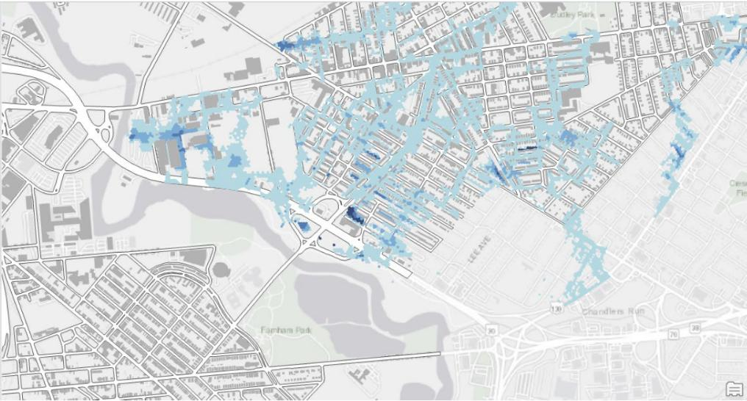
Mitigated flooding, January 2024 flood event

Slide 27
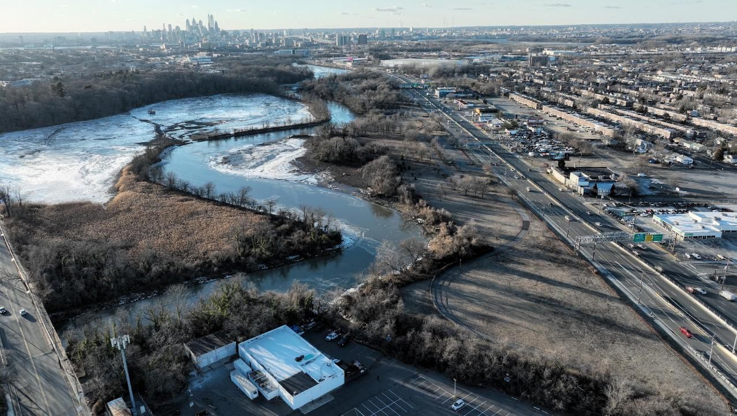
BAIRD BLVD
FARNHAM PARK
MARLTON
NEIGHBORHOOD
GATEWAY PARK
ADMIRAL
WILSON
BLVD
COOPER RIVER
PENNSAUKEN
THE PUB
GATEWAY-FARNHAM PARK AREA
PHOTO CREDIT: JON COMPTON

Slide 28
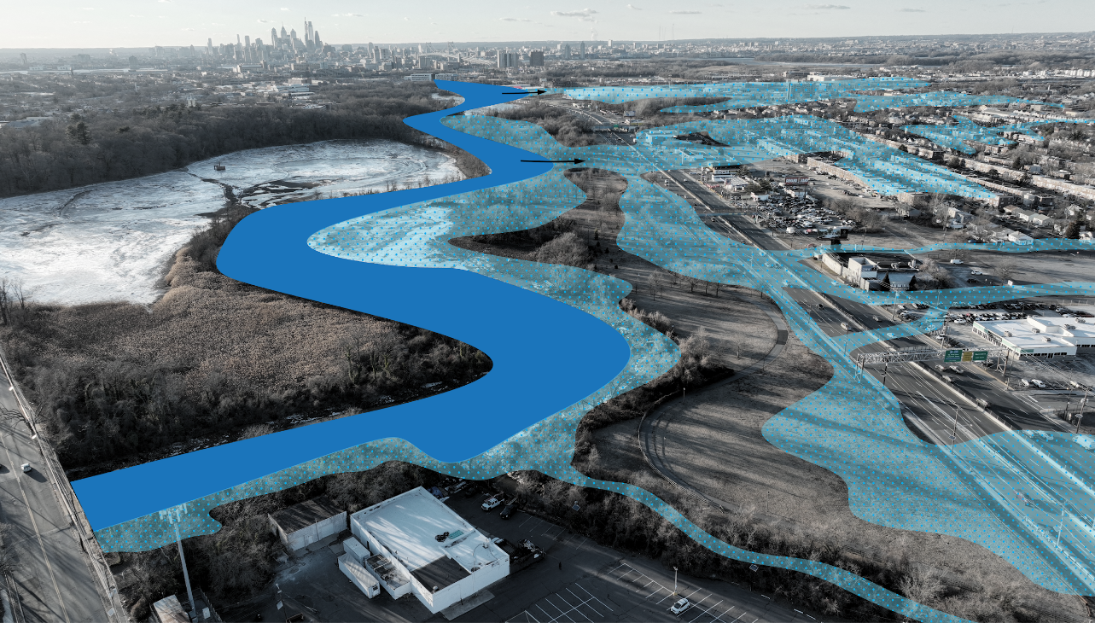
BAIRD BLVD
FARNHAM PARK
MARLTON
NEIGHBORHOOD
GATEWAY PARK
ADMIRAL
WILSON
BLVD
COOPER RIVER
PENNSAUKEN
THE PUB
CURRENT FLOODING PROBLEM IN EAST CAMDEN

Slide 29
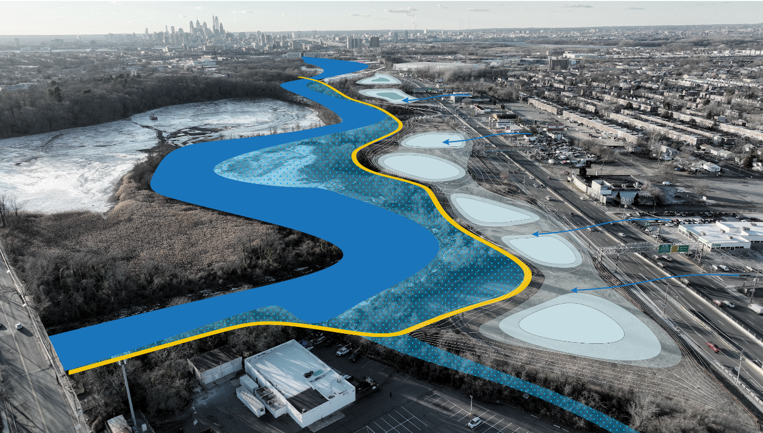
BERM
FLOODABLE
PARK AREA
MARLTON
NEIGHBORHOOD
COOPER RIVER
ADMIRAL
WILSON
BLVD
TRAIL ON AN
ELEVATED BERM
FLOODABLE
PARK AREA
ELEVATING THE LINK TRAIL IN GATEWAY PARK WILL CREATE A BERM OR LEVEE THAT PROVIDES FLOOD PROTECTION BY PREVENTING THE COOPER RIVER FROM SWELLING INTO ADMIRAL WILSON BOULEVARD AND MARLTON’S RESIDENTIAL AREA.

Slide 30
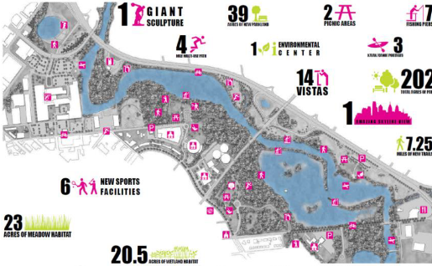
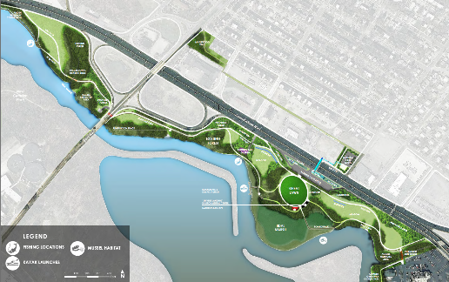
Projects align with neighborhood, city, and state priorities and plans
Cooper River Gateway West Vision Plan, 2014
Gateway Park Management Plan (New Jersey Conservation Foundation), 2018
My East Camden Neighborhood Plan, 2021
Lakes Management Plan, 2022
Current Camden County Municipal Utility Authority efforts to develop the Long-Term Control Plan
DEP site remediation plans
City and County redevelopment projects and priorities
Phase 1 Loop of LINK Trail to go into construction in 2027
Kayak Launch to go into construction in 2025
Cooper River Gateway West Vision Plan. Philadelphia: Cairone & Kaupp, Inc., 2014.
Gateway Park Management Plan: New Jersey Conservation Foundation. 2018.

Slide 31
Next steps
WITH SUPPORT FROM THE WILLIAM PENN FOUNDATION, WE ARE ADVANCING THREE NEXT STEPS:
MODELING SEWER BACKUPS AND FLOODING TO REDUCE CSO BURDEN IN MARLTON
DEVELOPING DESIGN DRAWINGS FOR A GREEN STORMWATER INFRASTRUCTURE PROJECT IN EAST CAMDEN (PROJECT #2A, #2B)
DEVELOPING EAST CAMDEN RESILIENCE PLAN IN PARTNERSHIP WITH SJCS
$133 K
$474 K
$315 K

Slide 32

Follow up
Franco Montalto
fam26@drexel.edu

Slide 33
Extra slides

Slide 34
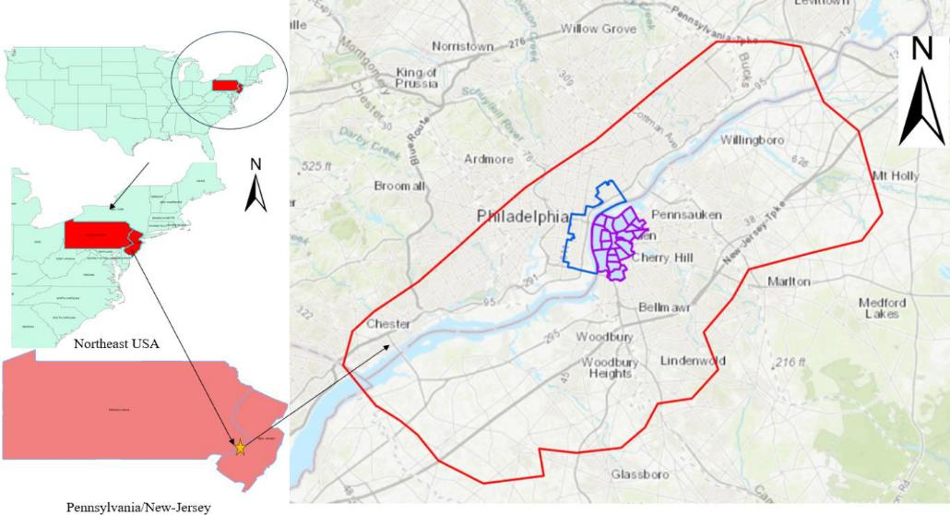
Regional 2D HEC-RAS Model

Slide 35

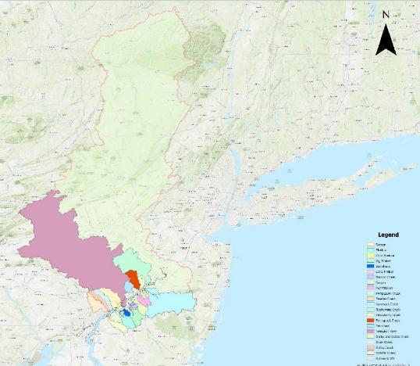
Regional 2D HEC-RAS Model
Observed and modeled flow from all tributaries added to the 2D mesh

Slide 36
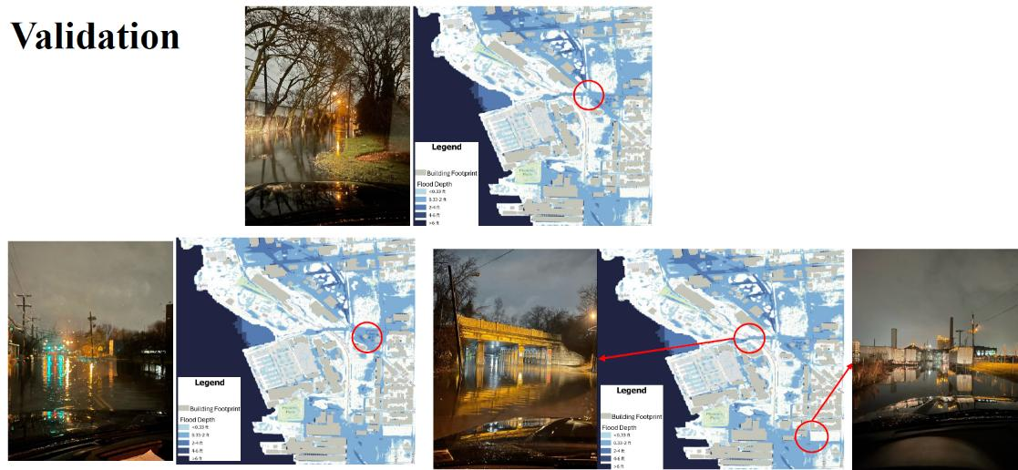
Validation against flooding photos provided by stakeholders

Slide 37
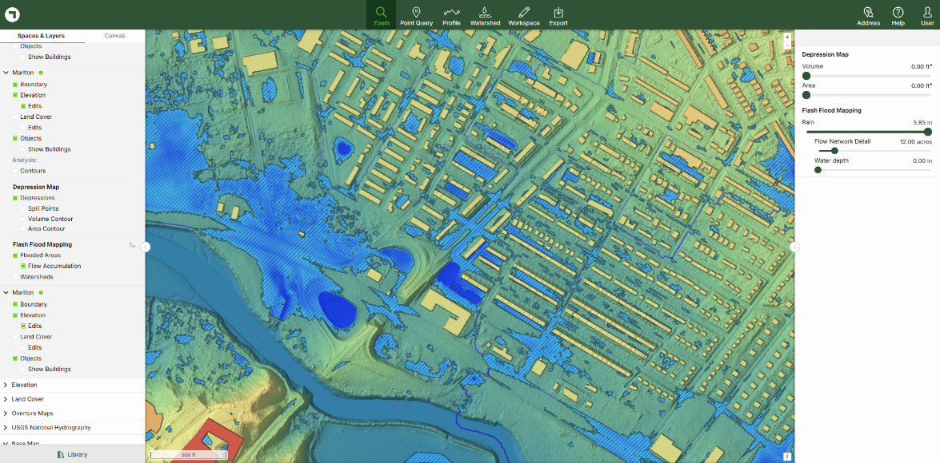
Localized site investigations
Scalgo supports “flash flood” and “Sea level rise” visualizations on terrain

Slide 38

Localized site investigations

Slide 39

1D-2D all pipes PCSWMM model

Slide 40
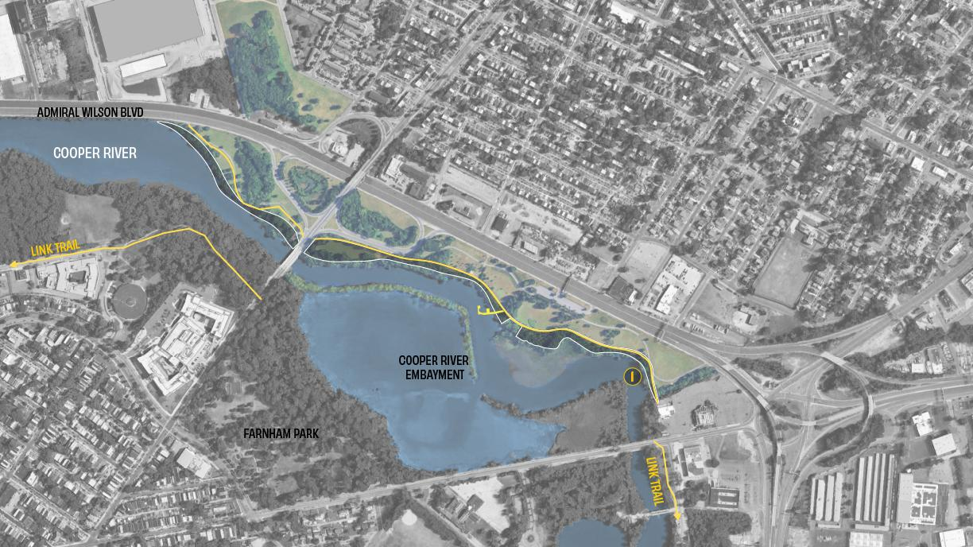
#1 GATEWAY PARK FLOOD PROTECTION BERM + LINK TRAIL + SHORELINE RESTORATION
GATEWAY PARK FLOOD PROTECTION BERM + LINK TRAIL + SHORELINE RESTORATION
Estimated cost: $13.3M
Shoreline Restoration: 4.8 acres
Total Flood Volume Reduction: TBD
Total CSO Reduction: 5,662,000 gal
$/Gal of Flood Volume Reduction: TBD
$/Gal of CSO Reduction: $2.35/gal

Slide 41
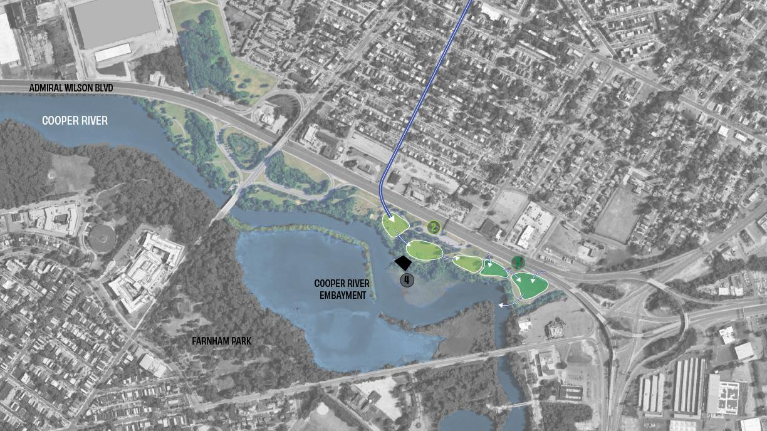
SPORTS COURTS AND FIELDS
(PROJECT #3)
Estimated Cost: $11.8M
Total Flood Volume Reduction: 1,782,000 gal
Total CSO Reduction: 0 gal
$/Gal of Flood Volume Reduction: $6.6/gal
$/Gal of CSO Reduction: N/A
GATHERING, EVENT, AND PLAY SPACES (PROJECT #2)
Estimated Cost: $14.5M
Total Flood Volume Reduction: 87,000 gal
Total CSO Reduction: 2,790,000 gal
$/Gal of Flood Volume Reduction: $167/gal
$/Gal of CSO Reduction: $5.2/gal
ENVIRONMENTAL CENTER
Estimated Cost: $10M
#2 GATHERING, EVENT, AND PLAY SPACES
#3 SPORTS COURTS AND FIELDS
#4 ENVIRONMENTAL CENTER

Slide 42
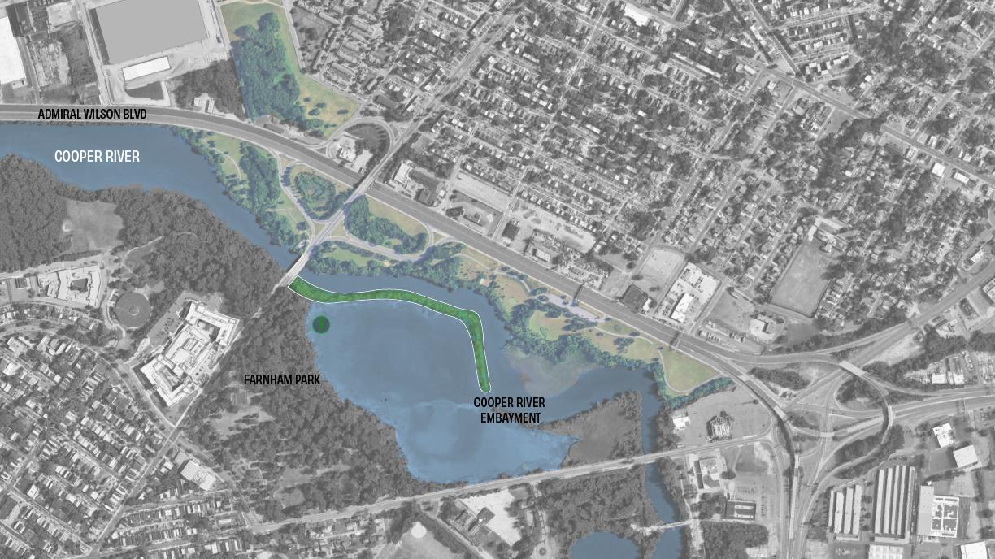
FARNHAM PARK LIVING SHORELINE
Estimated Cost: $10.6 M
Shoreline Restoration: 3.6 acres
# 5 FARNHAM PARK LIVING SHORELINE

Slide 43
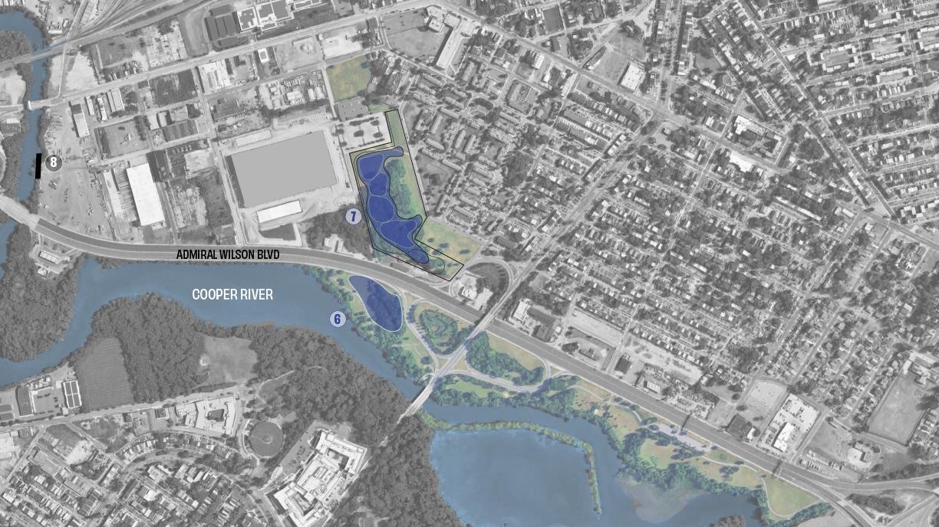
#6 FILTRATION WETLAND
#7 INDUSTRIAL PARK
#8 GREEN BULKHEAD FOR INDUSTRIAL AREA FLOOD PROTECTION
FILTRATION WETLAND
Estimated Cost: $9.6M
Total Flood Volume Reduction: 1,780,000 gal
Total CSO Reduction: 1000 gal
$/Gal of Flood Volume Reduction: $5.37/gal
$/Gal of CSO Reduction: $9560/gal
INDUSTRIAL PARK
Estimated Cost: $12.6M
Total Flood Volume Reduction: 1,784,000 gal
Total CSO Reduction: 0
$/Gal of Flood Volume Reduction: $7.03/gal
$/Gal of CSO Reduction: N/A
GREEN BULKHEAD
Estimated Cost: ~~$10M
Total Flood Volume Reduction: 1,780,000 gal
Total CSO Reduction: 0
$/Gal of Flood Volume Reduction: $0.56/gal
$/Gal of CSO Reduction: N/A

Slide 44
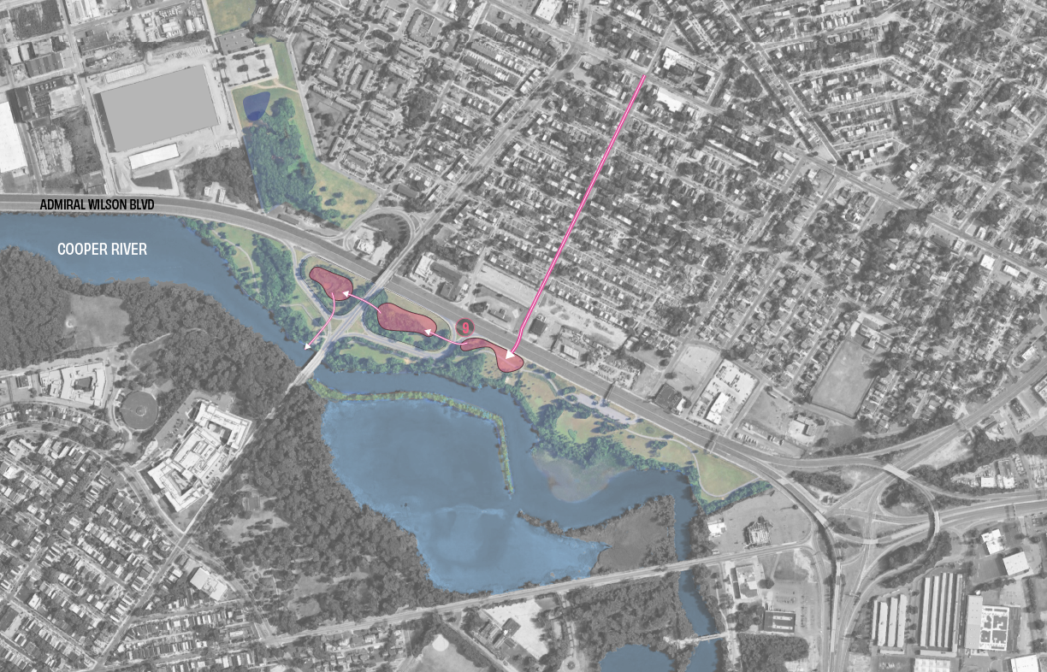
#9 COMBINED SEWER TREATMENT WETLANDS
COMBINED SEWER TREATMENT WETLANDS
Estimated Cost: $12.2M
Total Flood Volume Reduction: 143,000 gal
Total CSO Reduction: 340,000 gal
$/Gal of Flood Volume Reduction: $84.9/gal
$/Gal of CSO Reduction: $35.7/gal
$12.2m

Slide 45
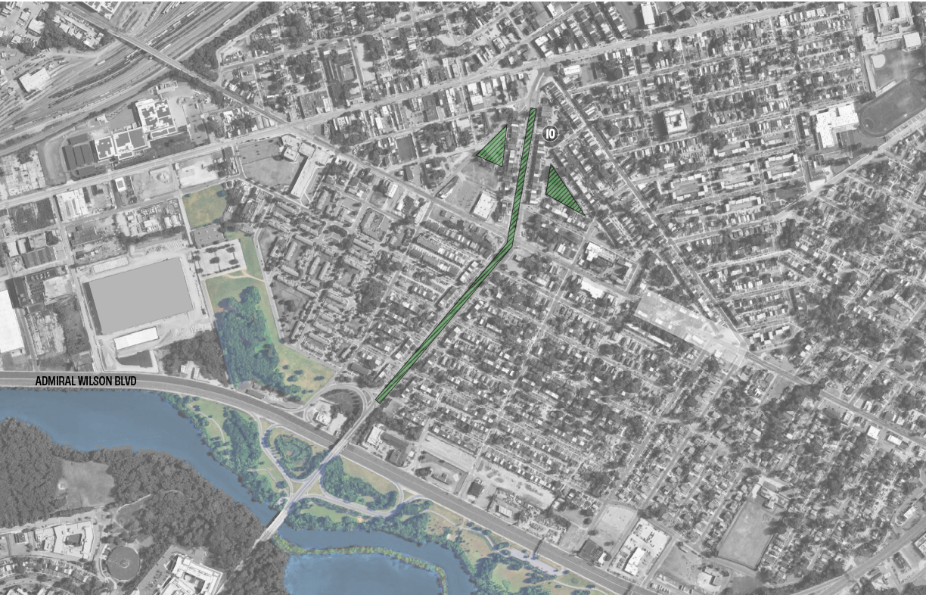
#10 GREEN STORMWATER INFRASTRUCTURE
GREEN STORMWATER INFRASTRUCTURE
Estimated Cost: $17.5M
Total Flood Volume Reduction: 1,849,000 gal
Total CSO Reduction: 62,000 gal
$/Gal of Flood Volume Reduction: $9.5/gal
$/Gal of CSO Reduction: $282/gal

Slide 46
