Slide 1
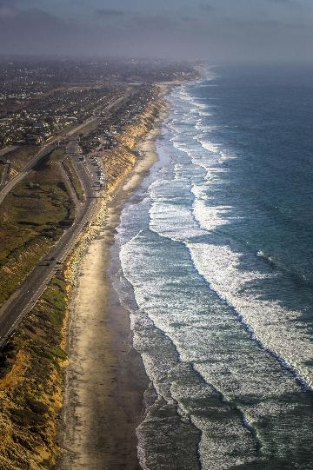

Pensacola Bay Salt Marsh and Oyster Reef & Orange County Shoreline Protection
Nick Brown, PhD

Slide 2
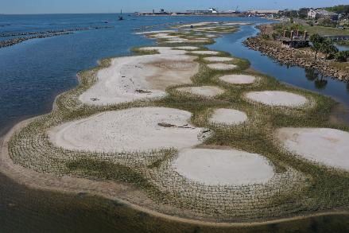
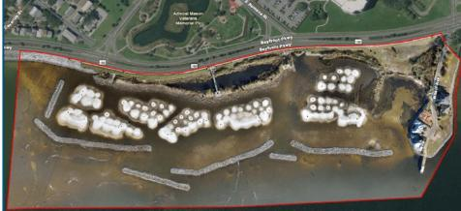
Pensacola Bay Living Shoreline
Location: Project GreenShores Site II along the urban Pensacola Bay shoreline near the Port of Pensacola.
Scale: 9.2 acres of salt marsh habitat and 3.5 acres of oyster reef breakwater
Cost: $10.9M

Slide 3
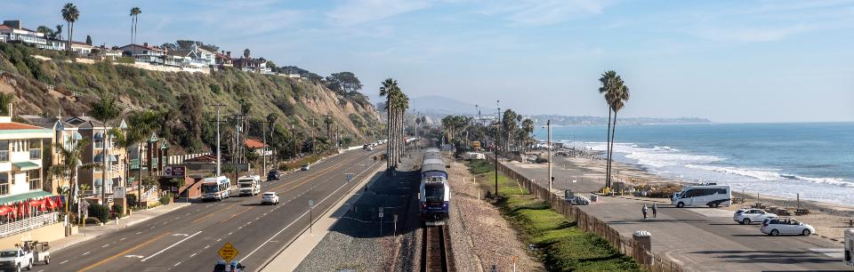
Orange County Shoreline Protection
Location: 7 miles of coastal rail along Southern California
Protection: Nourishment, riprap, engineered shorelines
Goal: Maintain rail operations in the corridor; protect from coastal erosion, hazards, and severe bluff erosion

Slide 4
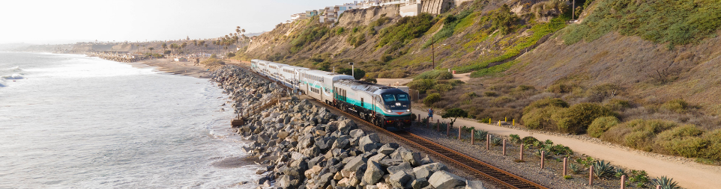
Orange County Coastal Rail Resiliency Study
Study rail challenges to address current and future environmental risks and issues to O&M in the corridor.
Evaluate strategies to protect the rail corridor in place for up to 30 years and ensure uninterrupted rail operations while minimizing passenger and freight service disruptions.
Mitigate existing threats in targeted areas
Notes:
The Orange County Transportation Authority (OCTA) owns 40+ miles of rail between the cities of San Clemente and Fullerton. This vital link in the 351-mile LOSSAN Rail Corridor is the second busiest passenger rail corridor in the nation and annually carries more than $1 billion in freight throughout Southern California. Between Los Angeles and San Diego, the line is designated as a Strategic Rail Corridor Network by the Department of Defense due to its connectivity with military bases and major ports.

Slide 5
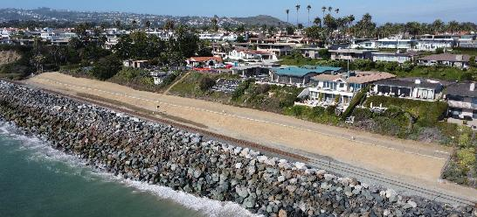
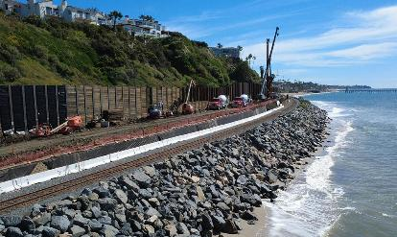
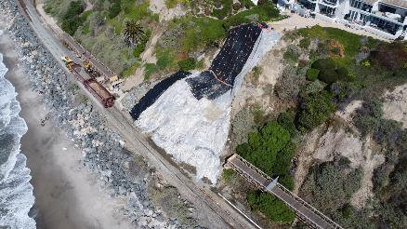
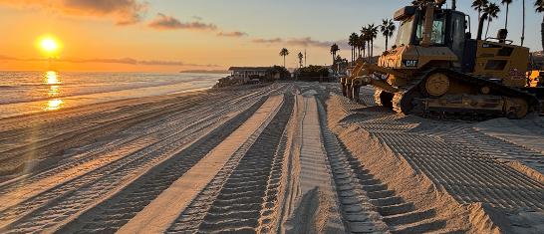
Orange County Shoreline Protection

Slide 6
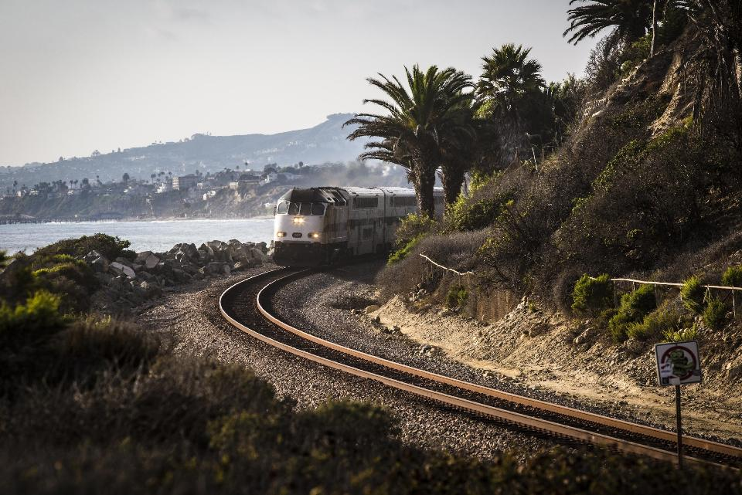
Contact:
Nick.Brown@HDRinc.com

