Slide 1
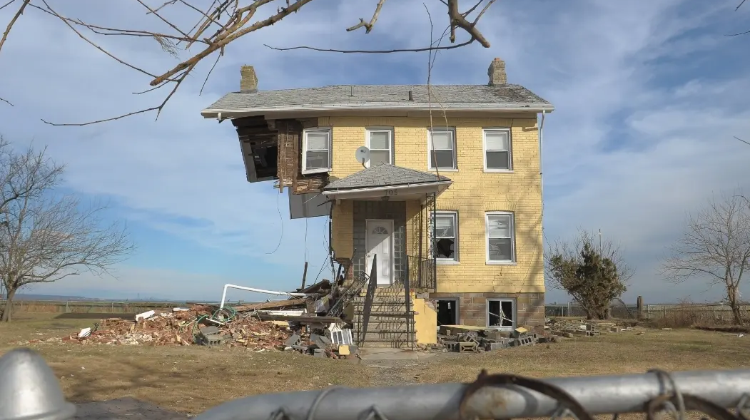

www.cupajoe.live
Front Row to a Changing Coast: Observations from the Shore

Slide 2

WEATHER TRIVIA!

Slide 3

WEATHER TRIVIA
Last Hurricane to make NJ Landfall?
2012
1985
1903

Slide 4
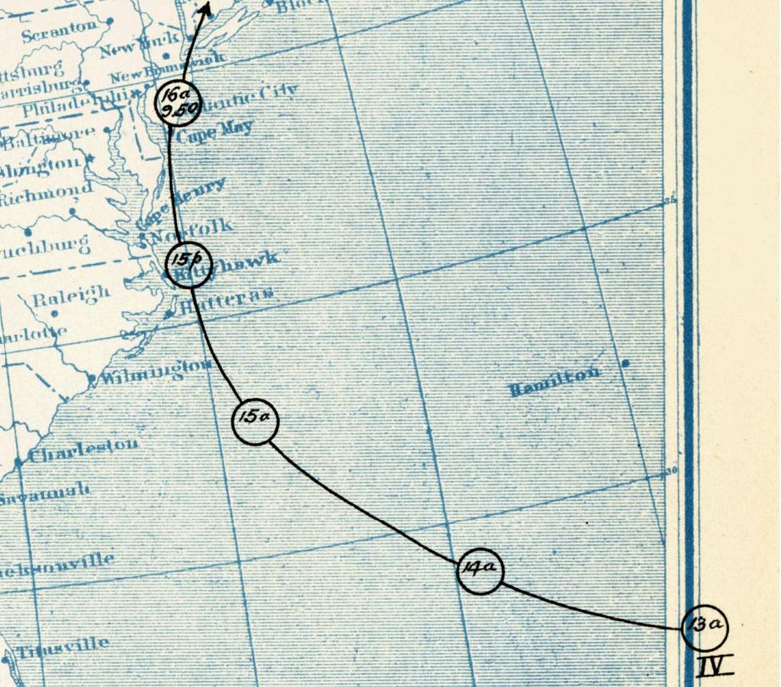
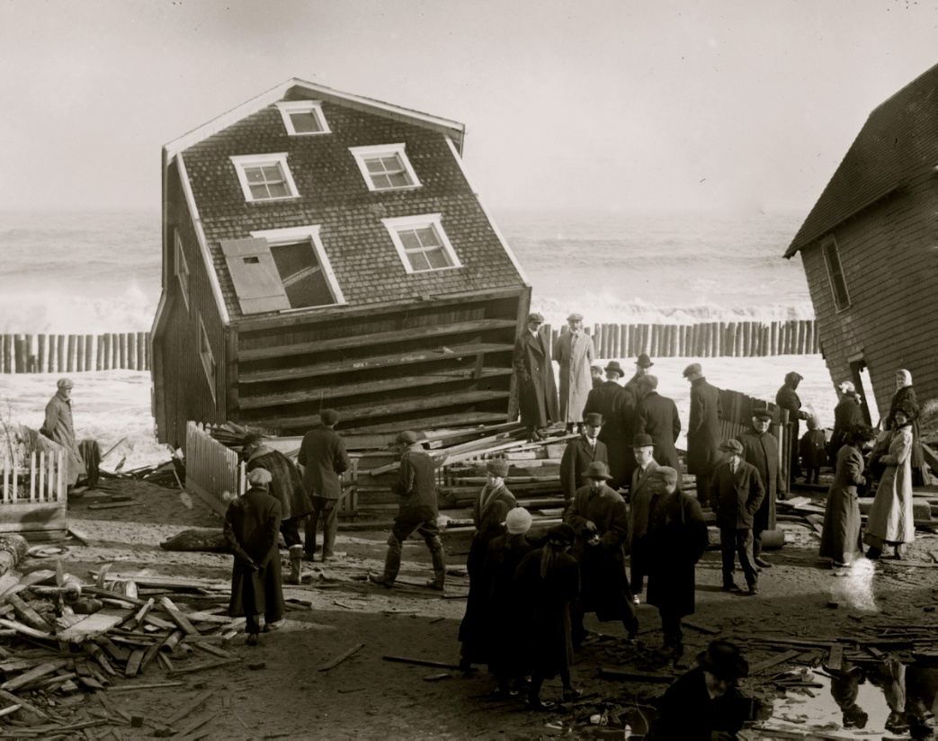
WEATHER TRIVIA
Last Hurricane to make NJ Landfall?
Sea Bright, Monmouth County
1903

Slide 5
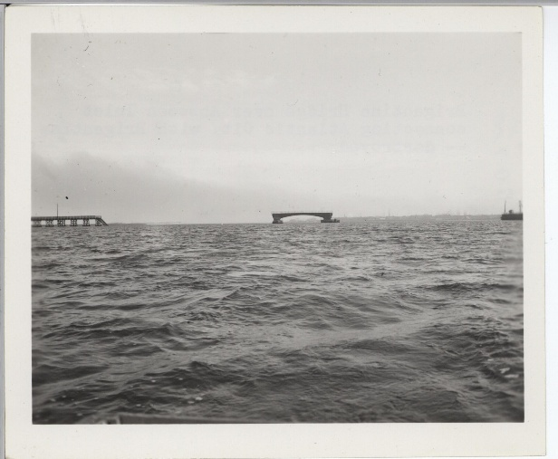
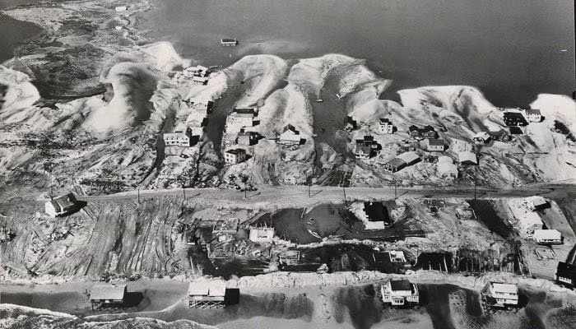
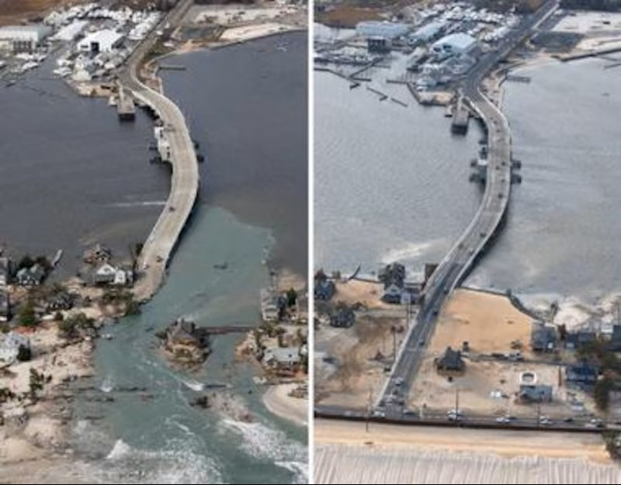
3 STORMS INFLUENCED THE SHORE’S DEVELOPMENT THE MOST
1944 Hurricane
1962 Nor’easter
2012 Sandy
Brigantine Bridge
Harvey Cedars
Mantoloking

Slide 6
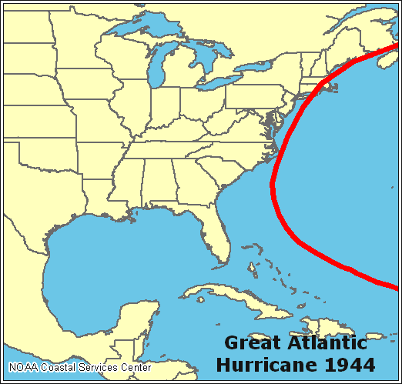
THE 1944 HURRICANE
Before the Hurricane - Largely unregulated development
Impact of Hurricane - Catastrophic damage.
- S Cape May erased.
After Hurricane - Rapid development.
- Some building codes.

Slide 7
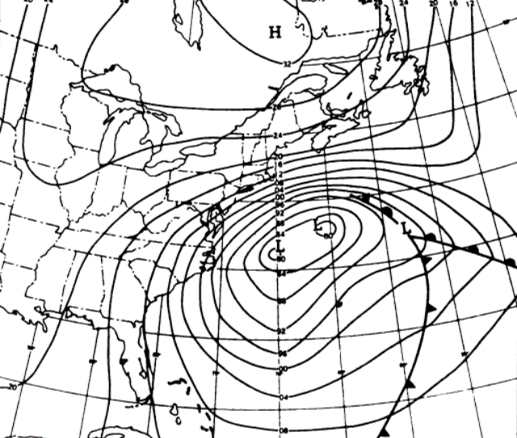
THE ASH WEDNESDAY STORM OF 1962
Before the Storm - Low density housing. - Some building codes.
Impact of Storm - Extreme tidal flooding.
- Breached LBI 5 times.
After Hurricane - Rapid restoration. - Major resilience focus.
A.I. Cooperman and H.E. Rosendal

Slide 8
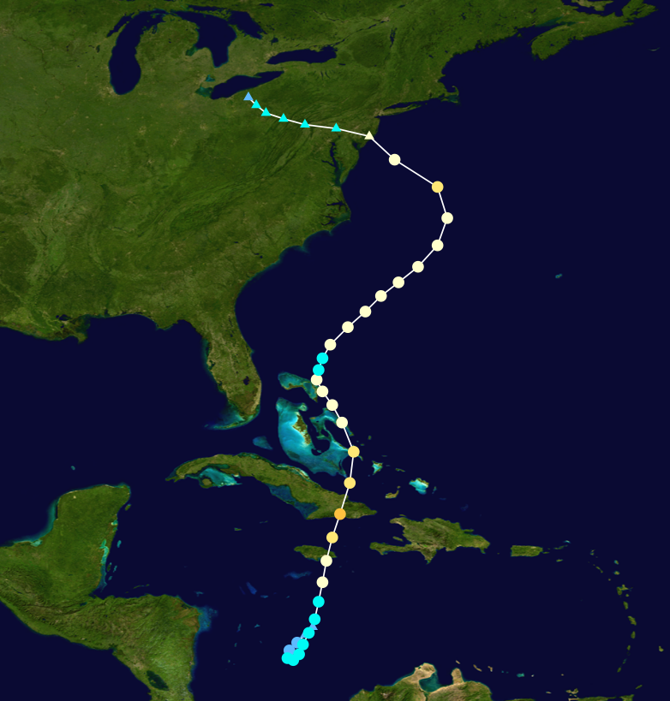
SUPERSTORM SANDY
Before the Storm - “Mega mansions”
- Low dune protection
Impact of Storm - $30 to $37 billion loss.
- Trailer parks, bungalows gone
After Hurricane - Elevated homes. - More mega mansions.

Slide 9
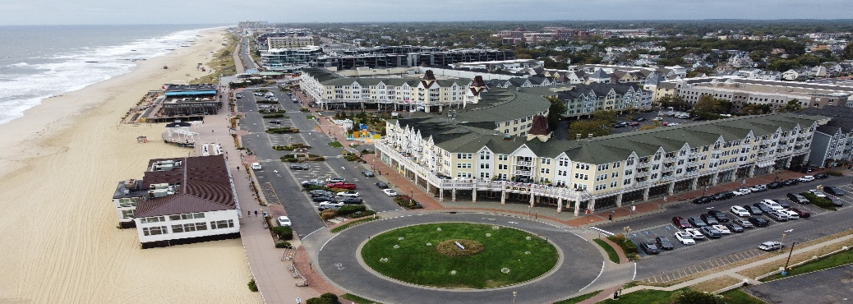
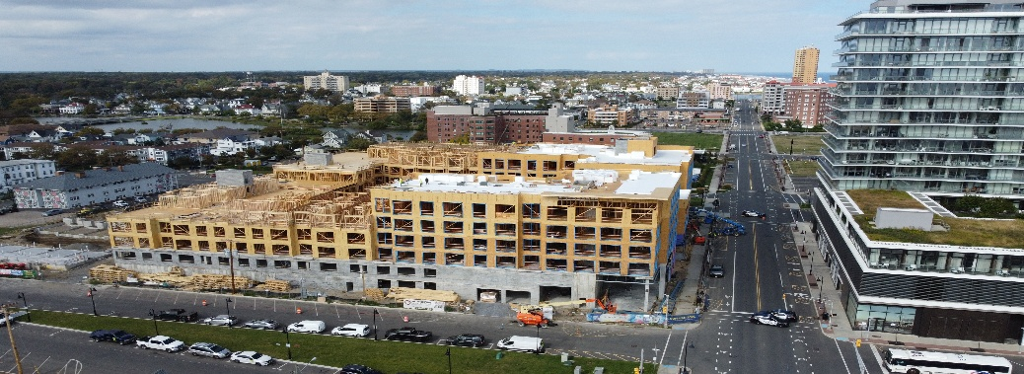
WHAT MAY BE NEXT
Before the Storm
After the Storm Our choice! 1) High-density housing. Public/gov’t debates ongoing (OC, Seaside).
2) Some retreat? Florida is an example. Back to 1) Could “cities” mitigate fears of owning single family home?
Long Branch
Asbury Park
PLUS: NJREAL, Rising Flood Insurance, COVID…

Slide 10
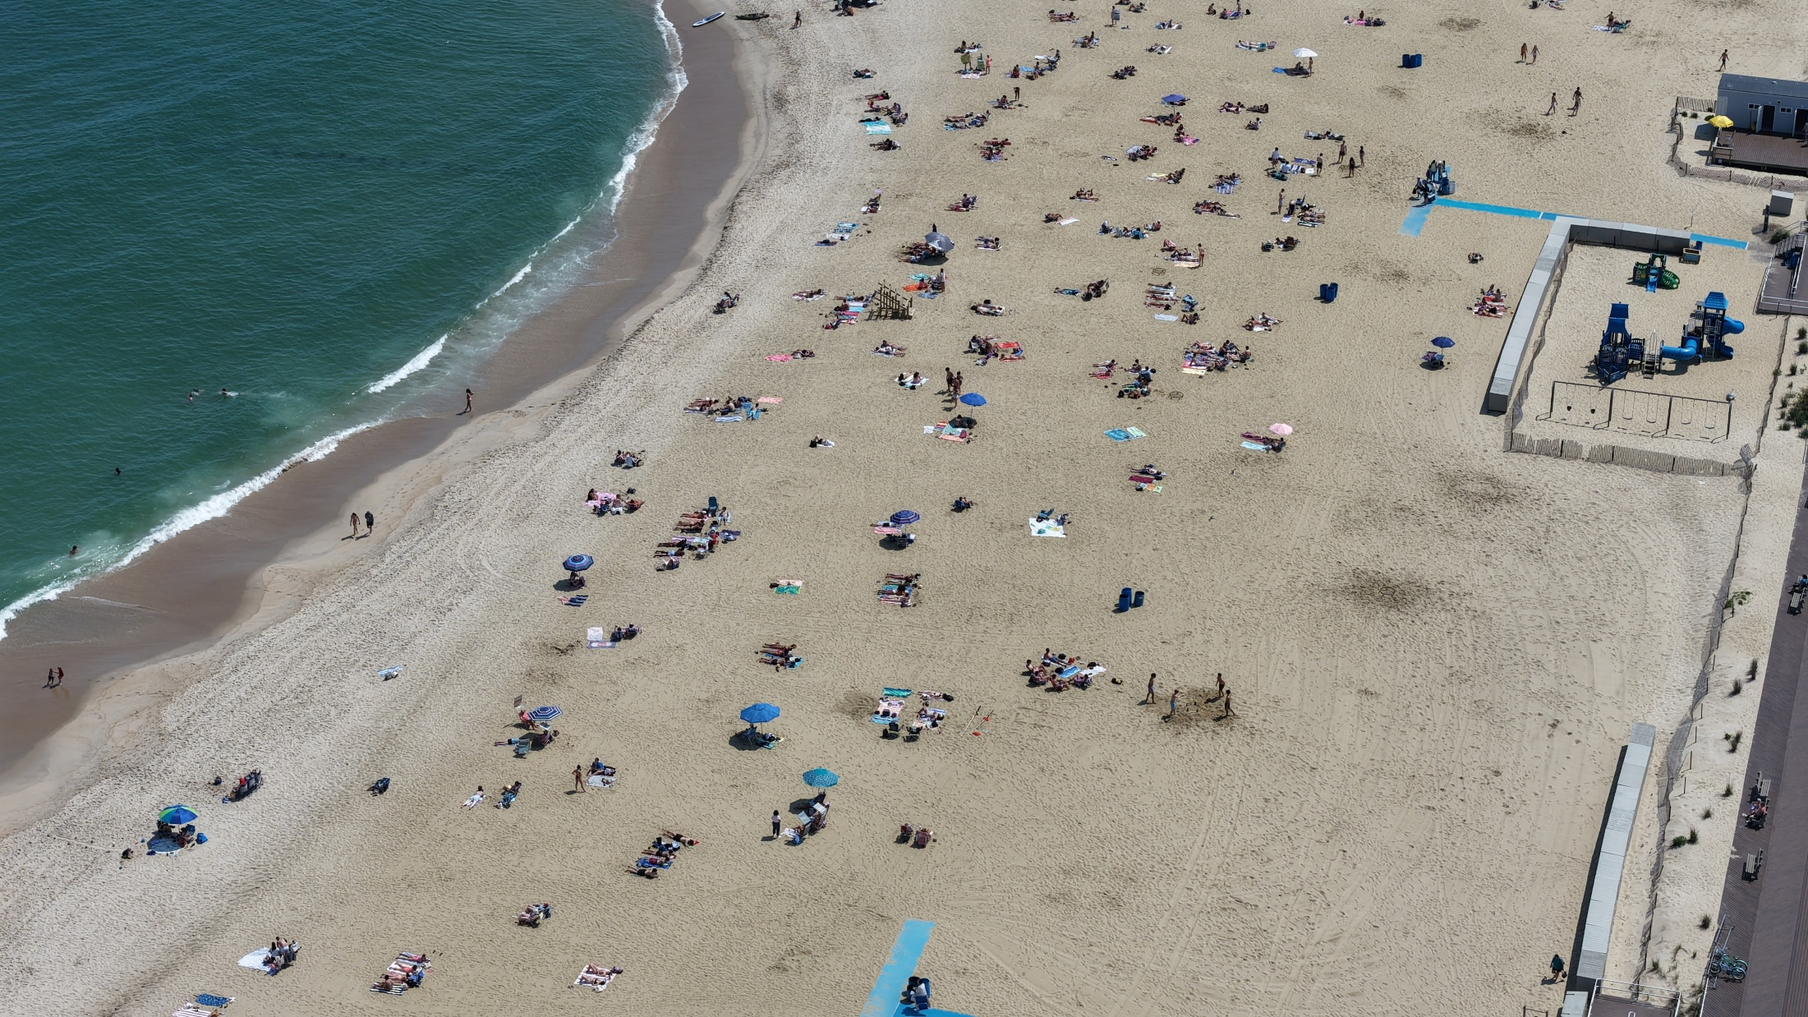




Thank you for Listening!
ShorelySafe (for government)
24x7 Jersey Shore Weather Channel
Our Website

