Slide 1


New Jersey Association for Floodplain Management
JOE BARRIS, AICP/PP/CFM
EXECUTIVE DIRECTOR
DIRECTOR@NJAFM.ORG

Slide 2


MISSION
PROMOTING SOUND FLOODPLAIN MANAGEMENT
to protect people, places, and property
An interdisciplinary network of professionals and practitioners
A forum bringing together public, private, academic, and nonprofit sectors
A hub for education, training, technical expertise, and support
A trusted partner in real world implementation

Slide 3
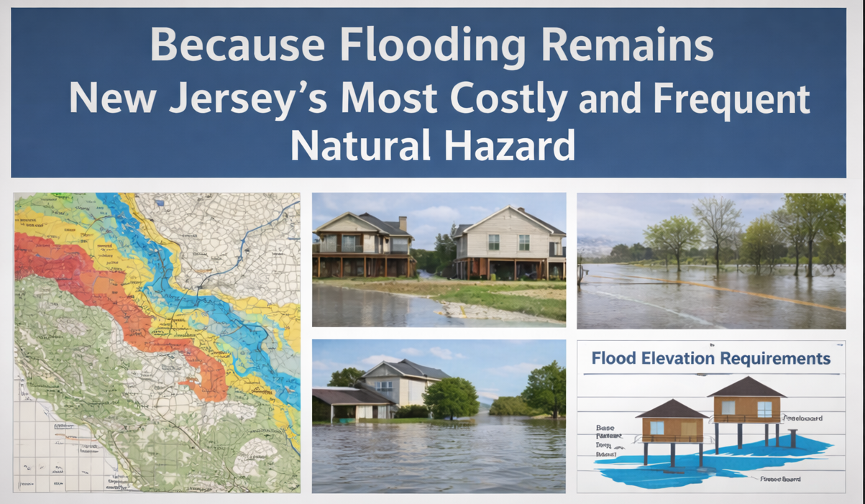
WHY WE EXIST
WHY WE EXIST
PURPOSE
Chapter of ASFPM
Promote responsible floodplain management
Reduce loss of life and property
Support resilient and stainable communities
Improve understanding of changing
rules and regulations
NEED
Increased flood frequency and intensity
Complex regulatory framework
Growing demand on local officials

Slide 4

MISSION DRIVEN
WE ADVANCE
Flood Hazard Mitigation Strategies
Climate Resilience Planning
Inland and Coastal Risk Reduction
Science-based decision-making
WE PROVIDE A COLLABORATIVE
PLATFORM FOR:
Technical Exchange
Regulatory Interpretation & Compliance
Policy Discussions
Professional Networking

Slide 5
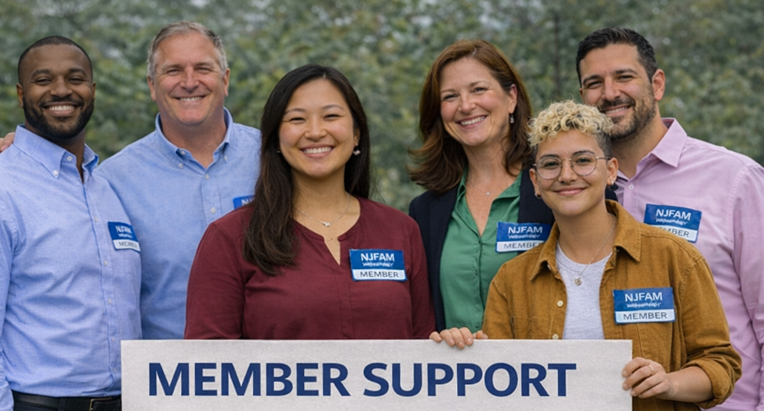
MEMBER SUPPORT
Professional Development
Annual conference
Conference Stipends
Continuing education credits
Topical workshops and webinars
Mentoring for young professionals
Technical Resources
Regulatory updates
Policy evaluation and response
Best practice sharing
Peer-to-peer knowledge exchange
Community-Based Approach
Interdisciplinary networking
Leadership opportunities
Committee participation
Professional Recognition

Slide 6

RECENT ACCOMPLISHMENTS
Celebrated NJAFM’s 20th Annual Conference
ASFPM National Chapter Award (2024)
Free NIFP Training in 8 NJ Counties (w/NJDEP)
19 Conference Stipends
NJAFM Conference CEC Credits
CFM
NJ-PE, NY-PE, PA-PE
AICP
NJ-PLS
CPWM
UCC

Slide 7
RECENT ACCOMPLISHMENTS
Provided comments on:
NJPACT REAL Rules
Inland Flood Protection Rules
SBA Disaster Recovery Federal Preemption Rule
CRS Redesign
Hon. Senator Cory Booker’s Office on National Flood Insurance
Restructured organizational processes and committee structure
Sponsor of the NJCRC Conference

Slide 8
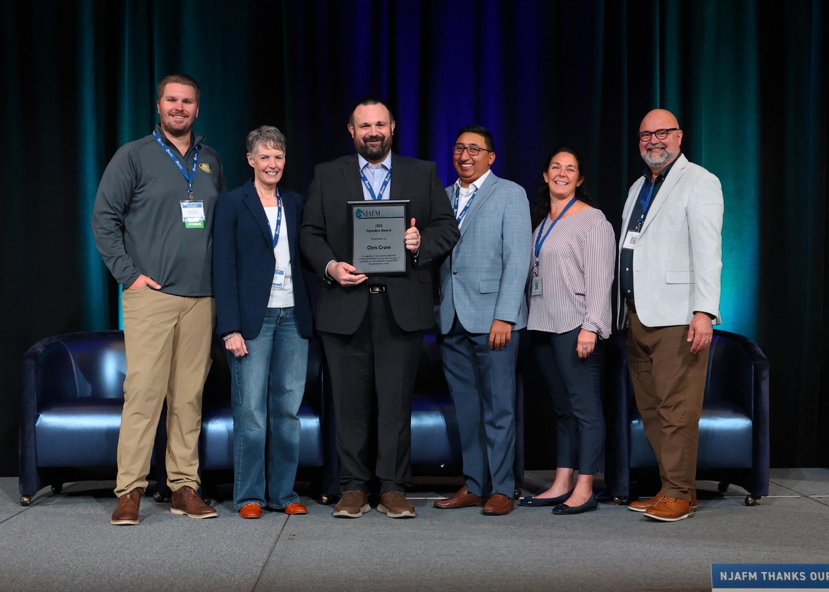
ORGANIZATIONAL STRUCTURE
Chris Crane, President
Liaison to
Conference Committee
Governance Committee
Legislative Committee
Elissa Commins
Past President
Liaison to:
Conference Committee
Governance Committee
Legislative Committee
Sean O’Leary
V. President
Liaison to:
Conference Committee
Professional Development
George Ibrahim,
Treasurer
Liaison to:
Conference Committee
Finance & Compliance
Ann Holtzman
Secretary
Liaison to:
Conference Committee
Membership Committee
Executive Staff
Joe Barris,
Executive Director
Sara Tsivkis,
IT and Marketing Director

Slide 9
THANK YOU, VOLUNTEERS
Conference Committee
Erin Foody
Kevin Thomas
Jessica Jahre
Membership Committee
Tom Slowinski
Chris Theodos
Professional Development Committee
Joseph Ruggeri
Jessica Jahre
Legislative Committee
Becky Jones
Michael Thulen
Andrew Banff
Tyler Ardron
Kevin Thomas
Jim Galantino
Bridget Neary
Finance & Compliance Committee
Tolga Yilmaz

Slide 10

ONGOING & FUTURE PLANS
Strengthening Our Foundation
Adopt and implement Strategic Plan
Formalize the new committee structure
Strengthen compliance and governance
Expanding Influence
Expanding Partnerships
Membership & Student Engagement
Offer more professional CEC
Advancing Impact
Engage on NJPACT Real
Tackle emerging legislative issues
Advance training and professional development
Modernizing Infrastructure
Technology upgrades

Slide 11


UPCOMING EVENTS
March 12 Lunch & Learn – Karen Hughes
Resilience Communication (online)
March 26 Lunch & Learn
NJ Interagency Council on Climate Resilience
Listening Session (online)
April 9 Lunch & Learn – Brian Shaw
ASCE24-24 Updates to Floodplain Design & Construction Standards
(online)
April 24 Cumberland County Resilience Road Trip
April 27-30 FEMA E-273 Managing Floodplain Development
Middlesex County Fire Academy, Sayreville
October 20-22 21st Annual NJAFM Conference
Hard Rock Hotel & Casino, Atlantic City
www.njafm.org

