Slide 1
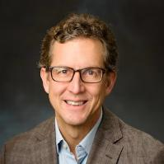
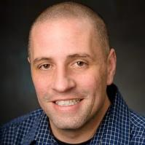


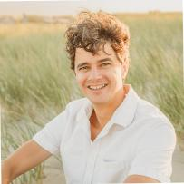

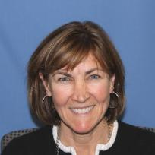
Mind the Gap! Universities Building a Local Knowledge Base for Resilience
Panel Speakers
Philip Orton, Stevens
Jon Miller, Stevens
Michel Boufadel, NJIT
Thomas Grothues, Rutgers
Owen Thomas, Montclair
Tom Herrington, Monmouth
Kim McKenna, Stockton

Slide 2
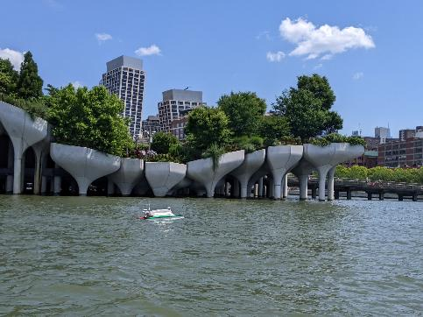









New Jersey Coastal Consortium for Resilient Communities
Community Resilience
Established by the State of New Jersey in 2021
A multi‐disciplinary, multi-university consortium to advance coastal community resilience in New Jersey through actionable research.
Focused on improved understanding of coastal systems to identify practical solutions and responses to climate change.
Utilizing Barnegat Bay as a living laboratory to research climate change impacts on coastal lagoon estuarine systems in urban and natural environments.

Slide 3
New Collaborations and Modeling Tools to Help Predict Bay Flooding and
Other Processes
Philip Orton
porton@stevens.edu
Funding from the New Jersey Coastal Resilience Research Consortium

Slide 4
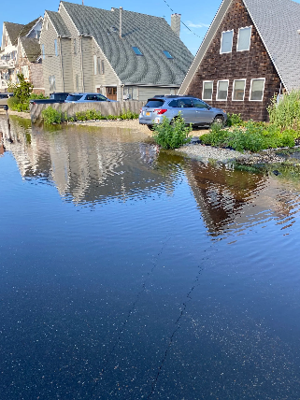
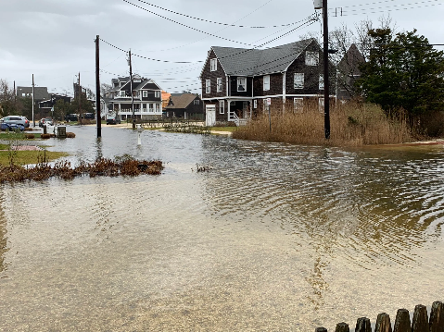
Motivation
Chronic high-tide and rain flooding

Slide 5
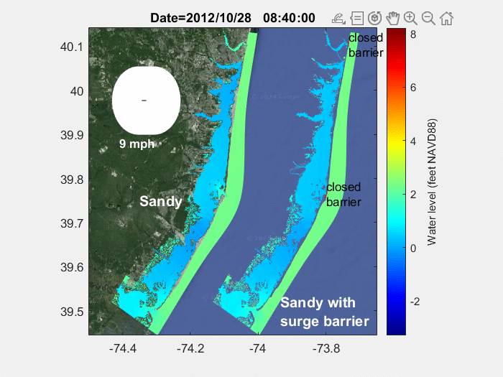
Hurricane Sandy Simulation using ROMS/COAWST
COAWST: Coupled Ocean, Atmosphere, Wave and Sediment Transport modeling framework (Warner et al. 2010) with the widely-used open-source ROMS-3D hydrodynamic model
Applications (USGS): Barnegat Bay circulation, flushing, Hurricane Sandy impacts, tidal wetlands and sediment transport (Defne et al. 2016, 2019; Donatelli et al. 2018)
wind
wind
Manasquan
Barnegat Inlet
Little Egg Inlet
Model and simulation of N. Ganju and Z. Defne (Defne et al. 2019)

Slide 6
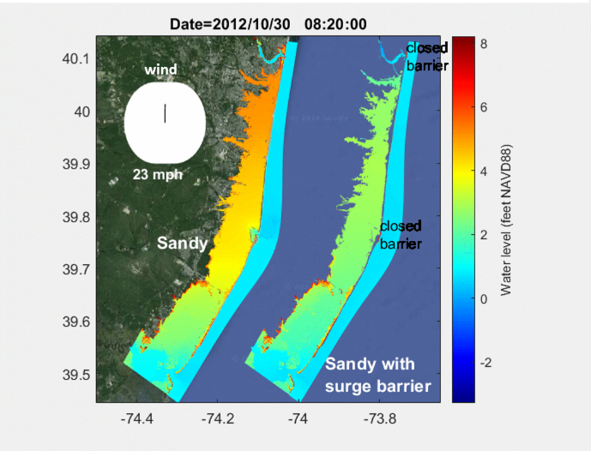
Simulation Results with Surge Barriers
Stevens applications
  Upgrade model to latest version of COAWST
  Simulate Hurricane Sandy with and without USACE surge barrier proposal → → →
  Study sensitivity of storm surge to wind stress parameterization
  Apply for NSF funding to study wind stress and storm surge
Other potential applications
  Wind wave impacts
wind

Slide 7
Outcomes
New Collaborations and Modeling Tools to Help Predict Bay Flooding and Other Processes
New MARACOOS-funded research project – collaboration between Orton, Kerr, Herrington
  Research into the drivers of flooding in the bays (Nathaniel Nwogwu’s poster on Monday)
  (ongoing) Development of a new SCHISM compound flood model and forecast system for the bays
  (ongoing) Deployment of new observational capabilities for bay flooding and waves
Let’s collaborate on other Barnegat Bay topics where these models can be useful!

Slide 8
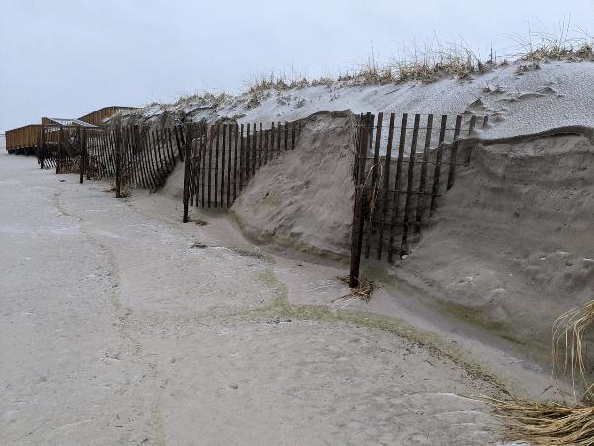

Forecasting Dune Impacts Using Data Driven Models
Stevens CERG
Jon K. Miller

Slide 9
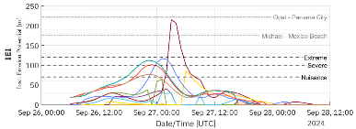
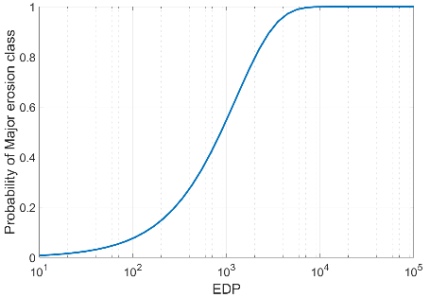
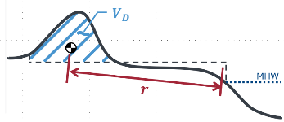

Approach
Data driven modeling
Storm Intensity
$$\text{EDP}= \frac{\text{Storm} \text{Intensity}}{\text{Beach} \text{Robustness}}$$
Engineering Demand Parameter
Fragility Curve
Beach Morphology
Probability of damage for a given storm and beach state

Slide 10
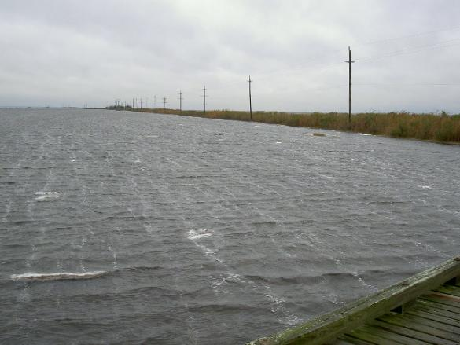
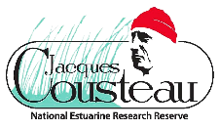

Quantifying Physical Parameters Tied to Resilience
Bathymetry and bedform constrain flow and drag
Flow and drag parametrize sediment movement, surge, wave height and direction
Bedform parametrizes erosion and accretion
Bedform is a proxy of habitat type and function

Slide 11
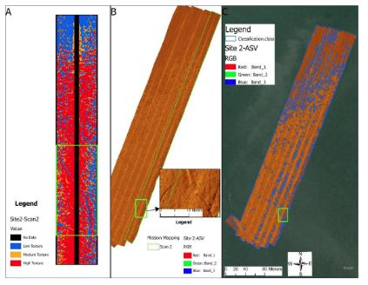
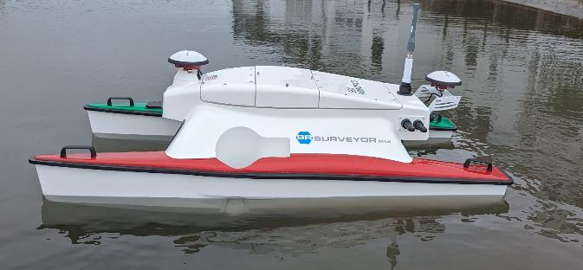
Challenges | Solutions
Spatial extent | Areal orthophotography
Turbidity/surface artifacts | Sonar
Shallow water navigation | Surface Robots
Ground-truthing | Underwater photography
Classification | Machine learning

Slide 12
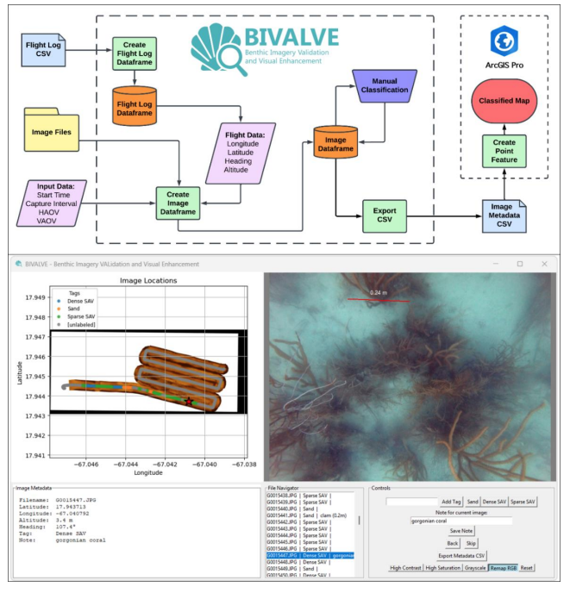
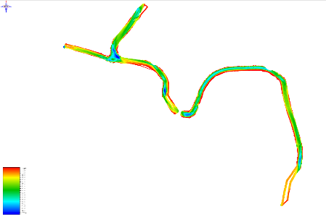
Building expertise
In capacity in ASV application
In software support of ML
In fundamental understanding
In simulation/modeling

Slide 13


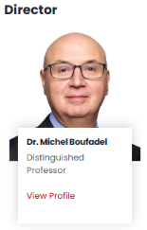



Center of Natural Resources, http://cnr.njit.edu

Slide 14
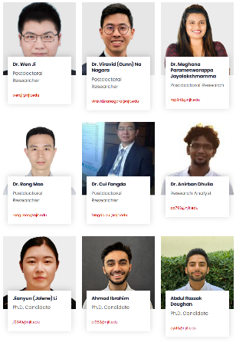
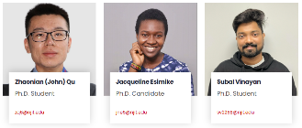


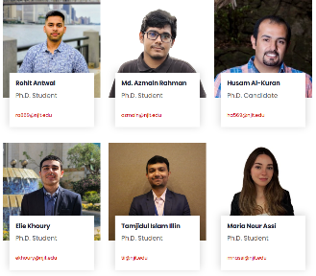


Postdocs (6) and students (14 PhD)
December 28 2025
http://cnr.njit.edu

Slide 15
Coastal Wetland Salinization Monitoring
Hypothesis: Due to evaporation, the pore water salinity exceeds that of seawater

Slide 16
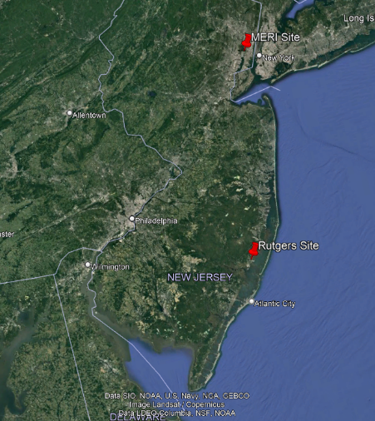
Location of Rutgers and MERI sites

Slide 17
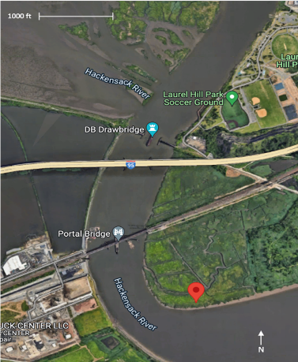
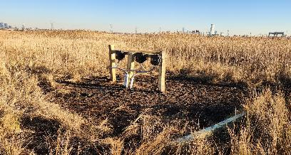

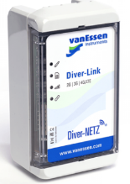
Setup in MERI
CTD sensors installed at 20 cm, 40 cm and 60 cm.
All CTD sensors connected to Diver-Link to transmit data to online to Diver-Hub.

Slide 18
Table 1: Data collected by the NJIT team based on two stations (see Figures 1, 2, and 3)
Data | Rutgers Jacque Cousteau Reserve. (39.593141, -74.346927) Start time/date: 1:15 pm / October 19, 2022 | Meadowland Environmental Research Institute. (40.750700, -74.091034) Start time/date: 2:02 pm / December 2, 2022
Porewater salinity | 15-min measurement interval | 5-min measurement interval
Porewater temperature | 15-min measurement interval | 5-min measurement interval
Porewater pressure (water level) | 15-min measurement interval | 5-min measurement interval
Air temperature | 15-min measurement interval | 5-min measurement interval
Air relative humidity | 15-min measurement interval | 5-min measurement interval
Wind speed | 15-min measurement interval | 5-min measurement interval
Wind direction | 15-min measurement interval | 5-min measurement interval
Barometric pressure | 15-min measurement interval | 5-min measurement interval

Slide 19
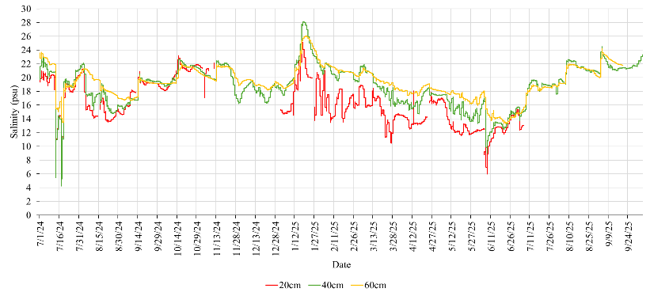
MERI – Porewater Salinity
July 1, 2024 – September 31, 2025
Salinity ranged ~10–25 PSU indicating brackish conditions.
Salinity increased with depth (20, 40, 60 cm).
Higher summer salinity due to evaporation and reduced freshwater input.

Slide 20
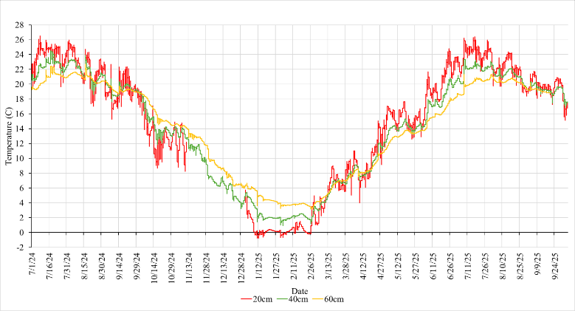
MERI – Porewater Temperature
Temperature ranged from about -1 to 26 °C.
Surface layer responded strongly to seasonal air temperature changes.
Deeper layer (60 cm) showed more stable and buffered conditions.

Slide 21
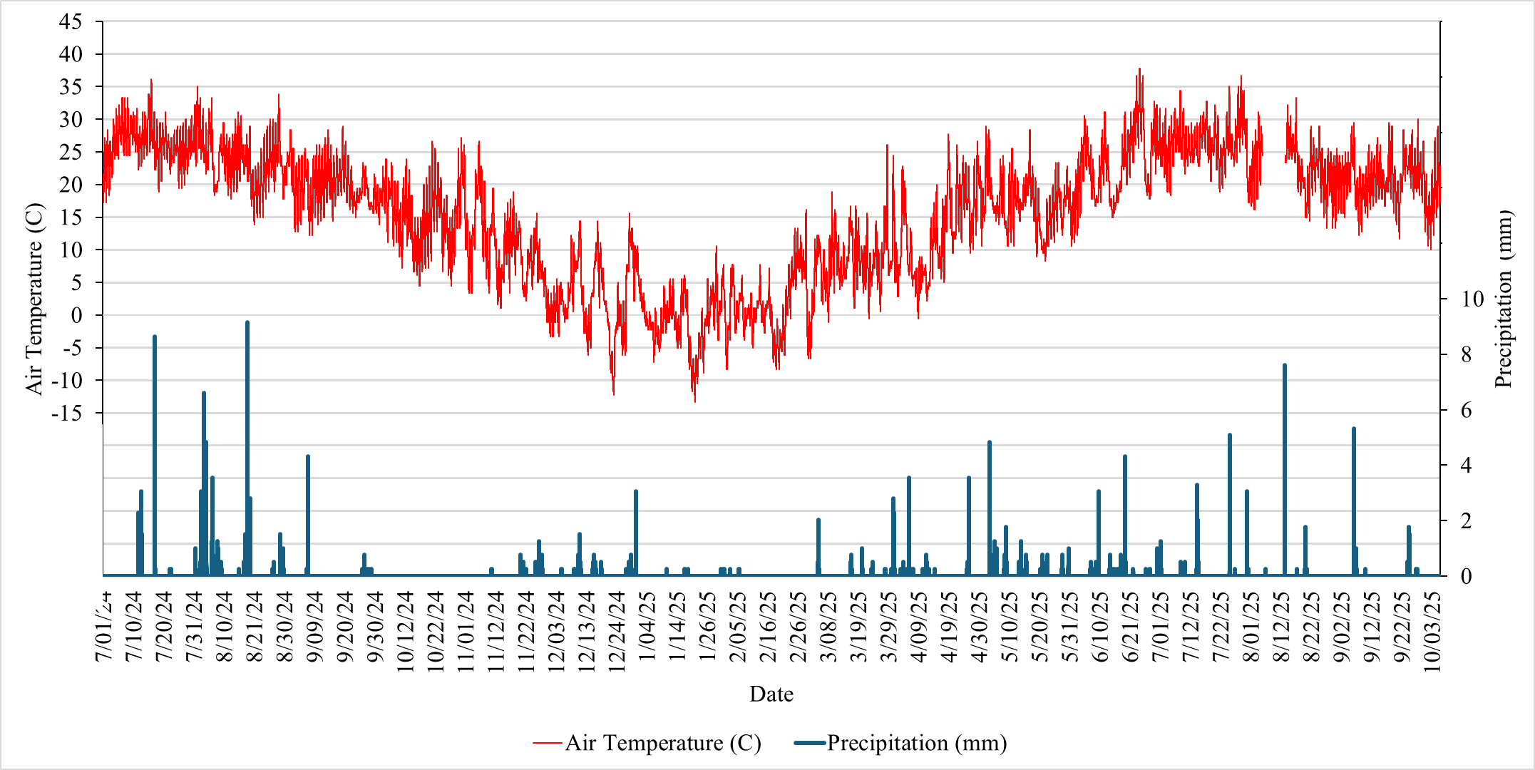
MERI – Air Temperature and Precipitation
Air temperature and precipitation influence porewater salinity.
Summer: higher temperatures increase evaporation and salt concentration.
Winter–spring rainfall dilutes salinity levels.

Slide 22
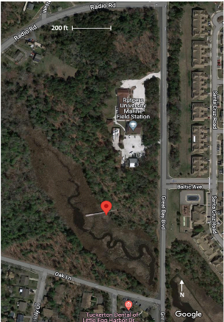
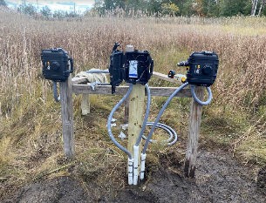
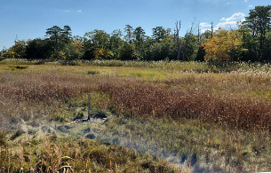
Setup in JCNERR-Rutgers
CTD sensors installed at 20 cm, 40 cm and 60 cm.

Slide 23
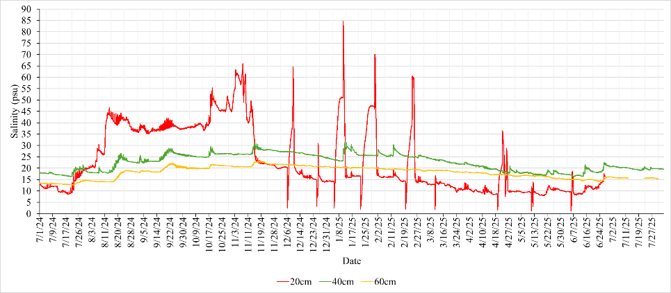
JCNERR – Porewater Salinity
July 1, 2024 – July 31, 2025
Salinity ranged from 10 to >70 PSU showing strong variability.
Surface layer (20 cm) showed the largest fluctuations.
High peaks related to tidal flooding and evaporation.

Slide 24
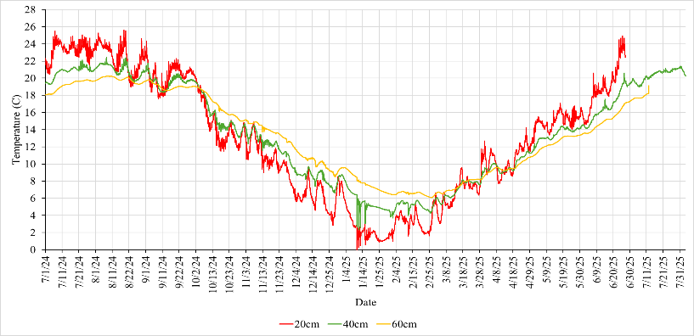
JCNERR – Porewater Temperature
Temperature followed seasonal trends similar to MERI (~ 0-26 °C).
Shallow sensor reacted fastest to air temperature changes.
Deeper layers remained more stable throughout the year.

Slide 25
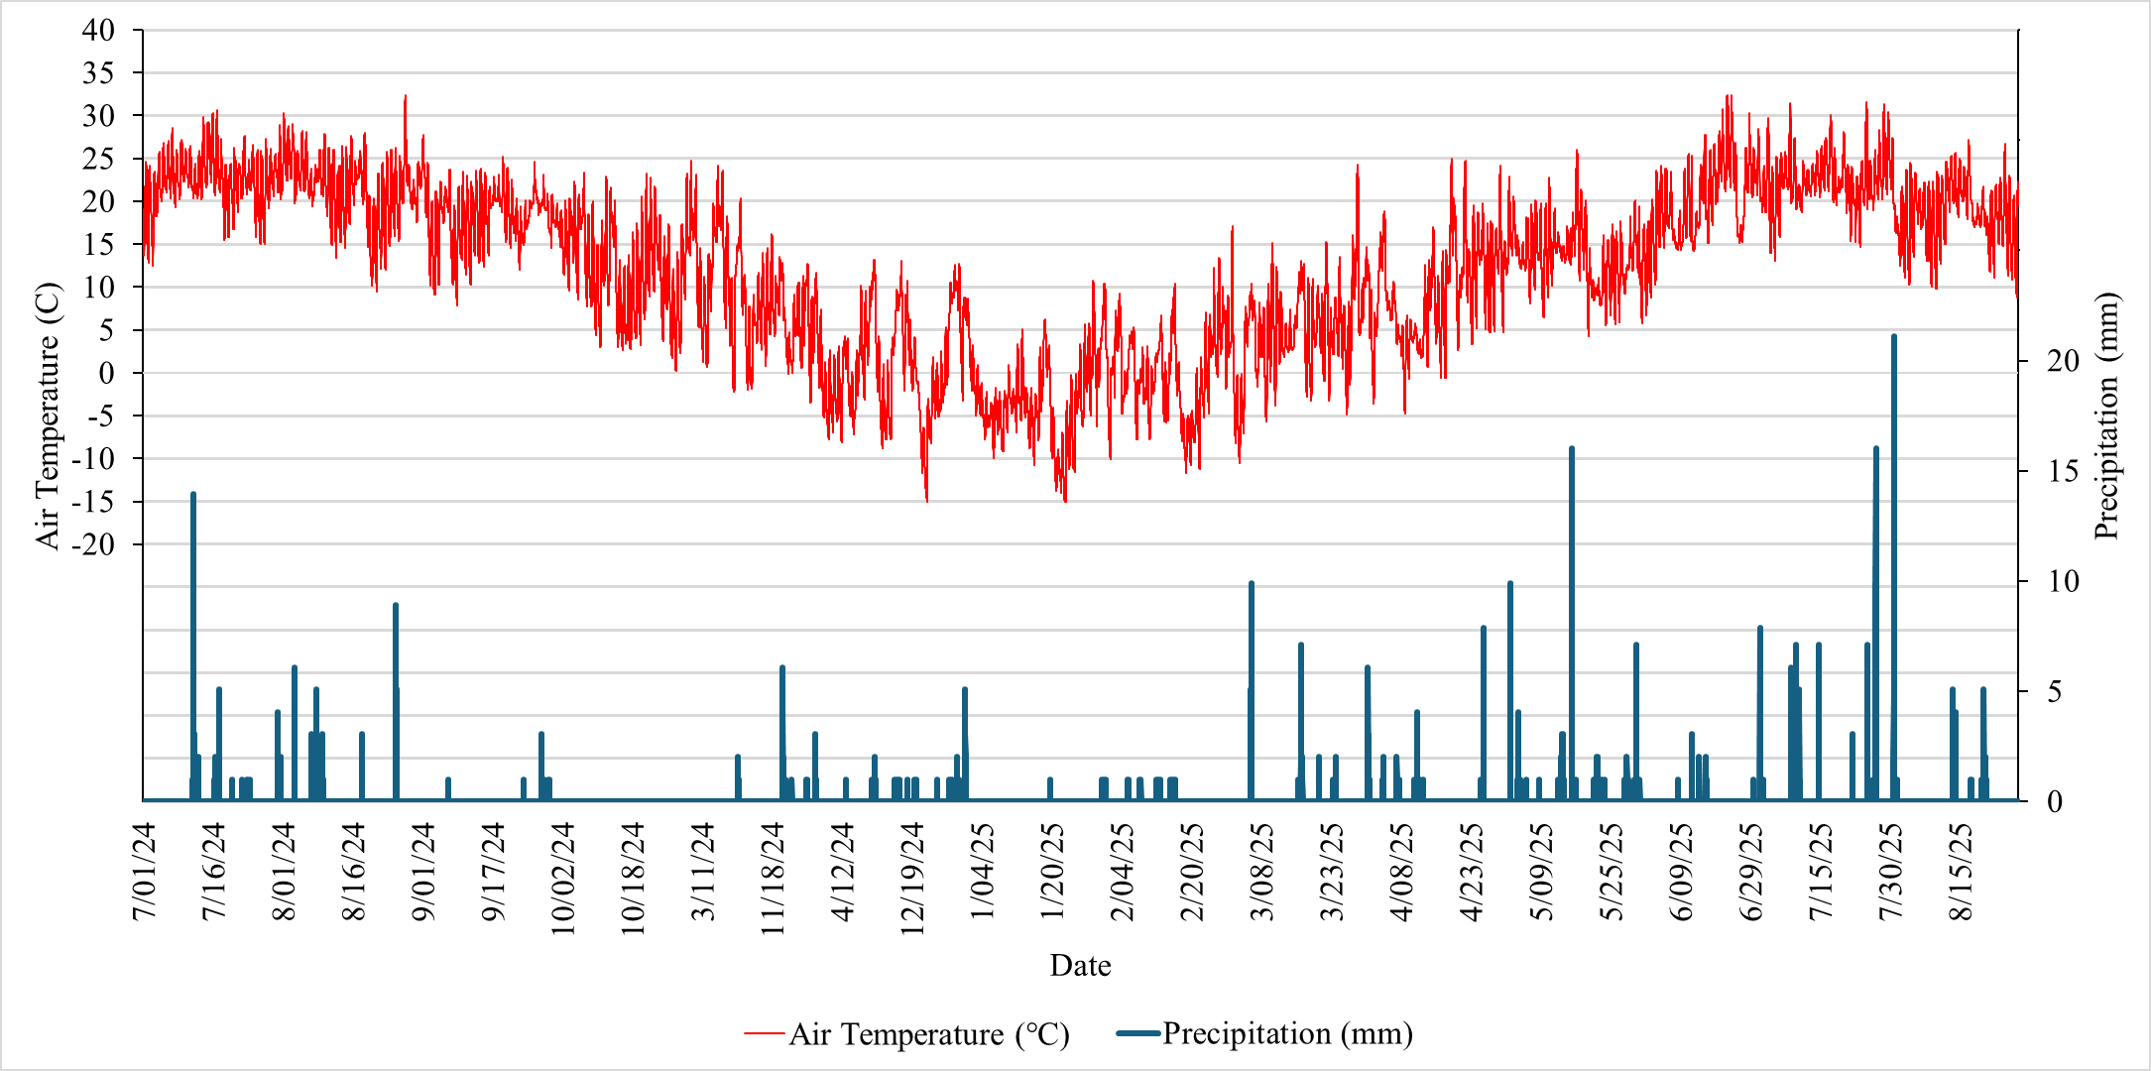
JCNERR – Air Temperature and Precipitation
Summer air temperature averaged about 23–24 °C.
Lower precipitation and higher evapotranspiration enhanced salinity.
Storm events caused temporary salinity spikes due to coastal flooding.

Slide 26

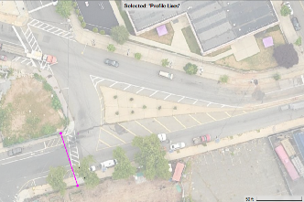
Study Site 1: 706 Market Street
Flow rate

Slide 27




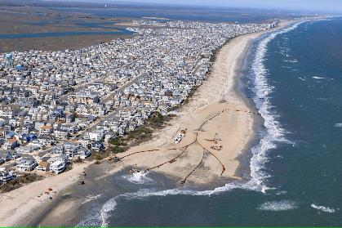
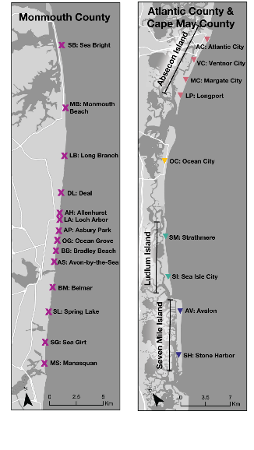
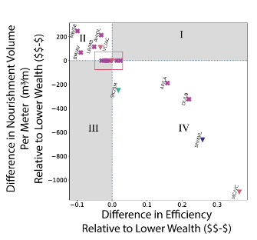
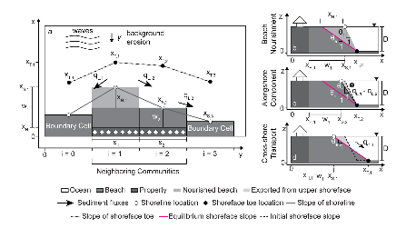


Geology & Economics of Beach Nourishment
By Owen Thomas
Beach Nourishment
Regional Study
Impact of Nourishment Efforts on Efficiency
Sea Isle City Beach Nourishment Project
Photo by Andrew Mills, NJ Advance Media and NJ.com
Numerical Model
Bridging the Gap

Slide 28
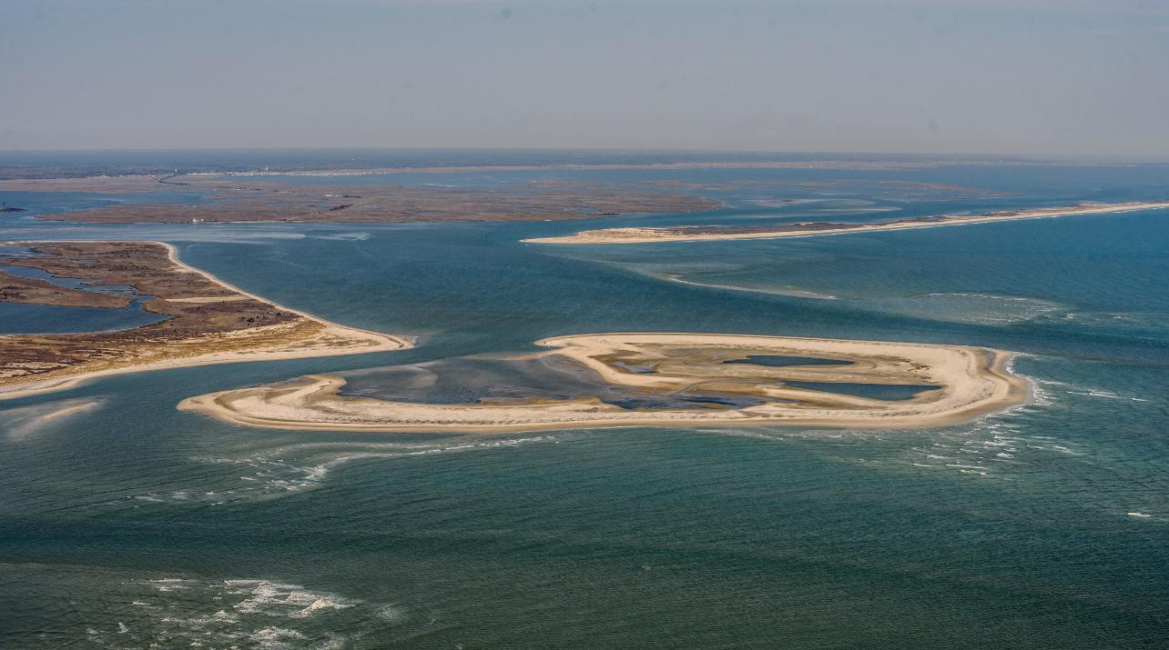

Evaluation of Alongshore and Inlet Sediment Transport
Long Beach Island & Little Egg Inlet
The role of sediment in New Jersey’s coastal communities & habitats
Kimberly McKenna
Interim Executive Director
Coastal Research Center (CRC), Stockton University
Photo courtesy T. Kingston April 24, 2025
Photo courtesy T. Kingston 11/29/2020
NJCRC-NJDEP Coastal & Climate Resilience Conference
Galloway, NJ March 9-11, 2026

Slide 29
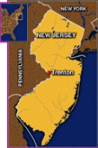
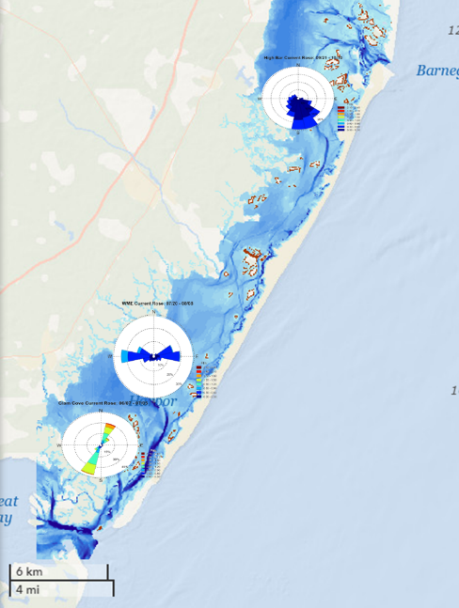
LEVERAGING FUNDS/CRC PARTNERSHIPS/PROJECTS
NJCCRC
2023 Little Egg Harbor/Holgate echosounder, Little Egg Inlet hydrographic pilot study, sediment transport white paper
Long Beach Township, Monmouth University UCI, New Jersey Bay Islands Initiative
2023-2025 wave, current, water quality, topo/bathy studies at High Bar Islands, West Marshelder Island, and Clam Cove (bay island restoration)
USCRP/NJSGC/Monmouth UCI/US Naval Academy
2024-2025 Little Egg Inlet drifter/ADCP waves & currents/suspended sediment/ hydro-morphological modeling/TAC, student, & stakeholder engagement
NJDOT-OMR/The Nature Conservancy/Monmouth UCI
2023-2025 NJ Atlantic Back Bays Regional Sediment Framework/Sediment Quantity & Dynamics
TNC/Partnership Delaware Estuary/Monmouth UCI/Stevens
2024-2026 wave, current, water quality, topo/bathy studies at 5 marshes (establish pipeline for marsh restoration)
NJDEP Div Science & Research/Rutgers CRSSA/Monmouth UCI
2023-2026 development of Marsh Futures sediment data layer
Barnegat Inlet
Little Egg Inlet

Slide 30
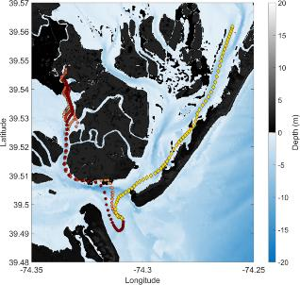
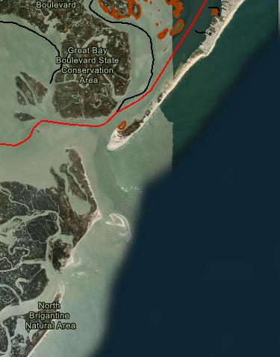
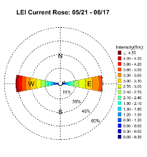
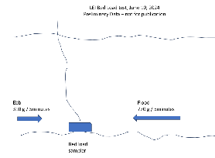
OUR OCEAN AND BACK BAY COMMUNITIES AND HABITATS NEED SEDIMENT!
Filling Knowledge Gaps
Surface current patterns
Sediment & currents through inlets
Quantify how much is reaching shorelines & habitats
To keep up with sea level and climatic changes.
Little Egg Inlet
Brigantine Inlet
Planned drifter release
Moored ADCP

