Slide 1
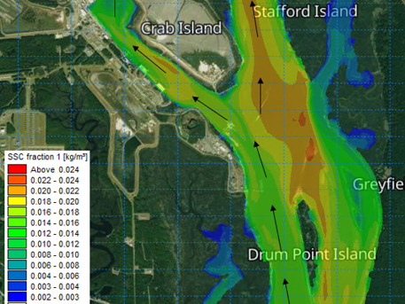
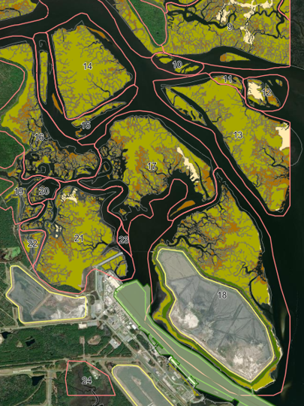
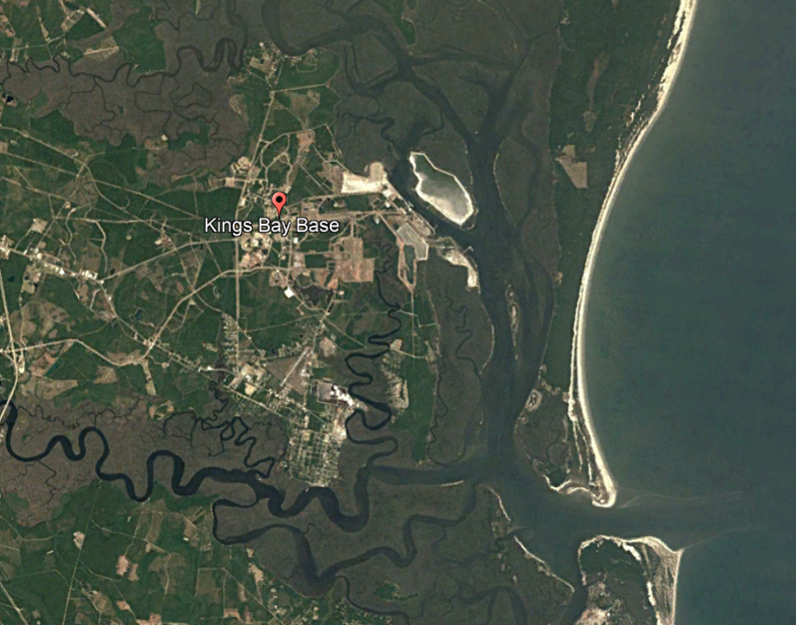

2026 New Jersey Coastal and Climate Resilience Conference
^{March 11, 2026}
Modeling of Sediment Motion in Marshes to Evaluate Shoaling and Beneficial Use Options
Christopher Bender, Ph.D., P.E., BC.CE
^{Co-author: Michael Kabiling}

Slide 2
Study Purpose and Presentation Outline
Review historical and present marsh features, shoaling, and dredging to understand local conditions
Develop a model capable of evaluating water levels, waves, and mixed sand/fines sediment transport pathways
Simulate potential alternatives to reduce shoaling and dredging requirements, including beneficial use of dredged material (BUDM) alternatives
Develop recommendations for future dredged material management strategies
OUTLINE
Project Location
Study Overview
Modeling Methods
Study Findings

Slide 3
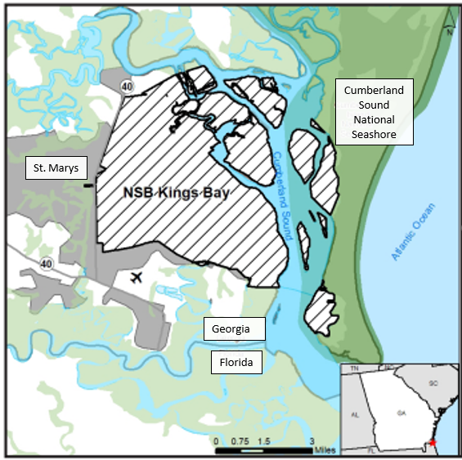
Project Location
Naval Submarine Base Kings Bay (NSBKB)
Located in Cumberland Sound, near the St Marys River, GA
Annual dredging volumes for the base and entrance channel exceed 1M cy/yr
Some dredged material placed in on-base dredged material management areas (DMMAs, aka a CDF)
Some material placed along the coastline or in offshore disposal area

Slide 4
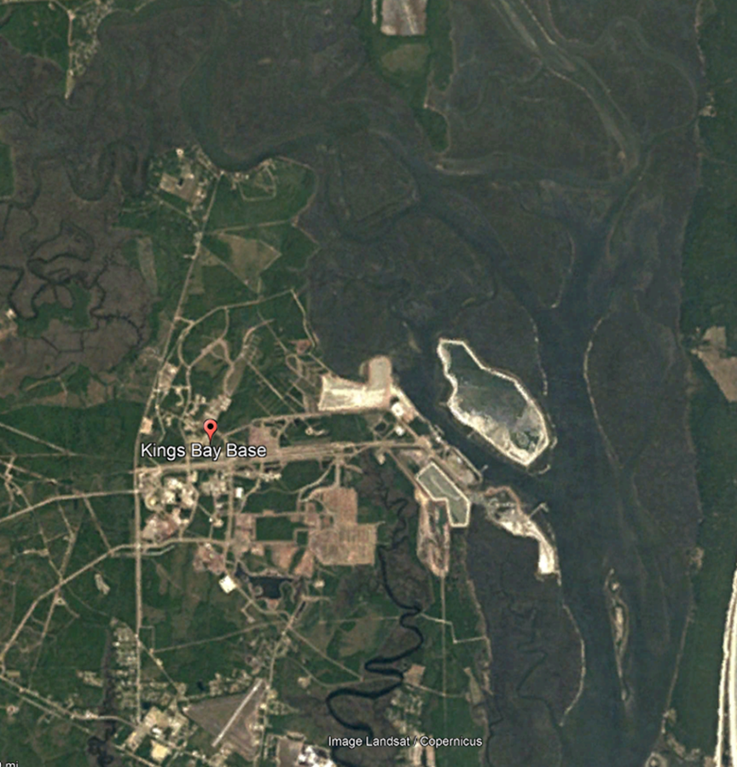
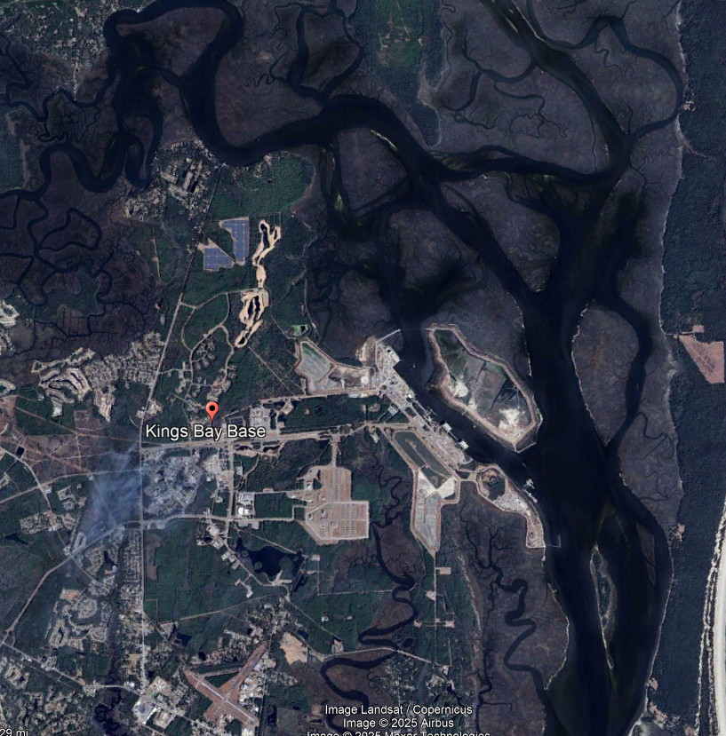
Project Location
Naval Submarine Base Kings Bay, evolving marsh conditions
December 1985
January 2025

Slide 5
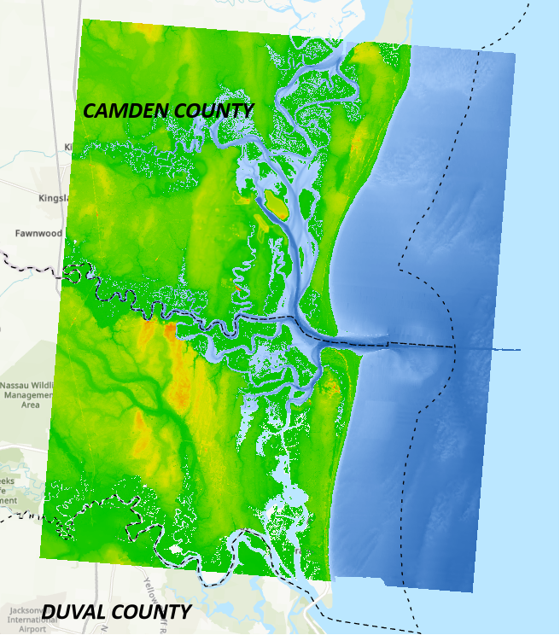
Study Overview
Develop a model to simulate local hydrodynamics, wave conditions, mixed sediment transport
Simulate suspended sediment and bed sediment transport
particle tracing to evaluate shoaling patterns
Apply the model to evaluate
potential alternatives to reduce shoaling
include the impacts of sea level change
marsh restoration

Slide 6
Study Overview
Prior studies provided valuable information
3D MIKE3 hydrodynamic, wave, sand and mud transport model (2016 to 2018)
Geo-Marine and AECOM Joint Venture (GMA)
Study collected water level, current, and sediment concentration data
Delft3D model for hydrodynamic, wave, and sediment transport near structures (2021)
Integral Consulting Inc. (ICI)
Athena Technologies Inc. collected and analyzed 16 vibracore samples

Slide 7
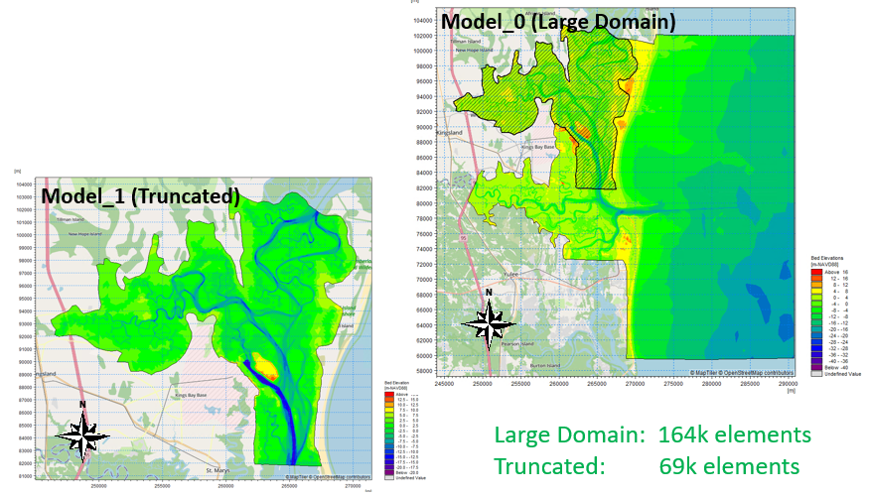
Modeling Methods
MIKE3 model for hydro, waves, sediment transport, particle tracking
Based on existing NSBKB model
3D hydro and mixed-bed model
Sand and silt
Captures bedload and suspended sediment
Erosion and deposition (shoaling)
Area of Interest

Slide 8
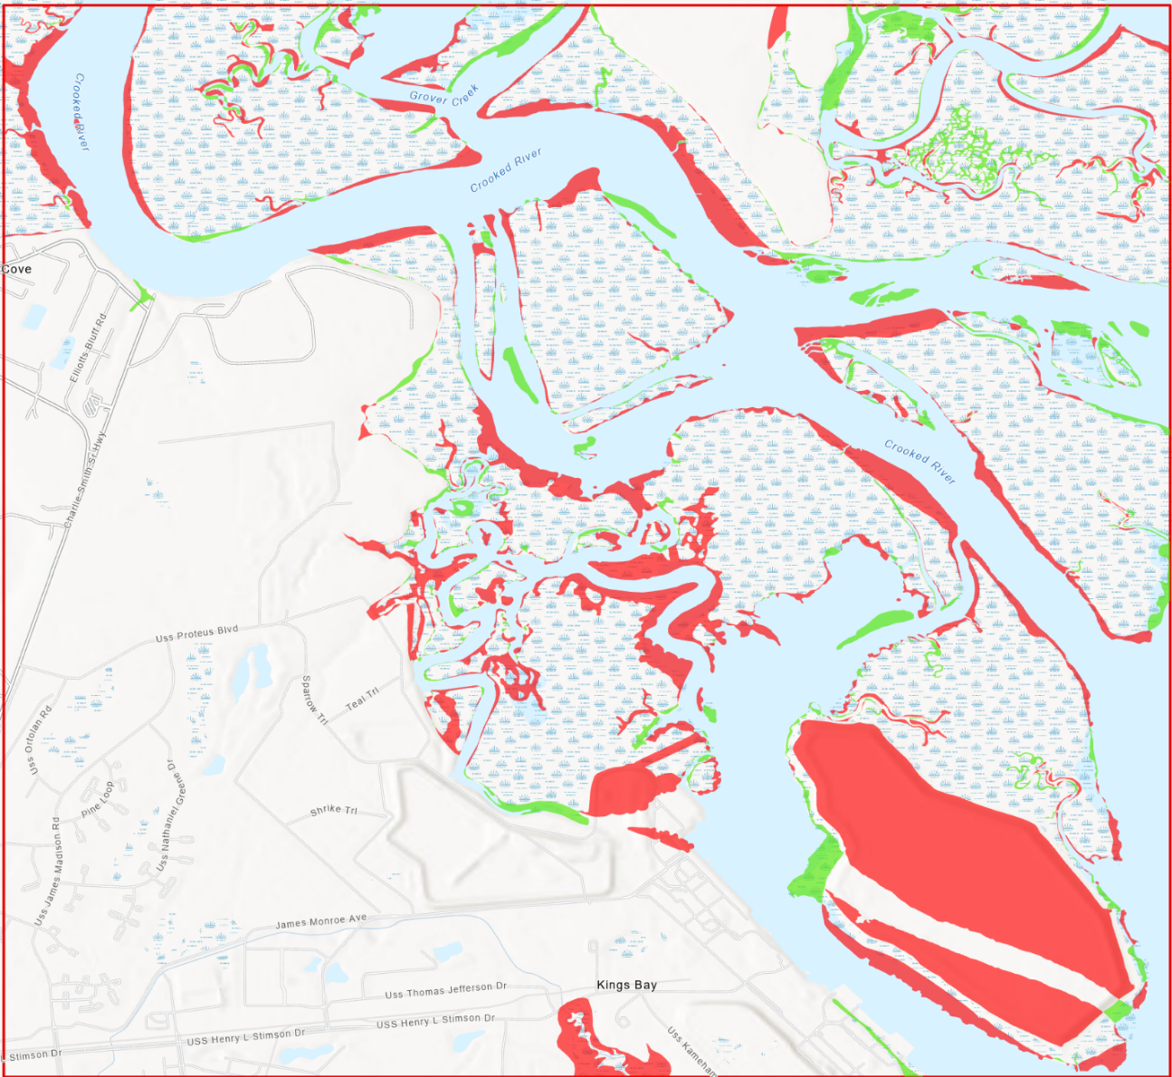
Modeling Methods
Concurrent study examined past, present and future marsh conditions
Marstel-Day and EAEST
Comparison of 1929 T-Sheets and the 2016 NWI datasets
areas of loss and gain (~1,000 acre loss)
SLAMM modeling examined marsh changes by decade (2030 to 2080)
Provided critical data for MIKE3 model
Studies shared info and alternatives

Slide 9
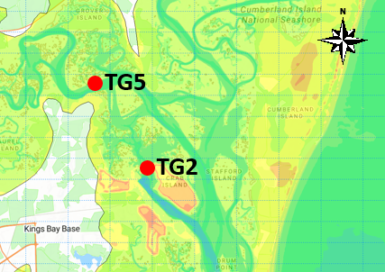
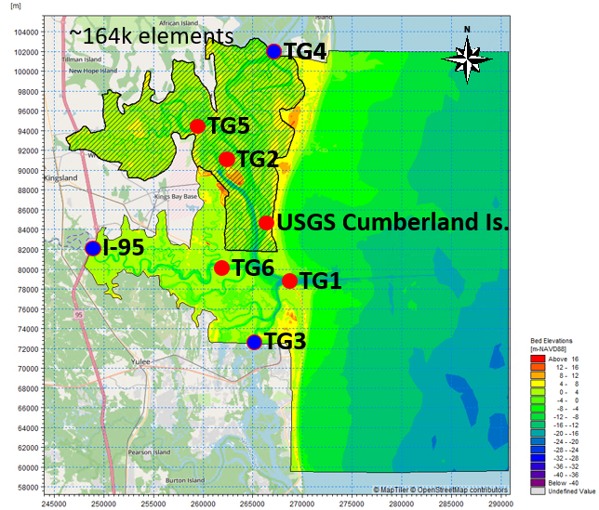
Modeling Methods
Apply data collected in the 2018 study
Water level
Current velocity
Sediment flux
Allow for calibration and verification near NSBKB
Demonstrate model’s capability for simulations

Slide 10
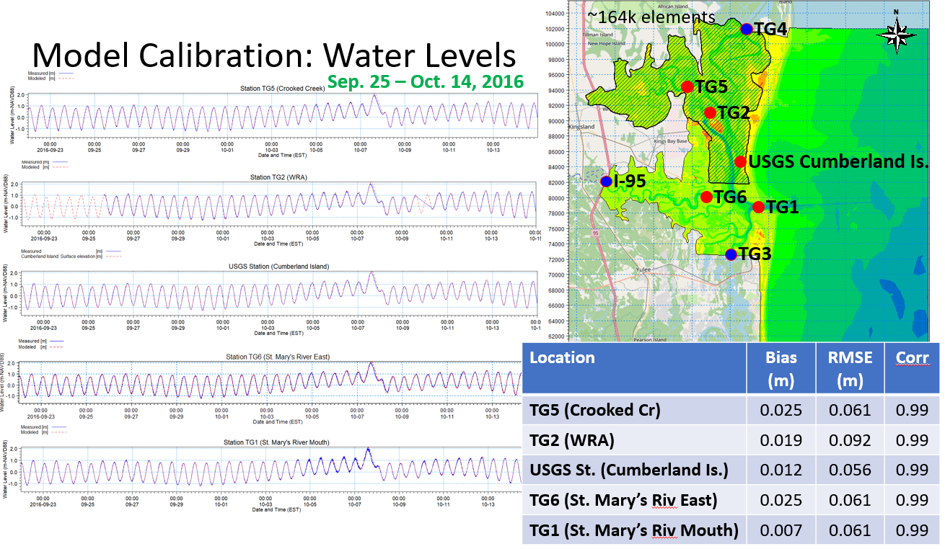
Modeling Methods
Calibration
3 weeks

Slide 11
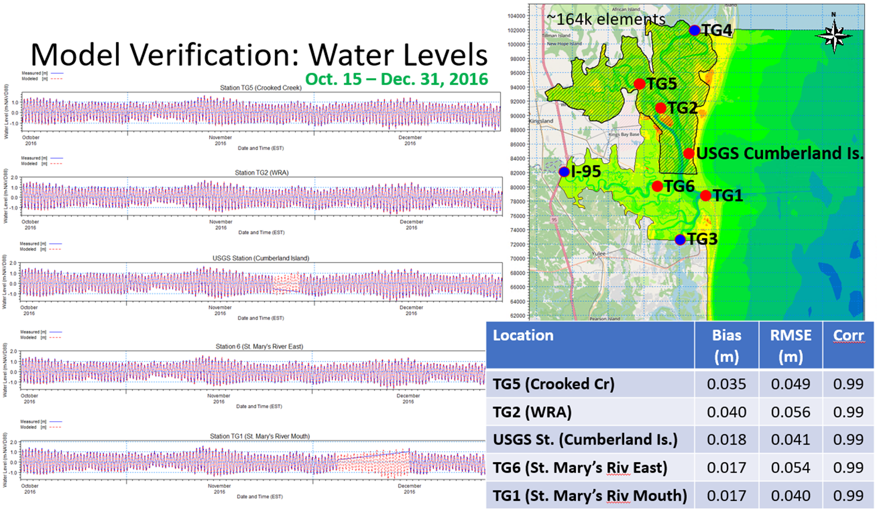
Modeling Methods
Verification
2.5 months

Slide 12
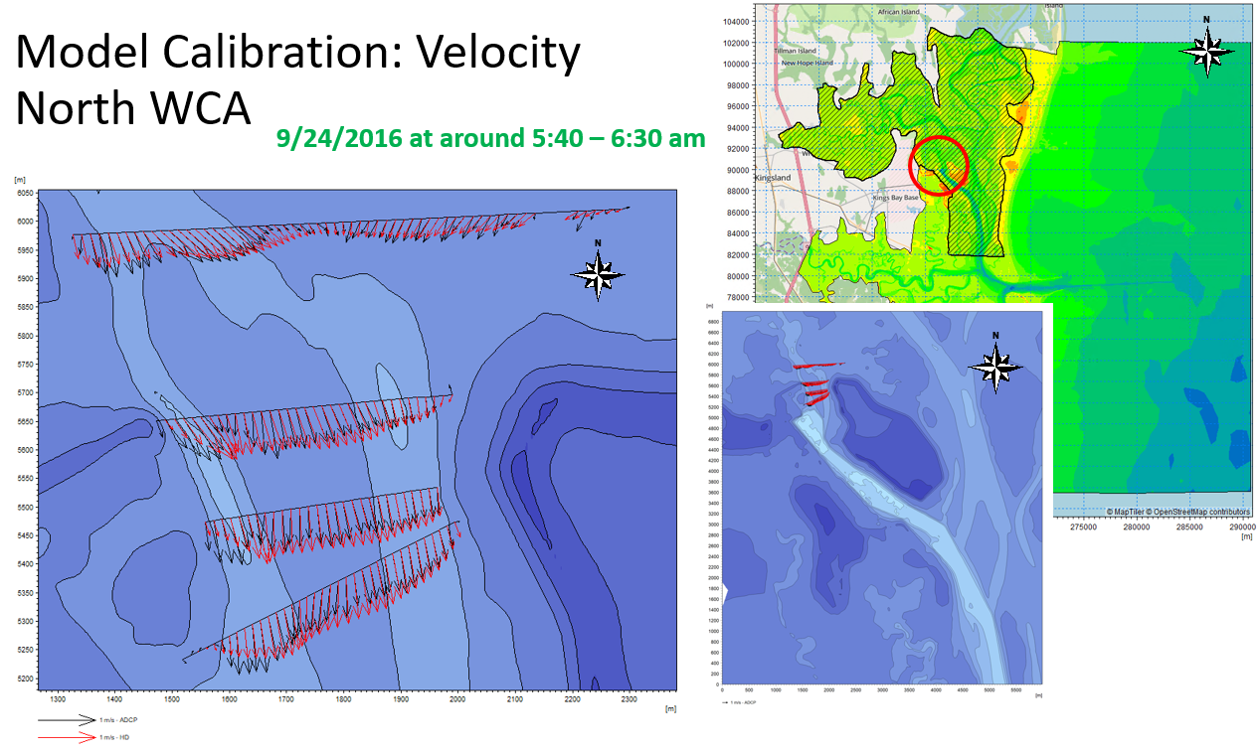
Modeling Methods
Calibration
Velocity

Slide 13
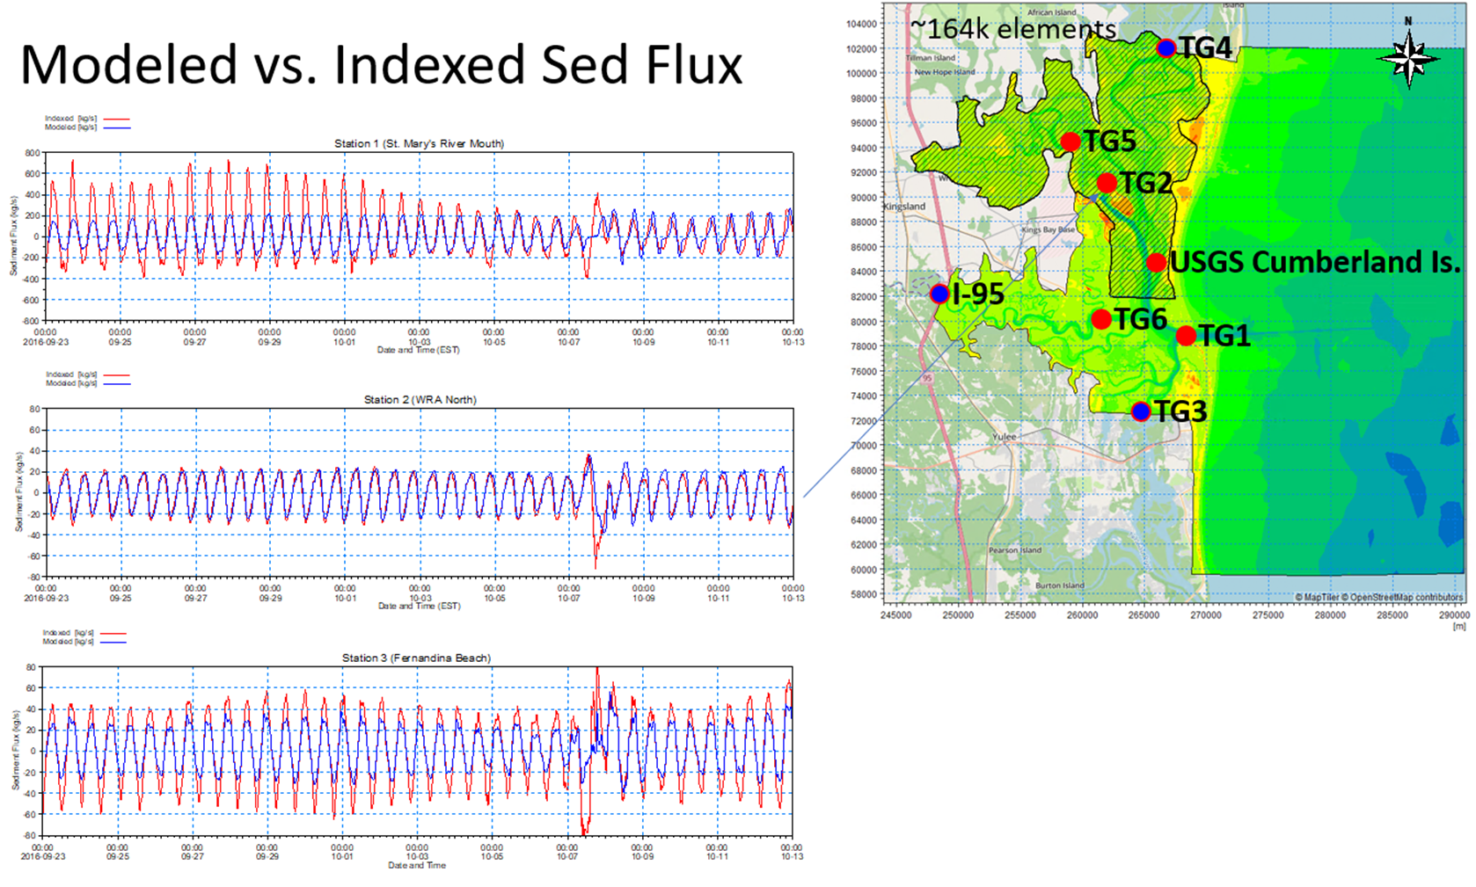
Modeling Methods
Calibration
Sediment Flux

Slide 14
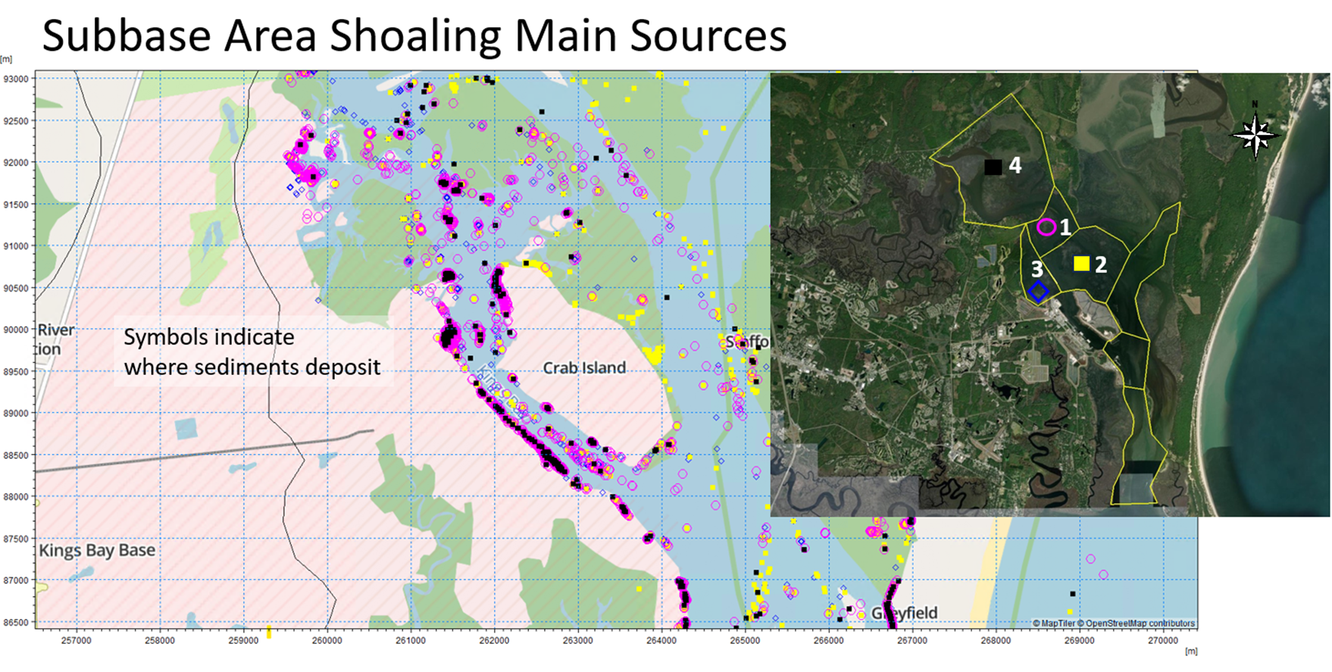
Modeling Methods
Particle Tracing
Shows origin and settling location
Allows for evaluation of shoaling patterns

Slide 15
Modeling Methods
Apply model to evaluate various alternatives
Beneficial use of dredged material (BUDM)
Marsh restoration and 5-year uplifts
Potential to restore marshes and sinuosity of channels and reduce shoaling
Structures within NSBKB to cut-off flow through the base
Full blockage of flow
Use of DMMAs and ODMDS
Current practice
Examine alternatives to 2080 with marsh changes due to sea level change by decade
Perform life cycle analysis and multi-criteria decision analysis (MCDA)

Slide 16
Conclusions
Model developed for marsh area near NSBKB
Hydro, waves, sediment transport, particle tracing
Calibrated and verified
Alternatives analysis include sea level change and marsh impacts from 2030 to 2080
Alternatives evaluation for BUDM projects, structural alternatives, and status quo (DMMA/ODMDS)
BUDM and structural solution shown to significantly reduce future shoaling and dredging vs status quo
Recommendation to further explore BUDM project with initial marsh restoration and then 5-year uplifts

Slide 17
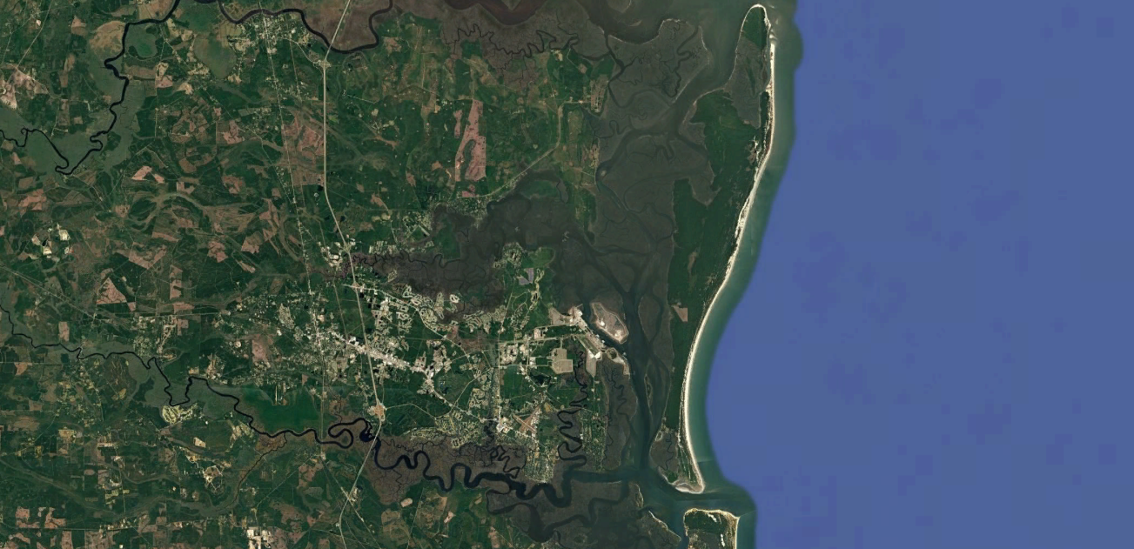
THANK YOU
QUESTIONS?

