Slide 1
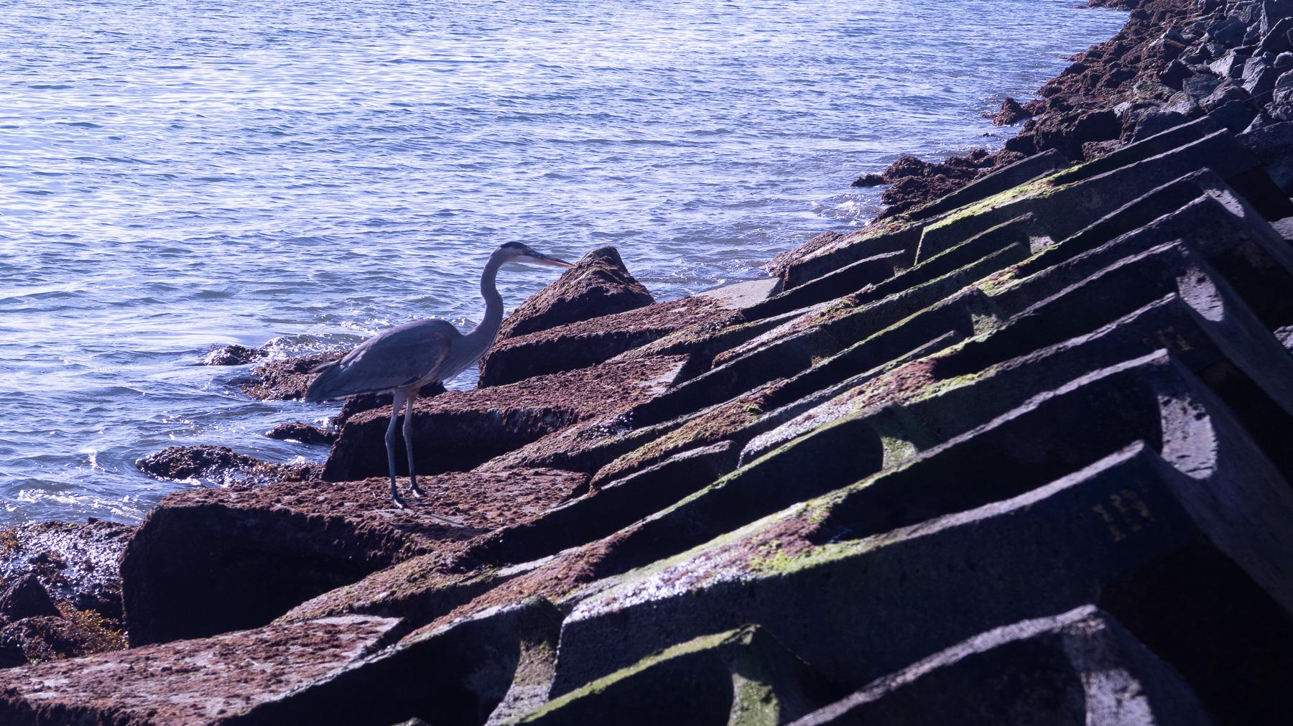

Building Climate-Resilient Coasts
Aliza Leit
Marine Ecosystem Integration Specialist
aliza@econcrete.us

Slide 2
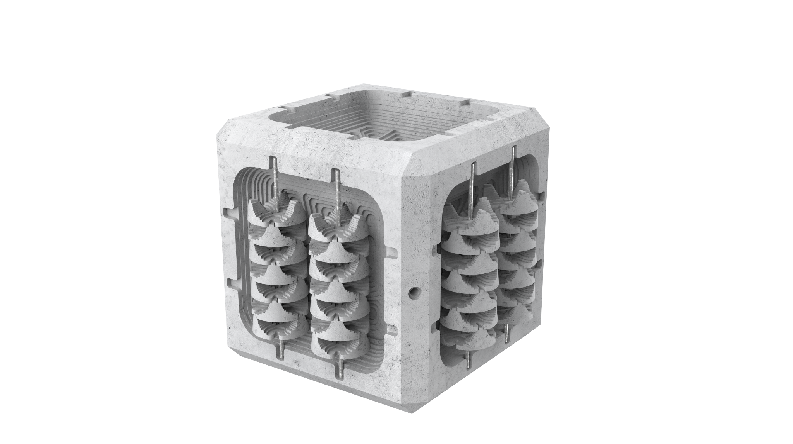
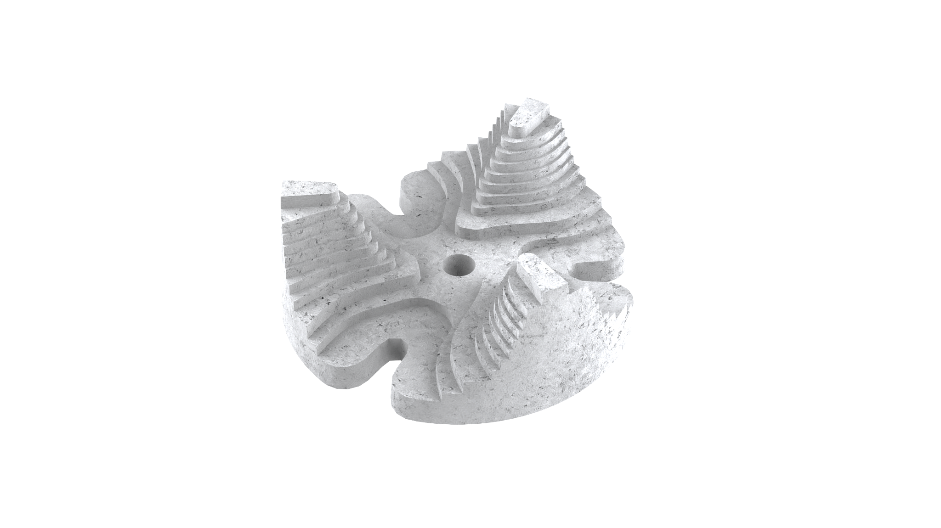
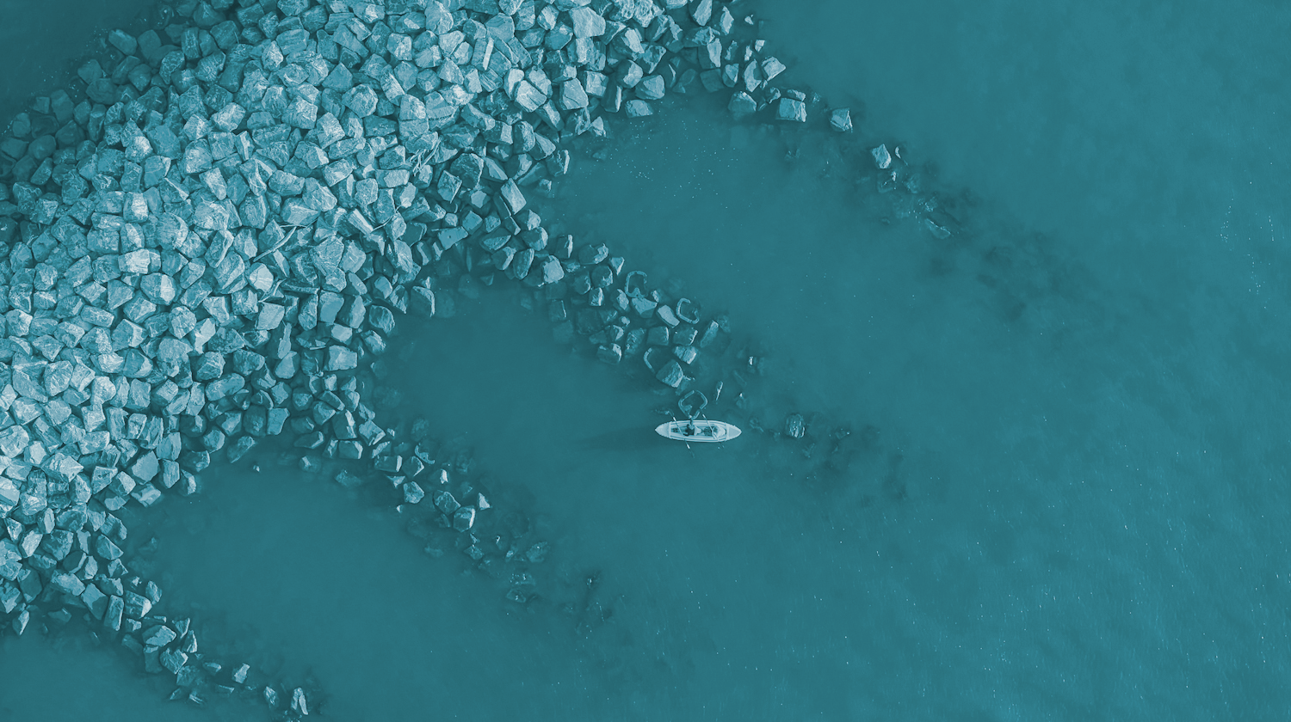
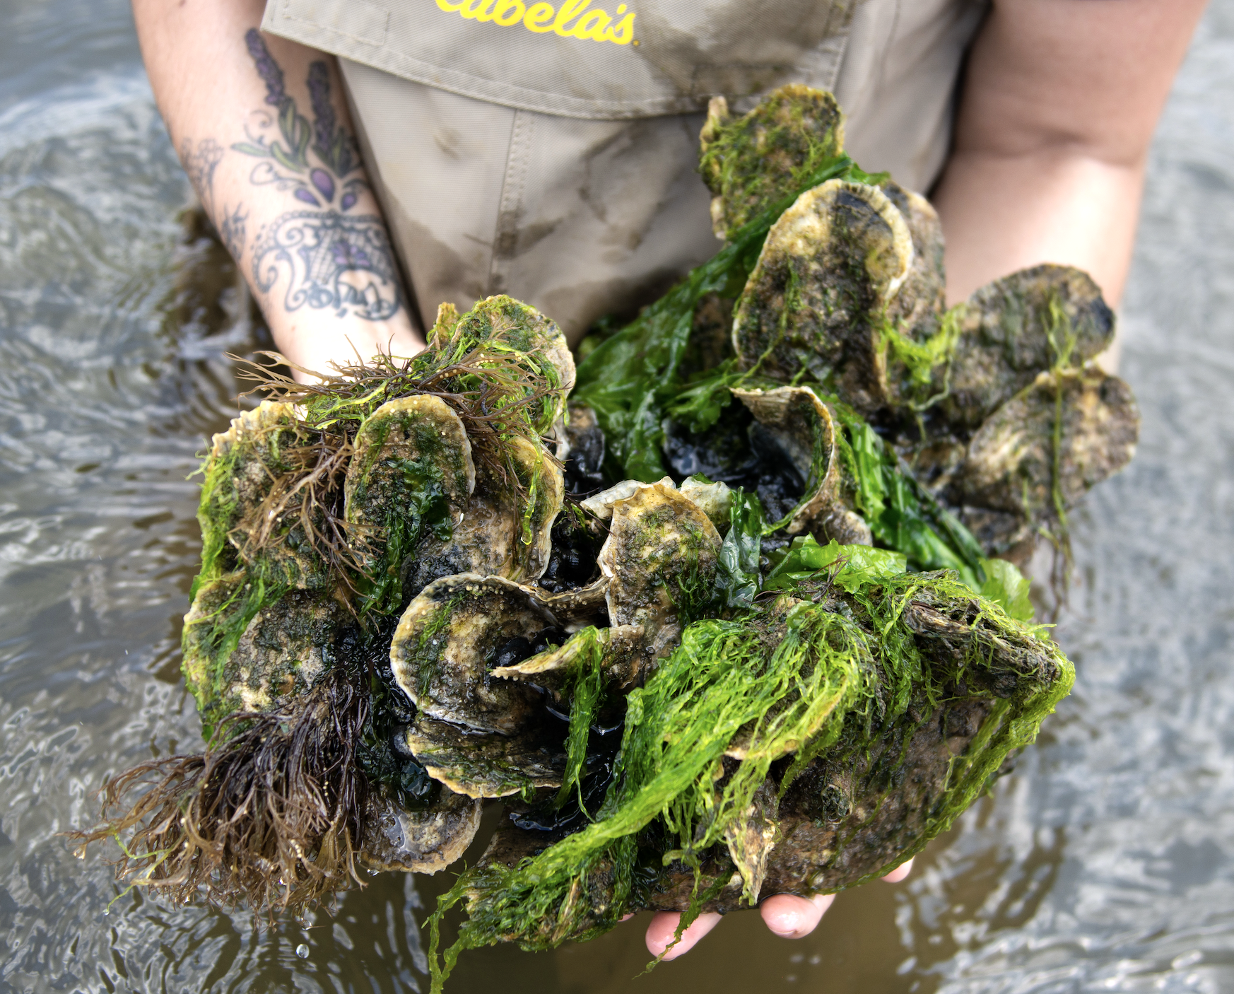


Living Breakwaters
Staten Island, New York
Notes:
we can design critical infrastructure like these breakwaters, that came from the devastation of hurricane sandy, and connect them to local restoration projects, collaborating with Billion Oyster Project to seed infrastructure, creating a living reef connected to the important efforts happening throughout the metropolitan area.
reduce mitigation of the project. What if the infrastructure is self mitigated?

Slide 3
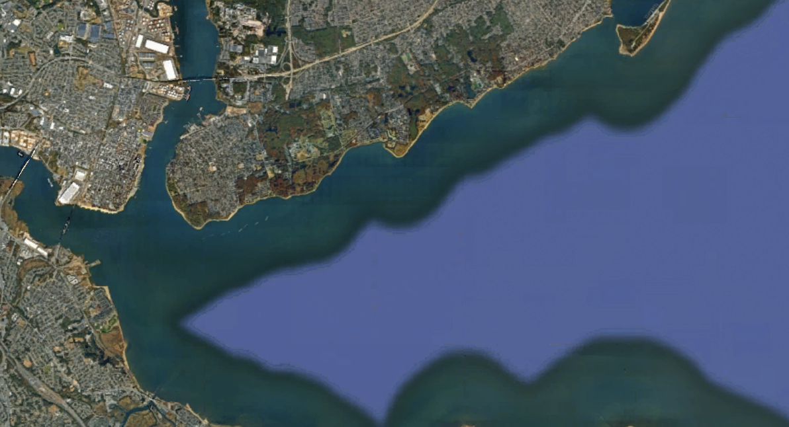
A.
HOW DO WE DESIGN FOR CONNECTIVITY?

Slide 4
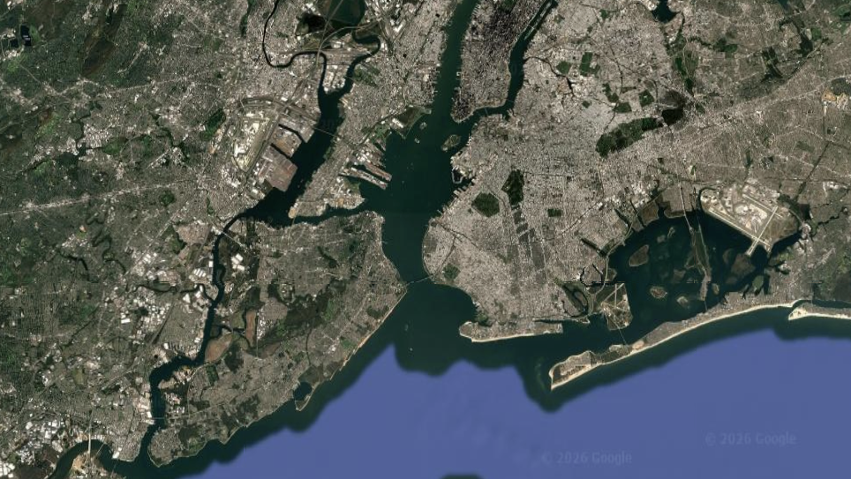
B.
HOW DO WE DESIGN FOR CONNECTIVITY?
A.

Slide 5
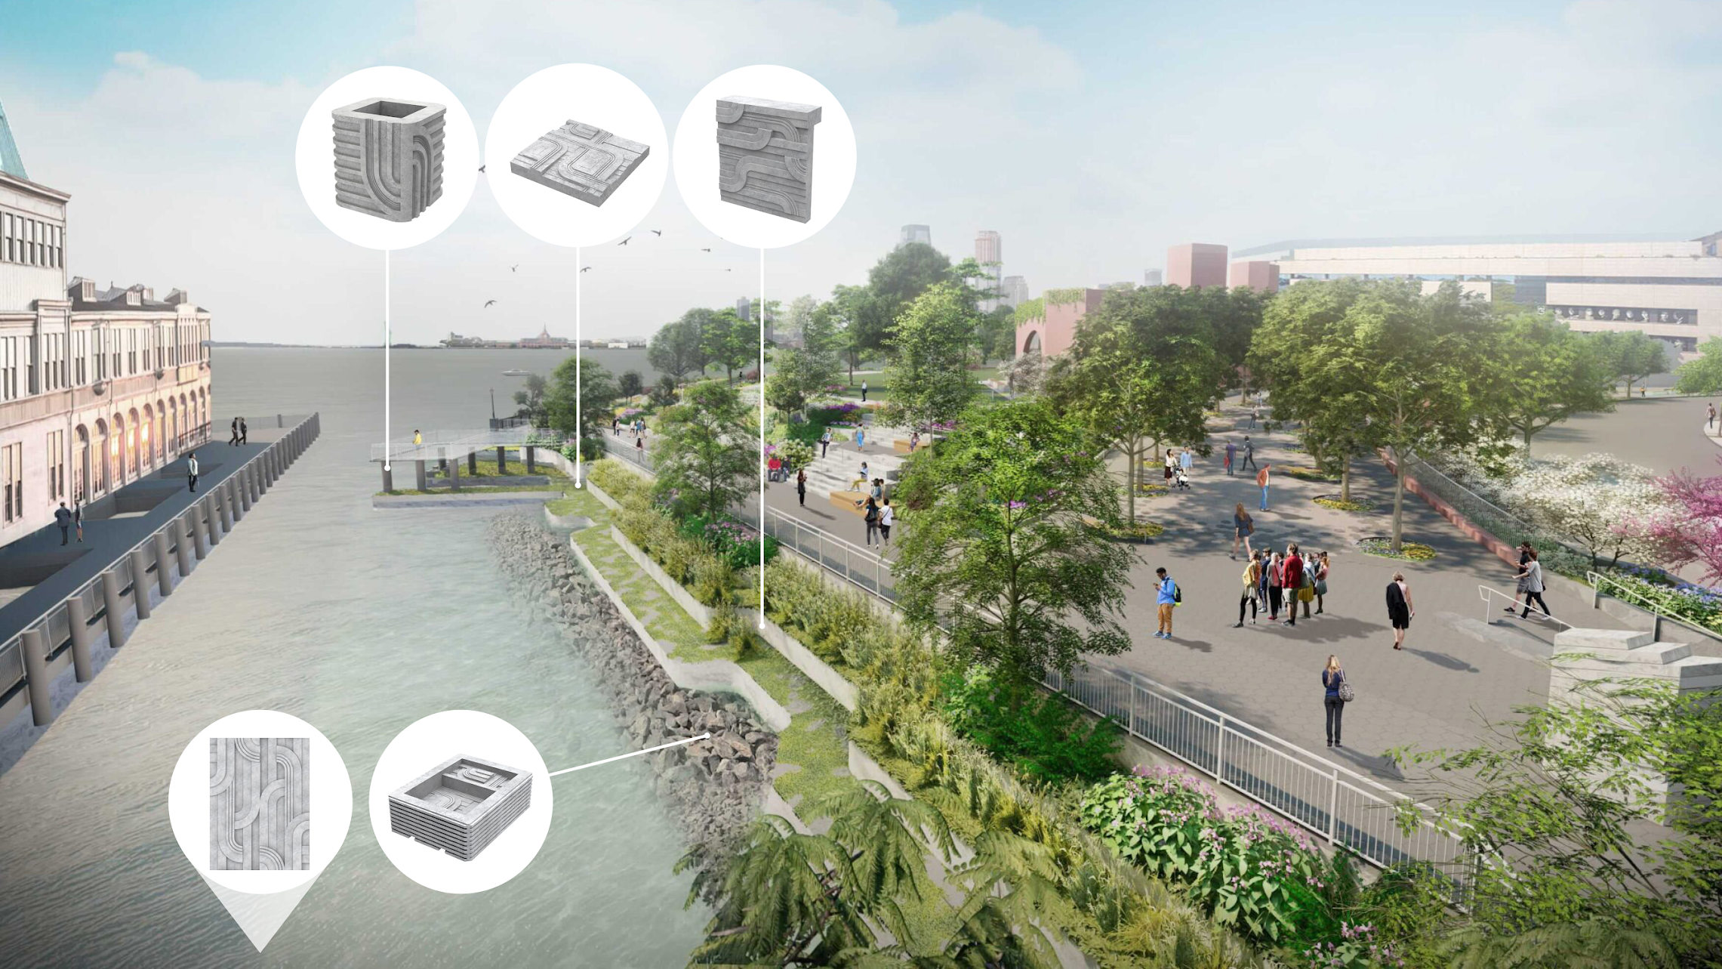



Battery Park City Authority

Slide 6
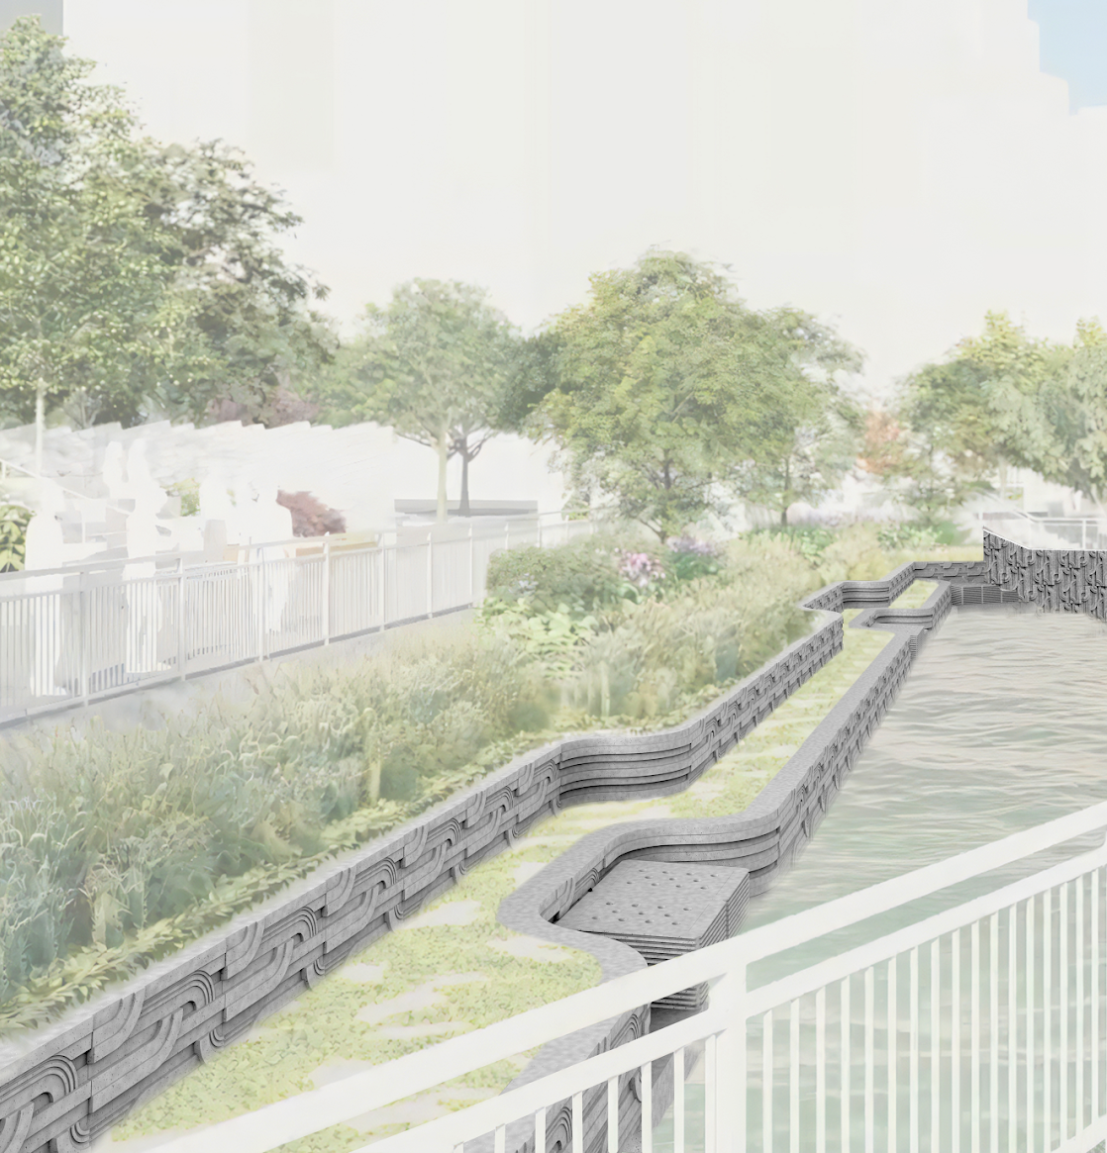
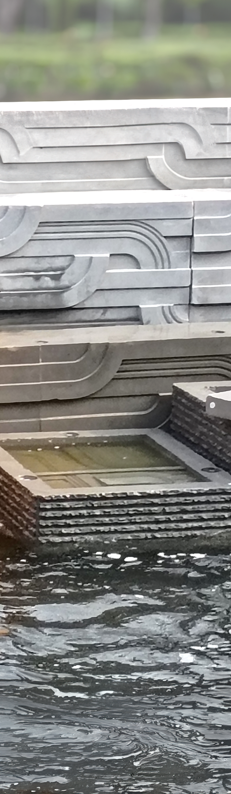
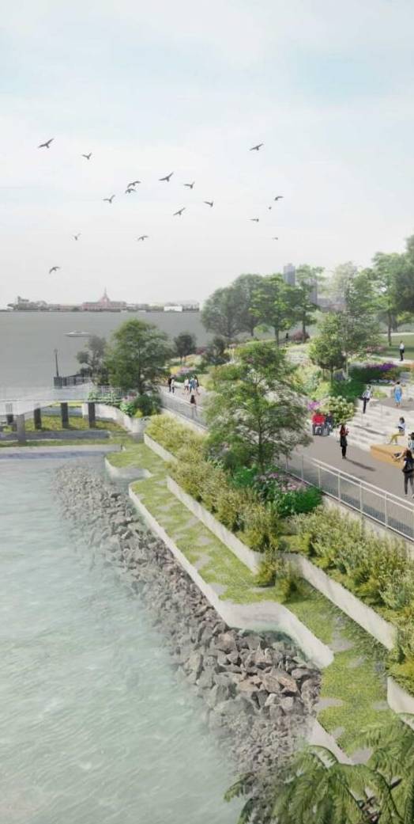
Battery Park City Authority

