Slide 1
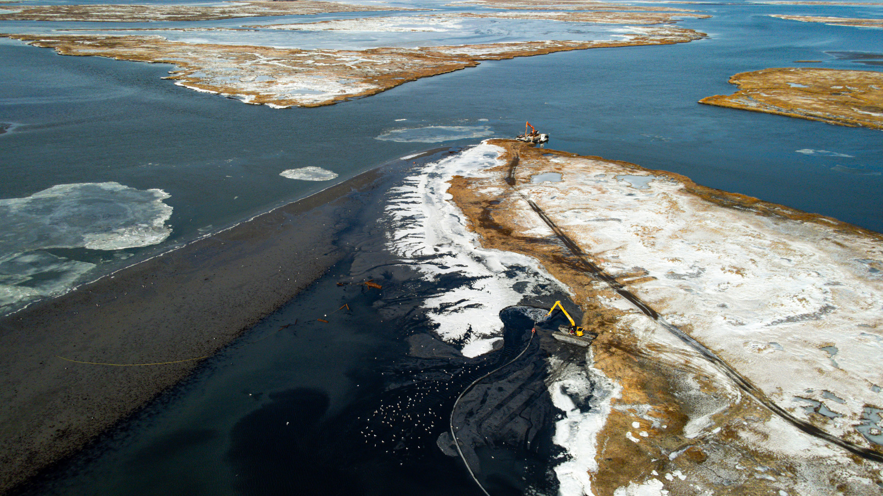
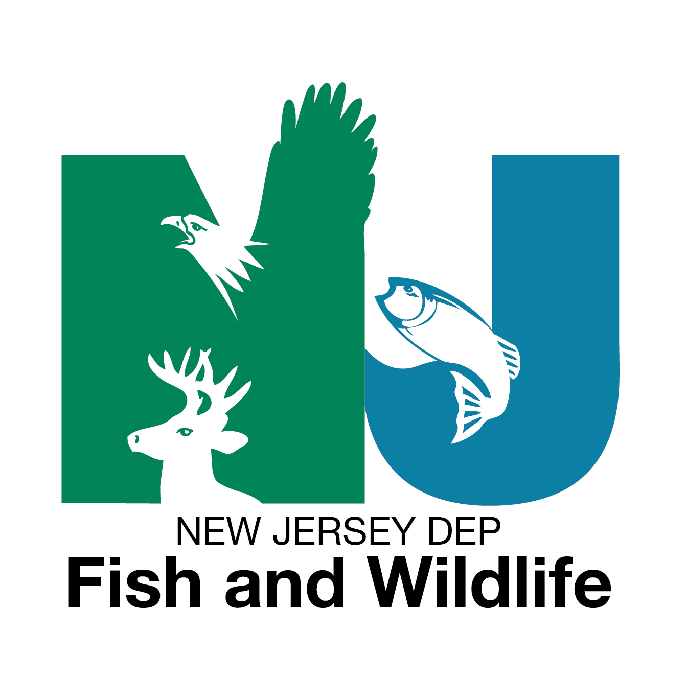
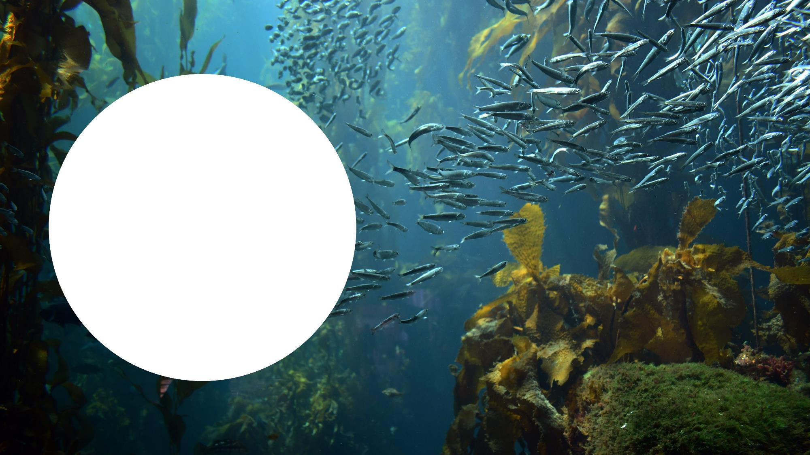
Why Ecological Restoration is Essential In a Global era
Photo Credit: NJDOT OMR
Notes:
Tyler Kinney, Coastal Biologist, NJDEP Fish and Wildlife
Background: Started my career as the Habitat Planner for New Jersey’s southern region (Forest Management, Grassland, Shorelines)

Slide 2
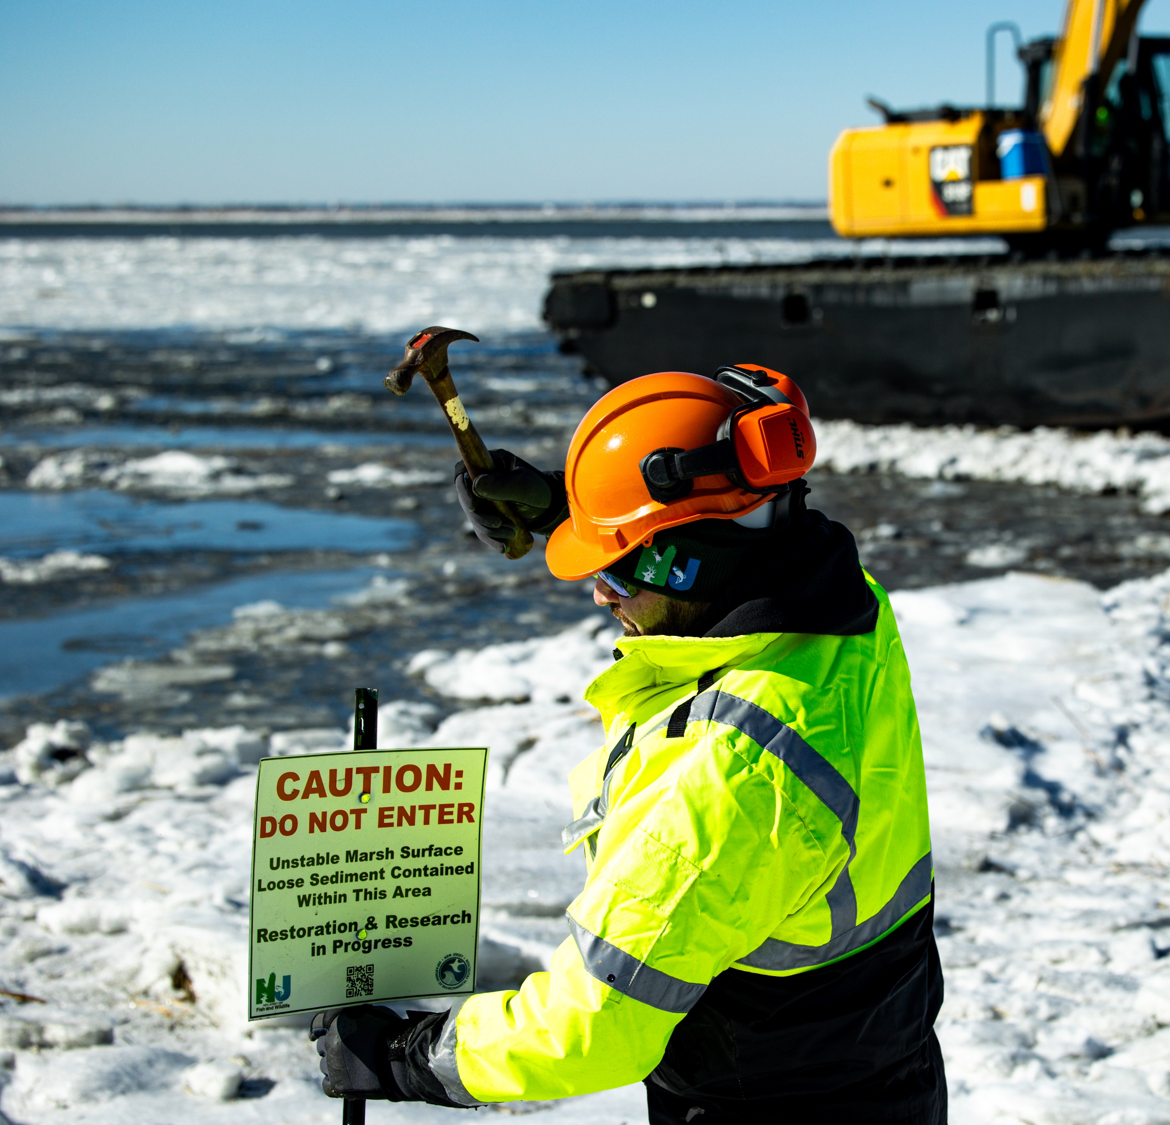
NJDEP Fish and Wildlife Coastal Program
Boot Island Restoration – Beneficial Use of Dredge Materials
Absecon Wildlife Management Area
Photo Credit: NJDOT OMR
Orchestrate conservation efforts at a landscape scale across the WMA system, aligning restoration and resilience initiatives with statewide priorities and maximizing the impact of partner contributions through coordinated direction and oversight.
Facilitate the Planning, Design, Implementation, and Monitoring of coastal habitat restoration and resilience initiatives on Wildlife Management Areas (WMAs)
Provide Landowner Oversight and Technical Assistance to conservation partners interested in managing a coastal restoration or enhancement project on the New Jersey WMA system.
Advise and Integrate Conservation Planning Efforts to maximize the effectiveness and long-term viability of coastal restoration efforts.
Engaging Stakeholders and Educating the Public on coastal restoration efforts
Notes:
2 years ago, tasked with Developing and Leading Fish and Wildlife’s Coastal Program

Slide 3
“We choose to go to the moon… not because it is easy, but because it is hard.”
– John F. Kennedy, September 12, 1962
Notes:
Giving the Program an Identity
Quote
Action Forward, Implementation Focused Program.
If you’re up for the challenge of completing restoration work...

Slide 4
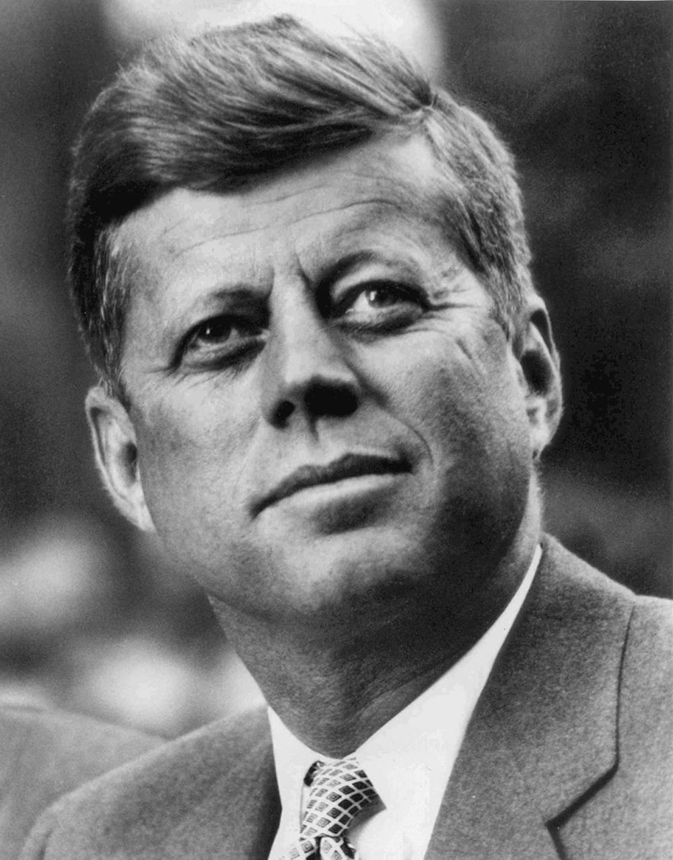
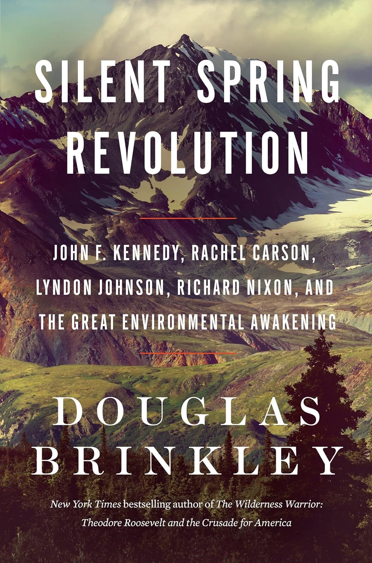
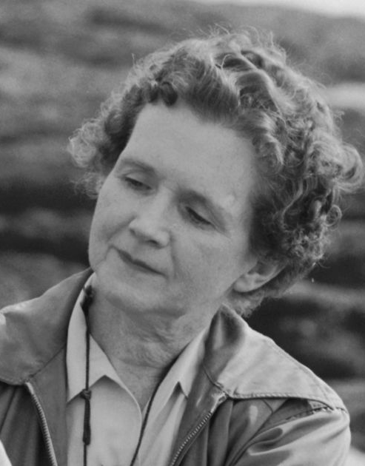
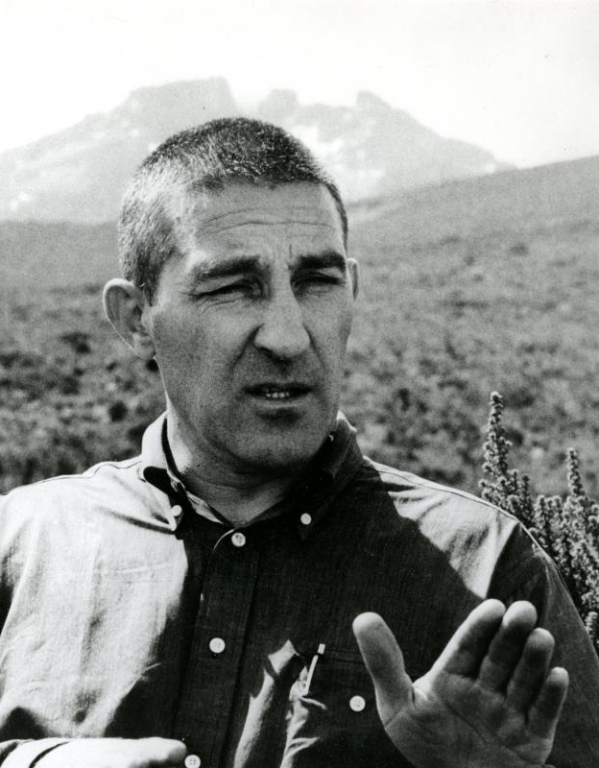
Understanding How we solved Problems of the past…
National Seashore Designations (1961-1963)
Multiple Signed into law by President John F. Kennedy
Clean Air Act (1963)
Signed into law by President Lyndon B. Johnson
Wilderness Act (1964)
Championed by John F. Kennedy
Signed into law by President Lyndon B. Johnson
National Environmental Policy Act (NEPA) (1970)
Signed into law by President Richard Nixon
Coastal Zone Management Act (1972)
Signed into law by President Richard Nixon
Endangered Species Act (1973)
Signed into law by President Richard Nixon
Notes:
Speaking of Kennedy…
When making conservation decisions, it is helpful to reference what has worked in the past.
“Who here has read the book Silent Spring Revolution?”
A great historic account of environmental history through the mid-1900’s
Thought leaders like Rachel Carson open eyes to environmental issues, and figureheads like JFK and Stuart Udall put those thoughts into action
Result was the genesis of our environmental regulatory framework, one of the most important conservation achievements in modern history.
Silent Spring Revolution demonstrates:
The power of using the right tool – for the right job.
We built a strong defense for the environment, with regulatory measures to solve problems on a national scale… and it WORKED

Slide 5
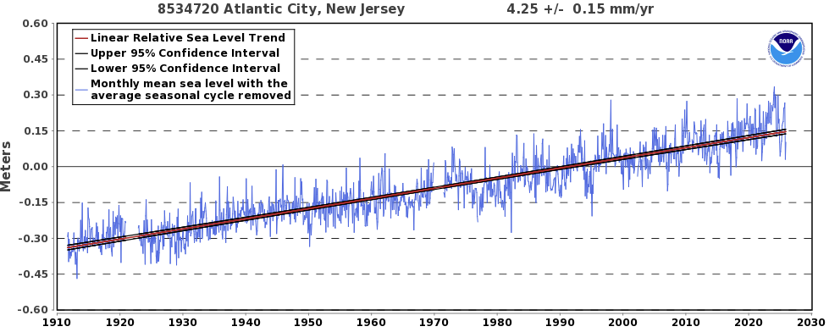
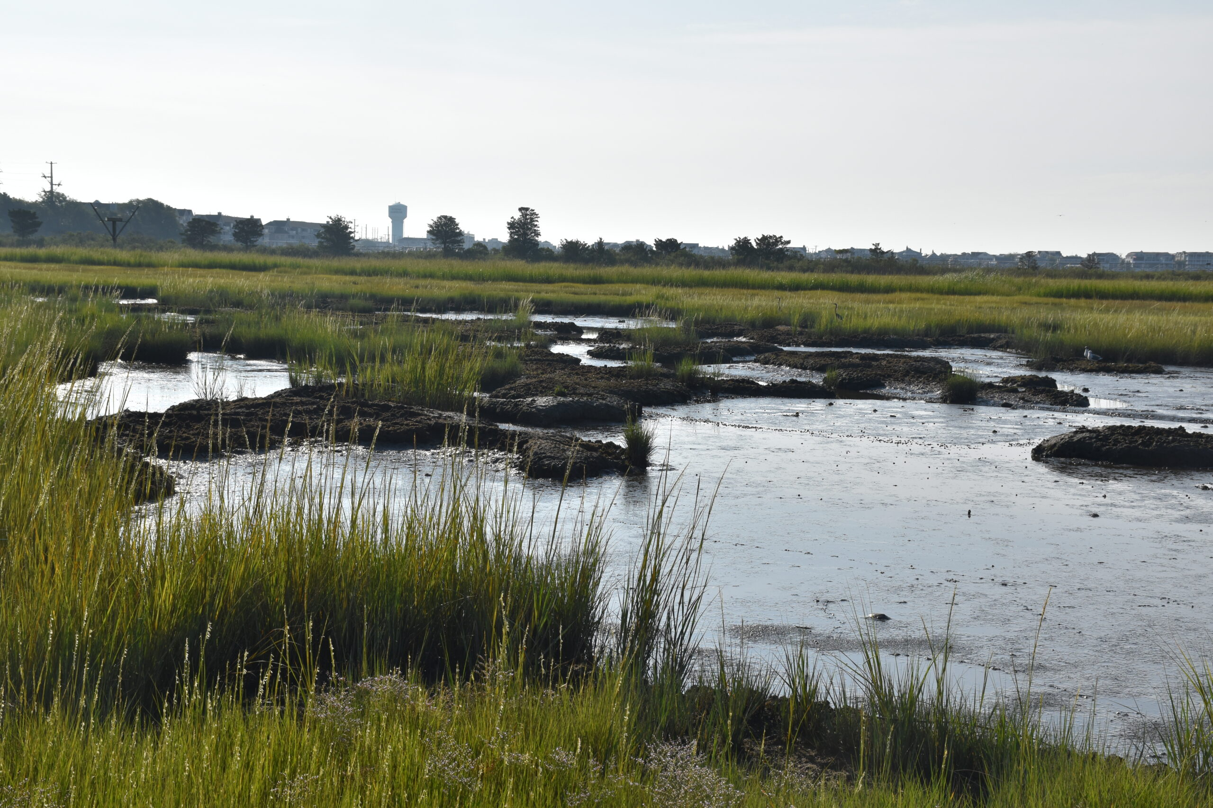
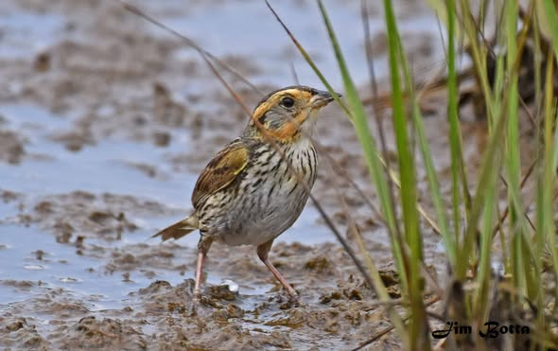
…Helps Us solve the problems of today
Relative Sea Level Rise
Degraded Habitats & Coastal Resilience
Imperiled Wildlife
Notes:
That begs the question… Are we using the right tools, for the job today?
1) Silent Spring Revolution revealed to me how much the scope of environmental threats have changed.
a) We used federal regulation to solve national problems
b) The threats we face today…

Slide 6
66%
Or greater chance New Jersey will experience 0.9 to 1.7 ft SLR by 2050.
Source: Kopp, R. E., A. Broccoli, G. Carleton, S. Dangendorf, R. DeConto, R. Frederiks, A.J. Garner, E. Grover-
Kopec, L. Haaf, B. Hamlington, N. Lin, J. Lorenzo-Trueba, J. Miller, D. Robinson, G. Vecchi, T. Wahl, J.
Walker, J.M. Barr, J. Shope, D.K. Apoznanski, P. Kumar, L. Marxen, A. Spector, K. O’Neill, L. Auermuller,
and M. Kaplan. New Jersey’s Rising Seas and Changing Coastal Storms: Report of the 2025 Science and
Technical Advisory Panel. Rutgers, The State University of New Jersey. Prepared for the New Jersey
Department of Environmental Protection. Trenton, New Jersey.

Slide 7
9%
Annual declines in global Saltmarsh Sparrow and Eastern Black Rail populations since 1990’s.
Source:
Atlantic Coast Joint Venture. 2020. Eastern Black Rail Conservation Plan for the Atlantic Coast. www.acjv.org
Hartley, M.J. and A.J. Weldon, eds. 2020. Saltmarsh Sparrow Conservation Plan. Atlantic Coast Joint Venture. www.acjv.org

Slide 8
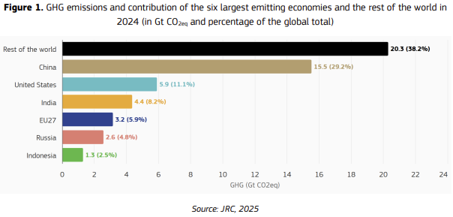
Source: Crippa, M., Guizzardi, D., Pagani, F., Banja, M., Muntean, M. et al., GHG emissions of all world countries - 2025 Report, Publications Office of the European Union, Luxembourg, 2025, https://data.europa.eu/doi/10.2760/9816914, JRC143227.
Notes:
1) Those threats are not national in scope like those of Kennedy’s day. Our threats today are GLOBAL in scope.
2) We can only regulate within our jurisdictional authorities

Slide 9

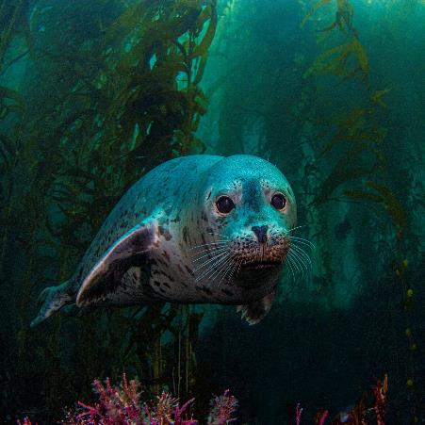
Challenge of Modern Day Ecological Restoration
Regulation provides Conservation Defense
Holding the line against accelerating global threats
Stewardship delivers Conservation Offense
Actively rebuilding the ecological system regulation alone cannot protect
Modern conservation requires us to scale our stewardship—our offense—in a way that is coordinated, strategic, and fully synergized with the regulatory defense that got us this far.
Notes:
that’s the heart of the challenge. Regulation is essential, but its power is limited by geography. Sea‑level rise isn’t. Species decline isn’t. Global emissions aren’t. We can’t defend our way out of global-scale threats using tools designed for national-scale problems.
That leads us directly into the modern conservation challenge.
defense alone won’t win the game. We have to pair it with a robust, scalable offense.
Modern conservation requires us to scale our stewardship—our offense—in a way that is coordinated, strategic, and fully synergized with the regulatory defense that got us this far.
This isn’t about choosing regulation or stewardship. They are two wings on the same bird. If they aren’t working together, we don’t fly.

Slide 10
“The worth of the ideal must be largely determined by the success with which it can in practice be realized.”
– Theodore Roosevelt, April 23, 1910
Notes:
These are lofty ideals, and that reminds me of a quote by my personal role model…read quote…. Any guesses?

Slide 11
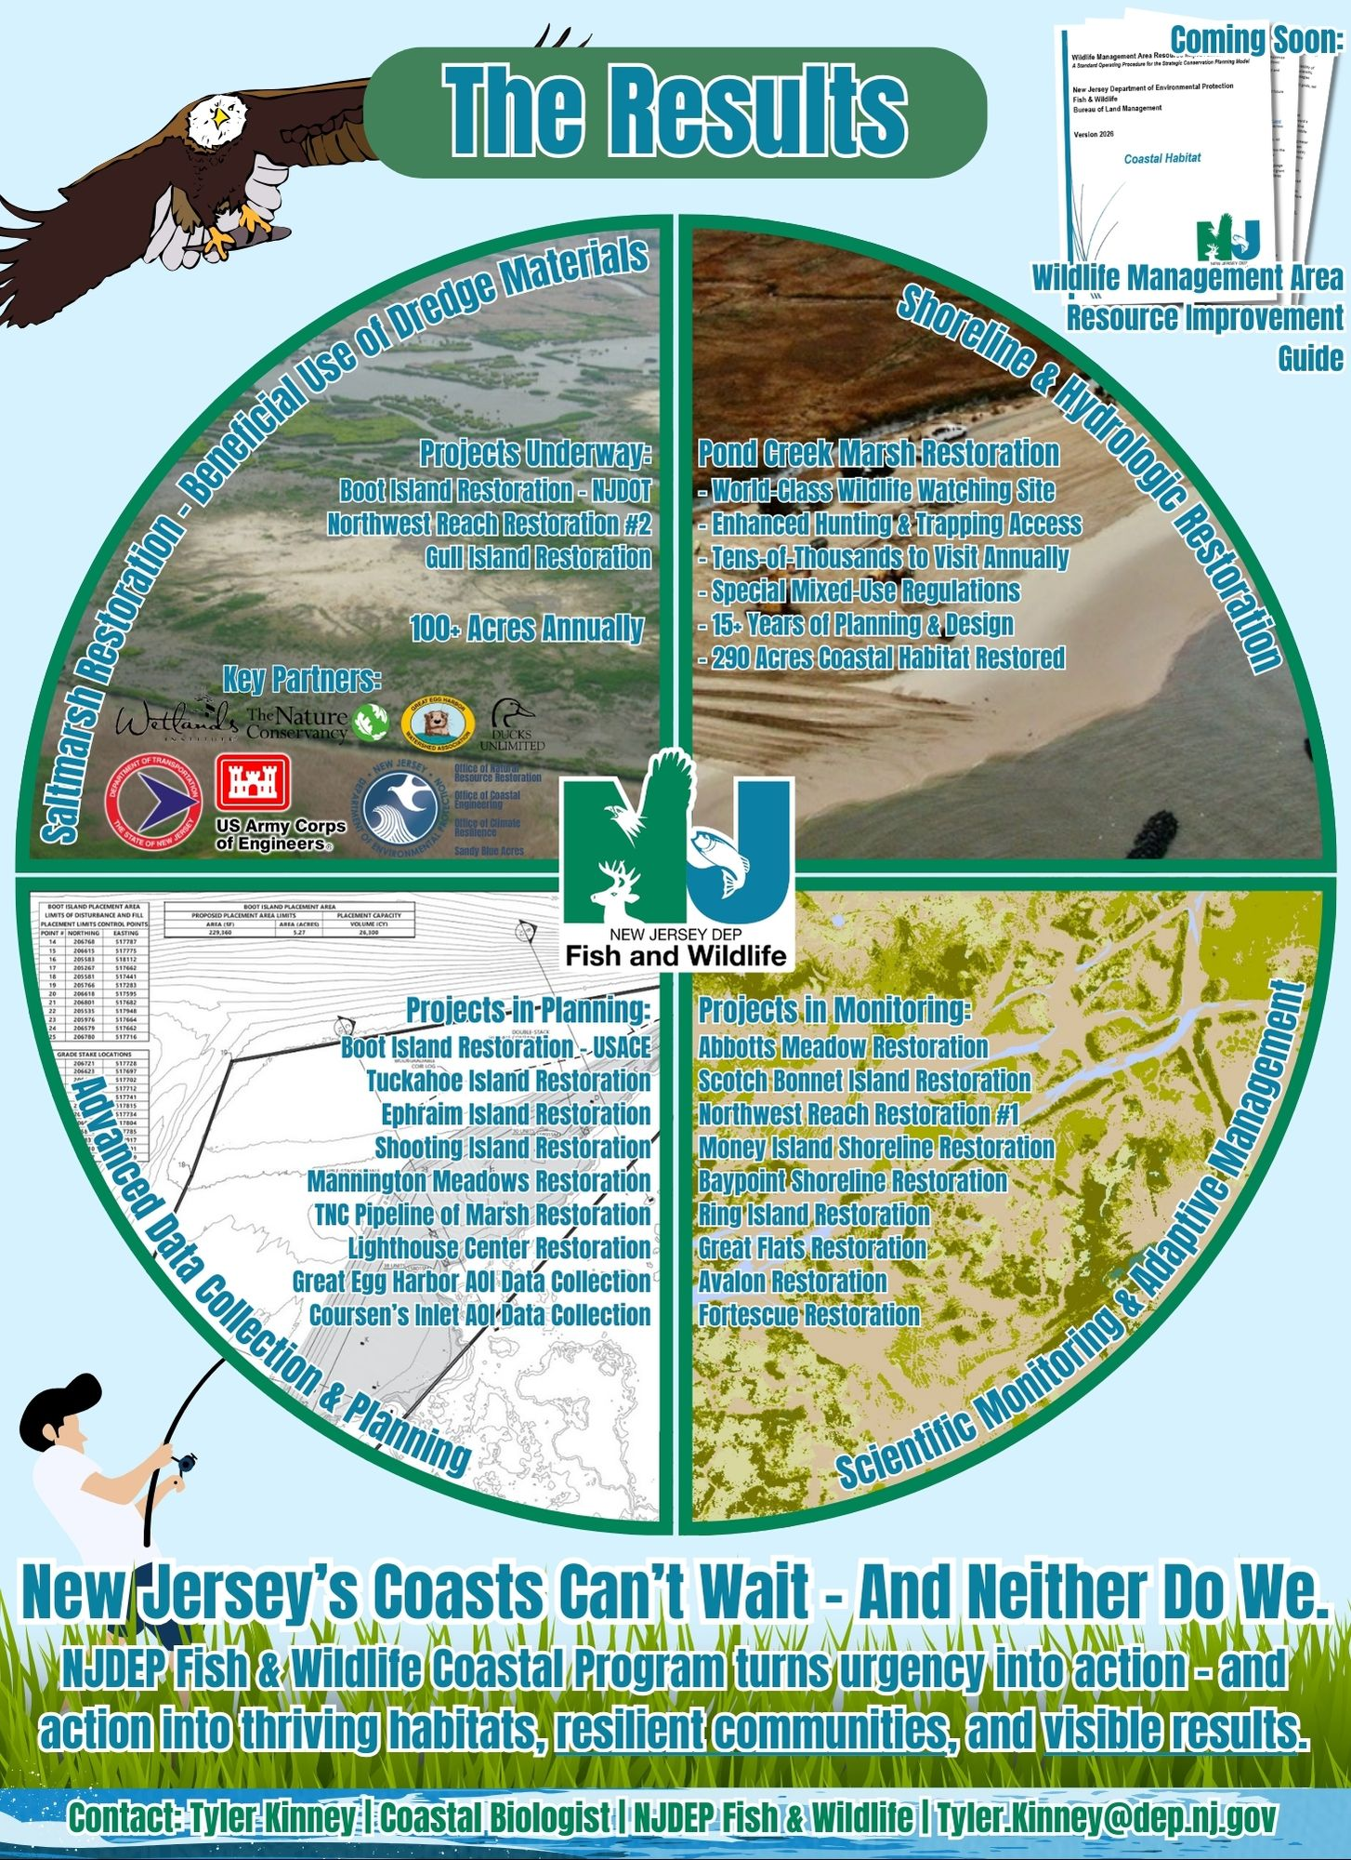
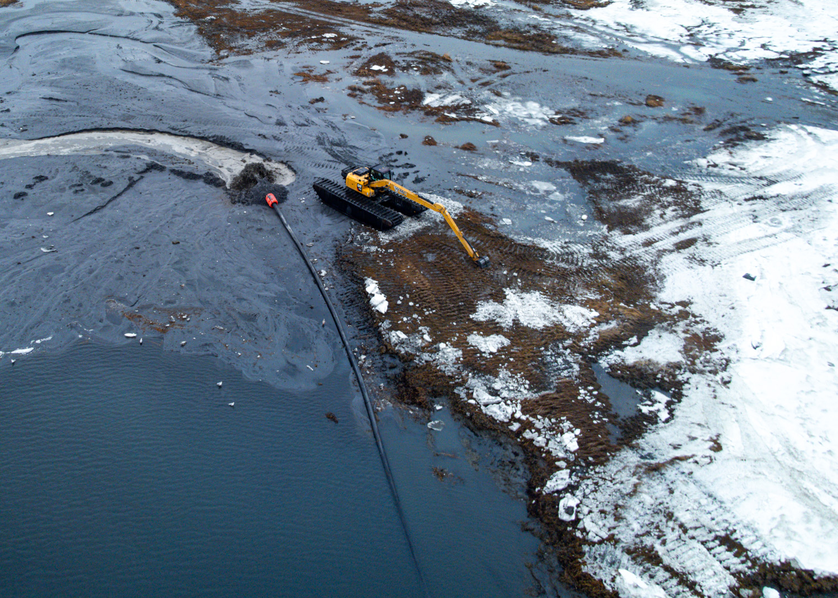
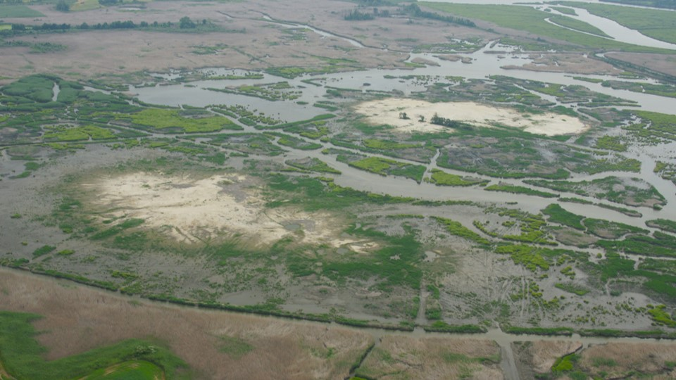
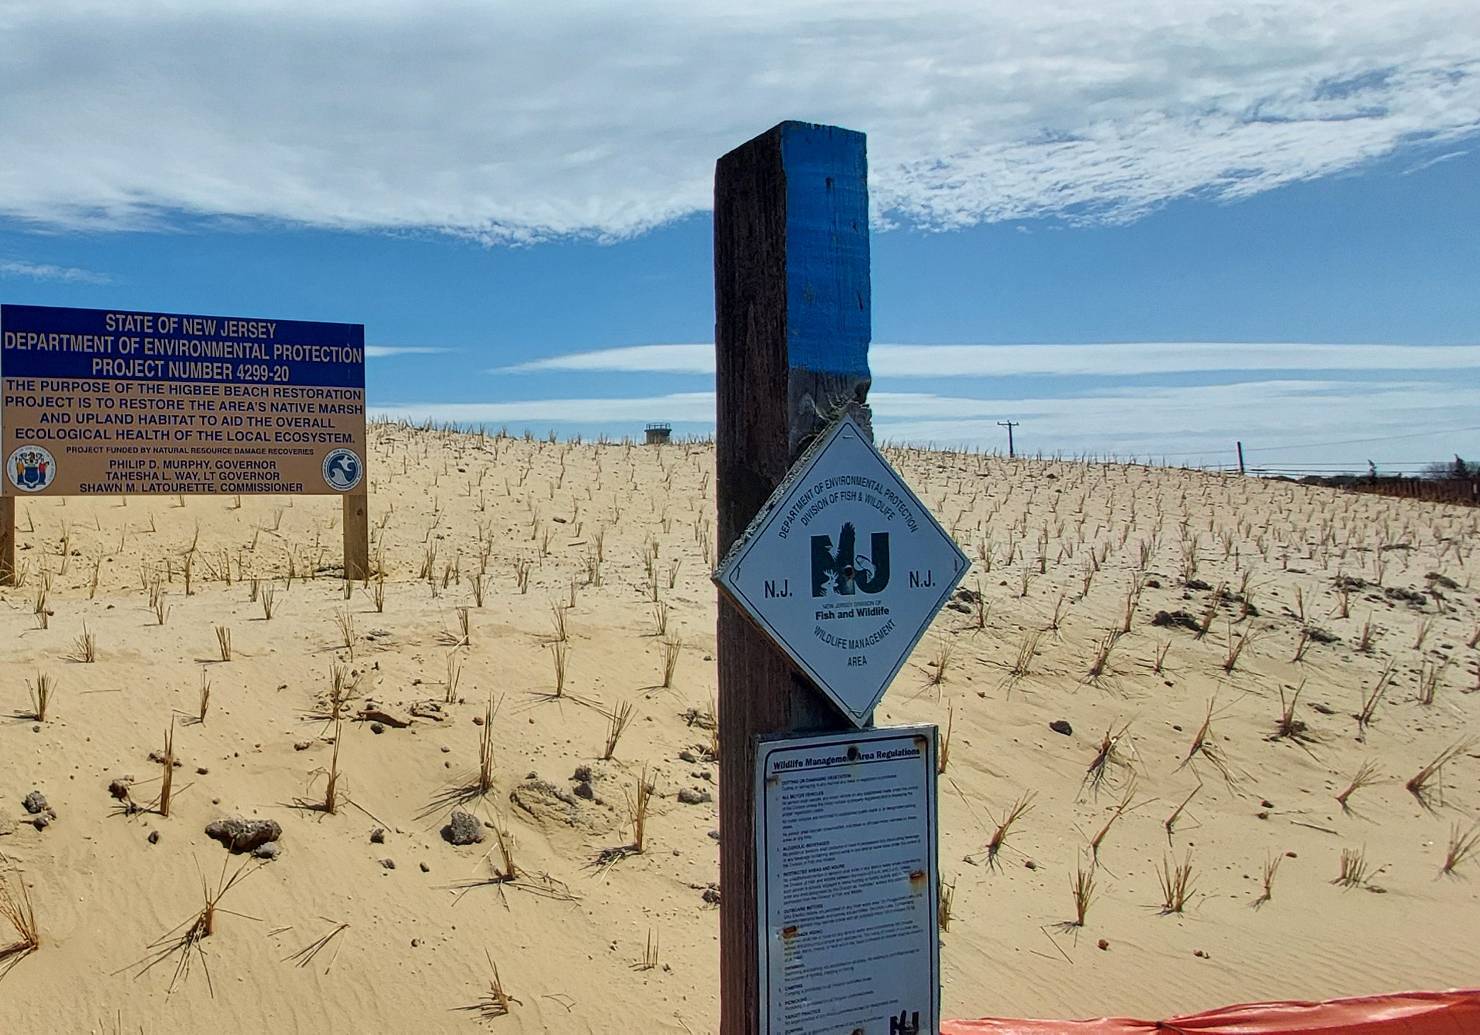
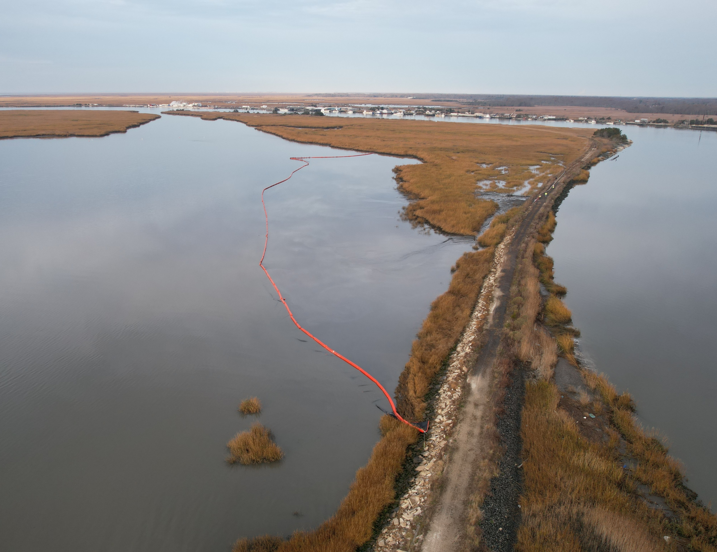
Boot Island Marsh Restoration
Abbotts Meadow Marsh Restoration
Pond Creek Restoration
NW Reach Marsh Restoration
Notes:
So, are our ideals in New Jersey worthy?
Does that mean we should stop improving?

Slide 12
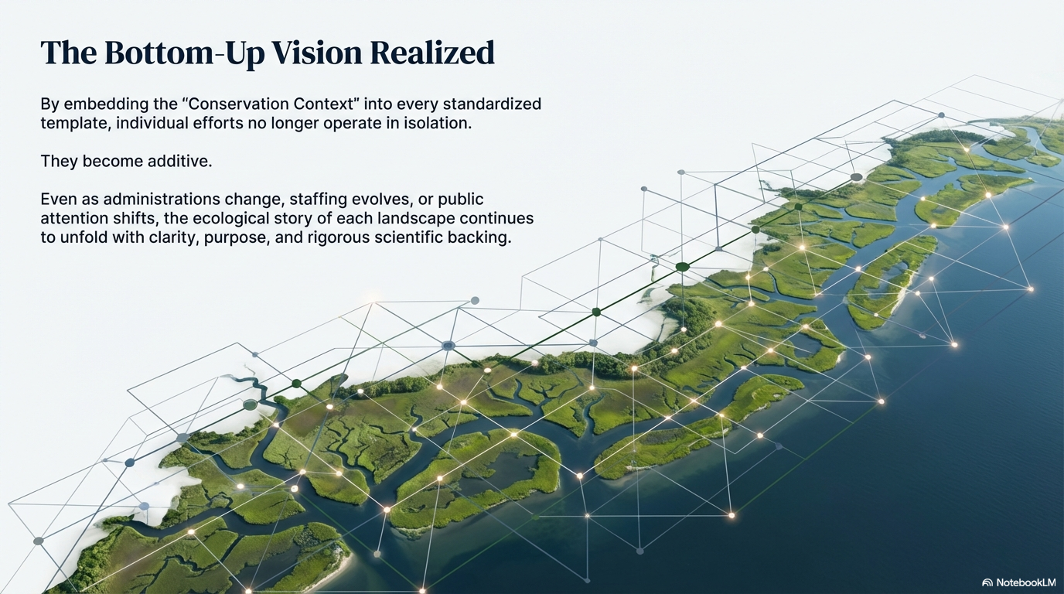
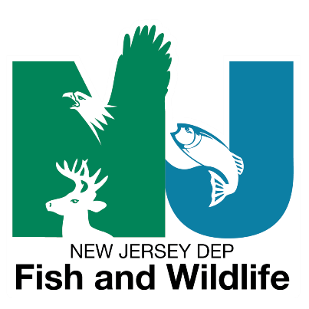
Landscape-Scale Conservation Realized
NJDEP Fish and Wildlife
Strategic Conservation Planning Model
COMING SOON
Notes:
No
New Jersey Fish and Wildlife has some ideas on the way we can improve our practice
For that, you will have to join us at with the scaling restoration panel tomorrow.
See you there.

