Slide 1

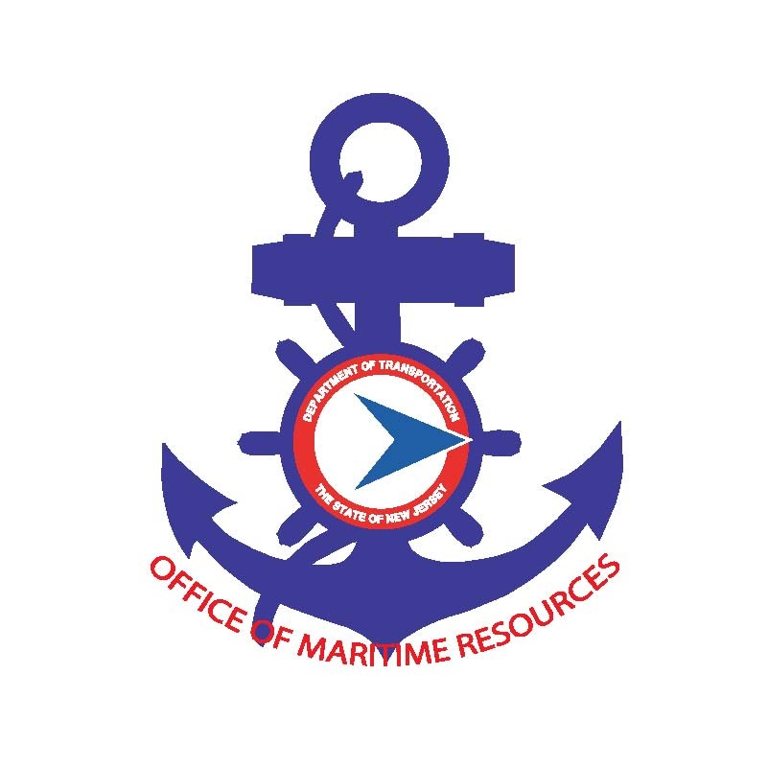
Innovation in Ecological Restoration Project Implementation in NJ
2026 NJCRC-NJDEP Coastal and Climate Resilience Conference
Navigating Changing Tides
March 10, 2026
Genevieve Clifton, NJDOT
Director, Office of Maritime Resources and Construction Support

Slide 2
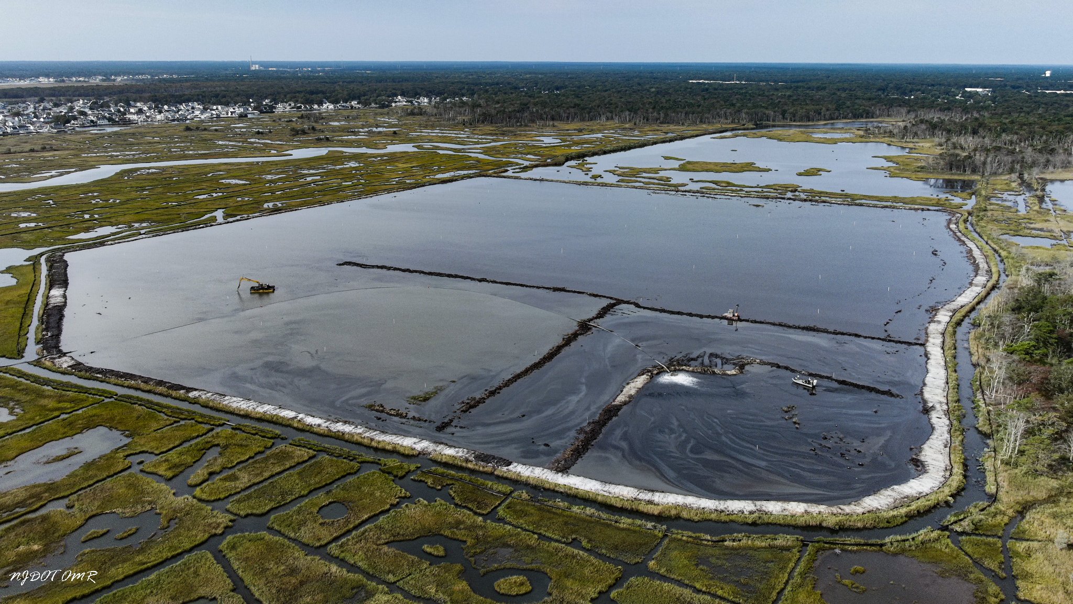
In the state of New Jersey, which public agency has planned, designed
and constructed the most acres of ecological restoration?

Slide 3
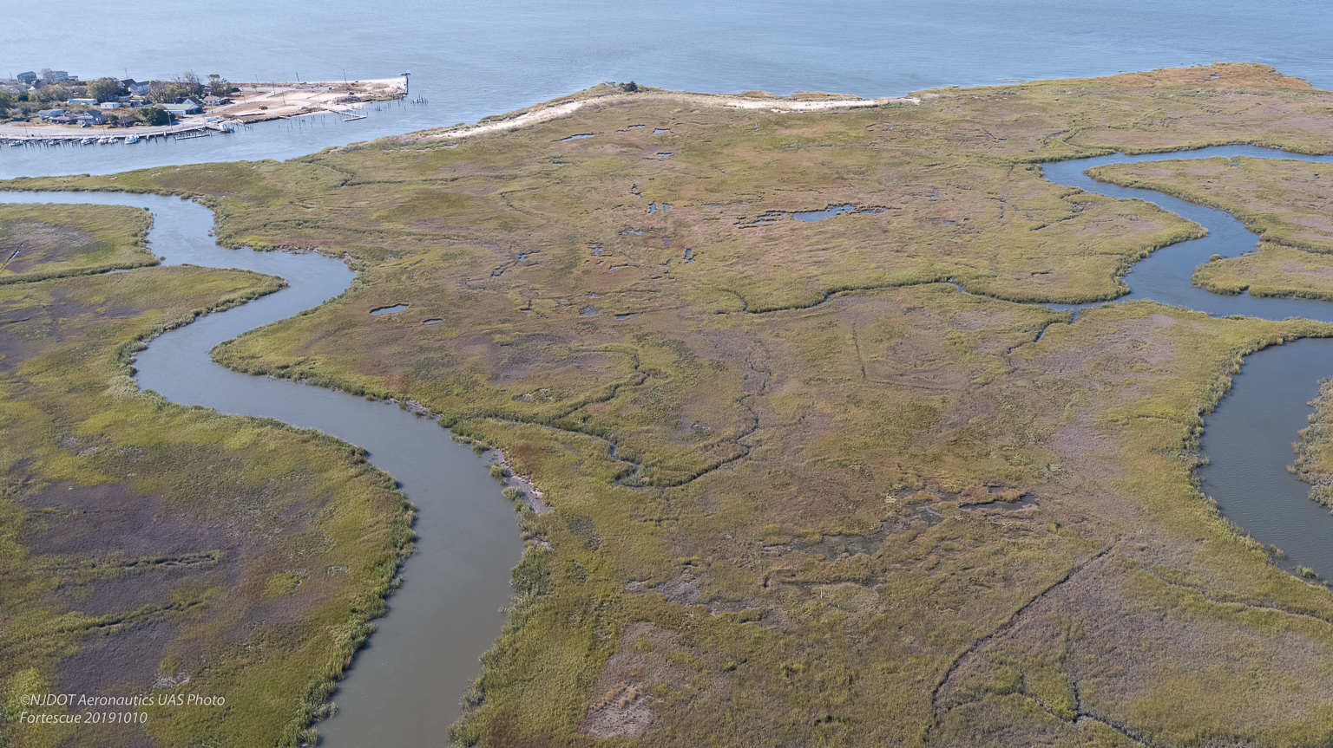
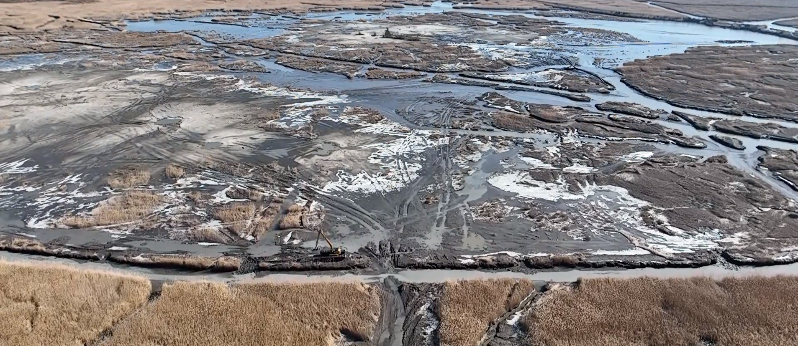
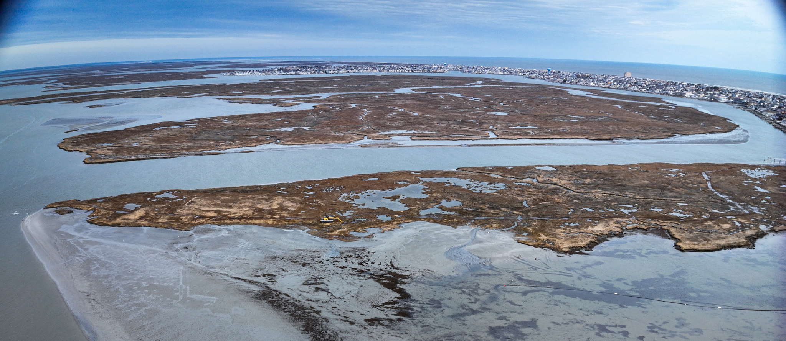
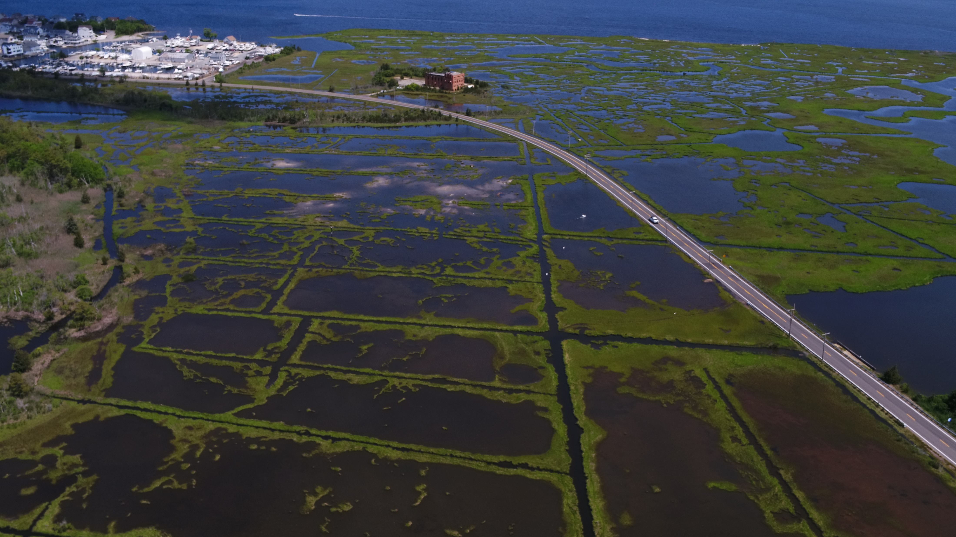
Fortescue: 6.6 Acres
Abbots: 89 Acres
Boot/Sunflower Islands: 11 Acres
Good Luck Point:
6.6 Acres
2026/2027 Planned: Tuckerton Island, Lighthouse Camp

Slide 4
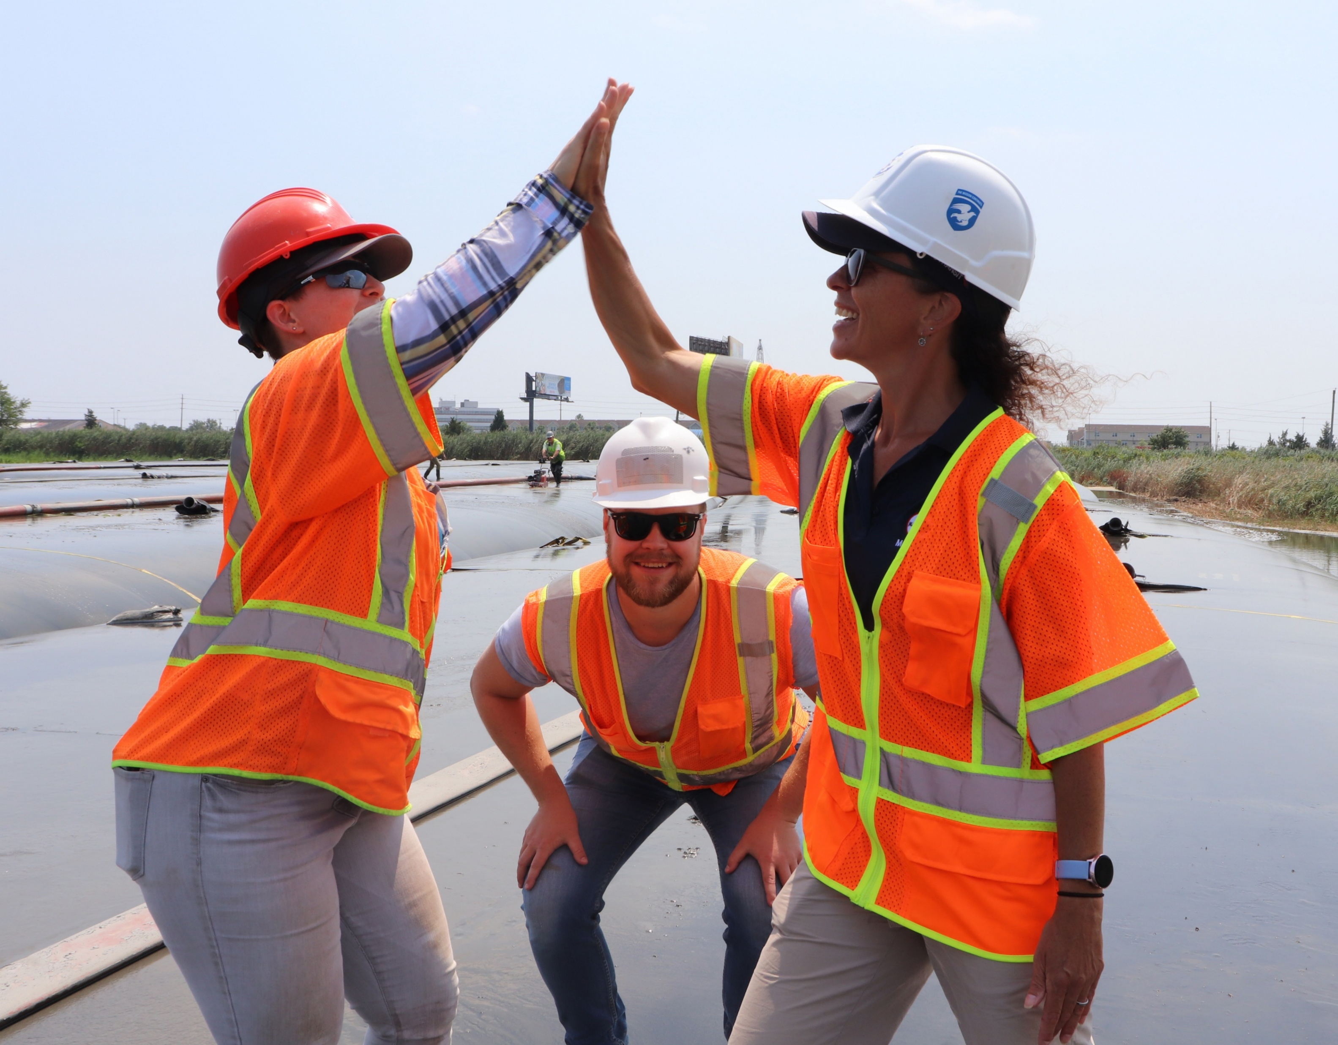
OMR Mission:
To facilitate the efficient transportation of people and goods into, out of, and upon the waterways of New Jersey for commerce, recreation, and tourism by planning for, providing, maintaining and improving maritime infrastructure Statewide.
Because we want to…
Partnership development
Navigating changing tides
Intense financial, data and human resource investment

Slide 5
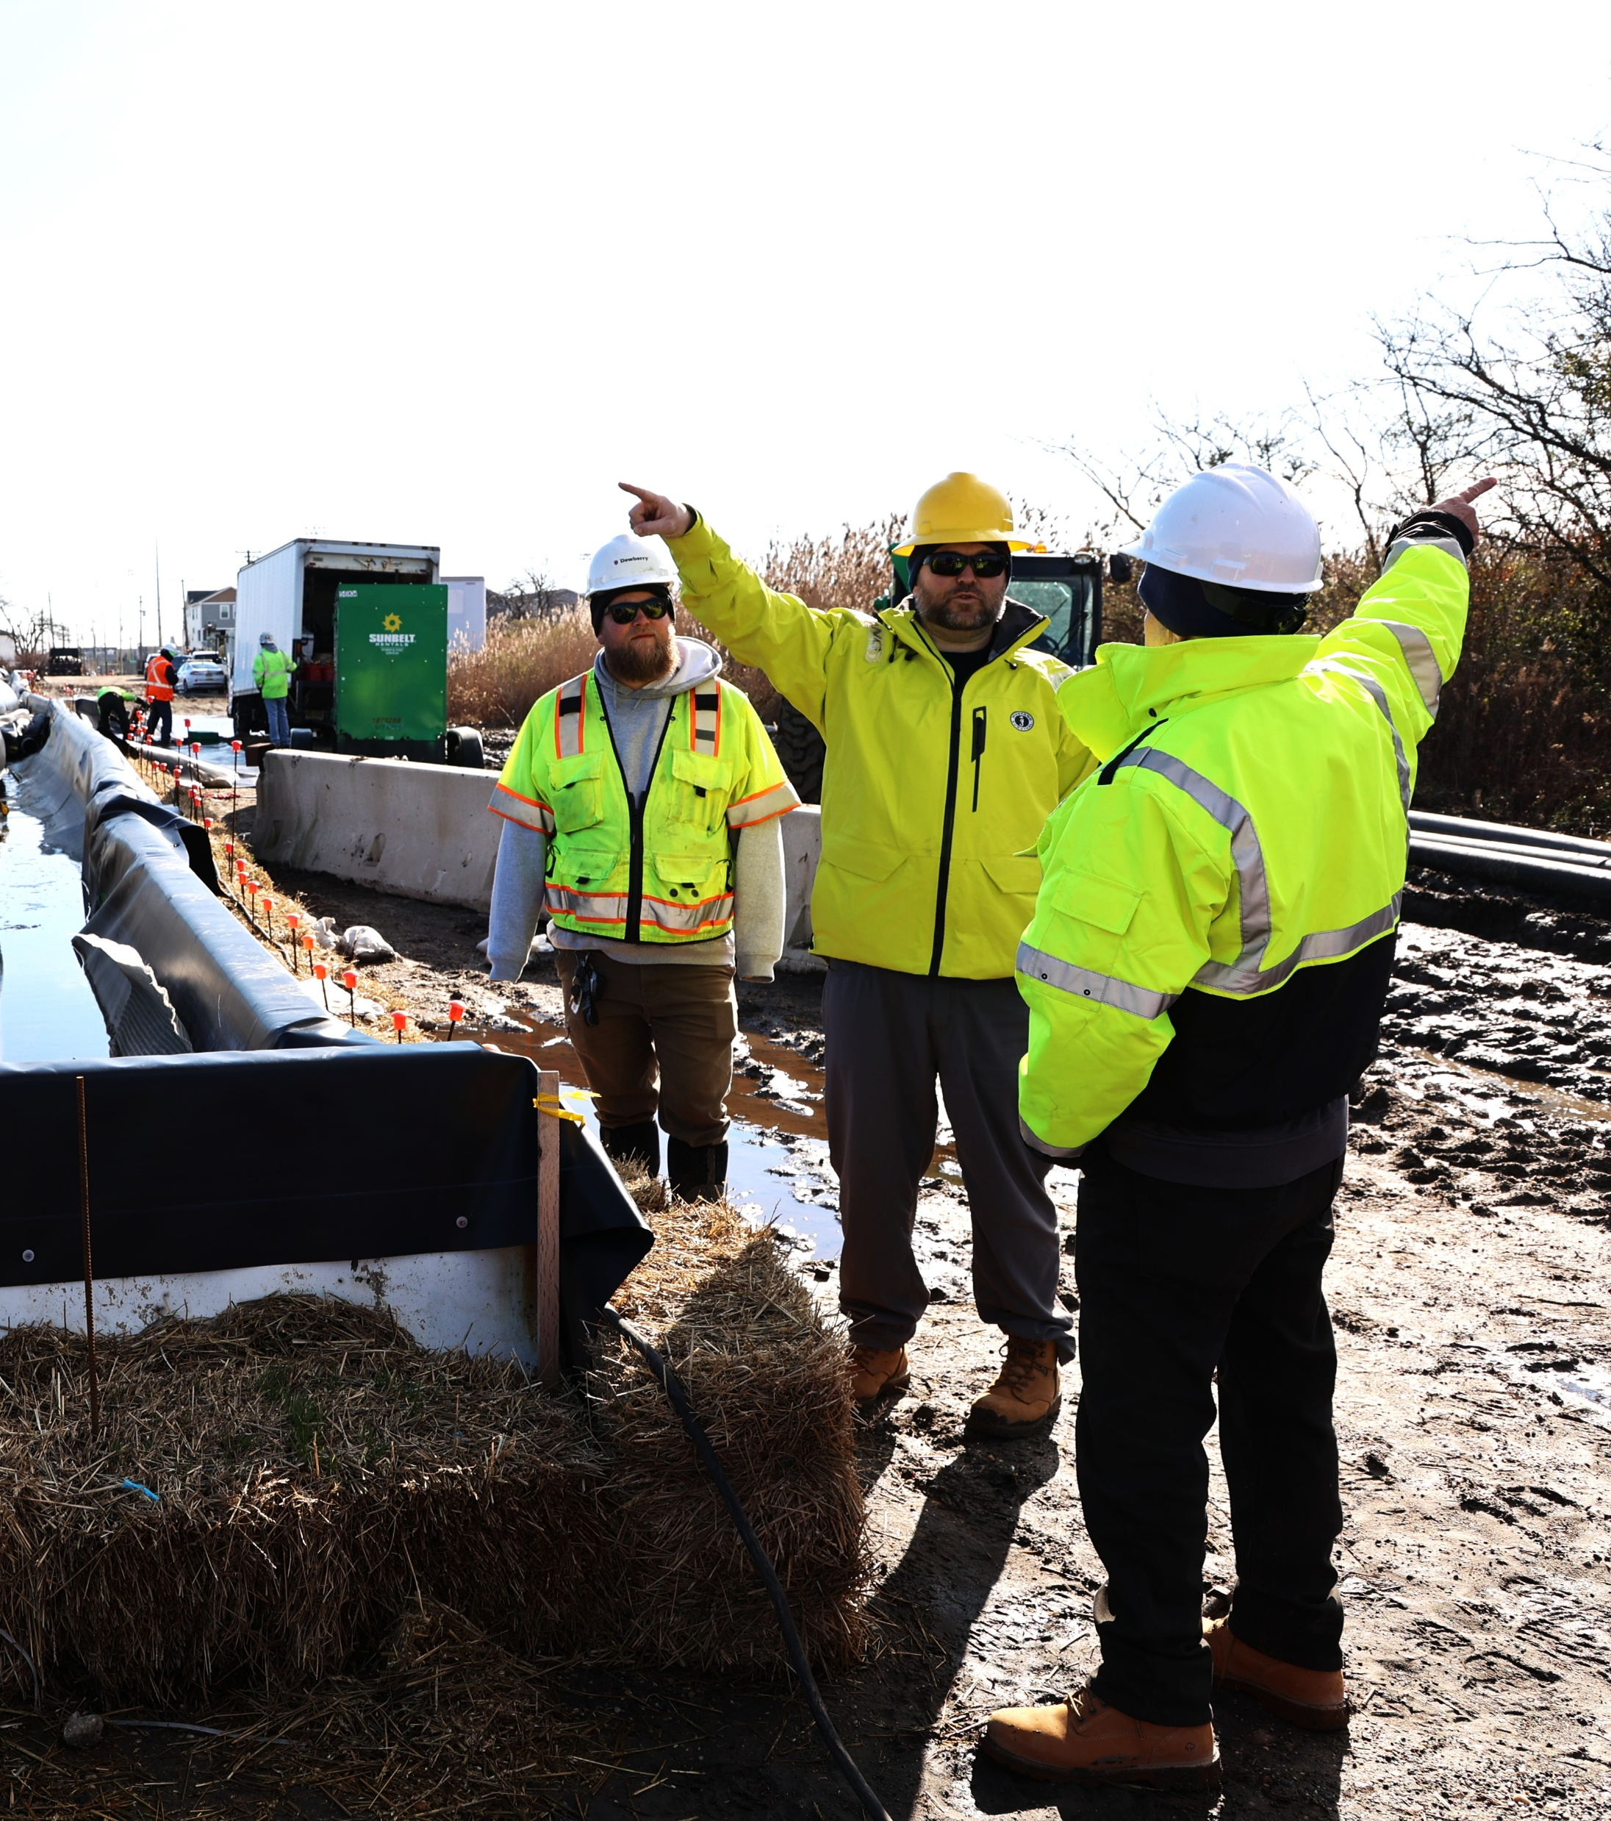
About Innovation:
There is no book
Monitoring and adaptive management plans inform what is working and what isn’t
Every project builds upon the experience of the last
Growth in why, how and who...

Slide 6
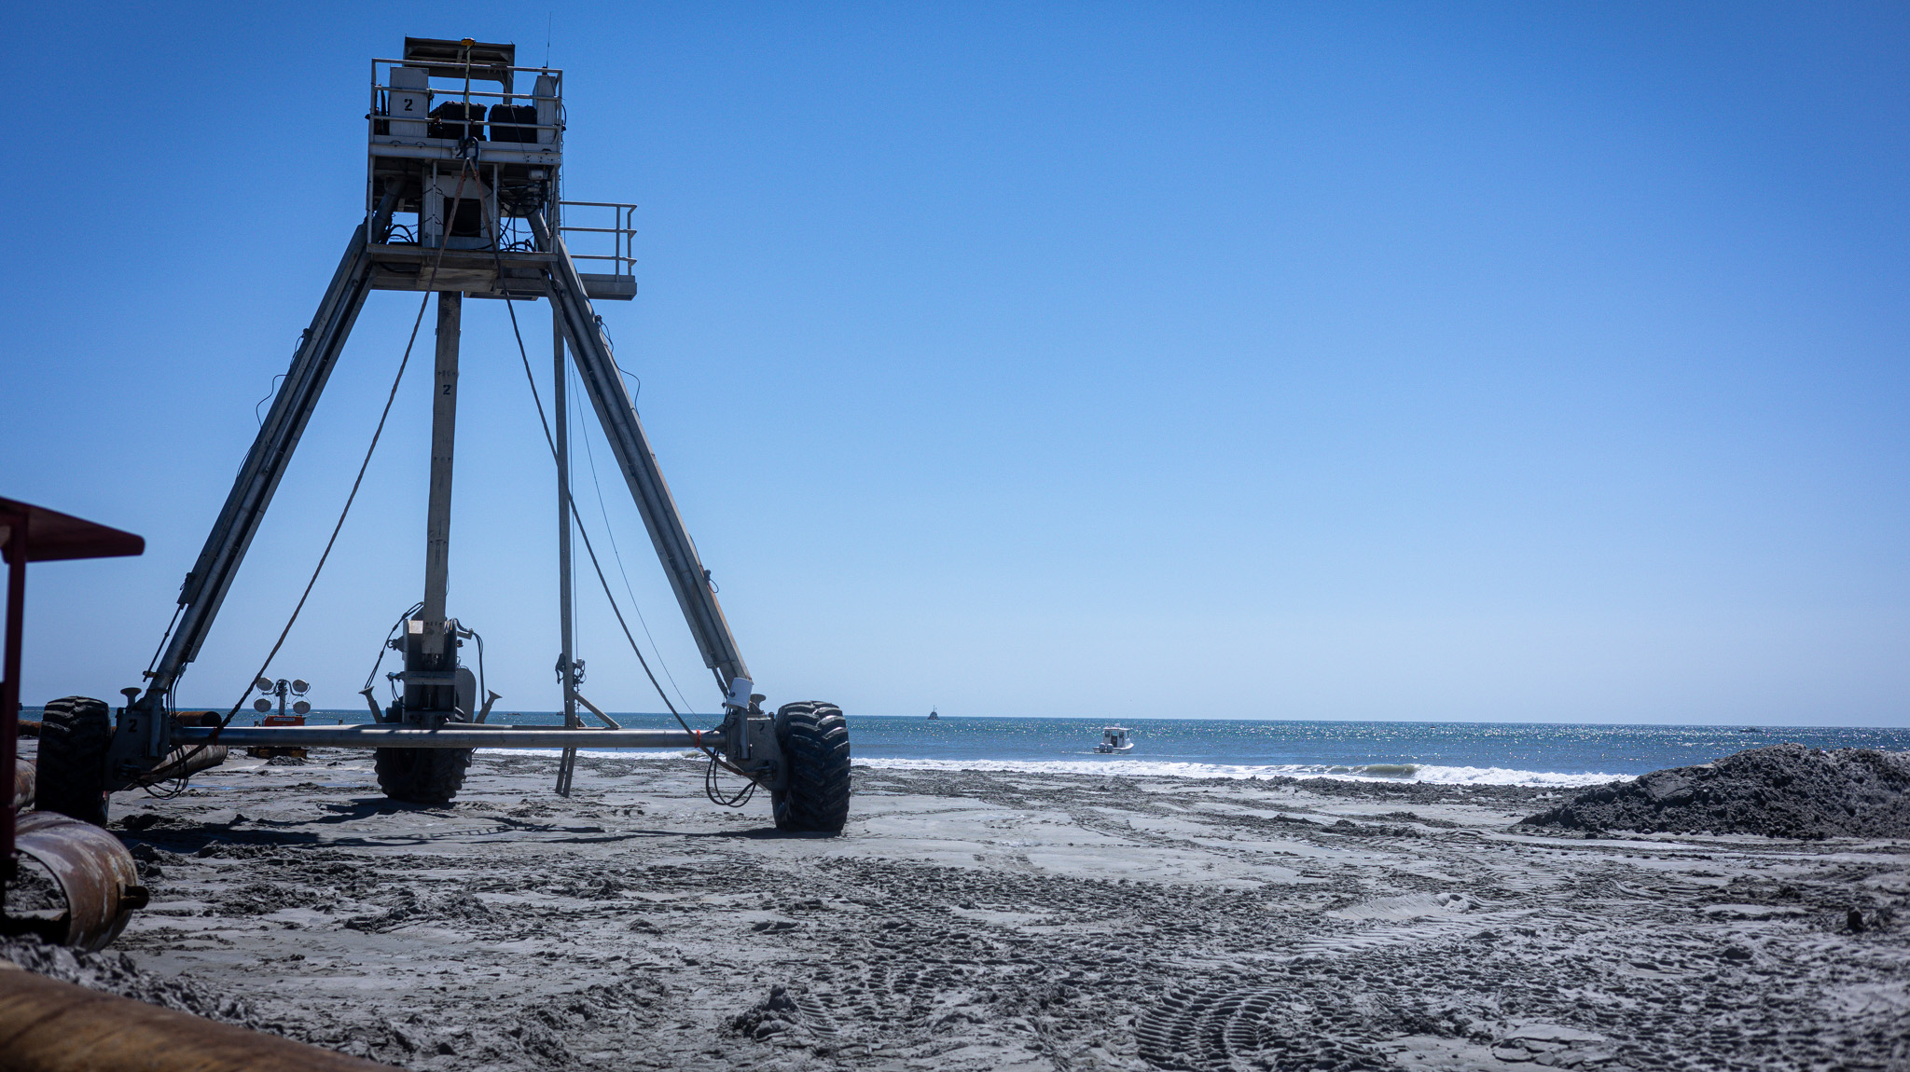
Neither state nor Federal regulatory systems are designed to support large scale public resilience/ecosystem restoration projects.

Slide 7

Room To Grow:
Regulations must meet the modern state of practice where it is; and, leave room to grow
Wholesale rethinking of regulatory review vs. partnership investment
  Silos have got to go
  Embedded – like the cia
  Pilot approach to public projects?
Costs down; Efficiency up; ROI up; Action; Highest restorative/protective value – ecological and upland resilience

Slide 8
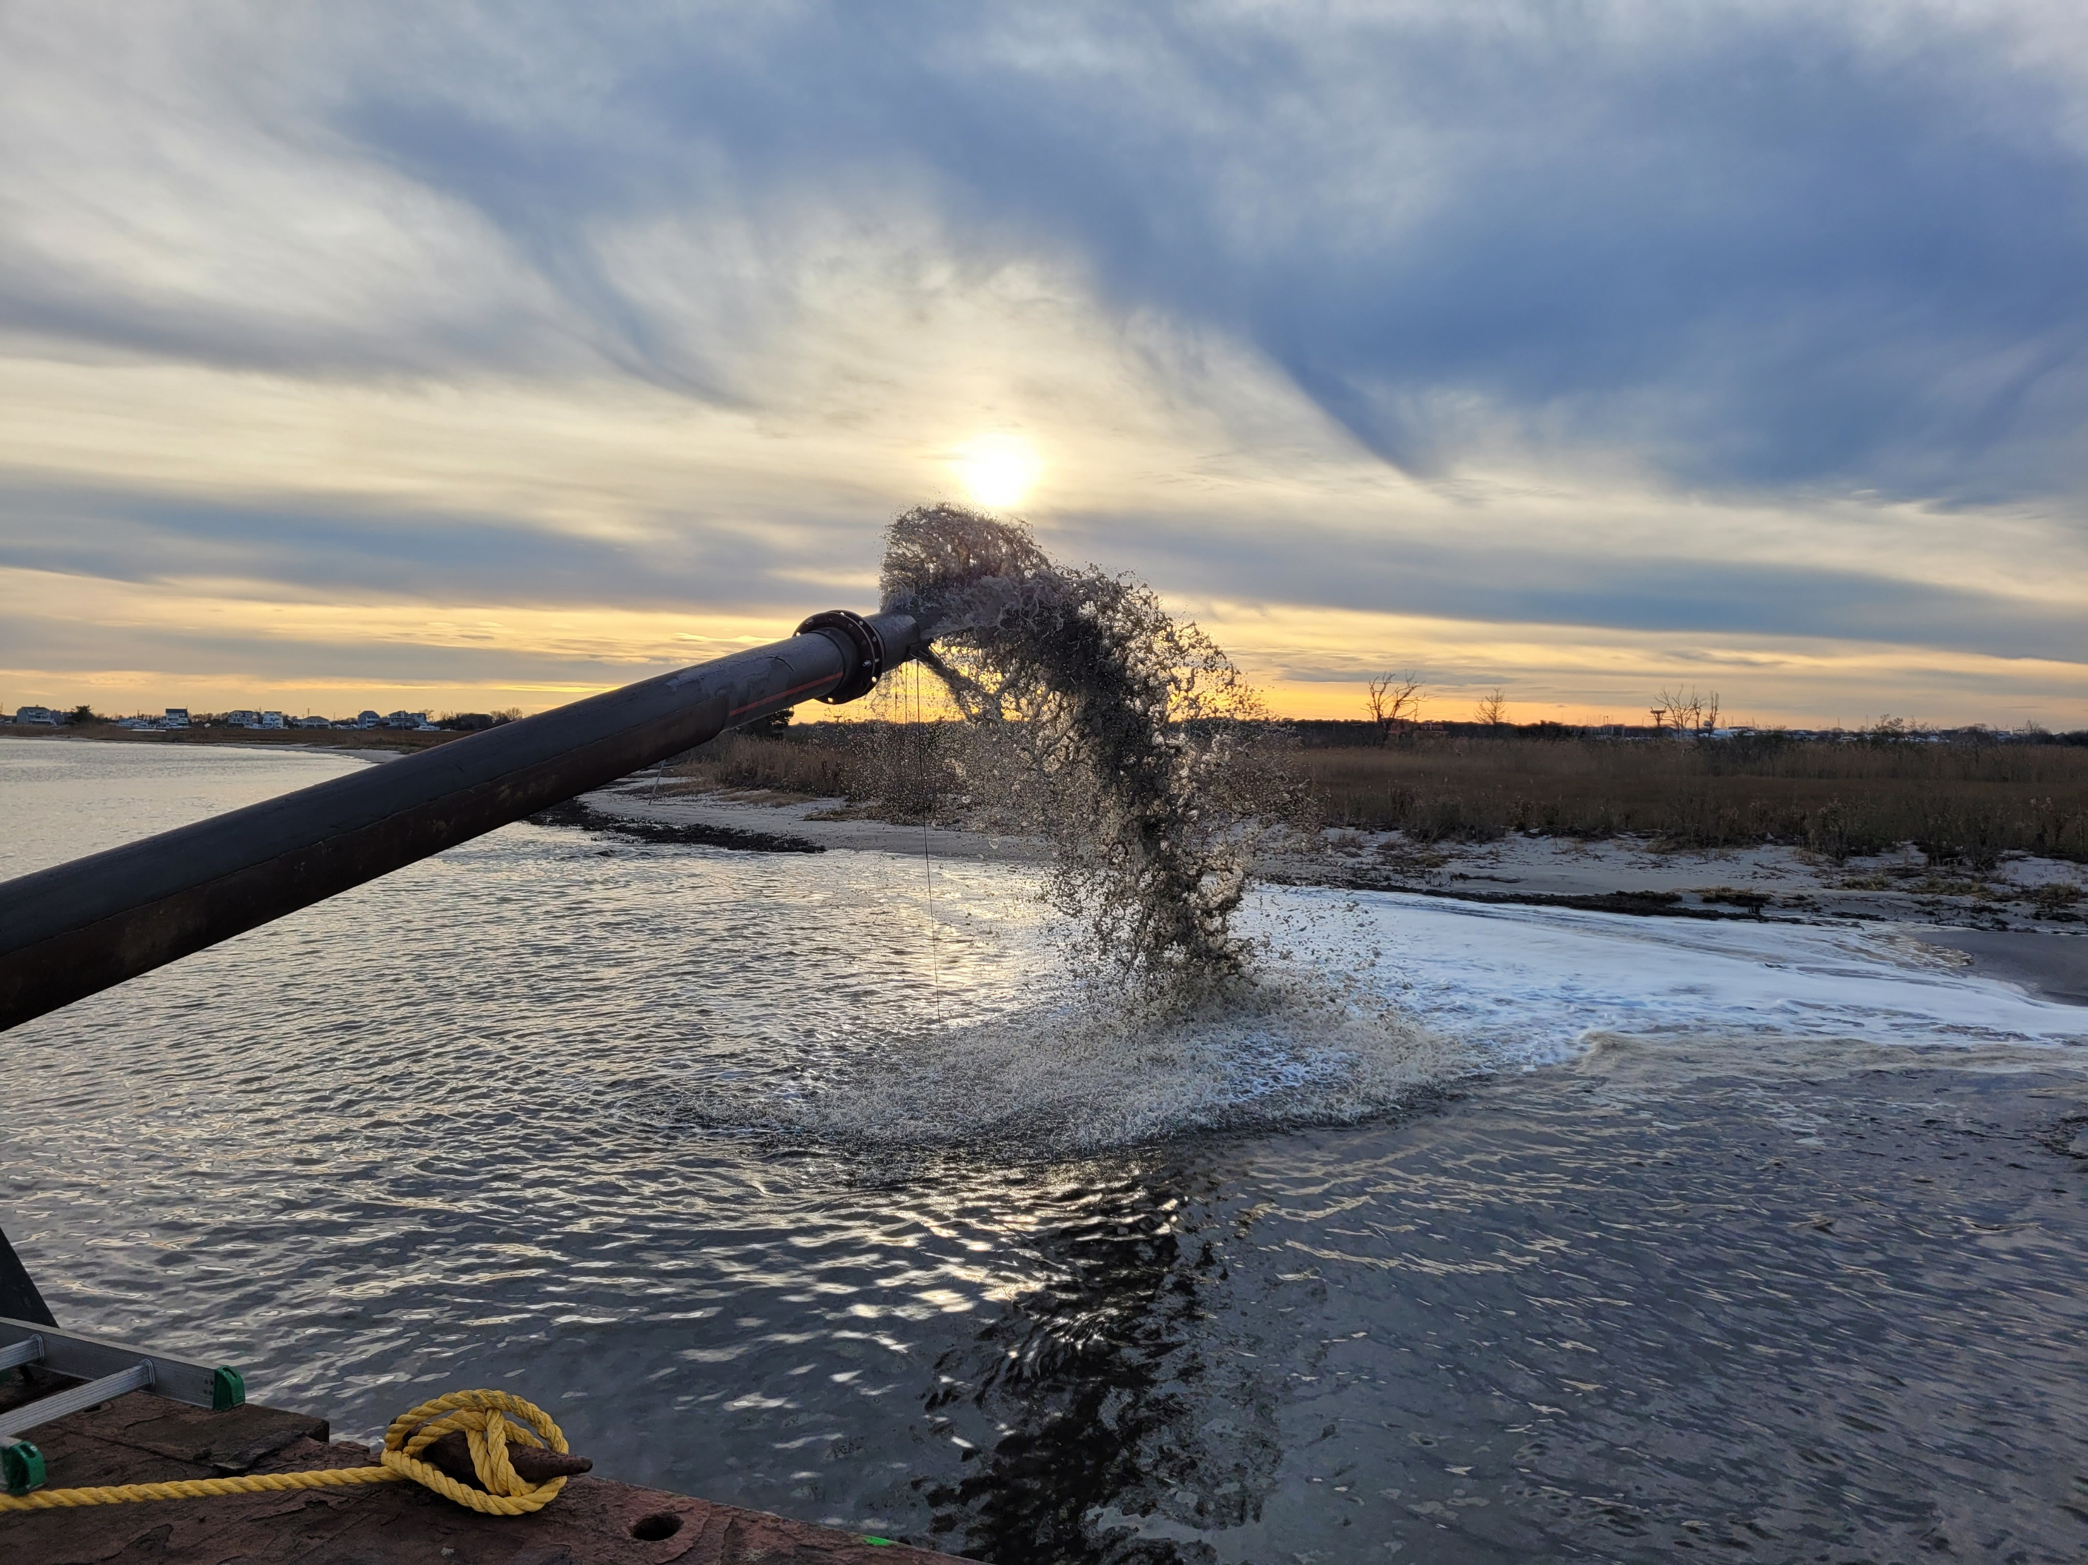
...And Thank You to the partners pushing the state of practice forward!
#NJDEP FW
#TNC
#ALS
#GEHWA

