Slide 1




Coming Soon! Flood Mapping and Improved Forecasting and Observations for New Jersey Bayside Communities
Philip Orton, Laura Kerr, Mahmoud Ayyad, Nathaniel Nwogwu,
Stevens Institute of Technology
Tom Herrington, Monmouth University, Urban Coast Institute
philip.orton@stevens.edu
Funding also from NOAA Office of Response and Restoration, a collaboration with NJ Sea Grant Consortium

Slide 2
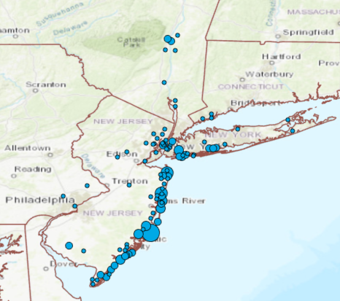
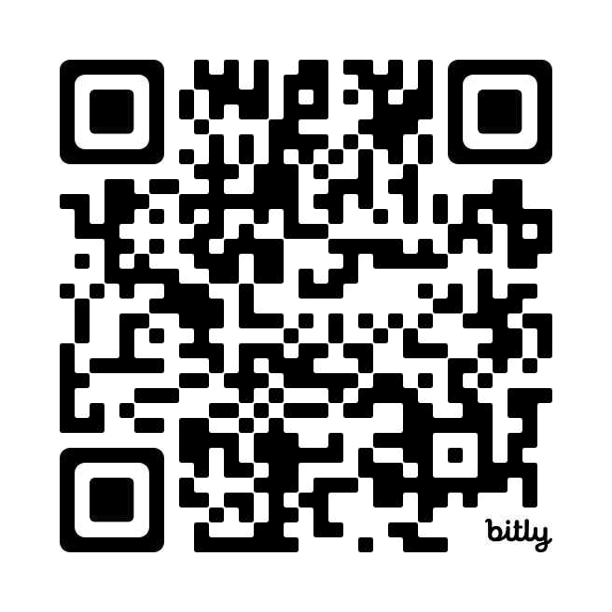
Stevens Forecasts: Used Widely
User Survey Responses
Scan me for
Published research and survey on Stevens Flood Advisory System
Number of Responses
1
2 - 5
6 - 15
16 - 30
31 - 50

Slide 3
New Project: Objectives
Engage back-bay communities from Bayhead to Atlantic City to learn of coastal hazard forecast needs
Set up and maintain water level, wave and flood observations
Intercompare different wind wave measurement technologies
Determine the best hydrodynamic model for community needs, set it up, and evaluate it against observations
Apply model in a daily operational forecast system

Slide 4
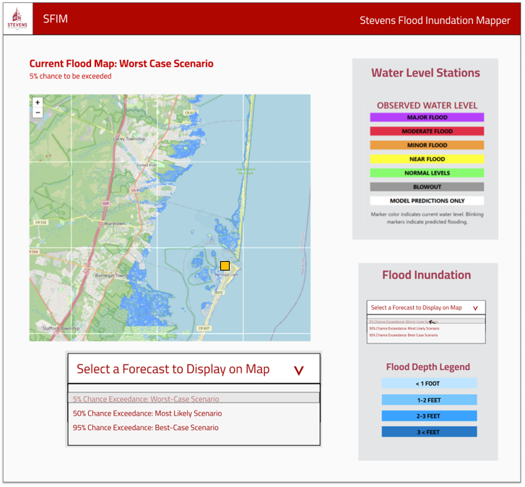

Slide 5
Improved Observations
SOFAR Spotter Buoy wave observations (at right)
Street flood observations – via camera and/or ultrasonic sensors
Tide / water level gauges
Data available via MARACOOS OceansMap webtool

Slide 6
Improved Modeling for NJ Bays
Old river, tide and storm surge model: ECOM
New model: SCHISM
Old resolution: NYHOPS grid ~1 km in NJ Bays
New resolution: TBD but likely ~100m
We may incorporate rainfall in the flood modeling.
We are developing the model and forecast system in collaboration with NOAA’s National Ocean Service storm surge modeling team.

Slide 7
Coming Soon! Flood Mapping and Improved Forecasting and Observations for New Jersey Bayside Communities
Philip Orton, Laura Kerr, Mahmoud Ayyad, Nathaniel Nwogwu,
Stevens Institute of Technology
Tom Herrington, Monmouth University, Urban Coast Institute
philip.orton@stevens.edu
Funding also from NOAA Office of Response and Restoration, a collaboration with NJ Sea Grant Consortium

