Slide 1
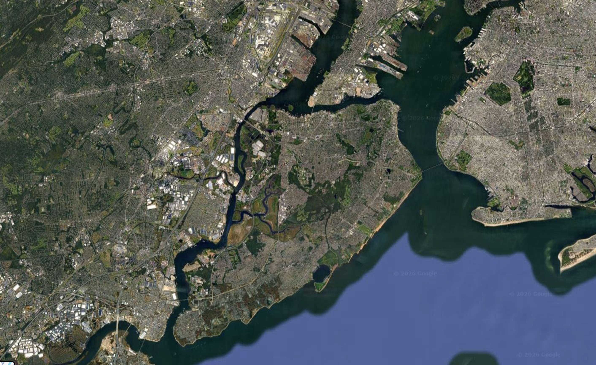

Understanding Climate Mitigation Programs on Staten Island: Using Publicly Available Data and the Flood Susceptibility to Harm and Recovery Index (FSHRI) To Evaluate Effectiveness
Michael E. Kress, Ph. D.
Valkiria Durán-Narucki, Ph. D.
Zhanyang Zhang, Ph. D.
Alan Benimoff, Ph. D.
Ricardo Toledo-Crow, Ph. D.

Slide 2
History & Background
Early Dutch Settlement in the 1600s.
Recreational Community 1900 - 1960
Residential Building Activities Increase 1970 - 2012
Bungalows Upgraded: 1990 - Present
Superstorm Sandy: October 29, 2012

Slide 3
Super Storm Sandy – October 29, 2012
Unusually large storm
Inundated Staten Island’s eastern and southern shorelines.
Modeling and observational data showed that low-lying coastal areas experienced extensive flooding
Roads, utilities, and other critical infrastructure had significant damage.
Topographic and coastal defenses influenced the extent of inundation and underscored the area’s vulnerability to extreme surge events (Kress et al., 2016).

Slide 4
Natural Climate Mitigation: Bluebelts
Bluebelts can absorb and slow excess water during storms, and trap pollutants, when linked to the storm sewer system.
Natural drainage features are typically wetlands and ponds.
By regulating water flow, they lower flood risk and help safeguard nearby homes.
The New York City Department of Environmental Protection touts Bluebelts as being more ecologically sound and to be relatively cost effective (Dalban, 2026; Garin et al., 2009).

Slide 5
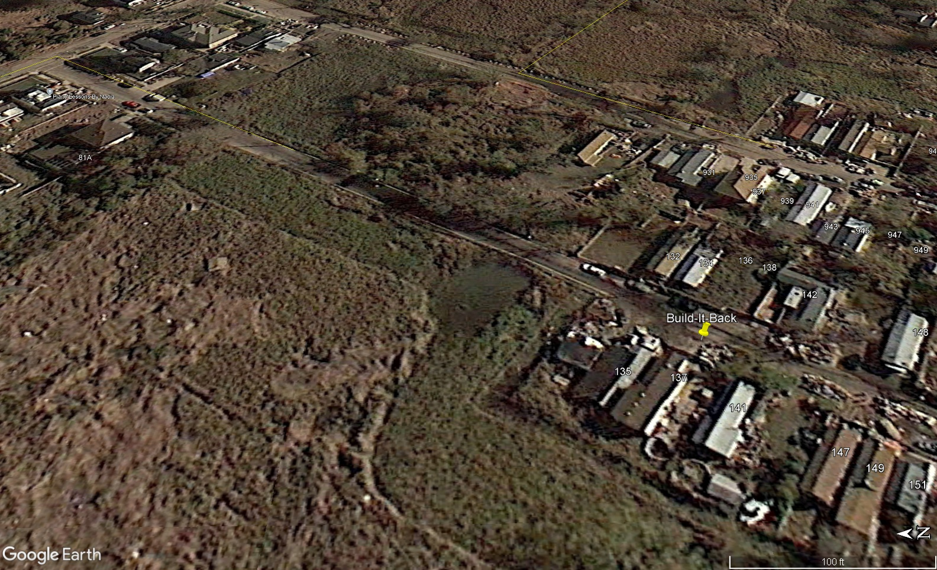
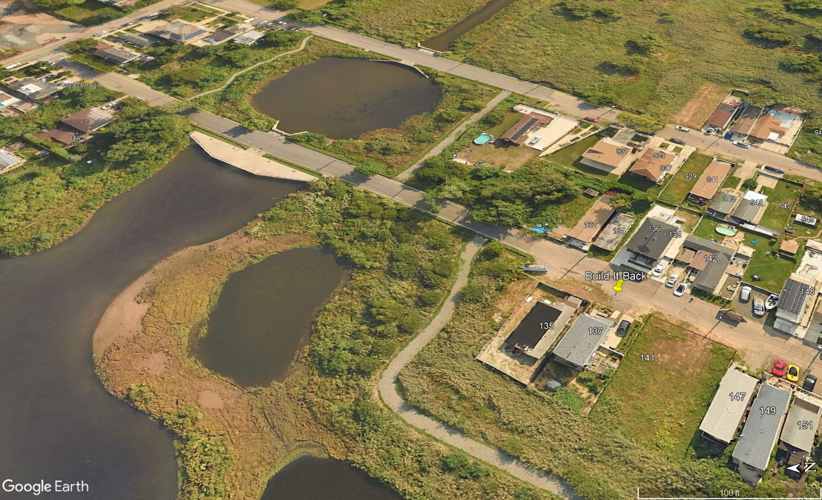
Natural Climate Mitigation: Bluebelts
West Branch of New Creek
Before – 2012
After - 2024

Slide 6
Climate Mitigation: “Build it Back Better”
Single Family Program (2012-2016)
Helped owners of 1–4 unit homes damaged by Hurricane Sandy:
Repair: Finish repairs on their home.
Repair & Raise: Fix and elevate their homes to meet flood rules.
Rebuild: Replace a destroyed home with a new, safer one.
Get Reimbursed: Be paid back for repairs already made.
Sell to the City: Voluntarily sell your home if it needed major work.

Slide 7
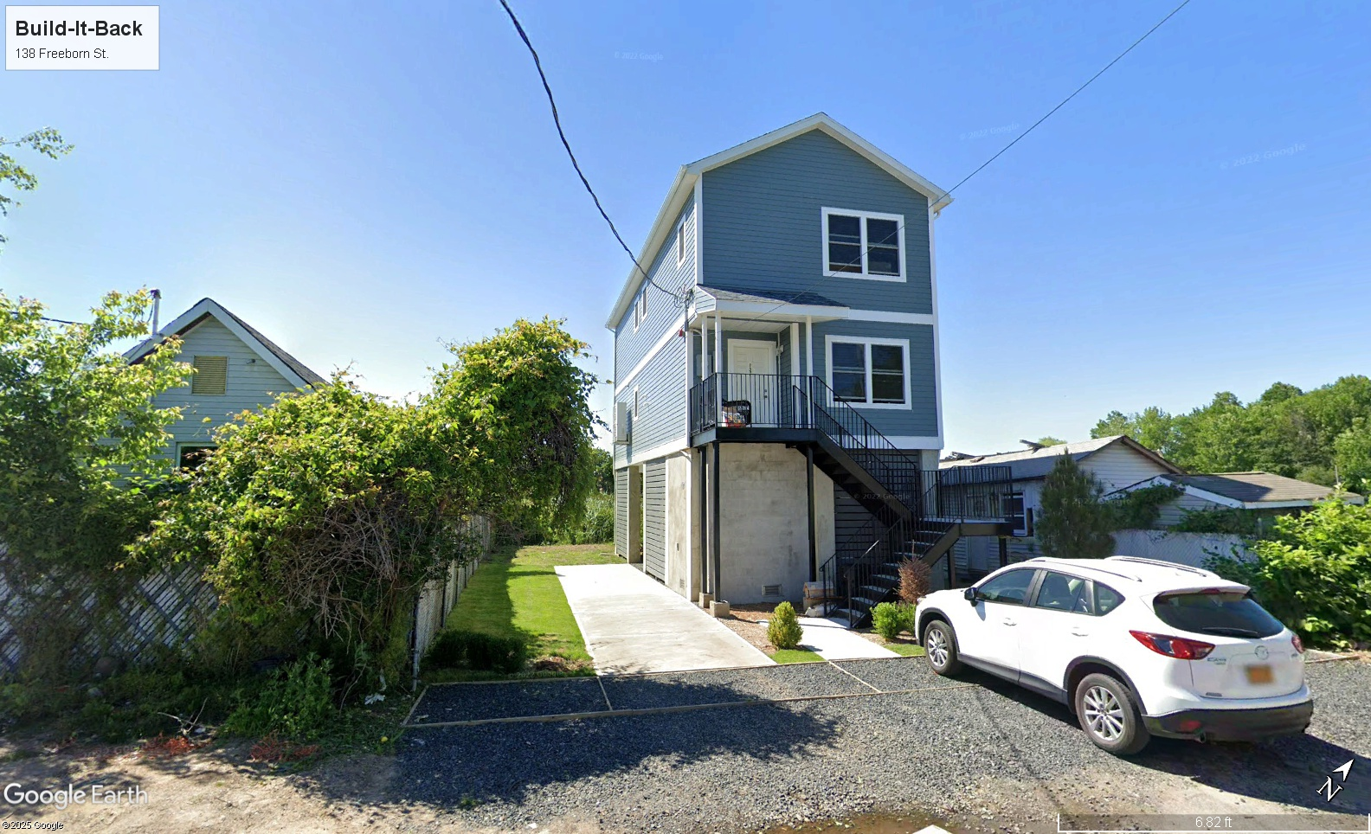
Climate Mitigation: “Build it Back Better”
2021
1901
1925

Slide 8
Climate Mitigation: Residence Resettlement Incentive
Starting in Fall 2016, the program helped certain Hurricane Sandy–affected homeowners sell damaged homes and buy new ones in NYC instead of making repairs.
The city purchased eligible homes at appraised value (minus prior federal aid), assisted with relocation, and ensured properties were safely redeveloped.
Incentives were limited to homeowners already in the construction pathway whose projects met cost-effectiveness criteria

Slide 9
Method
Public data was used to answer the following questions:
Focusing on the case of “New Creek”, can we use public data to detect changes in human variables in areas where climate mitigation has been developed?
What are relevant changes in census data, in the New Creek mitigation area, that can be helpful to understand the human impact of Bluebelts and other climate mitigation programs?
Can the Flood Susceptibility to Harm and Recovery Index (FSHRI) show meaningful changes related to the introduction of climate mitigation strategies?

Slide 10
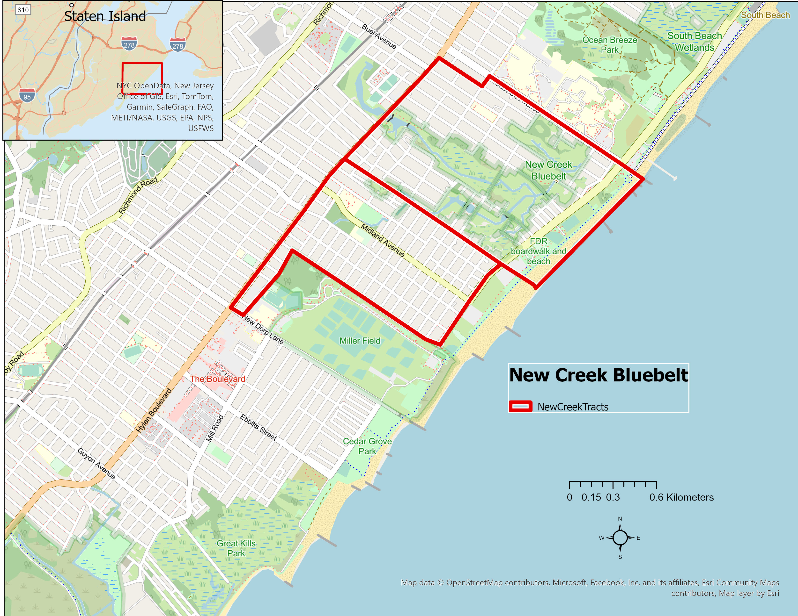
The New Creek Mitigation Area

Slide 11
Public Data – ACS & Census Data
American Community Survey (ACS) 2013 & 2023 | U.S. Decennial Census 2010 & 2020
Conducted annually by the U.S. Census Bureau Based on a sample of households (not a full count) Provides detailed social and economic data Income Education Employment Housing characteristics Commuting patterns Produces estimates with margins of error Tracks community change between census years | Conducted every 10 years by the U.S. Census Bureau Counts every person living in the United States Provides basic demographic data (age, sex, race, ethnicity) Includes housing occupancy information Used for congressional representation and federal funding allocation Serves as the official population benchmark

Slide 12
Flood Susceptibility to Harm and Recovery Index (FSHRI)
Developed as part of NYC’s Flood Vulnerability Index framework, it is a socio-demographic index measuring community flood vulnerability
Assesses both:
Likelihood of harm from flooding
Capacity to recover after flood events
Incorporates 12 indicators
Identifies neighborhoods where flooding may cause disproportionate hardship
Supports equitable climate adaptation and resilience planning
Lack of health insurance | Low-income households
Home ownership | Per capita income
Rent and cost-burdened homes | Population with a vulnerable age
Disability | Language isolation
Elder adults living alone | BIPOC residents
Total population | Household population

Slide 13
FSHRI Calculation & Difficulties
Our Team recreated the FSHRI because the city index was not fully clear in its calculation. Our team did not know:
The formulas used for normalization.
The technique used for aggregating the contribution from the normalized percent variables.
To recreate the index, maps of Staten Island with geolocated overlays of the normalized values of the 12 variables were produced.
The calculated FSHRI and the corresponding NYC published values were compared.
Statistical techniques were used for getting the bin edges to generate the distribution to be compared based on the histogram of the published indices.
Census tracts changed in the comparison years.

Slide 14
Results: Demographic Change using Census Data
NTA | Staten Island: New Dorp-Midland Beach [SI0202] Mutually Exclusive Race / Hispanic Origin
 | 2010 | 2010 | 2020 | 2020 | Change, 2010 to 2020 | Change, 2010 to 2020 | Change, 2010 to 2020
 | Number | Percent | Number | Percent | Number | Percent | Pctg. Pt.
Total population | 27,623 | 100.00% | 29,083 | 100.00% | 1,460 | 5.30% | 0
Hispanic | 3,669 | 13.30% | 4,221 | 14.50% | 552 | 15.00% | 1.2
White non-Hispanic | 21,665 | 78.40% | 19,149 | 65.80% | -2,516 | -11.60% | -12.6
Black non-Hispanic | 307 | 1.10% | 432 | 1.50% | 125 | 40.70% | 0.4
Asian non-Hispanic | 1,615 | 5.80% | 4,507 | 15.50% | 2,892 | 179.10% | 9.7
Some other race non-Hispanic | 84 | 0.30% | 250 | 0.90% | 166 | 197.60% | 0.6
Non-Hispanic of two or more races | 283 | 1.00% | 524 | 1.80% | 241 | 85.20% | 0.8

Slide 15
Results – Demographic Change using the ACS

Slide 16
Results – Demographic Change using the ACS

Slide 17
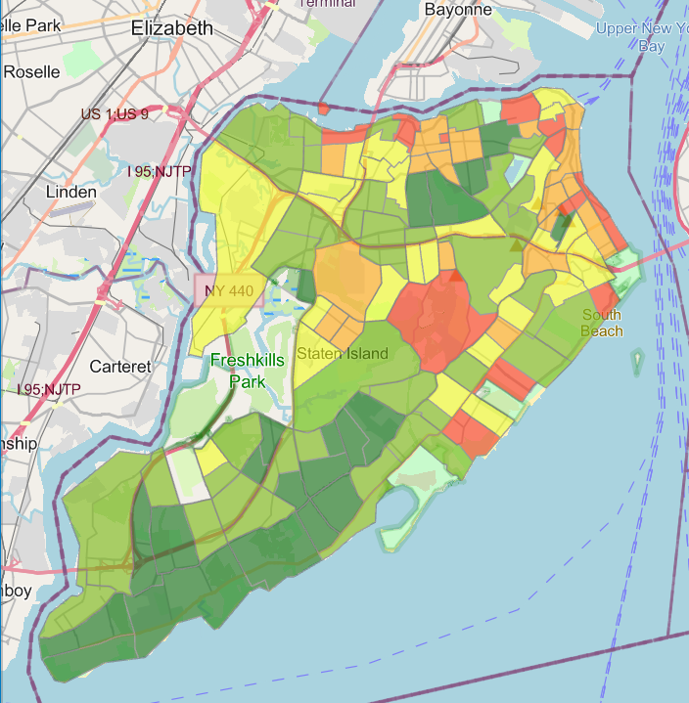
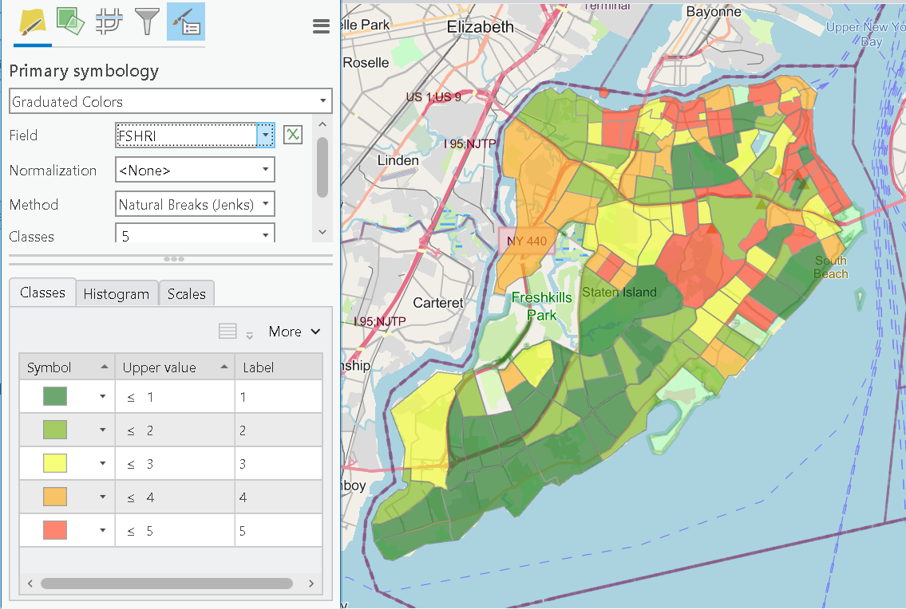
Results – Bluebelt FSHRI from New York City’s Flood Vulnerability Index Comparison with Recreated Data
Published
Calculated

Slide 18
Results: Recreating the FSHRI
The team was unable to benchmark the calculated FSHRI to the NYC published FSHRI
It did show, however, that 56% of the tracts on Staten Island agreed and 34% of the tracts were within 1 category. Essentially, 90% the tracts showed good agreement.

Slide 19
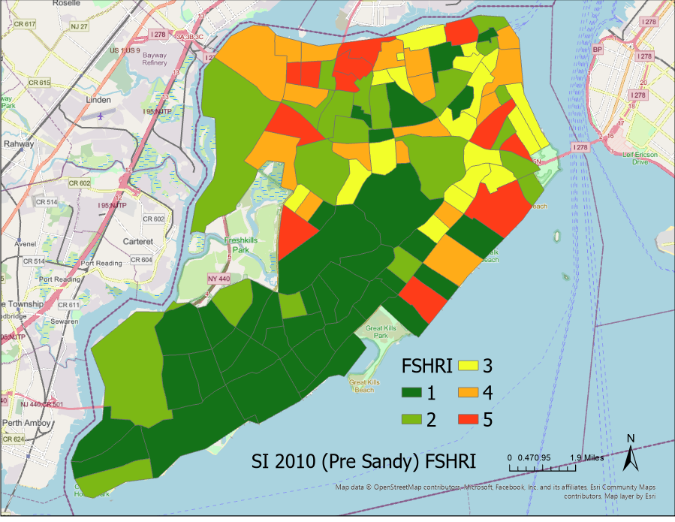
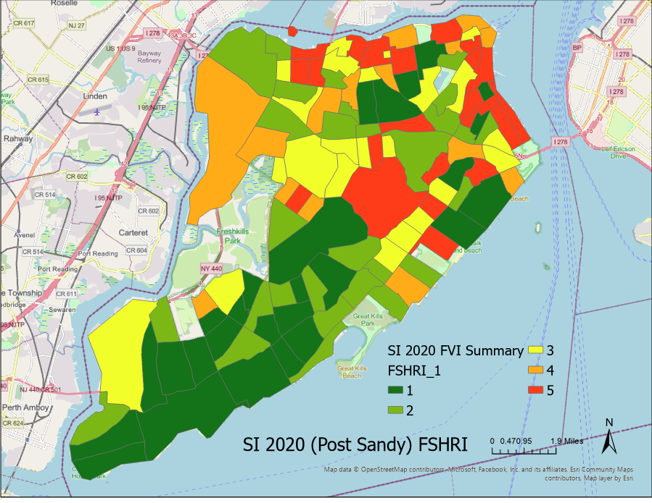
Results: Change in the FSHRI
FSHRI 2010
FSHRI 2020

Slide 20
Conclusions
Public data was useful in detecting demographic change matching the expected effects of mitigation programs, particularly regarding housing value and units.
Demographic change was found to occur in the New Creek mitigation area, however, the details of the effects of this change need to be studied separately, in a qualitative manner.
The FSHRI can show meaningful changes related to the introduction of climate mitigation strategies, however, its usefulness as public data is not yet clear. The lack of clarity on its calculation makes it hard to estimate its predictive value. The change in census tracts makes comparison less straightforward.

Slide 21
Limitations & Future Research Directions
Public data remains the best source of information to evaluate the impact of publicly funded climate mitigation. The production of the indices, however, can be murky.
Qualitative research (e.g. Solecki et al., 2017) is needed to understand the reasons why people select one mitigation program over other.
Attention to the duration of floods using existing sensors (FloodNet) might give further clues to quality of life variables relevant to both vulnerability and resilience in flood prone areas.

