Slide 1

New Jersey’s Regulatory Response to a changing climate
NJPACT REAL
NJ Protecting Against Climate Threats
Resilient Environments and Landscapes
10 March 2026
Vincent Mazzei, P.E.
NJ State Floodplain Administrator

Slide 2

Developed in response to Governor Murphy’s EO
  Most protective Statewide flood-resilience regulations in the nation
100+ stakeholder sessions since 2020
  Adopted: January 20, 2026
  Fully effective: July 20, 2026
Raises regulatory flood elevation in tidal areas
  Climate-adjusted flood elevation = BFE+4 feet
Creates “inundation risk zone”
  Land that lies above sea level today but is likely to be permanently inundated by 2100
NJPACT:
Resilient Environment And Landscapes (REAL) Reforms
Goal: to address the unavoidable impacts of climate change, such as sea-level rise, extreme weather, and chronic flooding, and focus on increased coastal resilience.

Slide 3


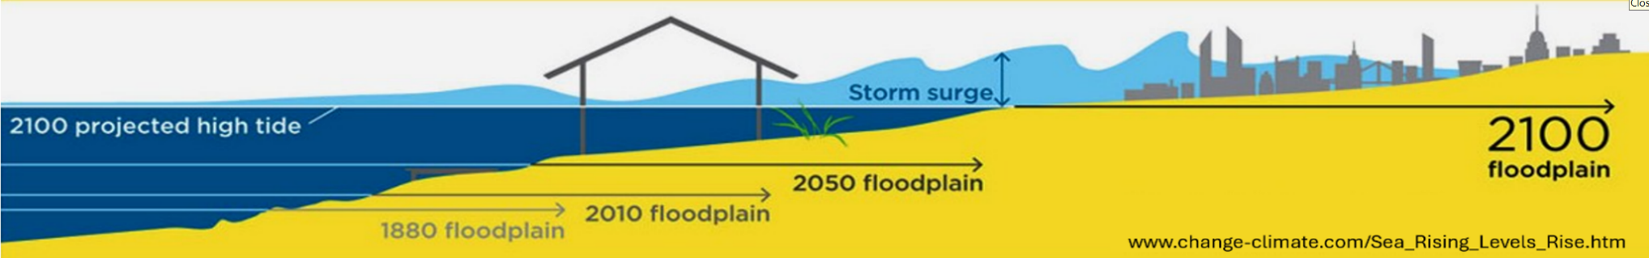
Effects of Sea Level Rise

Slide 4
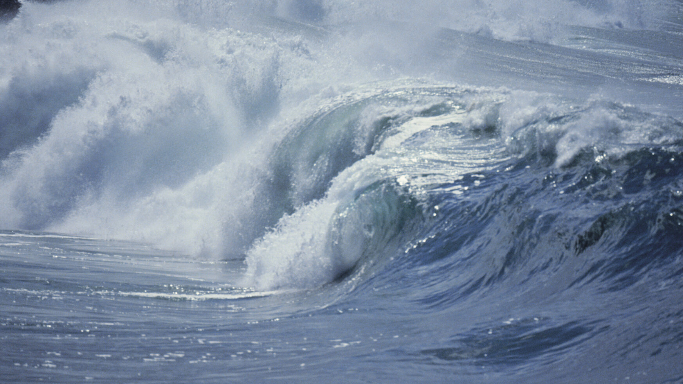


⅔
of NJ coastline already at high or very high risk to coastal erosion
98%
500,000
of the coastline at medium or very high risk to sea-level rise
acres of NJ
land highly vulnerable to coastal hazards.

Slide 5



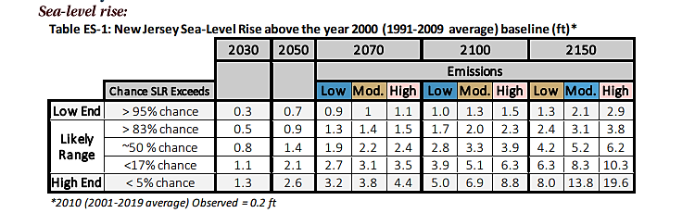
Coastal Inundation & Flood Damage
Rutgers University’s 2019 Science and Technical Advisory Panel (STAP) Report indicates a 50% probability that sea level rise will exceed 3.3 feet and a 17% probability that sea level rise will exceed 5.1 feet by 2100 assuming moderate emissions.
https://njclimateresourcecenter.rutgers.edu/resources/nj-sea-level-rise-reports/

Slide 6
Coastal Inundation & Flood Damage
Rutgers University’s 2019 Science and Technical Advisory Panel (STAP) Report indicates a 50% probability that sea level rise will exceed 3.3 feet and a 17% probability that sea level rise will exceed 5.1 feet by 2100 assuming moderate emissions.
https://njclimateresourcecenter.rutgers.edu/resources/nj-sea-level-rise-reports/

Slide 7
  Best-available NJ-specific information published after REAL proposal indicates a difference in the likely global temperature increase used in the 2019 STAP Report.
  Moderate emissions scenario now anticipates an increase in sea level rise of 4.4 feet by 2100 instead of 5.1 feet.
  NJDEP will review available climate change data every five years and adjust rules as needed.

Slide 8
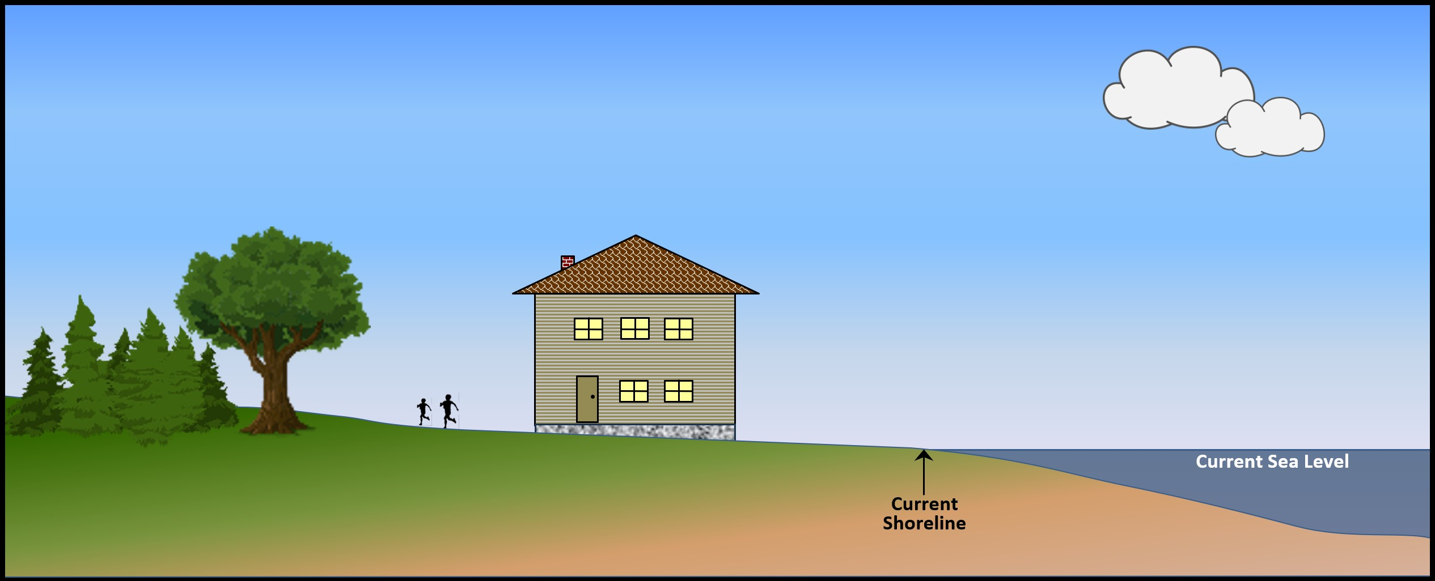
Inundation Risk Zone

Slide 9
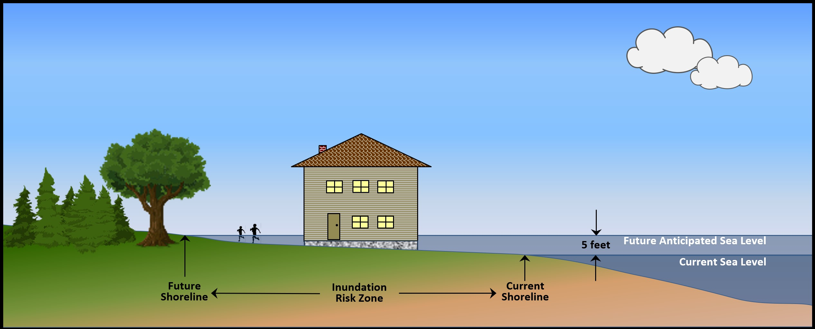

Inundation Risk Zone

Slide 10
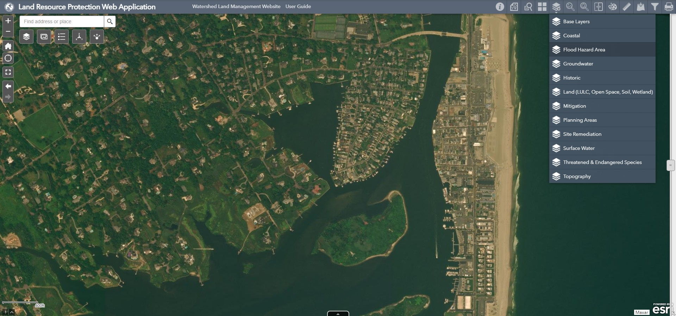

Slide 11
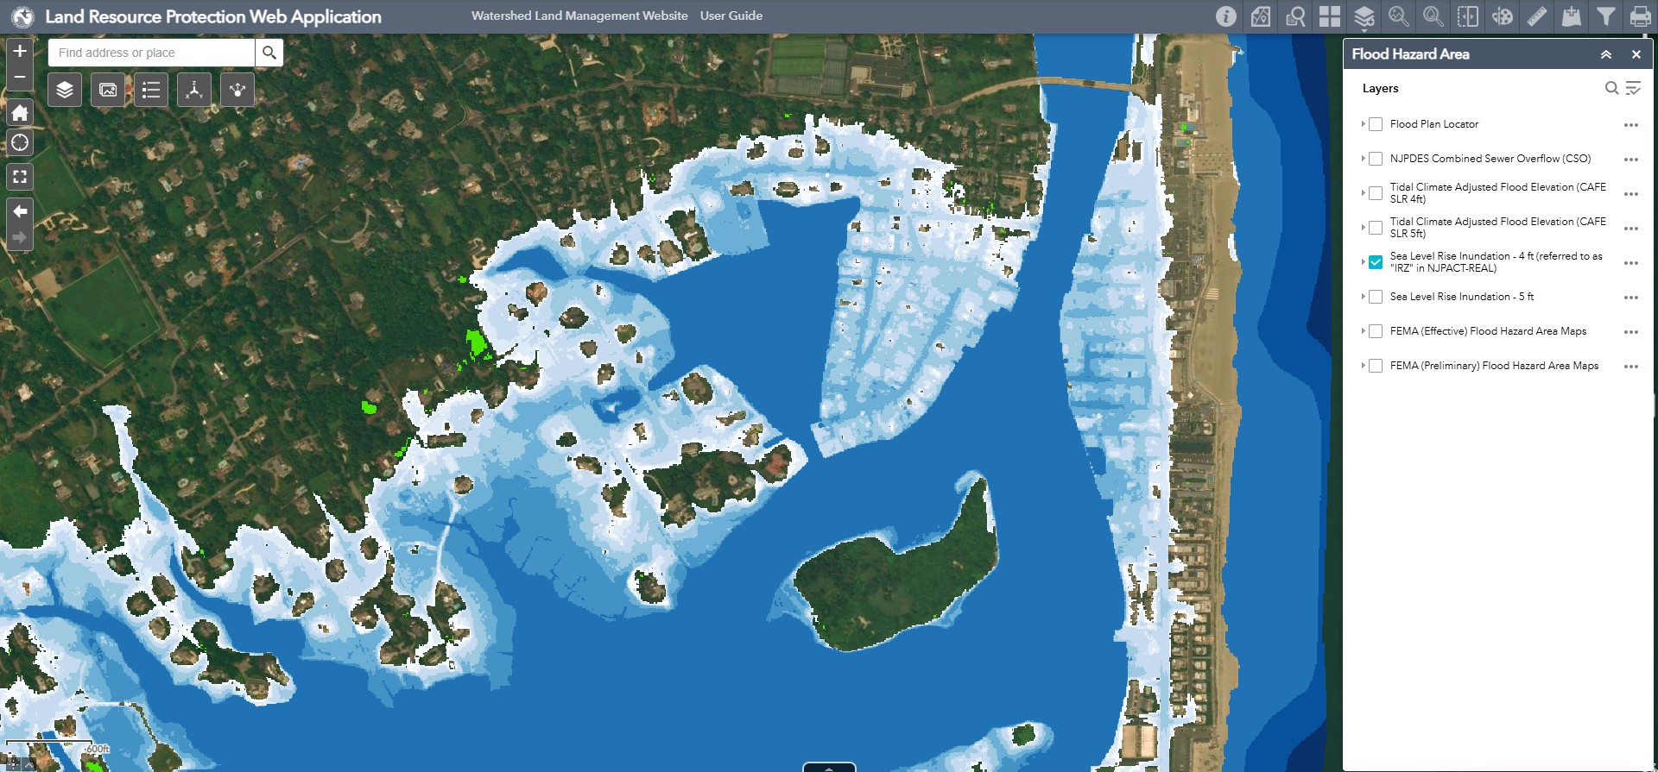

Slide 12
INUNDATION RISK ZONE
Residential buildings
Critical buildings
  Includes schools, fire and police stations, medical facilities, correctional facilities, power generating stations, critical aviation facilities.
Critical infrastructure
  Infrastructure necessary for emergency response and recovery during and after a flood, or that poses a risk to public health, safety, and welfare should it be damaged or unable to perform its intended functions.
New standards apply to new/reconstructed/improved:
Inundation Risk Zone standards do not apply to:
Commercial development
Industrial development
Buildings that are not “residential” or “critical”
Infrastructure that is not “critical”

Slide 13
INUNDATION RISK ZONE
Permanent standing water due to sea-level rise
Inundation Risk Assessment
  Narrative response to risk of loss/damage questions
  How much inundation is to be expected
  What are the potential impacts if/when site is inundated
On-Site Alternatives Analysis
  Examines on-site design alternatives to avoid or minimize risks for residential and critical buildings
Risk Acknowledgement
  Adds narrative disclosure based on Inundation Risk Assessment
  Recorded in title/deed

Slide 14
Inundation Risk Zone

Slide 15
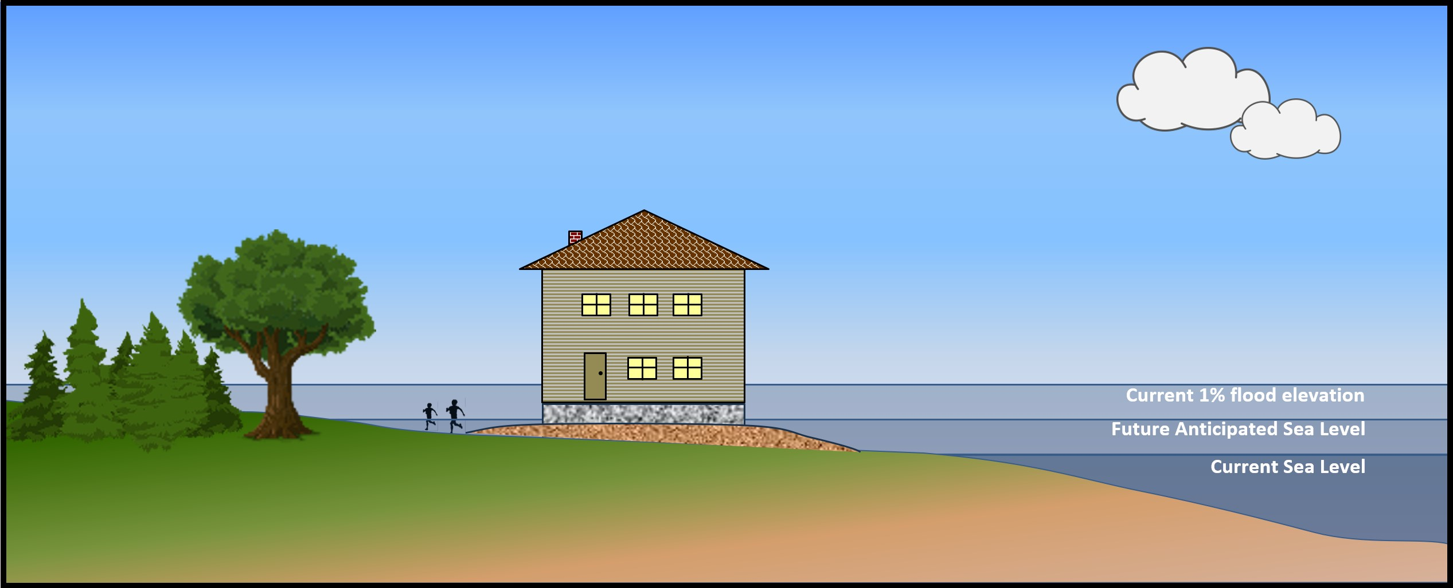
Inundation Risk Zone and Climate-Adjusted Flood Elevation

Slide 16
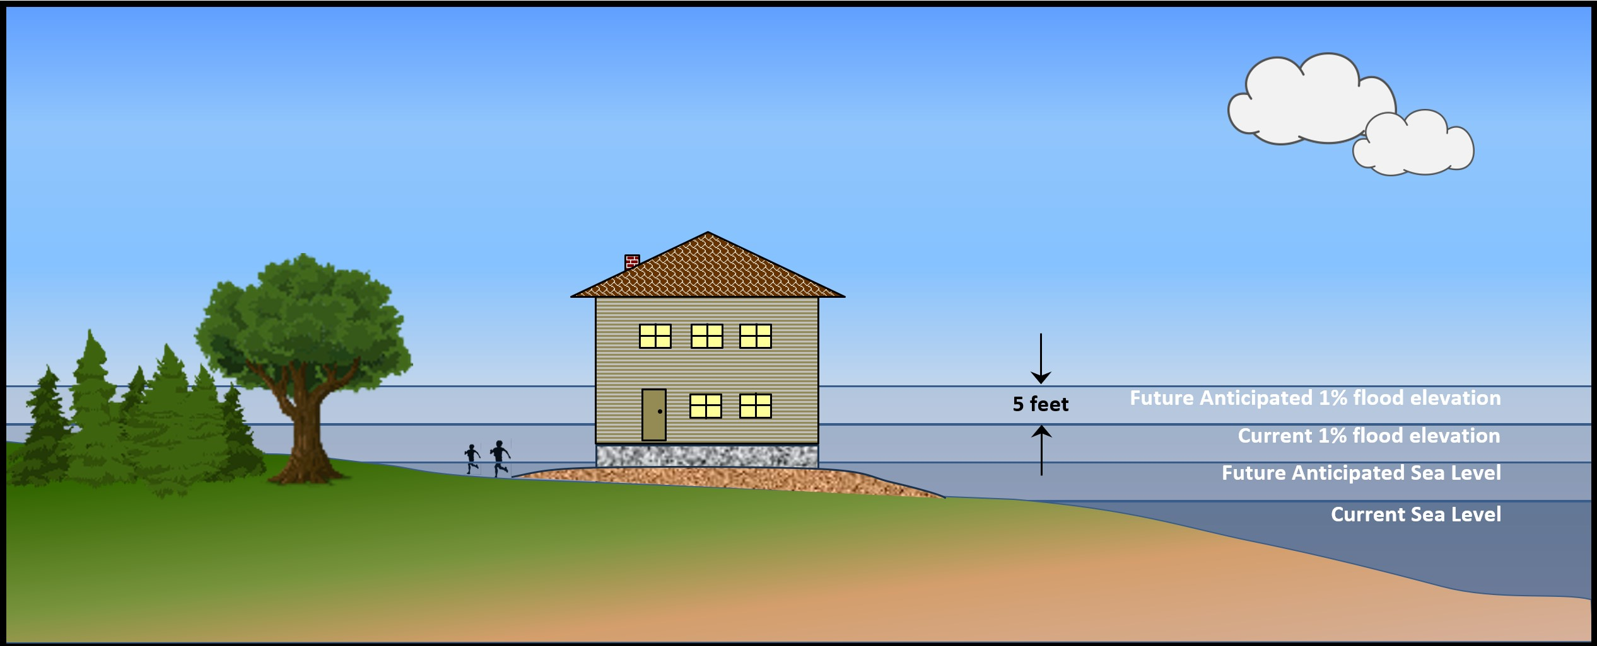

Inundation Risk Zone and Climate-Adjusted Flood Elevation
CLIMATE-ADJUSTED FLOOD ELEVATION

Slide 17
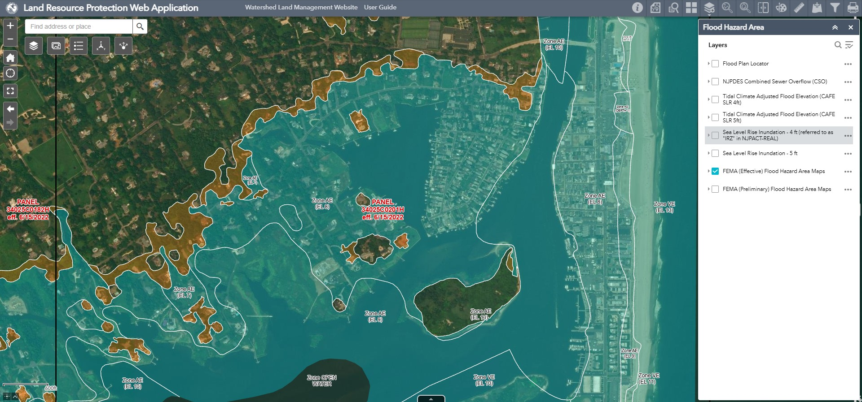

Slide 18
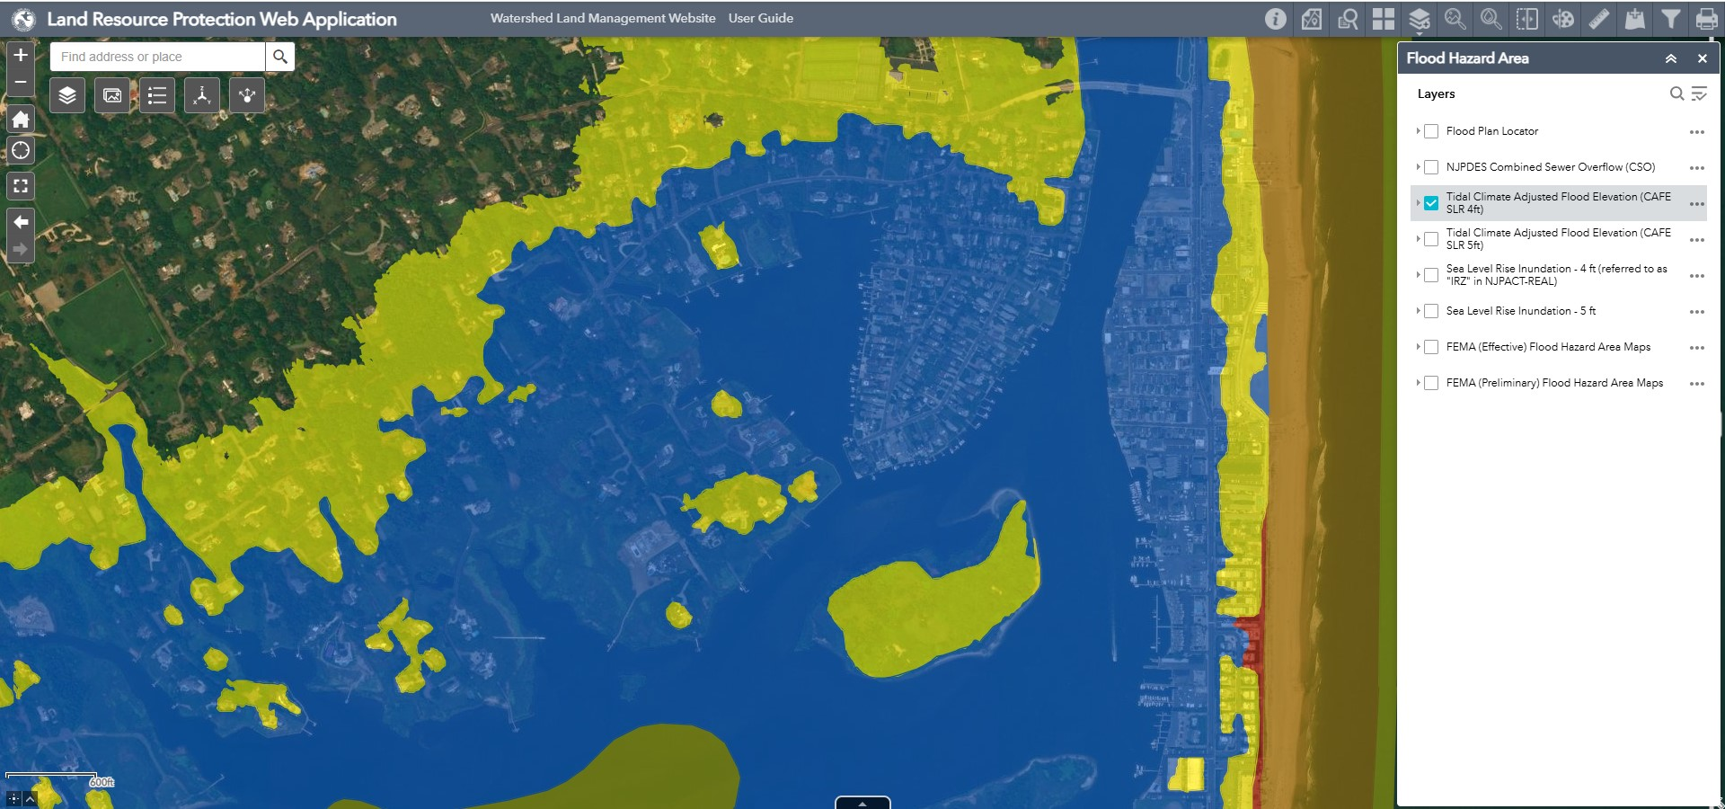

Slide 19
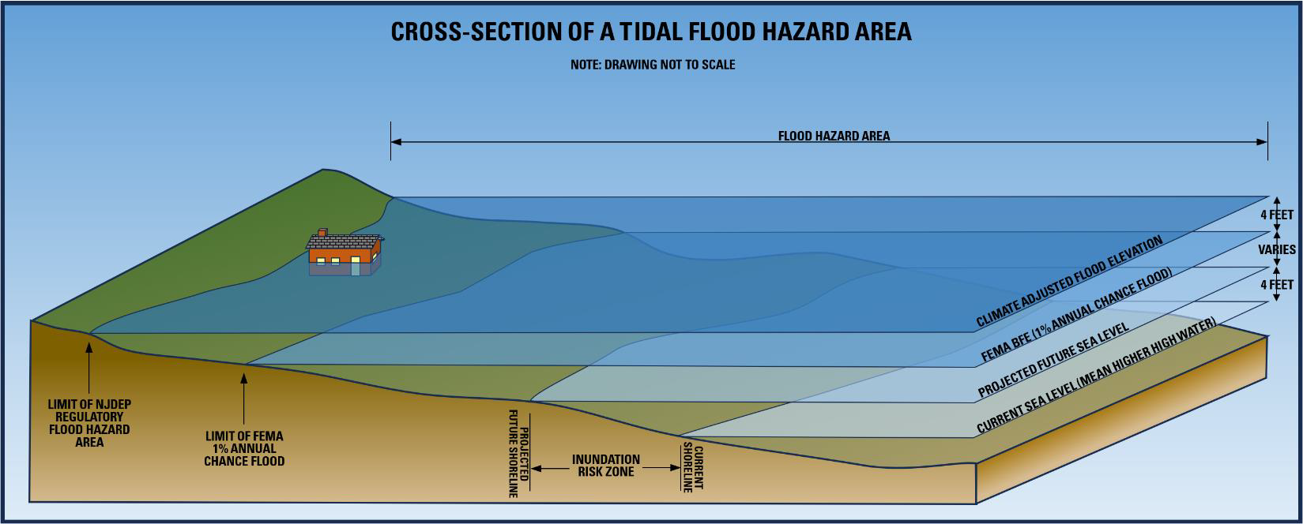

Slide 20
CLIMATE ADJUSTED FLOOD ELEVATION (CAFe)
IN COASTAL FLOOD HAZARD AREAS
PRIOR RULES
CURRENT RULES
Approximately 16% of NJ lies in a FEMA-mapped floodplain
Adds about 1.5% more land area into NJDEP’s regulatory floodplain
NJDEP’s regulatory flood was equal to FEMA’s 100-year (1%) base flood elevation (BFE)
One-foot of freeboard added for roads and buildings
Climate-adjusted flood elevation along the coast is equal to FEMA+4
One-foot of freeboard added for roads and buildings
For general discussion purposes only. Information provided is pre-decisional and does not constitute a final agency decision or action.

Slide 21
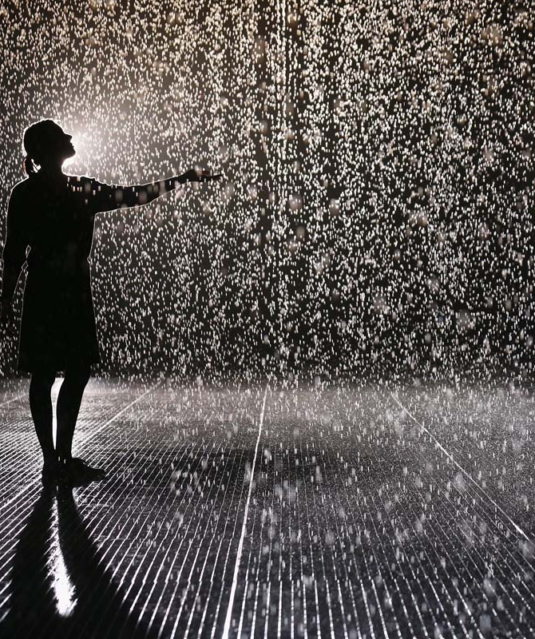
For more information see REAL website: https://dep.nj.gov/njreal email: vincent.mazzei@dep.nj.gov
z

