Slide 1
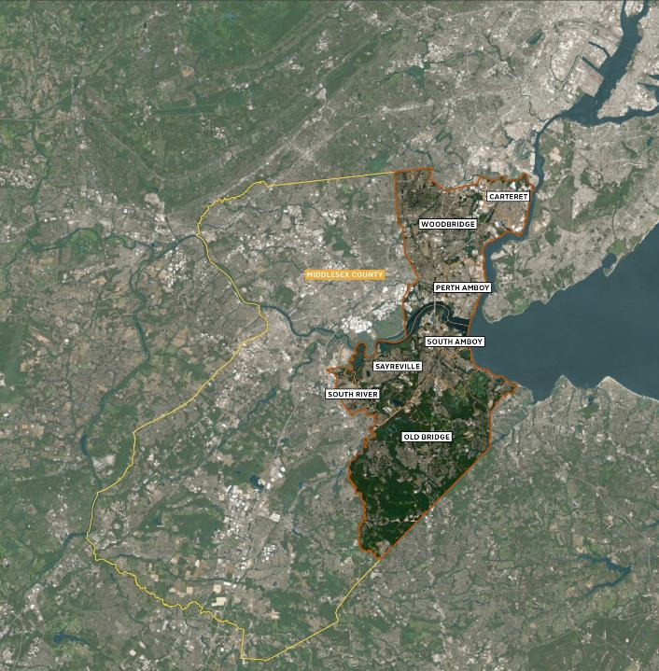










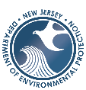


Implementing the Resilient NJ Raritan River and Bay Communities: Planning for Adaptive Reuse of Buyout Properties along the South River
NJ Coastal & Climate Resilience Conference
March 10, 2026

Slide 2
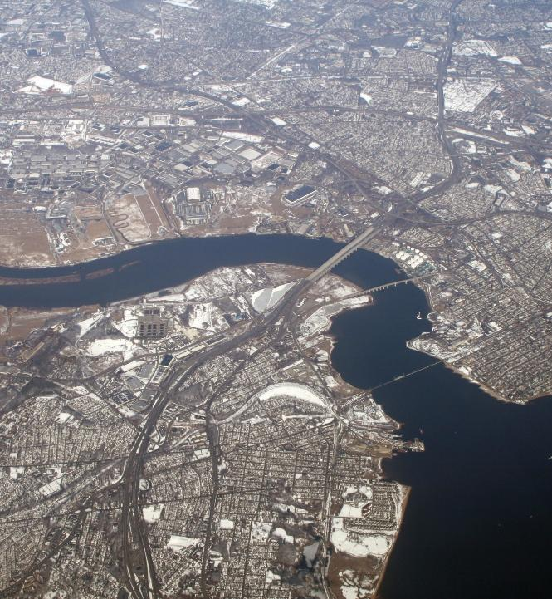
AGENDA
Program Overview
Regional Action Plan
South River Adaptive Reuse
South River Ecosystem Restoration and Flood Resiliency Enhancement Project
Blue Acres
Q&A

Slide 3


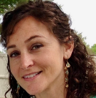
SPEAKERS
Vicki Chou
Water Resources Engineer
Arcadis
Pippa Brashear
Principal
SCAPE Landscape Architecture
Courtney Wald-Wittkop
Manager
NJDEP Blue Acres

Slide 4

RESILIENT NJ PROGRAM OVERVIEW

Slide 5

RESILIENT NJ PROGRAM
Launched in 2020 by DEP, provides technical assistance for climate resilience planning
Raritan River and Bay Communities (RRBC) region part of pilot Regional Planning Program
Goal: produce community-led resilience action plans
Steering Committee with representatives from NJDEP, County, municipalities, community-based organizations
Address flooding issues and increase resilience
Heavy focus on community engagement
Include flood risk assessments and action plans that respond in a variety of ways (i.e., infrastructure, zoning, NBS, etc.)
Notes:
-RAP, MAP, LPG

Slide 6
WHO IS INVOLVED?
REGIONAL PLANNING REQUIRES COORDINATED ACTION AT MULTIPLE SCALES
Individuals
Non-Governmental & Community Orgs.
Municipalities
Federal Agencies
State Agencies
(NJDEP)
Middlesex County
Notes:
-Emphasis on importance of partnerships, and making sure plans don’t sit on shelves

Slide 7
RESILIENT NJ RARITAN RIVER AND BAY COMMUNITIES ACTION PLAN

Slide 8
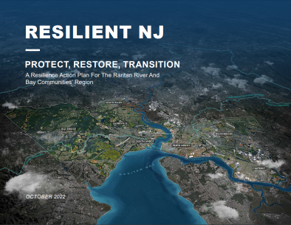
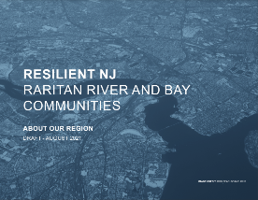
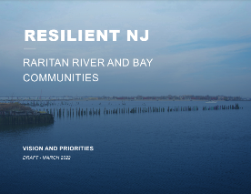

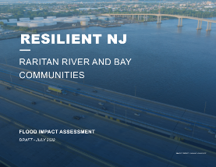
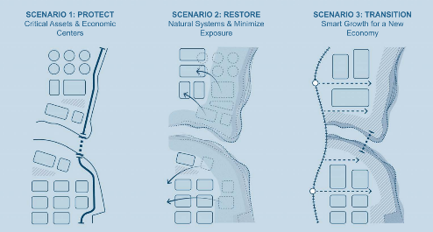
REGIONAL PLANNING PROCESS
Notes:
In the first phase of the Resilient New Jersey program, in order to develop a regional set of strategies for climate resilience, we first completed a comprehensive review of the region with the input from the many different individuals, organizations, and agencies in this area. The documents that summarize this foundational work include:
The Vision and Priorities report, which asked what changes do you want to see for yourself and future generations
The About Our Region report, which summarizes the past and current work advancing resilience in the region, as well as how new opportunities fit into the context of the history and features of the region and identify strengths or challenges in addressing climate risks in the area
The Flood Impact Assessment, which includes a flood analysis on how the region will be affected by current and future climate threats, along with what flood protection approaches the community would like to see implemented
Through this initial planning and community feedback, we then developed three scenarios that align with the region’s vision, address the flood risks identified, and include a combination of different flood risk-reduction tools. These three scenarios of Protect, Restore, and Transition were further refined and consolidated into one preferred scenario, based on community and region priorities. The strategies for this preferred scenario is detailed in the Action Plan, which provides a roadmap with the next steps for the region to reduce current and future flooding risks and improve quality of life.

Slide 9
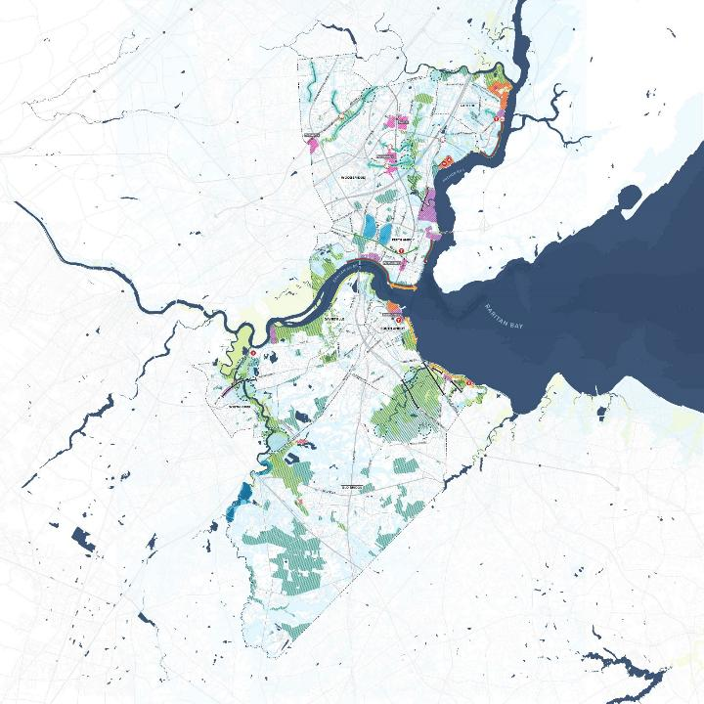

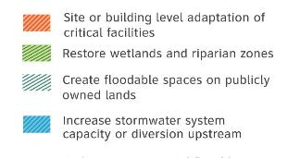


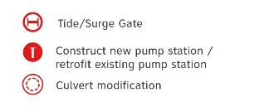
PREFERRED SCENARIO
Coastal flood barriers integrated with waterfront greenway
PHYSICAL AND NATURE BASED INFRASTRUCTURE STRATEGIES
Stream restoration and culvert modification of inland waterways
Adaptation of critical facilities to be flood resistant
Increased capacity of stormwater management system
Coastal beach replenishment and dune restoration
Wetland restoration along the Raritan River, South River, and other tributaries
Protection of critical transportation routes, such as Rte. 35, Parkway, and NJ Transit
Notes:
The preferred scenario included physical and nature based infrastructure strategies across the region, such as:
Wetland restoration along the Raritan River and South River
Improved stormwater management systems, like increasing capacity of existing systems or addressing combined sewer areas
Protection of critical transportation routes
And integrating flood protection infrastructure to critical facilities

Slide 10
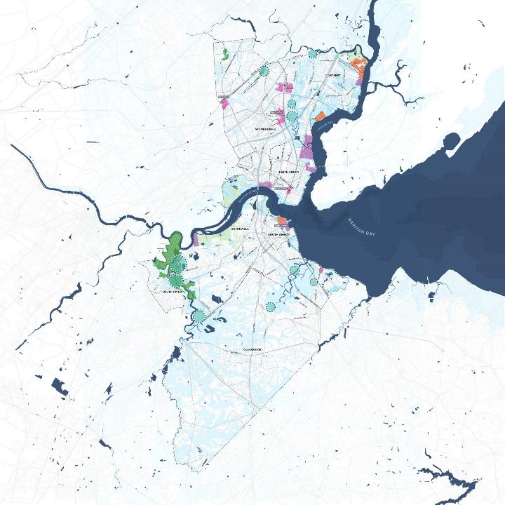

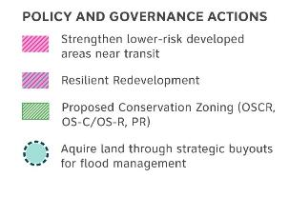

PREFERRED SCENARIO
POLICY AND GOVERNANCE ACTIONS
Outreach to private property owners to promote building adaptation to be more resilient
Increased density in lower risk areas and by transit
Redevelopment with more resilient building forms
Buyouts and limitations on future growth through zoning
Notes:
Another strategy is around policy and governance actions, including:
Managing growth by reducing density in highly at-risk areas through strategic buyouts and zoning changes, and increasing density in lower risk areas
Promoting resilient development through updating codes and policies
Providing technical assistance and targeted outreach to property owners to promote building mitigation and flood insurance
Promoting regional, watershed coordination among municipalities and county

Slide 11
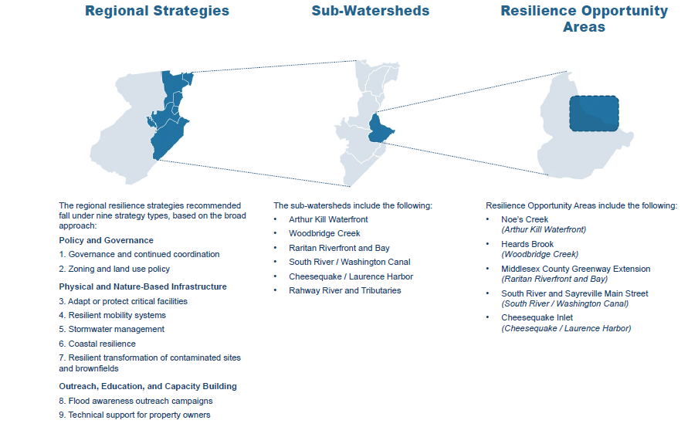



ACTION PLAN RECOMMENDATIONS
Notes:
The third regional strategy theme is Outreach, Education, and Capacity Building, which requires coordination across entities within the region. The Action Plan breaks down the regional strategies to the sub-watershed level, identifying how collective municipal coordination will be required to address sub-watershed level challenges. Going even more granular is the resilience opportunity areas level, where the Action Plan recommends targeted actions to be implemented by multiple entities to address specific risks to populations and critical assets. Taking coordinated action in these areas will improve resilience and help advance related actions across the region. One of the resilience opportunity areas identified is South River and Sayreville Main Street, which will be the focus of our panel today.
Regional – Organized into major themes (stormwater management, coastal restoration, land use policy, etc.)
Sub-Watershed – How all strategies work together when coordinated
Resilience Opportunity Areas – Specific high-risk areas with a concentration of recommended actions by multiple actors

Slide 12
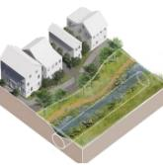
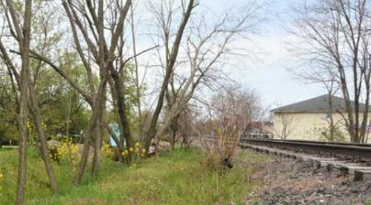

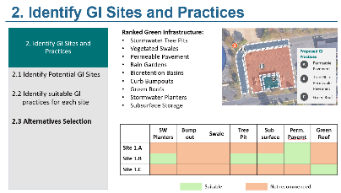
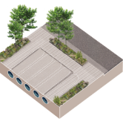
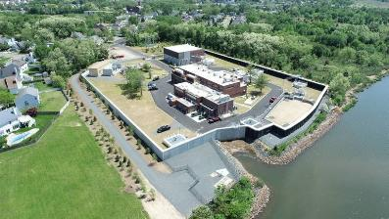
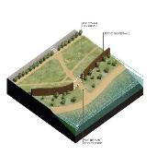
IMPLEMENTATION
SEWER SEPARATION
^{Perth Amboy Combined Sewer}
PHYSICAL AND NATURE BASED INFRASTRUCTURE
These strategies focus on preventing damage and disruption from flooding through nature-based solutions and improved built systems.
GREEN INFRASTRUCTURE TOOLS
^{Distributed GI Calculator}
FLOODPROOF/HARDEN
Sayreville Pump Station, Sayreville NJ
Notes:
Following the regional planning and release of the Action Plan, the region team then worked to advance the actions and recommendations from the plan in the second phase of Resilient NJ. Through monthly steering committee meetings to individual entity and community partner discussions, our team listened to identify where technical support would be most meaningful to help advance resilience actions and projects led by each entity. From these discussions with the region team and input from individual entities, we compiled the top priorities from the Action Plan for our team to support as it aligns with the Action Plan’s three overarching strategies: Policy and Governance, Physical and Nature-Based Infrastructure, and Outreach, Education, and Capacity Building Programs.
A few examples of physical and nature based infrastructure projects that were advanced included:
Development of concept designs to address combined sewer overflows and capacity challenges in Perth Amboy
Development of a distributed green infrastructure calculator tool to help with green infrastructure planning and prioritization for the region
Identifying and supporting grant applications to fund capital projects, such as protecting critical facilities, like pump stations in Sayreville and Woodbridge

Slide 13
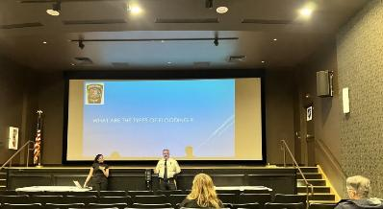


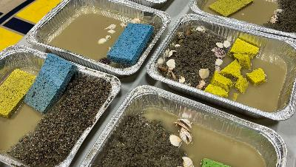
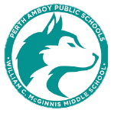
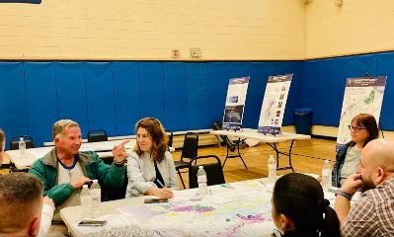

IMPLEMENTATION
COMMUNITY WORKSHOPS
^{YMCA Flood Awareness Workshops}
OUTREACH, EDUCATION, AND CAPACITY BUILDING
These strategies enhance public involvement and awareness in decision-making processes.
YOUTH PROGRAMMING
^{Summer Youth Education}
ONLINE WEBINARS
^{Local Action Education}
Notes:
For Outreach, Education, and Capacity Building, we collaborated with our community-based partners to organize events such as:
Flood awareness workshops
Youth climate education programs with summer camps and local schools
Online webinars on local actions

Slide 14
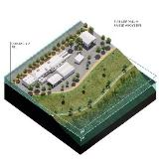
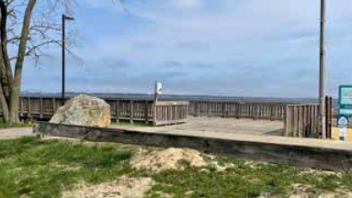

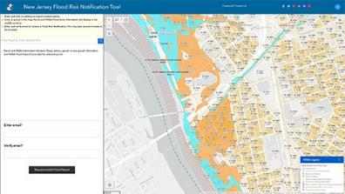
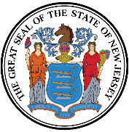
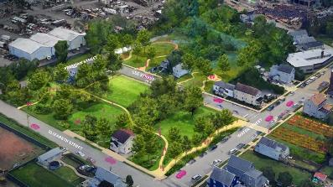
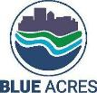
IMPLEMENTATION
RESILIENT DESIGN GUIDELINES
^{Laurence Harbor, Old Bridge NJ}
POLICY & GOVERNANCE
These strategies help the region transition to a more resilient future and enable coordinated large-scale strategies.
NJ Protecting Against Climate Threats (NJ PACT)
NEW JERSEY
NJDEP BLUE ACRES
^{Blue Acres Adaptive Reuse}
Notes:
For Policy & Governance, our team focused on providing support in reviewing local, state, and federal policy changes and how that affects the region and individual municipalities, as well as recommendations for master plans, redevelopment plans, and zoning. Our team provided recommendations on resilient design guidelines for the Laurence Harbor area in Old Bridge and worked with the County to provide guidance on how the NJ PACT rules affect stormwater management and MS4 permits.
One of the major priorities the region voiced was more guidance on how sites acquired through the Blue Acres program can be adaptively reused. Because of the regional collaboration facilitated through Resilient NJ, our team was able to work with the towns and the state to imagine reuse options for these sites that can become community assets and areas for passive recreation. Through this process, we were able to identify adaptive reuse strategies that will meet the needs of the local community while also allowing the area to function as natural floodplain areas to meet the Blue Acres program requirements.

Slide 15
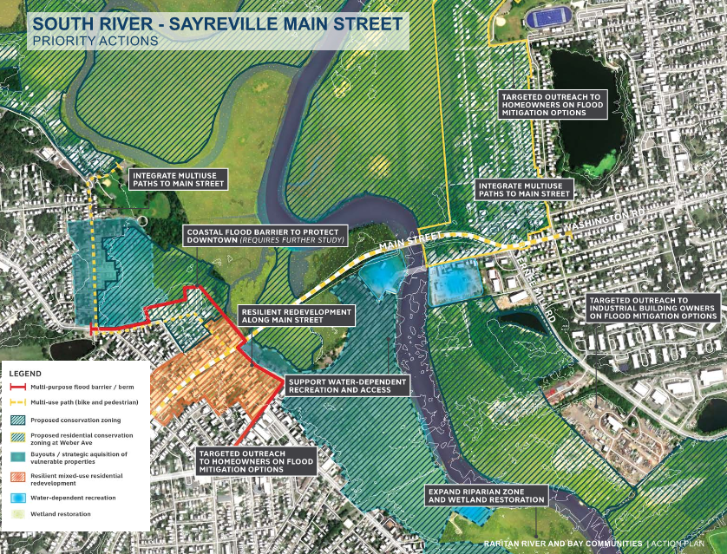
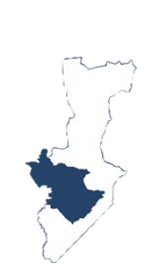
RESILIENCE OPPORTUNITY AREA –
SOUTH RIVER
&
SAYREVILLE
KEY MAP OF
SOUTH RIVER
SUBWATERSHED
Notes:
As stated previously, the South River running along the towns of South River and Sayreville was identified as a resilience opportunity area, where priority actions synthesized from community and regional feedback include wetland restoration, targeted outreach to homeowners on flood mitigation options, resilient development strategies, and coastal flood barriers. To advance these priority actions, two projects were supported through the implementation phase of the Resilient NJ program – the South River Adaptive Reuse Plan and Sayreville’s South River Ecosystem Restoration Project.

Slide 16
SOUTH RIVER ADAPTIVE REUSE

Slide 17
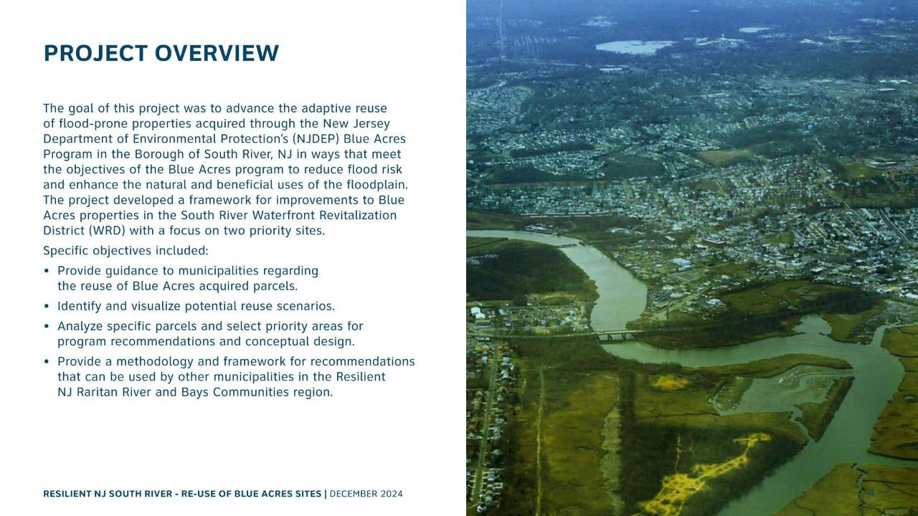

Slide 18
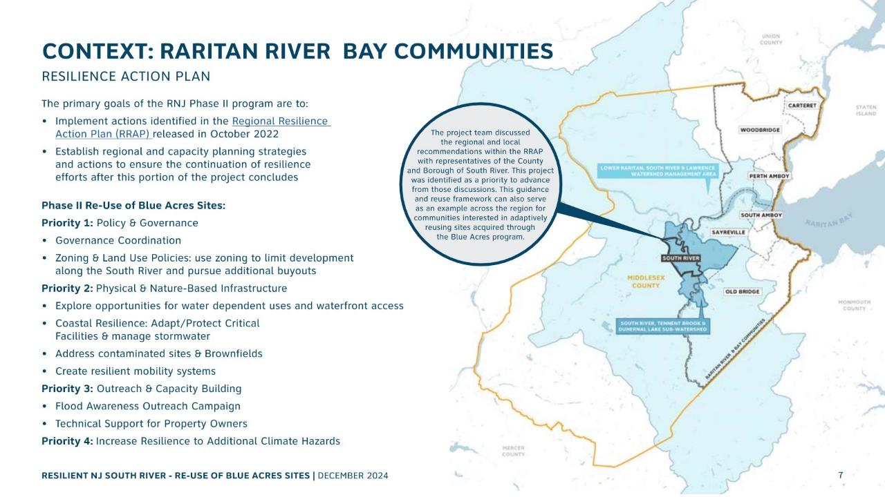

Slide 19
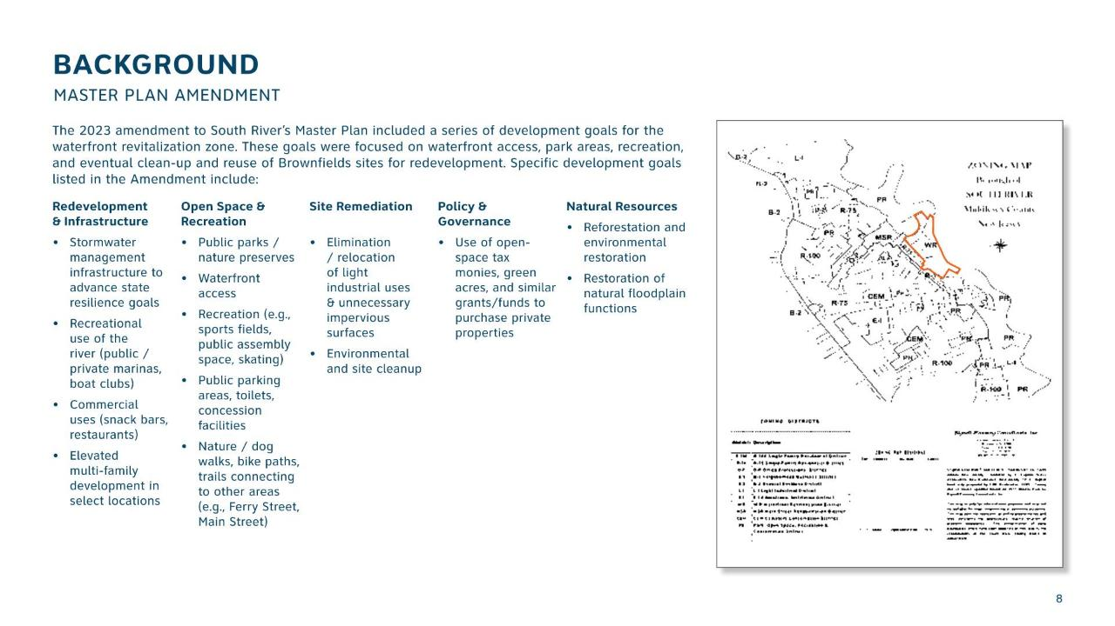

Slide 20
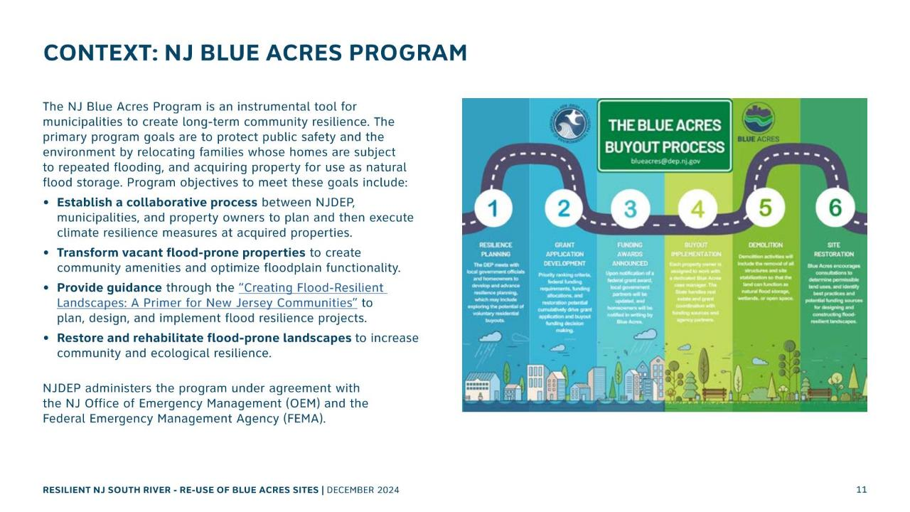

Slide 21
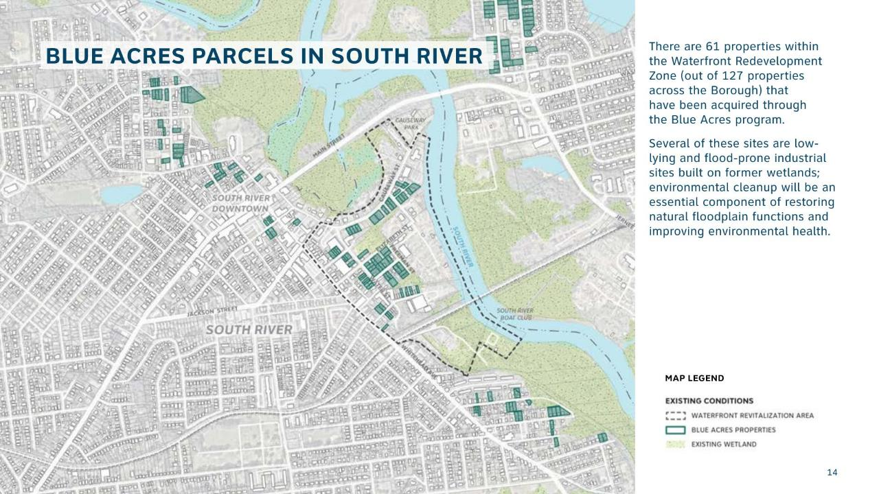

Slide 22
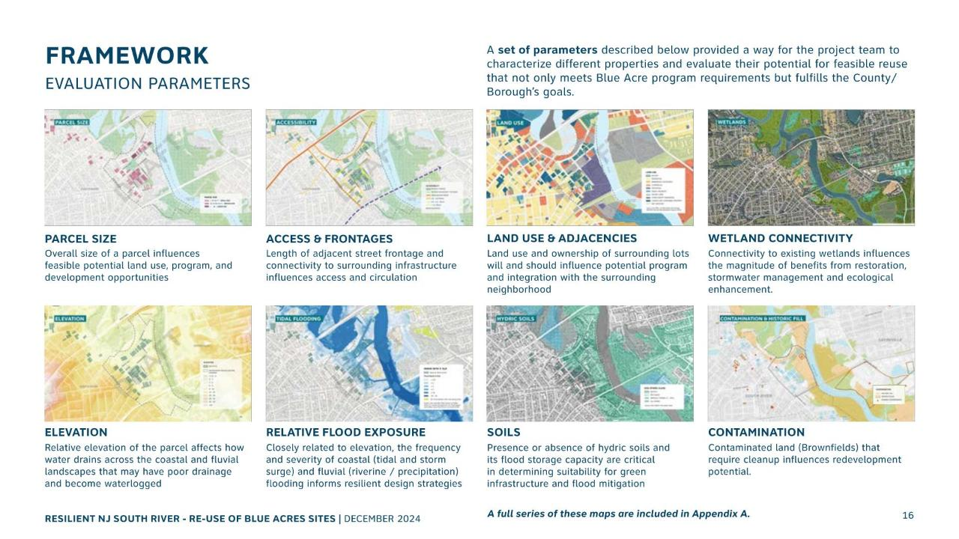

Slide 23
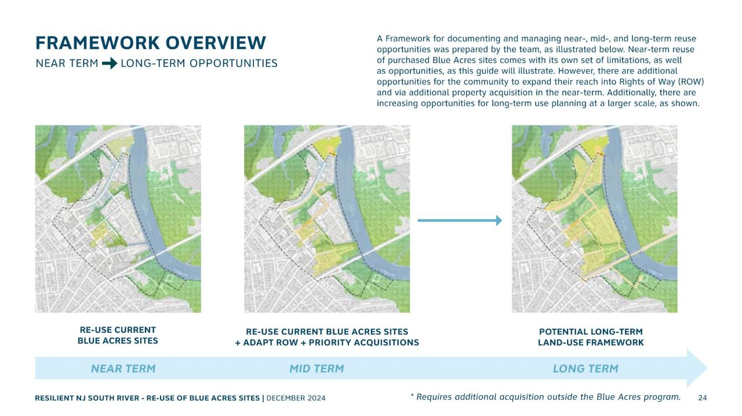

Slide 24
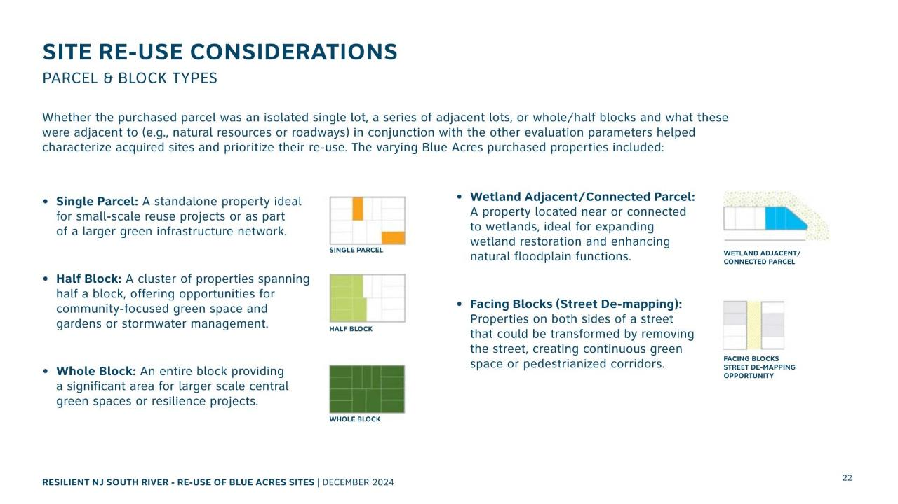

Slide 25
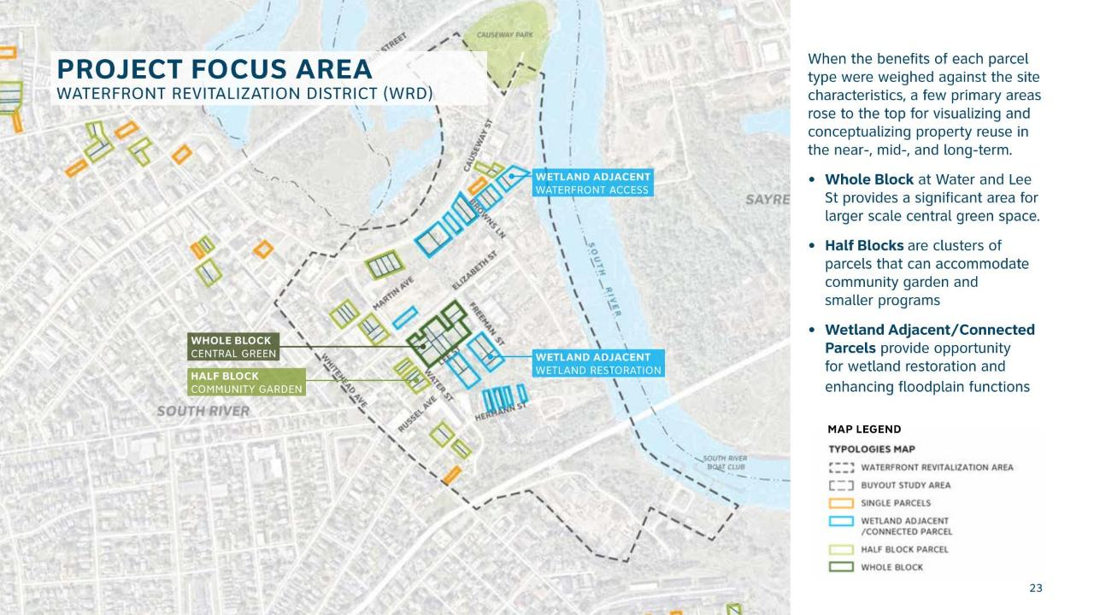

Slide 26
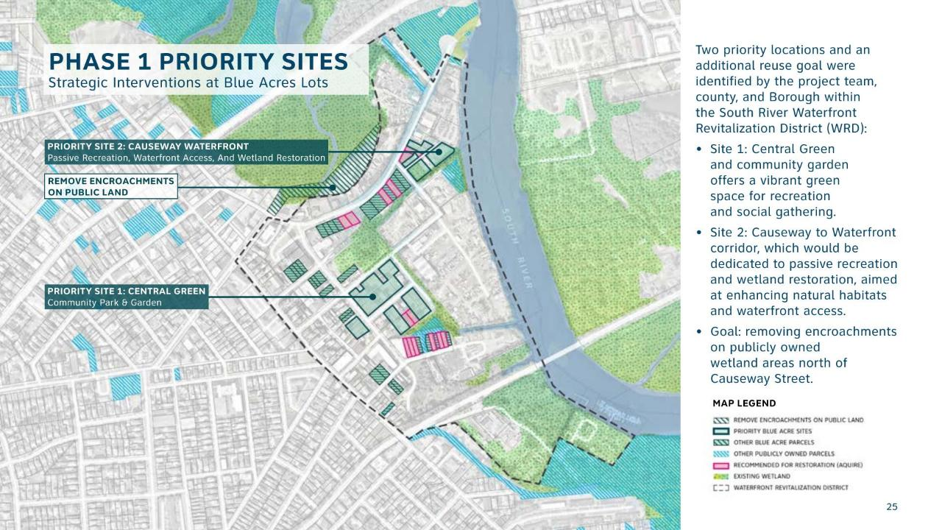

Slide 27
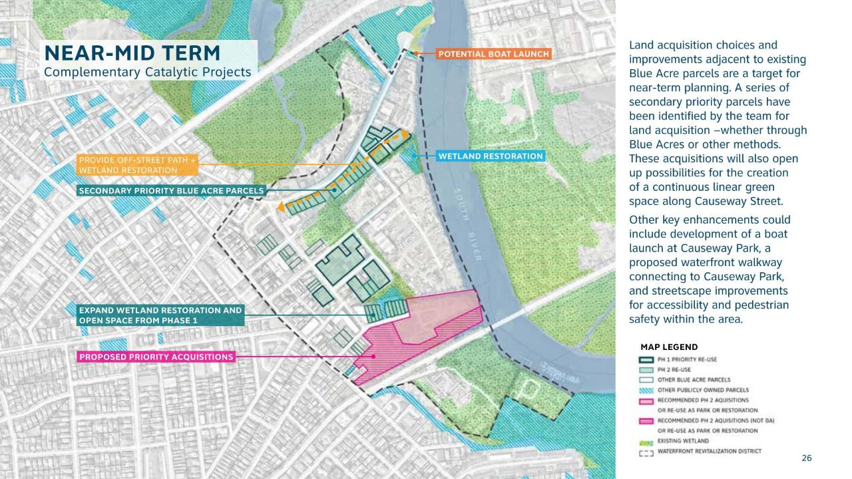

Slide 28
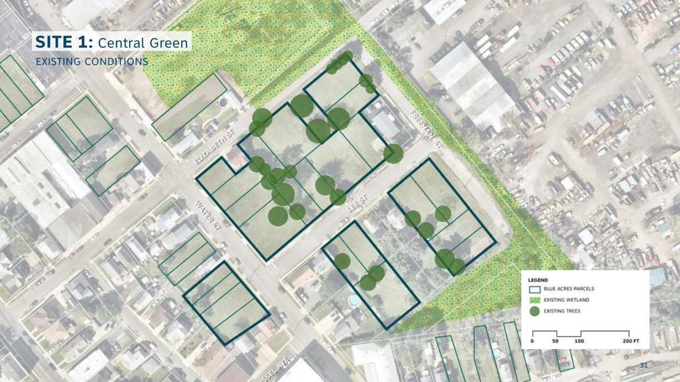
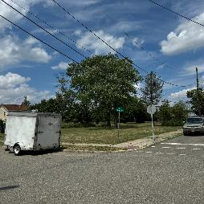

Slide 29
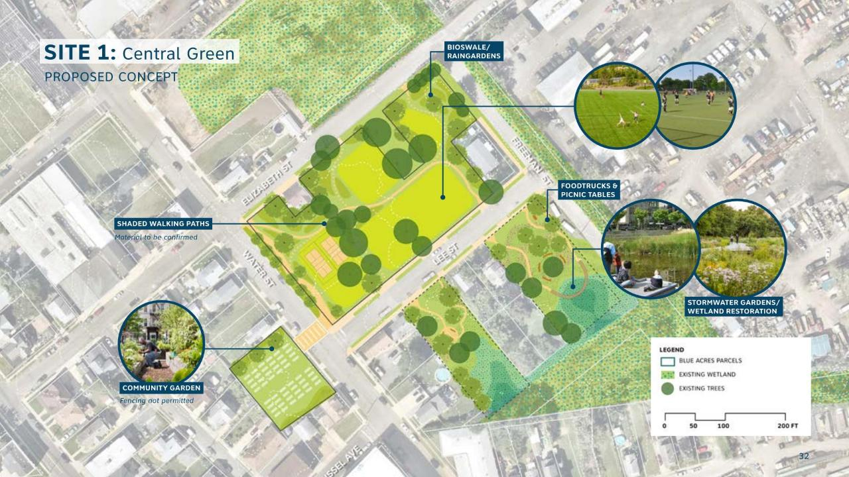

Slide 30
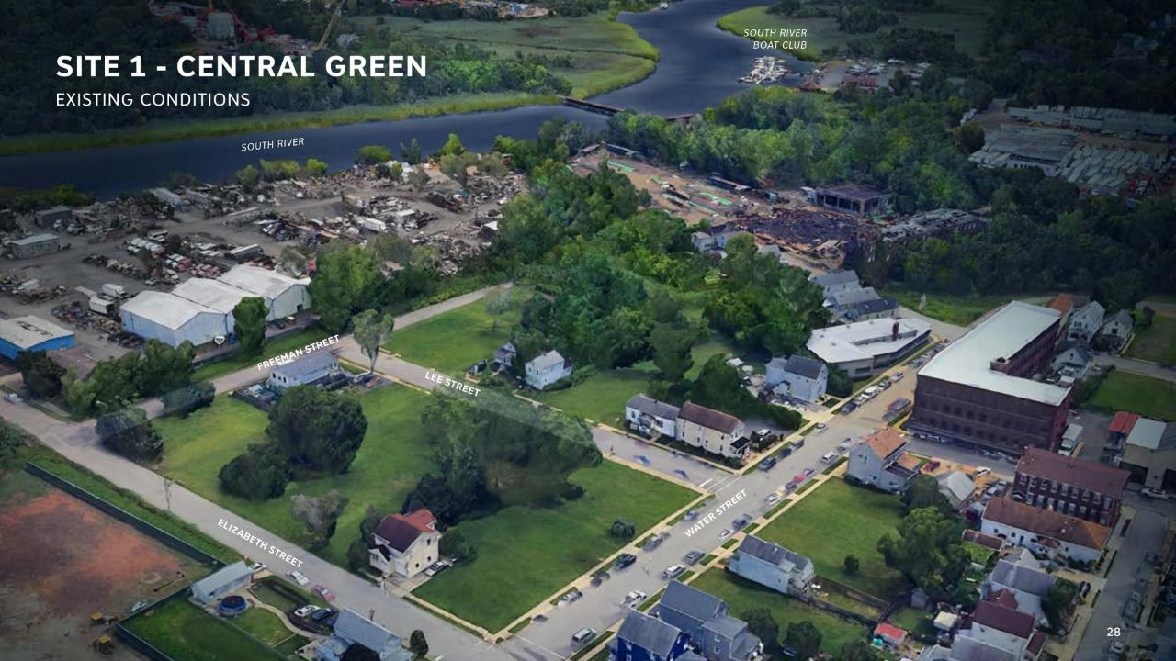

Slide 31
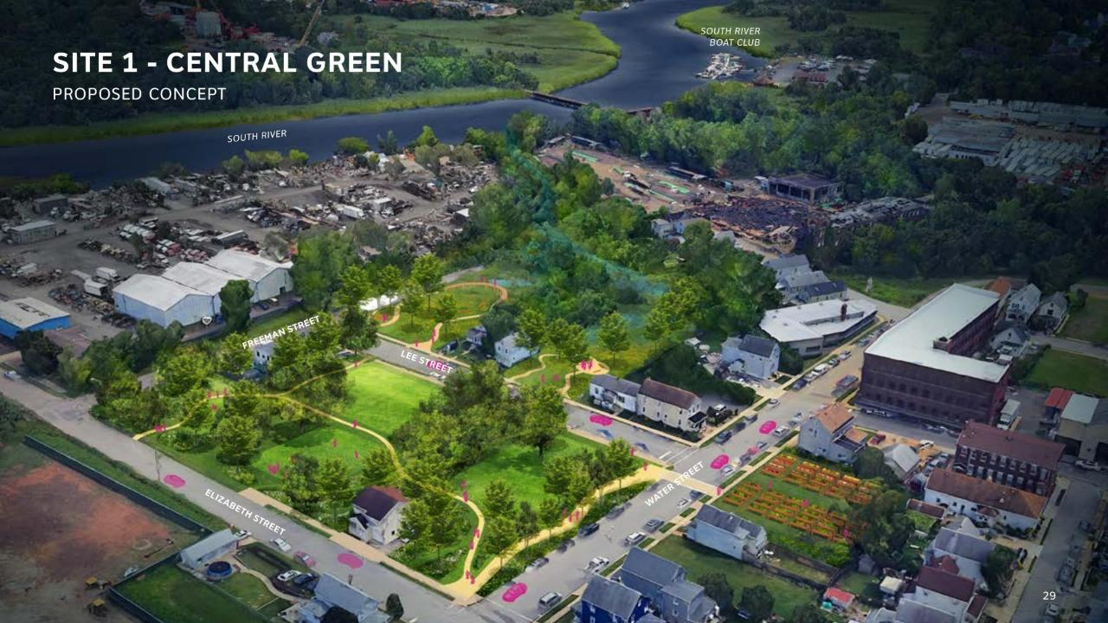

Slide 32
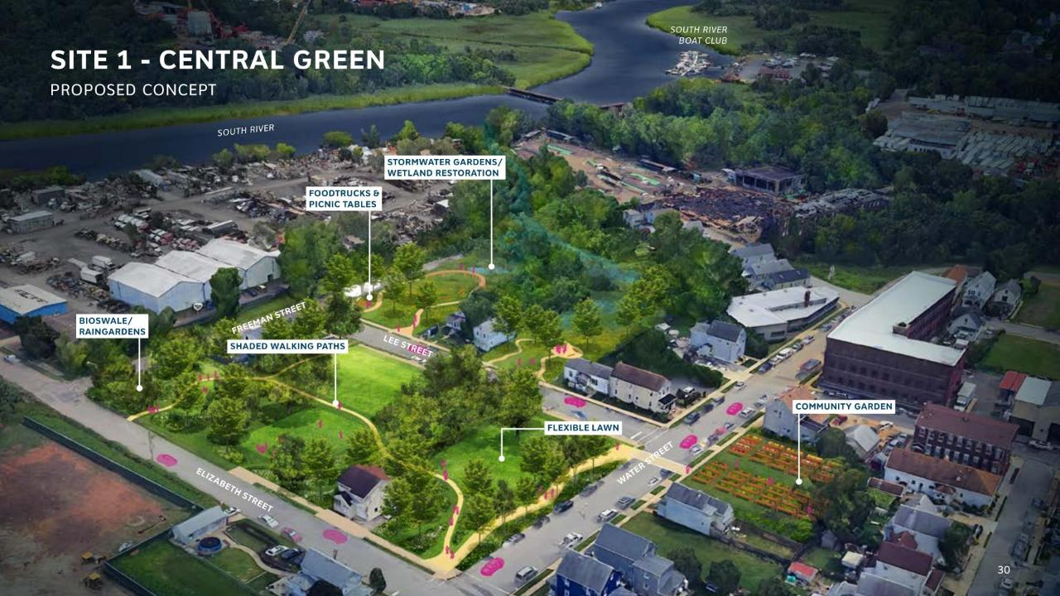

Slide 33


Slide 34


Slide 35


Slide 36


Slide 37


Slide 38






Slide 39


Slide 40
SAYREVILLE’S SOUTH RIVER ECOSYSTEM RESTORATION AND FLOOD RESILIENCY ENHANCEMENT PROJECT

Slide 41





PROJECT OVERVIEW
Project goals include:
Restore natural function of floodplain
Enhance flood resiliency
Improve habitats for wildlife and native species
Integrate passive recreation and community engagement activities
Notes:
The South River Ecosystem Restoration Project is a great case study for how Resilient NJ and buyouts can be great tools for implementing resilience solutions. The project’s goals include:
Restoring natural function of floodplain
Enhancing flood resiliency to address tidal and periodic flooding, sea level rise, and coastal erosion
Improving habitats for wildlife and native species
Integrating passive recreation and community engagement activities
This project is the result of regional collaboration, including Sayreville, South River, NJDEP, Rutgers, and Lower Raritan Watershed Partnership.

Slide 42


BLUE ACRES BUYOUTS
Blue Acres Program
Sayreville was first partnering municipality
Leadership prioritized goals of Blue Acres Program
Sayreville Blue Acres Restoration Plan
Partnership between Rutgers Cooperative Extension and Sayreville
Restoration Plan completed in 2016
Implementation Plan completed in 2023
Notes:
For some background on this project, Sayreville was the first partnering municipality to participate in the Blue Acres program. They set a great example for the region to give the community the option to participate in the buyouts. As buy out properties were returning to a more natural state with plants and animals returning, there were complaints from neighbors about how the areas were becoming too wild, but Sayreville’s leadership did a great job managing the community concerns while still prioritizing the goals of the Blue Acres program by not mowing or landscaping the buy out areas to allow them to function as natural floodplains. Success in managing buy out properties requires strong local government leadership as well as engagement with community groups, including promoting access to the water and demonstrating the benefits of the flood resilience improvements.
Sayreville partnered with Rutgers Cooperative Extension to develop a Restoration Plan in 2016 to understand how the 103 acquired residential properties, spanning about 23 acres, can be effectively used for flood storage, recreation, and wildlife habitats. This plan included an existing conditions characterization, open space and recreational opportunities for the project area, and ecological restoration and public amenity recommendations. A follow-up Implementation Plan was developed in 2023 to provide specific recommendations for the MacArthur Avenue project site, which includes Borough-owned properties and Blue Acres parcels. Recommendations include ecological interventions like invasive species management, turf management, meadow establishment, and leaf mulch application. The plan also includes recommended social interventions like restricting public access to Blue Acres lots to prevent improper usage of the sites for parking or storage and a mowed buffer, not in the planting zones, to provide visual separation from private properties

Slide 43

60% DESIGN
Restore 165 acres of wetland habitat
Funded by NFWF National Coastal Resilience Fund (2019) – led by LRWP
Notes:
The South River Ecosystem Restoration project on the adjacent wetland area to the Blue Acres parcels completed 60% design through funding by the National Fish and Wildlife Foundation’s National Coastal Resilience Fund in 2019. This 60% design included 165 acres of wetland habitat along the South River within both the boroughs of South River and Sayreville. This project phase was led by the Lower Raritan Watershed Partnership.

Slide 44




100% DESIGN
Included 23 acres of the Blue Acres properties to restore a total of 188 acres of wetland habitat
Funded by NFWF Coastal Resilience Fund (2025) – led by Sayreville
Grant proposal completed through Resilient NJ
Collaboration of local government and community-based organizations
LIVING SHORELINE
WETLAND RESTORATION
STORMWATER MANAGEMENT
PASSIVE RECREATION
Notes:
In 2025, the project was awarded grant funding by the NFWF Coastal Resilience Fund to advance the 60% design to 100% design. This project scope expanded the area to include the 23 acres of the Blue Acres properties with recommended improvements as identified in the Rutgers Implementation Plan. The project includes restoration of almost 200 acres of wetland and wildlife habitat, a 2,500 ft living shoreline, stormwater management enhancements, and passive recreation for the community. Resilient NJ’s role helped to award funding to this project by providing additional organization and structure to the project team and facilitating collaborative partnerships with Sayreville leading this second design phase of the project. The success of this grant proposal is a result of the regional collaboration between local government and community-based organizations, making sure the project meets the needs of the regulatory framework for the Blue Acres program, restores the project site area to a natural wetland and floodplain area, and creates passive recreation opportunities for the community to be able to access the water and waterfront areas.

Slide 45

IMPLEMENTATION
Funding to be determined
Sayreville to lead operation & maintenance
Community engagement opportunities through passive recreation and civic science research
Notes:
For implementation of the project, the funding is still to be determined with Sayreville leading the operation and maintenance of the project area. There are plans for continued community engagement through passive recreation and also civic science research to track the progress of the restoration and shoreline. Through the comprehensive regional planning efforts of Resilient NJ, important projects like this one can advance through to design and implementation in combination with other tools like Blue Acres buyouts and grant funding.
Note: the NFWF National Coastal Resilience Fund is currently accepting applications, with the pre-proposal due on March 31

Slide 46
NJDEP BLUE ACRES PROGRAM

Slide 47



DEP Blue Acres helps New Jersey residents and communities identify and avoid risks of flooding through strategic climate resilience planning and the state-led acquisition of flood-prone property.
Core missions: Disaster recovery: Blue Acres helps New Jersey residents whose homes have been damaged in flooding events.
Disaster Preparedness: Blue Acres implements buyouts that increase community resilience by acquiring lands that are flood-prone or may buffer other lands at risk due to sea-level rise, storms, or storm-related flooding.
Notes:
Photo: New Jersey State Police

Slide 48






Nature based flood & erosion controls
Floodplain buyouts create space for waterways to breathe, wetlands to flourish, and communities to become more resilient
Promote groundwater recharge/filter pollutants
Provide wildlife habitat
Offer passive recreational and open space benefits
Notes:
Blue Acres (10 min)
1. Policies at the state level (purpose of buyouts & funding constraints)
How to make Blue Acres sites work for communities (allowable uses/power of visioning to emphasize benefits)
Planning ahead and how to use programs/funds to support (don’t wait to vision until buyouts are complete/evolving process/engage & partner with DEP)
Improved sites can curb illegal parking/dumping (effective flood prone land use practices will deter mgmt. headaches and complaints)

Slide 49




Blue Acres Buyout Funding Source & Floodplain Location
Influence Permittable Land Uses
Notes:
The deed restrictions provide guidelines that dictate what is and is not allowed on our land. The overall takeaway is that we must prioritize protecting and enhancing the natural functions of the floodplain. Any other use takes a back seat. So, although recreation is allowed, creating recreation opportunities cannot detract from flood storage.

Slide 50


Blue Acres Land Use
What is Allowed:
What is NOT Allowed:
Plantings of native, non-invasive species.
Unimproved, unpaved walkways or bike paths
Passive recreational activities
Restrooms
Unwalled shade structures
Fences*
Walled structures other than a restroom
Paved surfaces
Parking vehicles or vehicular traffic
Storage areas or staging areas for construction items
Fences*
Blue Acres aims to ensure that all land uses prioritize protecting and enhancing natural floodplain functions (absorbing and storing flood water).
*Fences are not allowed in the floodway; fences outside of the floodway may be allowed if their use is justified and they are designed to allow for the flow of flood waters and to minimize the trapping of debris.
Notes:
Things that are allowed include plants, unpaved walkways, passive recreation, restrooms, and unwalled shade structures. I have fences in both allowed and not allowed because only certain fences – those that minimize the trapping of debris and allow for the flow of floodwater – are allowed, anything that does not meet that criteria is not. Other non-allowable things are any walled structure that's not a restroom, paved surfaces, the storage of items, and vehicle use. We don't want to compact the soil or add any impervious surfaces.

Slide 51




Post Buyout Land Use Visualizations
Reduce Local Management& Maintenance Burden
Transitional Landscapes
Native Plants
Flood Storage
Notes:
Post-acquisition planning is critical for securing municipal support and delivering flood risk reduction benefits justifying buyout investments. Support mechanisms include university partnerships for ecological restoration, landscape design assistance, guidance on scattered parcel management, and maintenance protocols. Without planning, cleared properties become eyesores rather than community benefits. States that treat buyouts as landscape adaptation strategies build necessary municipal support.

Slide 52



Priorities to Consider: Passive Recreation
Source: Montgomery County, MD
Source: City of Summit, NJ
Photo by Pat Sutton

Slide 53



Priorities to Consider: Wildlife & Biodiversity
Source: The Nature Conservancy
Photo by Pat Sutton
Blue Acres in Woodbridge Twp

Slide 54




Priorities to Consider: Education & Memorializing
Source: Terrabilt.com
Photo by Elyse Zavar
Source: VackerSign
NJDEP Community Arts Grant Program

Slide 55




Blue Acres Signage & Land Use Management Oversight Support
Notes:
Potential Community Groups to Involve in Restoration Activities:​
Master Gardeners​
Local environmental commission​
Girl Scouts and Boy Scouts​
Faith based organizations​
School groups

Slide 56


THANK YOU! QUESTIONS?
RARITAN RIVER AND BAY COMMUNITIES
dep.nj.gov/ocr/resilientnj/
Notes:
How to get started?
Any challenges and how were they overcome?
Funding opportunities?

