Slide 1
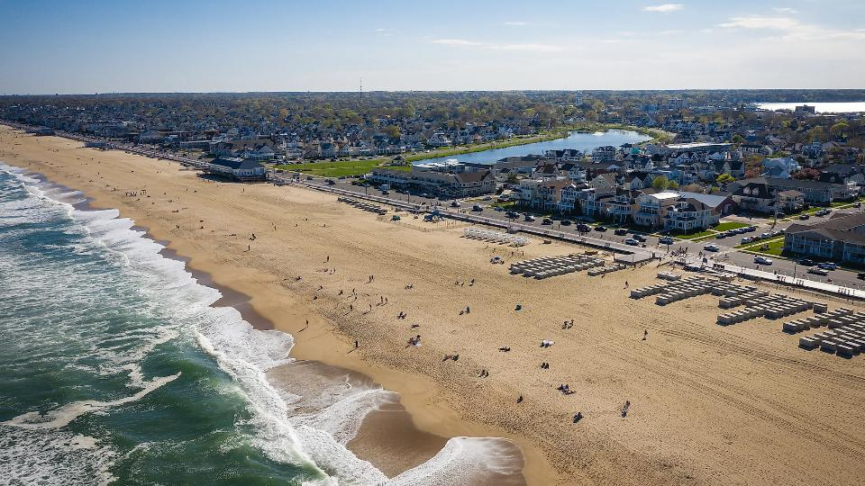
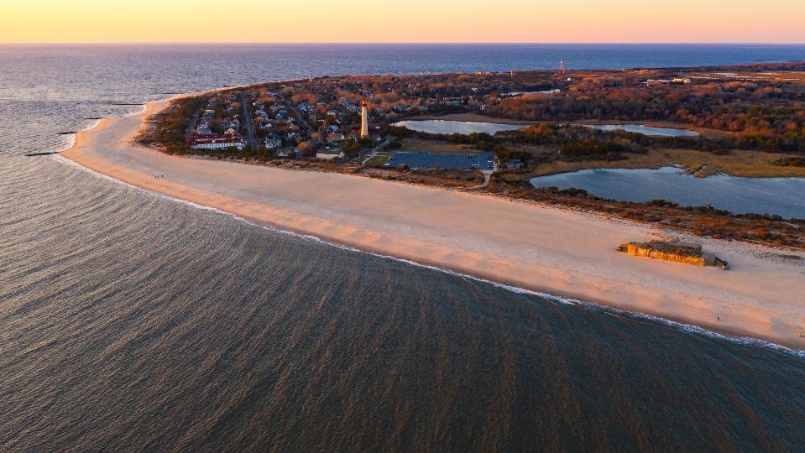


Belmar, NJ
Unlocking the Buildout Analysis for a CCRHVA
Name Barbara Allen Woolley-Dillon, PP, AICP
Title Staff/ Resilience Planner
Office of Climate Resilience | Bureau of Climate Resilience Planning
New Brunswick, NJ
Notes:
Good afternoon, everyone. I am Nick Angarone, New Jersey’s Chief Resilience Officer and manager of the Office of Climate Resilience at NJDEP.
As Chief Resilience Officer, I’m the Vice Chair of New Jersey’s Interagency Council on Climate Resilience and work with 22 state departments and agencies to coordinate state resilience policy, including development and implementation of the Statewide Climate Change Resilience Strategy.
As manager of the Office of Climate Resilience at NJDEP, I oversee the Bureau of Climate Resilience Planning and the Blue Acres program. Much of that work entails providing tools and direct technical assistance to our communities, and working with many of our local partners through coordinated and networked initiatives administered through my office, including the Coastal Management Program.

Slide 2
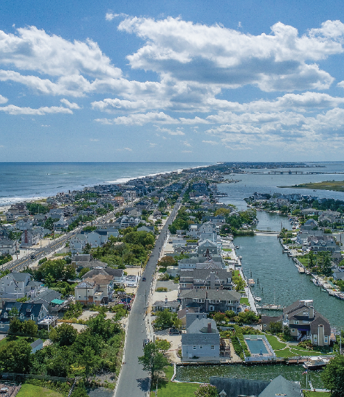


c
Overview
Bay Head , NJ

Slide 3



What Is a Buildout Analysis?
A method for projecting a municipalities maximum development capacity under current zoning.
Projects maximum development capacity under current zoning.
Estimates potential residential and non-residential development.
Helps understand long-term growth patterns and impacts.

Slide 4


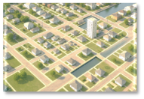

Why Conduct a Buildout Analysis?
Identifies future growth potential
Assess impacts on infrastructure, traffic, schools, etc.
Evaluate natural hazards and climate change vulnerabilities/ risks

Slide 5

Different Purposes
Scenario Planning provides a “snapshot” of growth capacity.
Determine future capacity/ need– schools, water, sewage, traffic, etc.
Calculate capacity of designated growth areas for urban growth boundaries.
Evaluate natural hazards and climate change vulnerabilities/ risks.
For a CCRHVA it is performed to understand where future development will occur and how projected impacts from climate change can affect a community or region.
Notes:
Why conduct a buildout analysis?
Understand future growth patterns
Assess impacts on:
Water / Sewer Capacity
Traffic
School enrollment
Open space, parks, resources
Municipal tax base
Overall quality of life
Evaluate vulnerabilities to natural hazards and climate change risks
Ensure zoning and development regulations align with environmental and hazards data

Slide 6

Planning & Hazard Impacts
Supports
Zoning Ordinances
Informs
Comprehensive Plans
Complies
Required as part of a municipal CCRHVA
Subdivision Ordinances
Flood Plain & Hazard Area Regulations
Long-term Land-use Goals.

Slide 7

Necessary Data
Maps
Parcels
Zoning
Information
Ownership Records
Other
Open Space/ Preserved Areas
Redevelopment Plans
Environmental
Wetlands
Floodplains
T & E Species
Land Uses
Zoning Ordinances
Development/ Building Data
Affordable Housing Plans
Recent aerial maps and images may be helpful to confirm accuracy.

Slide 8

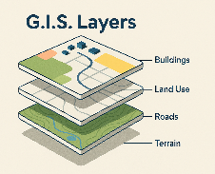
Role of GIS
Enhances efficiency and accuracy
Ability to import multiple existing data layers
Supports scenario testing and climate layer integration
Improves public communication through online mapping

Slide 9

c
Methodology
Bay Head , NJ

Slide 10





1. Document Existing Conditions
Maps
Helpful Information
Development & Zoning Regulations
Redevelopment Plans
Boundaries
Zoning Map
Land Use Map
Development Constraints
Preserved Lands
Roadways
Tax Maps
Recent Aerial Images
Utility Locations
Zoning Regulations
Subdivision Regulations
Flag Lot Provisions
Recent Subdivisions
Recent Building Permits
Redevelopment Plans – not fully built out or where not completed.
Tax Records

Slide 11
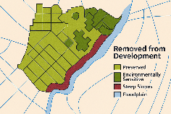
2. Remove “Undevelopable” Land
Developed
Lots containing developed uses without potential for subdivision
Preserved
Public or private recreation
Preserved open space
Constrained
Steep slopes
Preserved farmland
Wetlands and stream corridors & buffers
State & Federally ranked T & E and vernal pools
Floodplains and limits of REAL/ PACT rules

Slide 12

2. Remove “Undevelopable” Land
Developed
Lots containing developed uses without potential for subdivision
Preserved
Public or private recreation
Preserved open space
Constrained
Steep slopes
Preserved farmland
Wetlands and stream corridors & buffers
State & Federally ranked T & E and vernal pools
Floodplains and limits of REAL/ PACT rules

Slide 13

3. Identify Developable Areas
Undeveloped (vacant) land
Underdeveloped parcels and infill areas
Redevelopment zones and approved projects.

Slide 14
4. Estimate Future Growth
Calculate developable land in each zoning district based on minimum required lot area.
Estimate number of dwelling units, size of commercial uses, and industrial uses. Use density, maximum building coverage and/ or floor area ratio (FAR). Provide as a range.
For redevelopment areas, calculate area(s) left undeveloped. Again, determine estimate number of dwelling units, size of commercial uses, and size of industrial uses. If structures will be removed, then deduct dwelling units, size of commercial/ industrial use from calculations.

Slide 15
c
Helpful Information
Bay Head , NJ

Slide 16

Redevelopment Plans
Plans may replace or overlay zoning
Both regulatory layers may need evaluation
Account for demolition when projecting growth

Slide 17


Tips:
Do not assume a post apocalyptic scenario. Do consider vacant lots or underutilized lots that might be subdivided.
Use a range for estimates.
Cannot use buildout assessment from DEP’s Municipal Stormwater Management Plan ( 1 square mile exception).
Remember challenges with Redevelopment Plans.
Isolated undersized lots may be developable. Loechner case is the rule but there are several exceptions.
“Flag Lot” provisions are important.

Slide 18
Resources:
NJDEP| Office of Climate Resilience | Resilient NJ
NJ DEP Open Data
NJ-GeoWeb
NJ DEP GIS App Gallery
New Jersey Wildfire Risk Explorer - Basic Viewer
NJGIN Open Data Portal (NJ OIT)
NJDEP| Climate Change | Tools and Web Apps
NJGIN Open Data Portal (NJ OIT)
Home Page | NJFloodMapper
NJ Tax Records Search

Slide 19

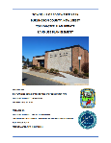
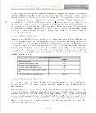


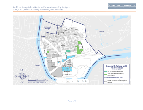
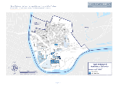
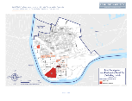
Examples:
Florence Township KM_C554e-20220811131533
Harrison
Edgewater Park
FINAL_EPT_Land_Use_Plan_052021_Signed_Reduced.pdf (pp. 71 & 72)

Slide 20
Cape May, NJ
New Brunswick, NJ
Questions?

Slide 21
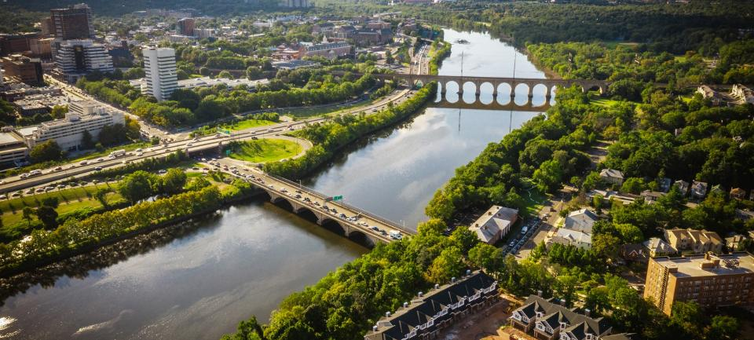






Contact
New Brunswick, NJ
@newjerseydep
@nj.dep
Name Barbara Woolley-Dillon, PP, AICP
Position/Office Staff / Resilience Planner
Office of Climate Resilience
Email Barbara.Woolley-Dillon@dep.nj.gov

