Slide 1
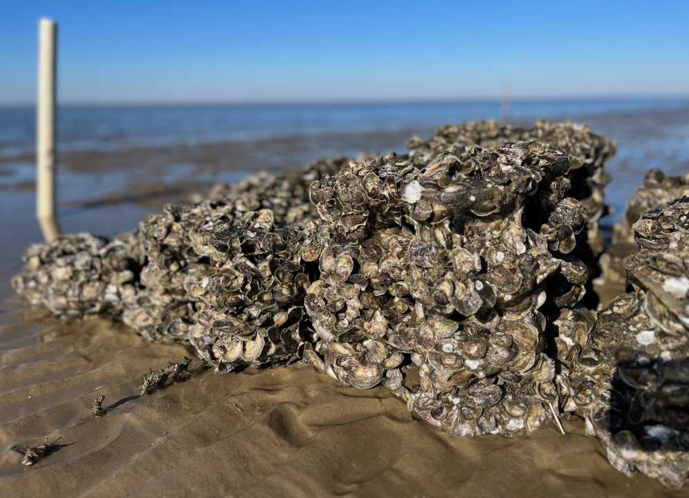













Evaluating Biological and Physical Metrics of a Living Shoreline MosaicTM Approach for Reefense
Jenny P. Shinn, Rutgers University, Haskin Shellfish Research Lab
On Behalf of;
David Bushek, RU
Rebecca Morris, UoM
Ella Rothermel, PDE
Leah Morgan, PDE
Ximing Guo, RU
Kelly Kibler, UCF
Iacopo Vona, UCF
Eric Sparks, MSU
Cynthia E. M. Lupton, MSU
Matthew Virden, MSU
Nigel Temple, USA
Scott Rikard, AU
Jenny P. Shinn, Rutgers University
Haskin Shellfish Research Lab
Notes:
Thank you – I’m happy to have this opportunity to talk about our DARPA Reefense project. You can see from the author list and the collaborating institution logos that this is a big project and I certainly don't aim to take credit for all the hard work of all collaborators. Rutgers University leads a multi-disciplinary, international team of 11 partner organizations in developing the LSM strategy* in response to the DARPA REEFSENSE program. The overarching goal of Reefense was to Develop “self-healing, hybrid biological and engineered, reef-mimicking structures to mitigate coastal flooding, erosion, and storm damage”. The 5-year program started in May 2022 and was supposed to go until May 2027, however, it was prematurely cut short and ended earlier this month. I am going to provide a brief overview of the projects and provide some preliminary monitoring data.

Slide 2
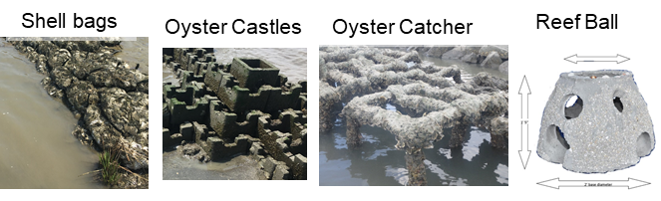
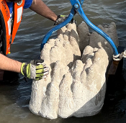
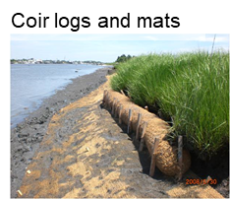
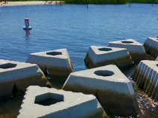
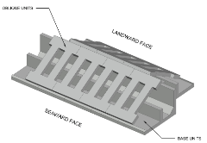
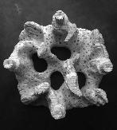
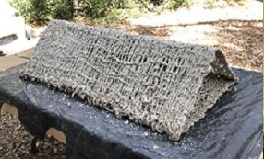
Many materials and structural forms are available to implement in NbS/shellfish enhancement projects…
Natrx ExoForms
WADS
Reef Prism
Quick Reef
Grow Reef tiles
Notes:
I’m sure many of you know that there is an array of materials available and ways to deploy them. DARPA was as well but was also aware of how the innovation has advanced faster than the science or the engineering, so the Reefense Program is a challenge to get ahead of that curve and provided opportunities for accelerated and deliberate research and development.

Slide 3
Project Timeline: Installation and Monitoring
May 2022
Project Started, research and development begins
October 2024
All permits finalized
November 2024
Main breakwater reef construction completed in approx. 2 weeks
February-March 2025
Smaller patch reefs and vegetation installed (mosaic habitats) in several events
March-October 2025
Monitoring
November 2025
DARPA Project ends and Reefense Collaborative formed to continue work
Notes:
Brief overview of the timeline of the project to set the stage, but I will mostly focus on design and monitoring aspects. There was extensive research and development that informed all components of the project including the reef materials, design and construction, but I won't have time to share those results today.

Slide 4
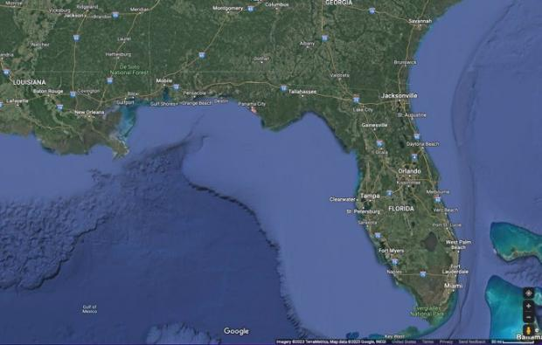
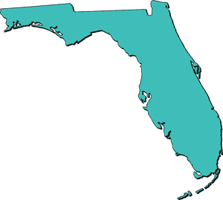
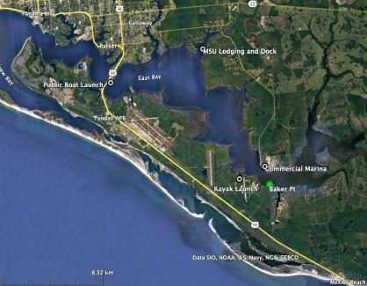
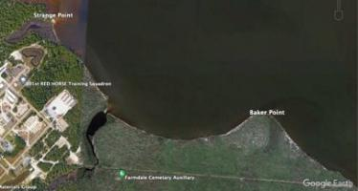
Test site: Bay County, East Bay of St. Andrew Bay, Florida
Project site
Baker Point, Tyndall Air Force Base, Panama City, FL
Shoreline of East Bay (St. Andrews Estuary)
Devasted by Hurricane Michael in 2018
Baker Point
Mosaic site
Notes:
Baker Point site
Maximum erosion rate 25 cm/yr since 1968

Slide 5
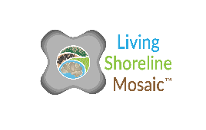
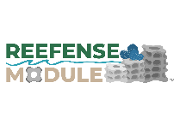
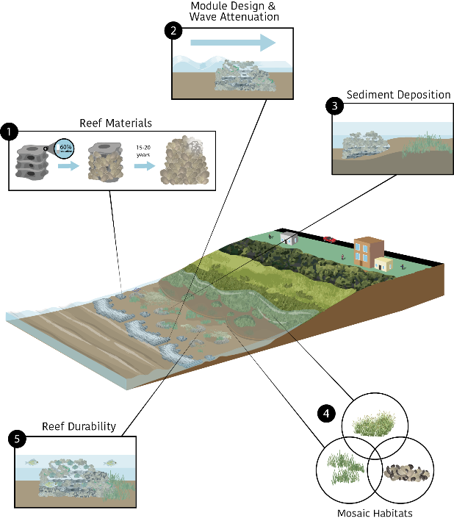
1. Reef Materials: Novel concrete materials are under development to create materials that have one or more attributes: sustainability, durability, and biodegradability.
2. Module Design and Wave Attenuation: Perforated concrete Reefense Modules nest together to dissipate wave energy by up to 92% while promoting biological colonization.
3. Sediment Deposition: The LSM design integrates physical processes, like sediment transport and deposition, to support the ecology of foundation species across multiple nearshore elevations.
4. Mosaic Habitats: LSM design creates hydrodynamic conditions favorable for vegetation and shellfish, thereby creating a seascape of interconnected habitats supporting processes that increase shoreline resilience.
5. Reef Durability: The colonization and persistence of calcareous-forming organisms, such as oysters, on a reef structure increases reef durability. Persistence is facilitated by design features that provide natural protection of juveniles from predation, while genomic selection enhances disease resistance under changing environmental conditions.
Notes:
The LSM strategy that our team came up with I response to the Reefense call incorporates novel reef materials in a modular design to attenuate waves, facilitating sediment deposition, and supporting a suite of mosaic habitats that collectively enhance the durability and resilience of the shoreline.

Slide 6
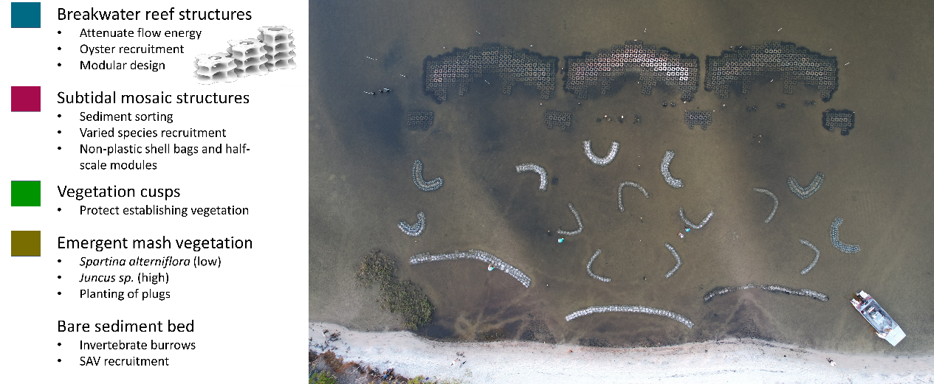
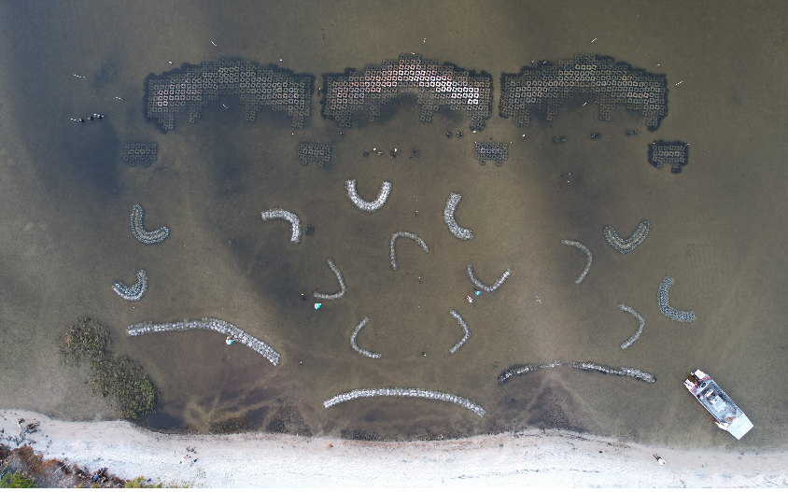
Living Shoreline Mosaic Design and Structure
20 m

Slide 7





















Living Shoreline Mosaic Design and Structure
20 m
Notes:
In order to test the LSM strategy, a pilot field location was chosen at Tyndall Air Force Base in Panama City, Florida (Fig. 2). Observations and data from field visits nearby were used to select target species and goal elevation ranges for habitat mosaic components. The final LSM design consisted of both subtidal and intertidal structures to promote habitat diversification at the site (Fig. 3). Complimentary living aquatic habitats integrated spatially to create a patchy habitat mosaic. Elevation gradient from channel to upper intertidal governs species’ placement based on hydrodynamic habitat preference. Intertidal reef – crest at MWL.

Slide 8
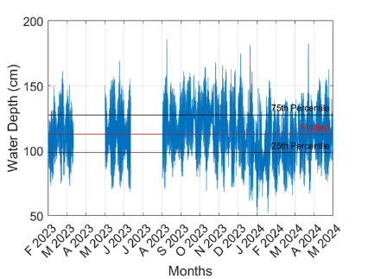
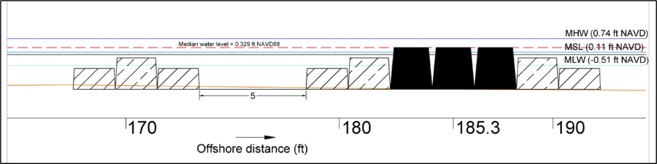
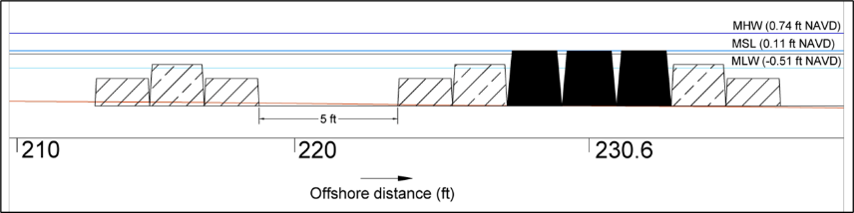
Which design water level? yesterday’s, today’s or tomorrow’s?
Yesterdays water level: NOAA (Panama City gauge) tidal epoch MSL = +0.11 ft (+0.03 m) NAVD
Today’s water level: median water level measured prior year on site = +0.329 ft (+0.10 m) NAVD
  Vertical difference = 0.219 ft (6.7 cm); Horizontal difference (relative to shoreline) = 45.3 ft (13.8 m)
56.5 m from shoreline
water level measured on site with Nortek Signature over the year prior to design
70.3 m from shoreline
Kelly Kibler, University of Central Florida
8
Notes:
Just wanted to take a minute to mention a decision that our team had to make regarding reef placement water level. We made the decision to install the main reef structure at measured water level because our project was being evaluated in current time, not future time.

Slide 9
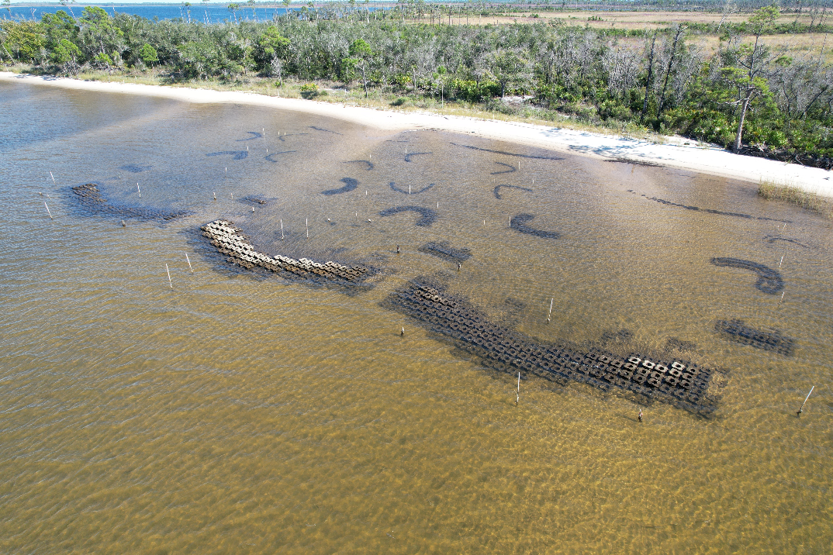
Eric Sparks, MSU

Slide 10
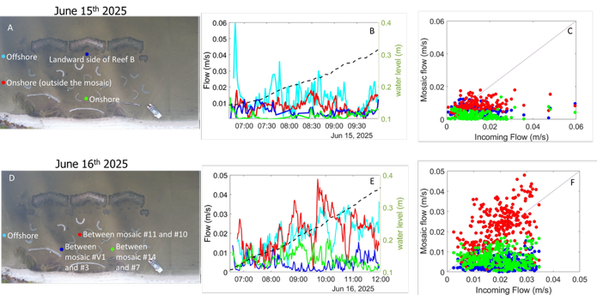
Long-shore flow configuration 1
Long-shore flow config 2
Instrument deployments, flow and water level time-series, and flow attenuation relative to incident flow in the cross-shore (A-F) and along-shore (G-L) directions.
Flow attenuation in both onshore and longshore directions
Kelly Kibler
Iacopo Vona
Notes:
Overall, the Reefense project appears to be working well in increasing shoreline resilience, as attenuation of flow velocity and turbulent parameters within the LSM was observed compared to the baseline data. Extensive monitoring occurred in the year or so before installation and for about 7-12 months after the main structure was installed. Incoming flow velocity was reduced up to 95% within the LSM. Compared to the baseline data, flow attenuation was 30% higher after Reefense installation. Turbulent energy was reduced up to two order of magnitude compared to the baseline data. Moreover, such flow and turbulent attenuation has led to enhanced sediment retention.
Achieved over 80% in wave flume using the bare modules
Achieved up to 92% in the wave flume using oyster-laden modules. Demonstrated that module orientation within the reef has negligible influence

Slide 11
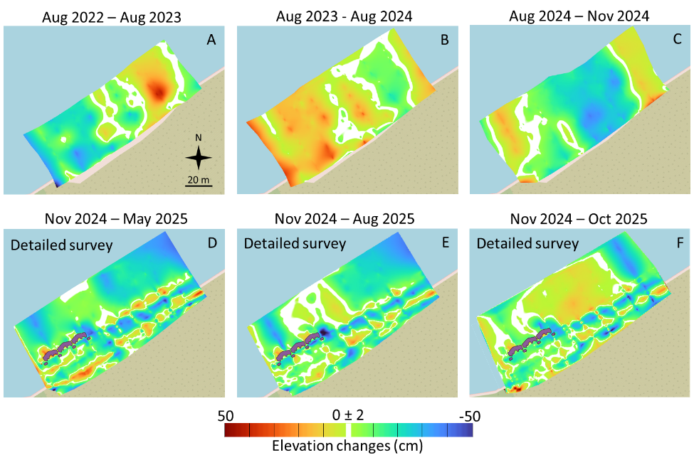
Observed Elevation Changes
Sediment deposition within the LSM installation area with some erosion detected landward of the breakwater structure.
Flow attenuation in both onshore and longshore directions
Areas of localized flow acceleration within the mosaic habitat
Organic matter in core samples increased after the project installation compared to control
Kelly Kibler
Iacopo Vona
Elevation changes at the reef and near-reef site from 2022 to 2025. Deposition (elevation gain) is indicated in red, and erosion (elevation loss) is indicated in blue.
Notes:
Breakwater installation completed in November 2024. Patch reef, and vegetation planted in February-March 2025.

Slide 12




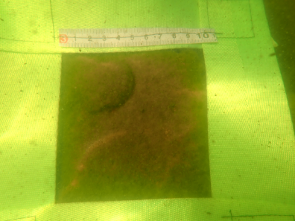
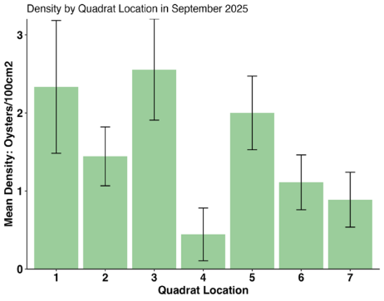
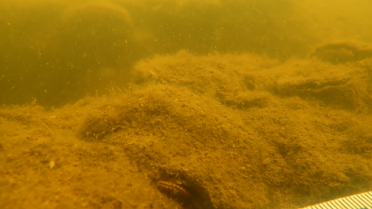
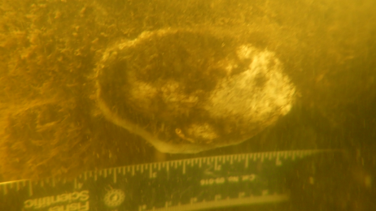
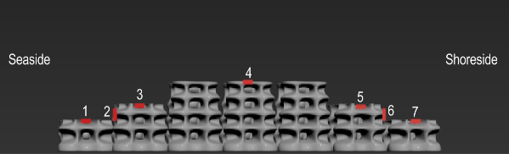
Monitoring recruitment of oysters and other organisms on the reef
Hooked mussels were observed colonizing the reef, among the oysters
70 mm oyster on the reef
Bayside
Notes:
When we look at early reef establishment, The quadrats were placed at seven locations spanning the seaside base, crest and shoreside base of the reefs. This is looking at a side profile of the main breakwater structures. The following data were recorded from each quadrat: number of live oysters, number of dead oysters, shell height of five oysters, number of mussels, percent cover of algae, barnacles or other sessile organisms.

Slide 13
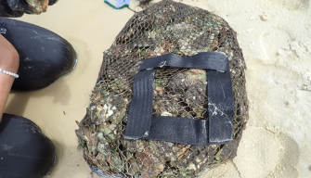
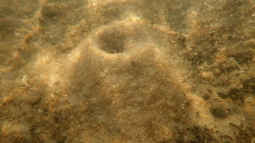
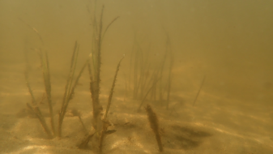
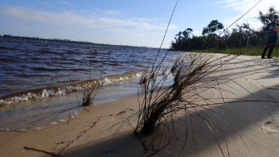
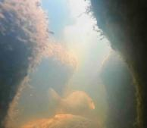
Assessment of mosaic components
Structural Integrity and Burial
Most mosaic structures 20-50% buried
Structural integrity of mesh materials are good, most observed damage likely occurred during construction
Oyster Recruitment
Randomized shell bag deconstruction revealed much higher densities
  10x10 surface counts may describe only 0-16% of the actual oyster abundance
Burrow Hole Density
No significant differences in counts between treatment and control
  Spatial hotspots were visible and reef not not decrease burrow density compared to control site
Presence of SAV
SAV observed in July 2025 no longer present in September 2025
New shoots were observed in 2 locations
Vegetation Density
Patches of planted Juncus decreased in
area but stable
Planted Spartina plugs did not persist
Notes:
The LSMTM components were successfully installed in February and March of 2025 and have shown initial success in terms of sediment deposition, habitat creation, and overall durability. However, since LSMTM materials had been deployed for less than a year when final monitoring occurred, all habitat enhancement results should be considered preliminary. Biota such as marsh grasses, submerged aquatic vegetation (SAV), and shellfish may take multiple years to fully establish and reach maintenance population levels. Vegetation planting at the control area had a zero percent survival rate; however, plants within all three vegetation cusps of the reef area remain growing; seemingly due to the protection provided by the structures. SAV naturally recruited to the LSMTM and was observed at multiple time points but seemed to be ephemeral.

Slide 14
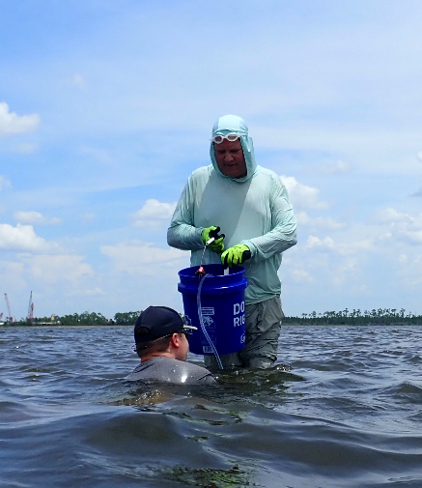
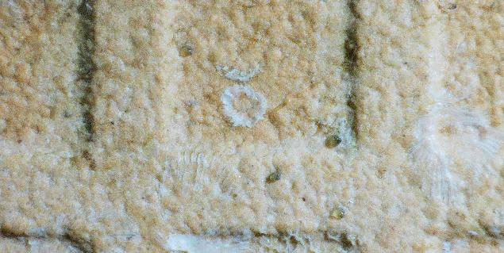
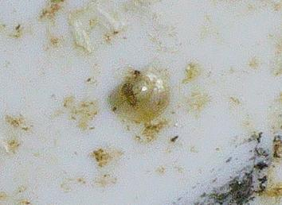


40 million FLGS25 larvae were released onto the reefs
*First FL approval to release genomically selected oysters
FLGS larvae observed as set on tiles placed breakwater within 24 hours of release
Ximing Guo
ZhenWei Wang
Jerome La Peyre
Sandra Casas
Scott Rikard
Mason Williams
A hose and bucket were used to create a siphon to disperse larvae onto the structures beneath the surface.
Notes:
Samples of young oysters were collected off the reef last fall and several of the sampled oysters were positively confirmed to be from this stock of oysters planted on the reef.
Achieved 76.9% increase in overall survival after two generations and an increase in growth of 25%. Genetic evaluations demonstrated that F3 genomic-selected lines maintained high genetic variation with only minimal differences from wild populations, confirming their suitability for local restoration without significant risks of inbreeding or genetic differentiation.

Slide 15
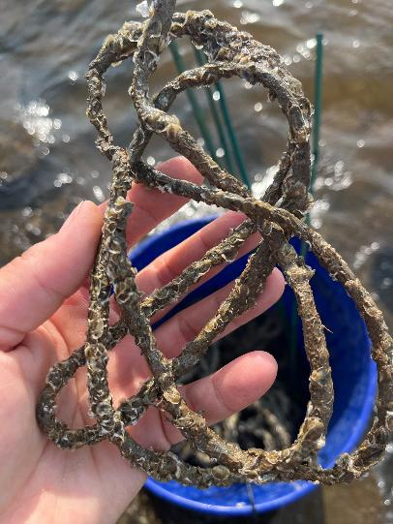
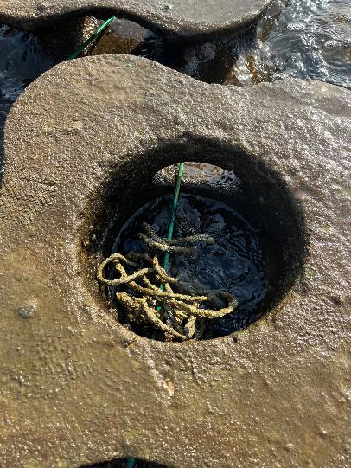
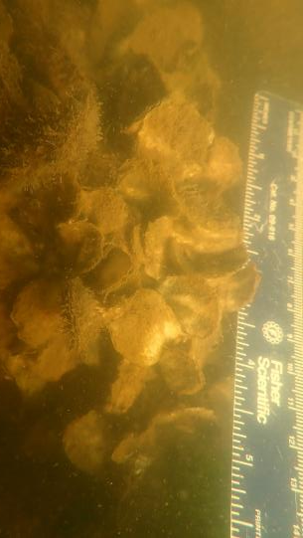
400 Oyster CatcherTM Tufts seeded with FL wild oyster spat were deployed 7/21/25
Scott Rikard
Mason Williams

Slide 16
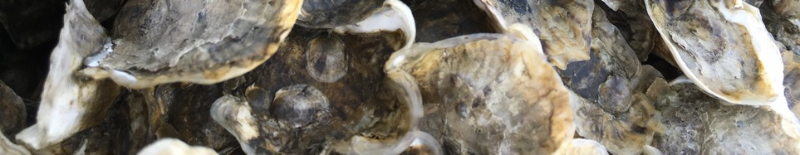
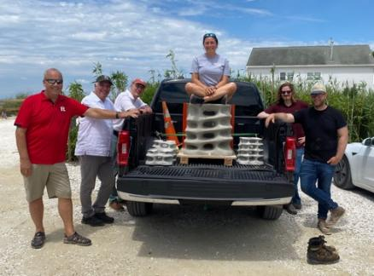

Questions?
Jenny Shinn
Field Researcher III
Haskin Shellfish Research Lab
Rutgers University jenny.shinn@rutgers.edu

Slide 17
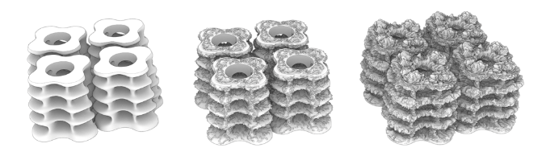
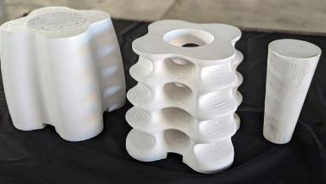
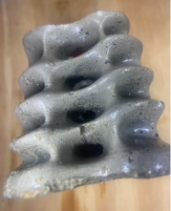
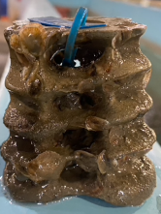
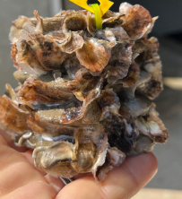
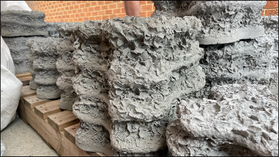
Tested occlusion by oyster colonization
(courtesy Hongwei An & Scott Draper)
Module colonization in the annular flume matched predictions
Figure 7． Configuration 1 with oyster bags, final scour profile with U = 0.2m/s.
Notes:
On going work at UWA includes modelling and testing what happens as they reefs become colonized or completely filled in. As you can see, the units from the annular flume study mimicked what is predicted. UWA created occluded units to test wave attenuation impacts first by simply filling in the holes and secondly by creating 3D printed modules from 3D modelling of colonized modules.

