Slide 1
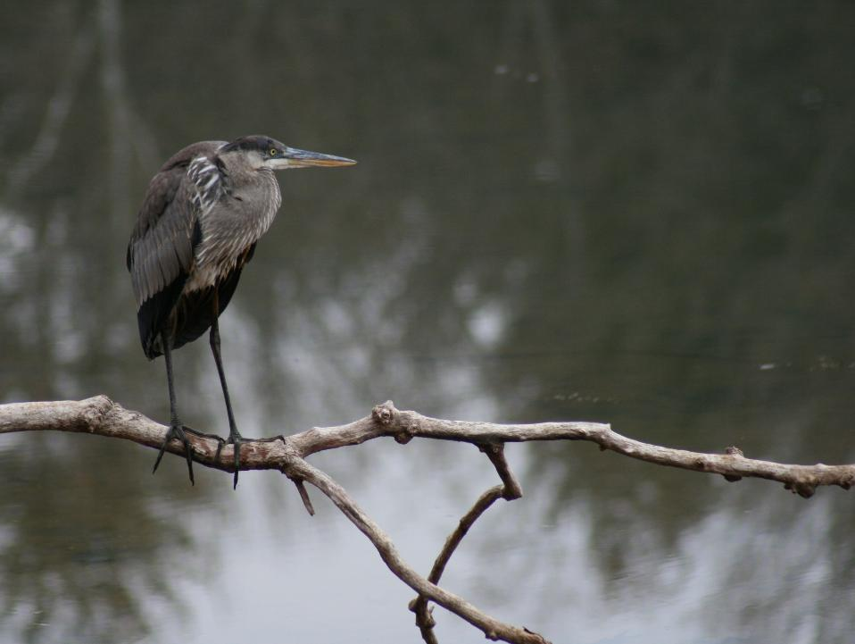

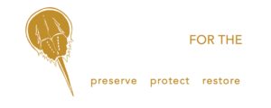
Nature as a Key Stakeholder in Resiliency Planning
New Jersey Coastal and Climate Resilience Conference
March 9-11
Mike Trumbauer, CERP
Principal Restoration Ecologist
Biohabitats, Inc.
mtrumbauer@biohabitats.com

Slide 2
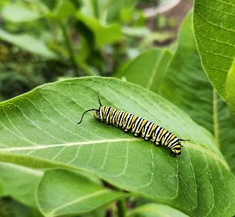
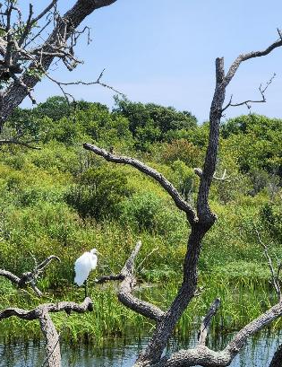
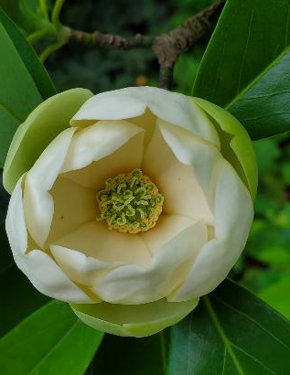
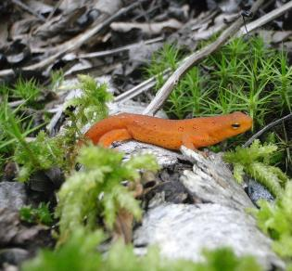
What is nature?
Notes:
Pause on this. Think of your definition of nature…plants…animals…processes…life

Slide 3
What is nature?
Nature
noun (Life)
all the animals, plants, rocks, etc. in the world and all the features, forces, and processes that happen or exist independently of people, such as the weather, the sea, mountains, the production of young animals or plants, and growth (Cambridge Dictionary - https://dictionary.cambridge.org/)
Notes:
I found this definition, ..,”exists independent of people”. So nature does not need us? We certainly need nature.

Slide 4
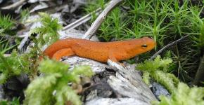
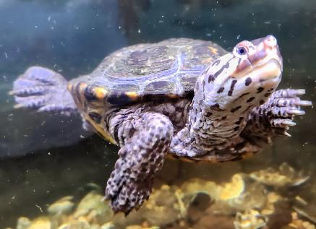
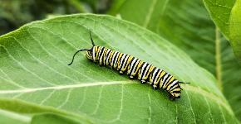
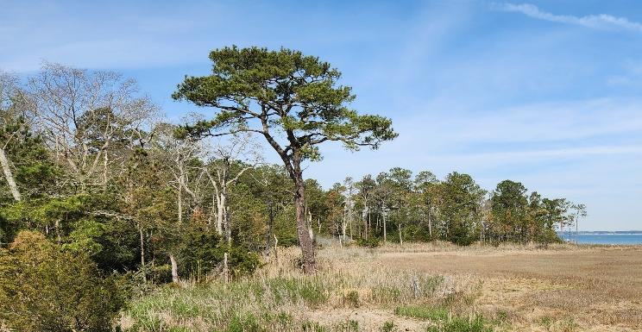
What does nature need?
It depends who you are.
Diamondback terrapin
Red spotted newt
Monarch caterpillar
Maritime forest
Saltmarsh
Notes:
A diamond back terrapin lives and breeds in brackish water, but needs to come on shore to nest so it needs natural shorelines. Which is much different than monarch caterpillar that feeds exclusively on milkweed. But a monarch needs ample nectar and milkweed across the landscape to support a multigenerational migration cycle. A salt marsh needs the right mix of tidal water, sediment and nutrients thrive.

Slide 5
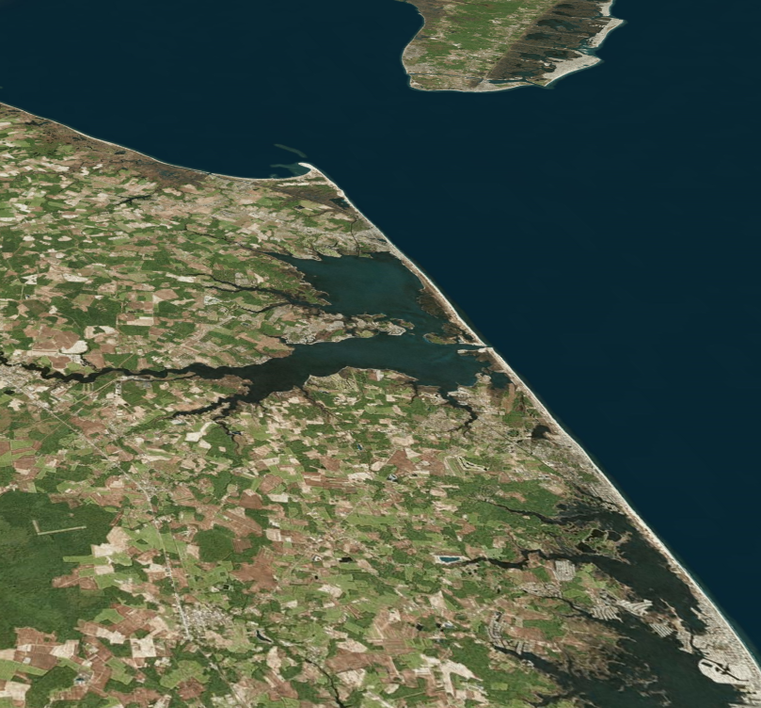
Why does nature need a voice?
The reality of the Anthropocene:
70% of all ice-free land has been altered¹
More than 1/3 of all plant & animal species at risk of extinction²
41% of ecosystems at risk of collapse²
https://www.un.org/en/climatechange/science/climate-issues/biodiversity
https://NatureServe.org
Image: Bing Maps
Notes:
Within the last century we’ve entered the Anthropocene, where our actions are strongly influencing the earth’s systems

Slide 6
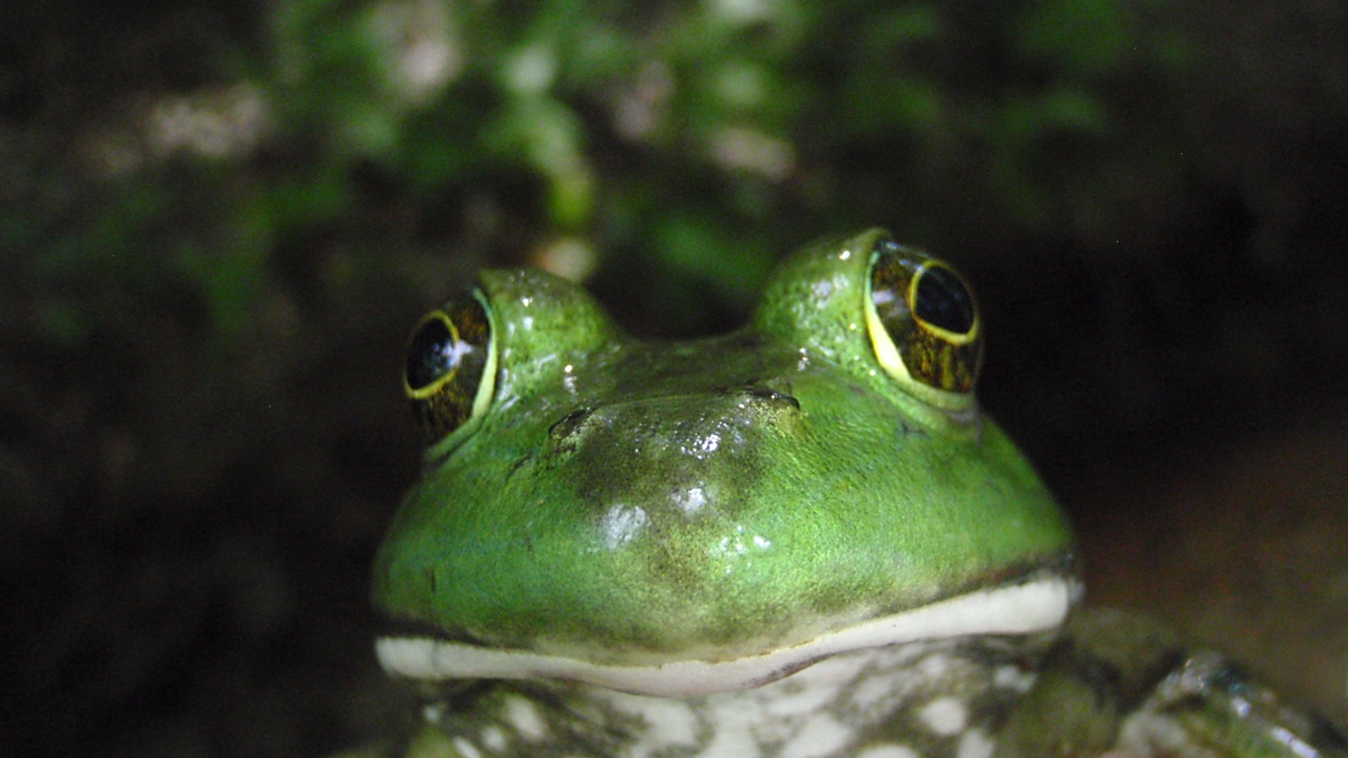
Nature has a significant stake
Not in my back pond

Slide 7
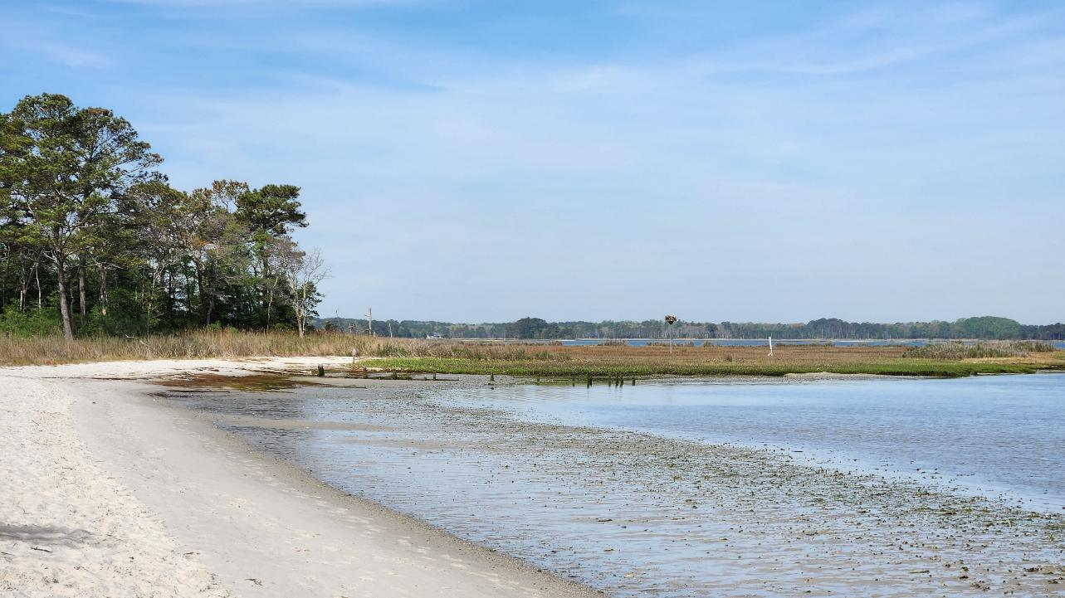
Case Study: Delaware Inland Bays Habitat Management Plan
Conserve and restore a healthy and diverse mosaic of habitat types to protect the biodiversity of the Inland Bays in the context of a changing environment.

Slide 8
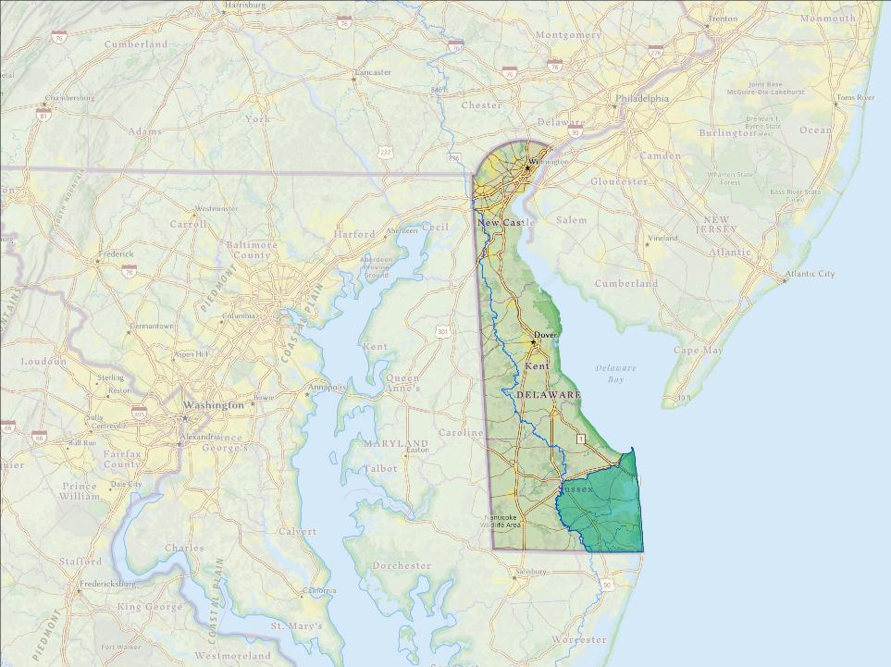
Delaware Inland Bays
Indian River Bay
Rehoboth Bay
Little Assawoman Bay
Barrier Island
292 sq. mi. watershed
Notes:
Three shallow estuaries connected separated by a barrier island system with one inlet. The bays are fed by a 292 sq. mi watershed.

Slide 9
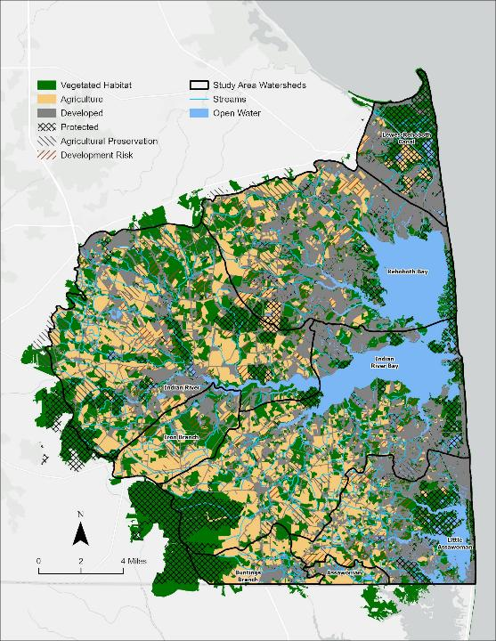
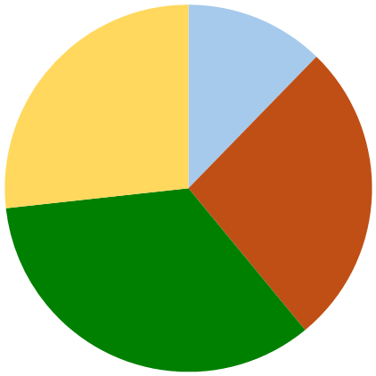
Generalized habitats of the Inland Bays
Open
Water: 12%
Agriculture: 27%
Developed
27%
Vegetated
Habitat: 34%
Notes:
The general habitats types consist of 12% open water habitat that transitions to a relatively even distribution of developed, agriculture, and naturally vegetated land. What is important to not is the arrangement of the habitats in the watershed, with the developed land represented in gray occupying the majority of lands bordering the bays and the ag and veg dominating the upland mosaic.

Slide 10
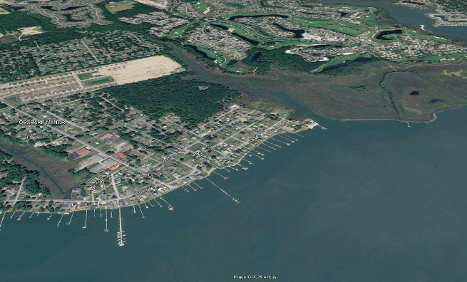
Generalized habitats of the Inland Bays
Perspective on 87 square miles of developed land
Image: Google Earth
Notes:
Putting these development patterns in perspective, there are a couple of typologies. First we have the typical shoreline development right to the waters edge. Then we have some intact marsh that transitions to upland and quickly to the developed edge. Few intact gradients exist from bays to marsh to riparian forest to upland forest without being disrupted by developed land

Slide 11
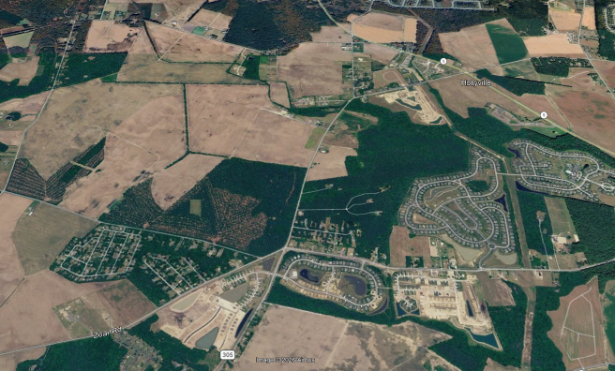
Generalized habitats of the Inland Bays
Perspective on agricultural and vegetated habitat
Image: Google Earth
Notes:
Similar patterns existing on the agricultural and vegetated habitat landscape where there a distinct patches of each with hard defined edges between. With development also encroaching

Slide 12
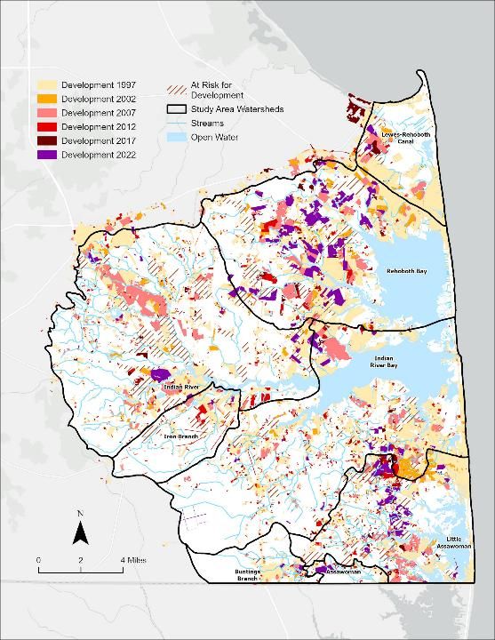
Land Development Patterns
Notes:
The threat of development is ongoing in the bays, with developed land increasing by nearly 40 square miles in 30 years with all watersheds now exceeding 10% developed land which is the threshold that often triggers degradation of water quality and watershed adjustment

Slide 13
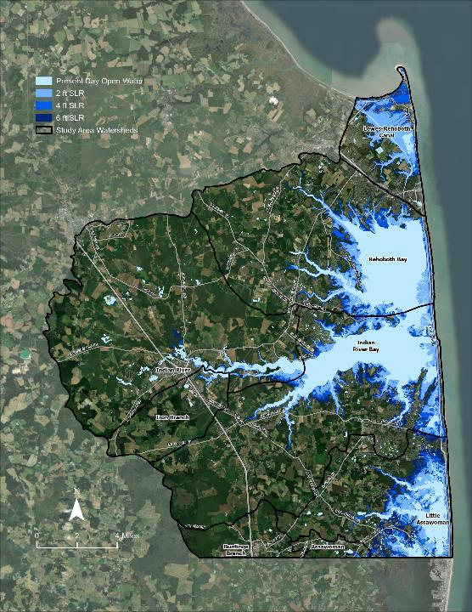
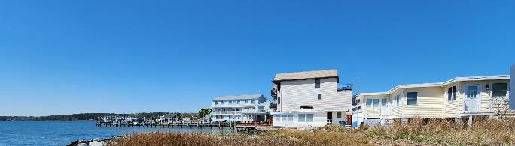
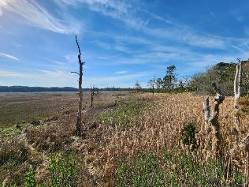
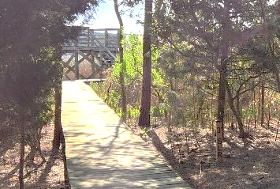
Sea level rise
Increases of 1.5’ by 2050 and 3’ by 2100 are likely
Notes:
Sea level rise not only threatens our costal communities that are common throughout the bays, but we currently watching our forest retreat with low quality phragmites encroaching on the fringes of coastal marshes a process that will continue as you can see in the photo with the 3’ SLR marker

Slide 14
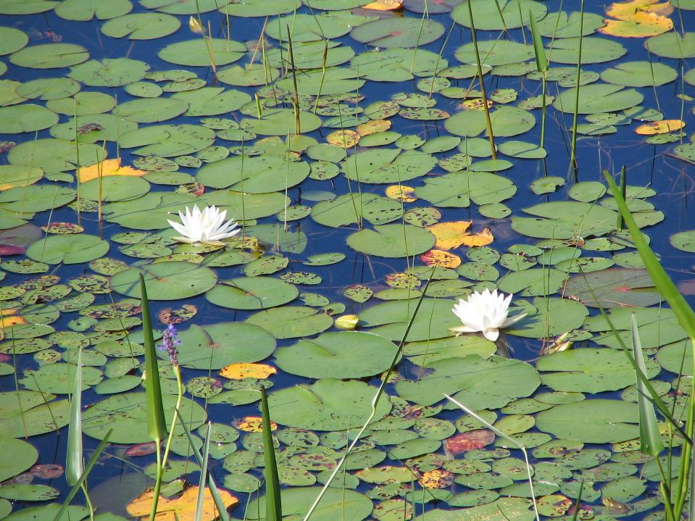
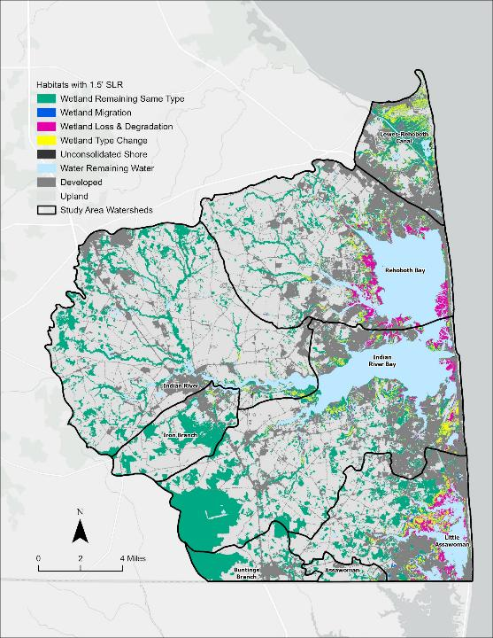
Wetland loss & conversion
Notes:
Also wetland loss and conversion are driven by SLR. Monitoring shows that the Bays tidal marshes are not keeping pace with SLR and 6.5% of wetlands are projected to be lost by 2050. This is largely due to the conversion of high value vegetated marsh to unconsolidated shore which essentially a drowned marsh.

Slide 15
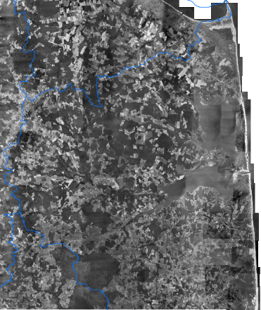
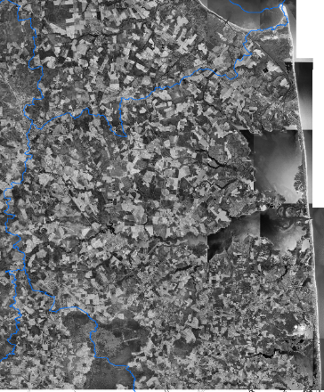
Habitat loss
Patterns of loss matter
Inland Bays’ watershed
1954 land cover pattern
Inland Bays watershed
1997 land cover pattern
Notes:
In addition to lost habitats, the patterns of habitat loss can impact habitat quality. The black and white images represent the bays in 1954 and 1997. In the 1954 image there are expansive contiguous tracts of dark which represent forest and in 1997 those dark patches are much small and more diffuse.

Slide 16
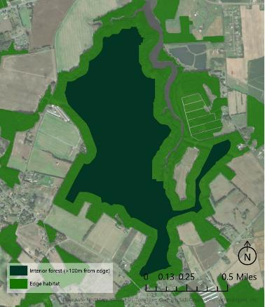
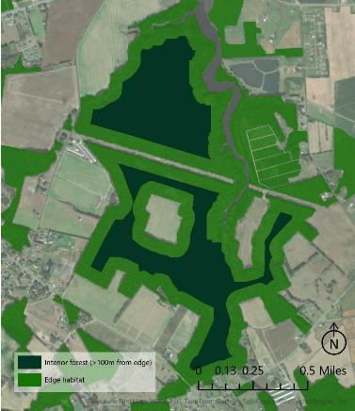
Habitat loss
Patterns of loss matter
Pre-development
interior & edge conditions
Post-development
interior & edge conditions
Notes:
Zooming in to the patch level patch size and shape are important. On the left, you can see a large dark green patch representing a forest interior surrounded by light green forest edge. On the right you can see where a road bisects that forest interior significantly increasing the edge and decreasing the interior space. Additionally, the edge-area ratio influences patch quality as some of those narrow fingers of interior habitat only provide nominal value because the resulting interior habitat is simply are not large enough to sustain interior dwelling species.

Slide 17
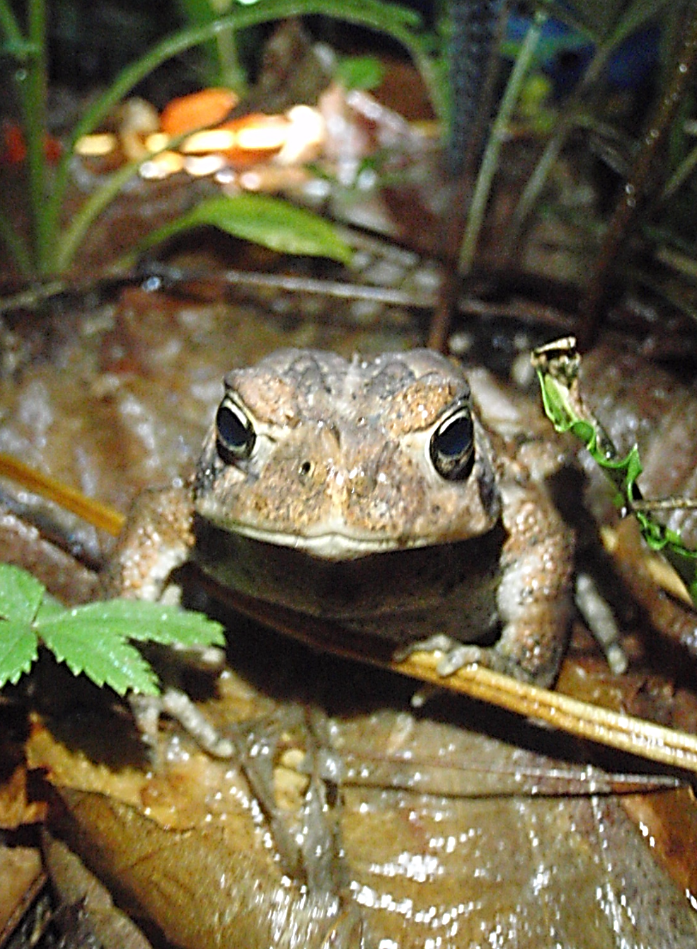
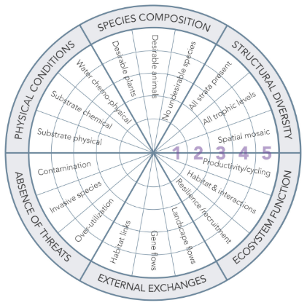
What would nature advocate for?
Society for Ecological Restoration Recovery Wheel (Gann et al. 2019)
Notes:
As this toad suggests, the 6 key ecosystem attributes represented in the Society of Ecological Restoration’s recovery wheel. … Are a great way to benchmark and track ecosystem function at the patch or project level.

Slide 18
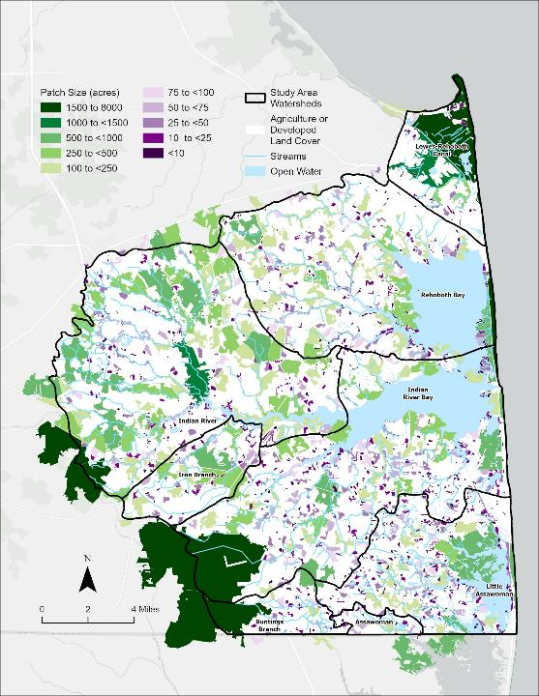
Space for Habitat
Habitat loss and conversion is the primary threat to biodiversity in the Inland Bays
Most species of greatest conservation need (SGCN), specifically birds, require large contiguous patches of habitat
Notes:
At a landscape level, Nature might advocate for space for habitat. …

Slide 19
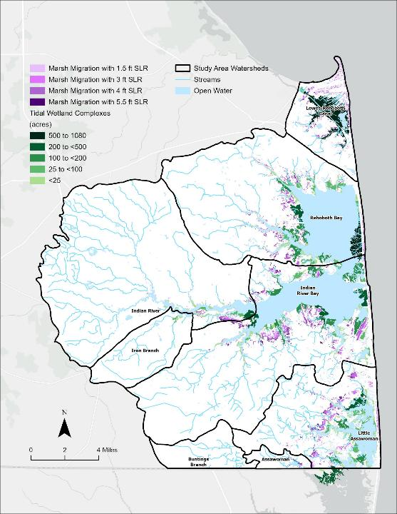
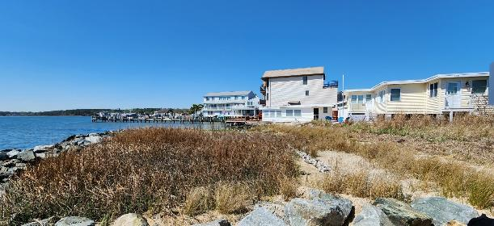
Space to adapt & migrate
Hardened shorelines and developed lands restrict nature’s ability to naturally migrate habitats along the upland gradient
Notes:
… The colored areas on the map to the right represent where there is move for natural habitats to migrate along the upland gradient. The abundance of white on the edges of the bays generally represents where development is impeding the migration.

Slide 20
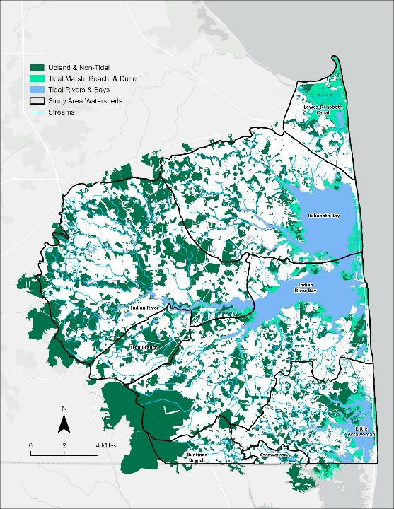
Diverse habitat mosaic
Habitat needs vary among species and life stage
Notes:
… Different species need different things at different times. A total of 608 SGCN make their homes in the inland bays and use a variety of habitats as represented in the tables. There are also a number of habitat specialists like the salt marsh sparrow that only existing in one habitat and when the salt marshes decline, so do the sparrows.

Slide 21
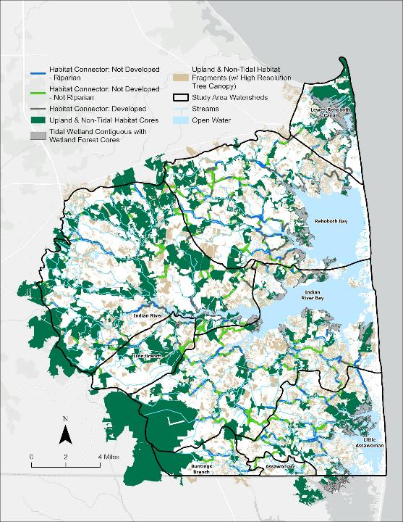
Connected landscapes
Roads, right of ways, and changes in land use affect how species move across the landscape
Species move more freely among connected patches of similar type and quality
Notes:
The map to the right starts to highlight opportunities to reconnect the largest and most valuable natural habitats.

Slide 22
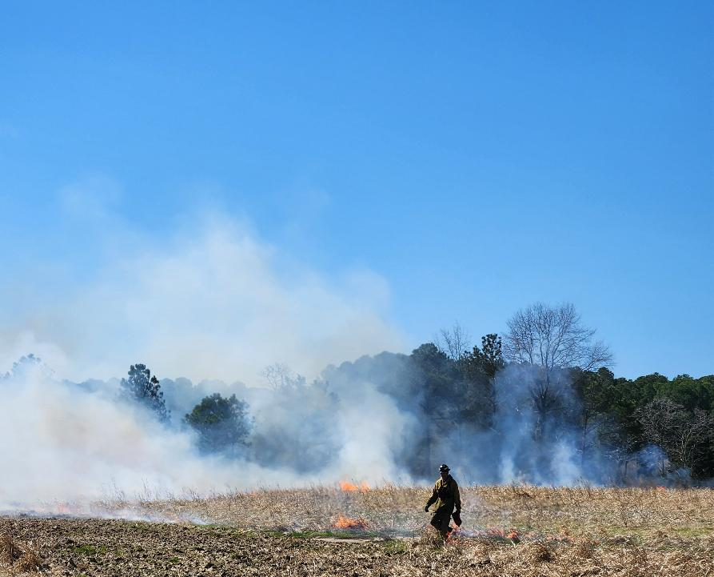
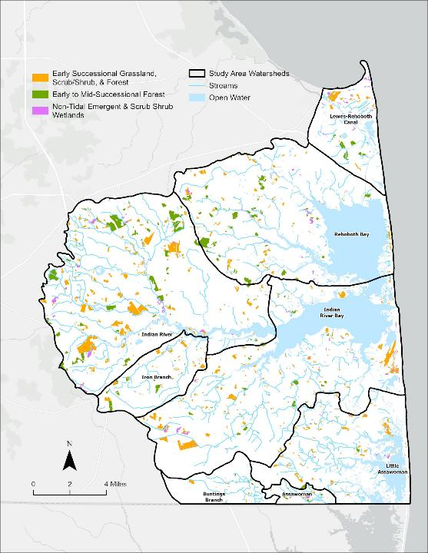
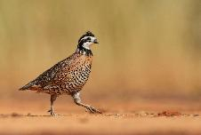
Natural lands stewardship
Active management is necessary to sustain early successional, tidal marsh & other habitats where natural processes have been disrupted or lost due to factors like fire suppression and accelerated sea level rise
Credit: Adobe stock
Notes:
… The northern bobwhite had been in decline due to habitat loss and changes in agricultural practices; however, they are now recovering due to efforts to restore habitat and introduce prescribed fire as a means of sustaining early successional grasslands.

Slide 23
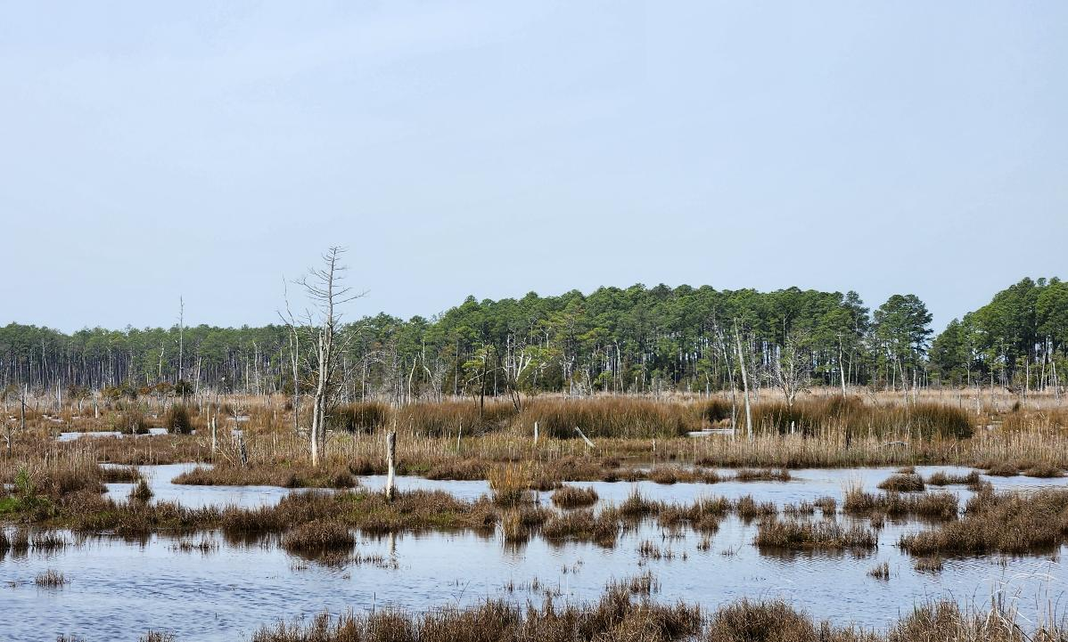
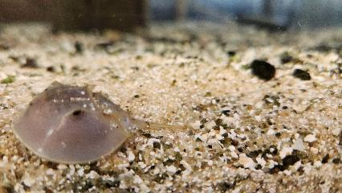
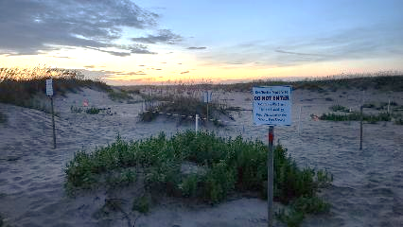
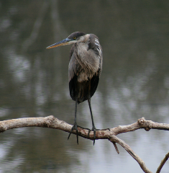
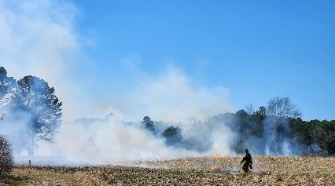
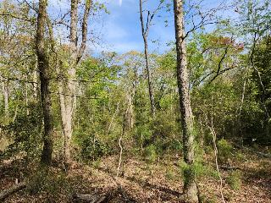
Healthy habitats
Clean rivers and bays
Regenerating natural forest communities
Well managed early successional lands
Undisturbed and safe breeding, nesting & brooding sites

Slide 24
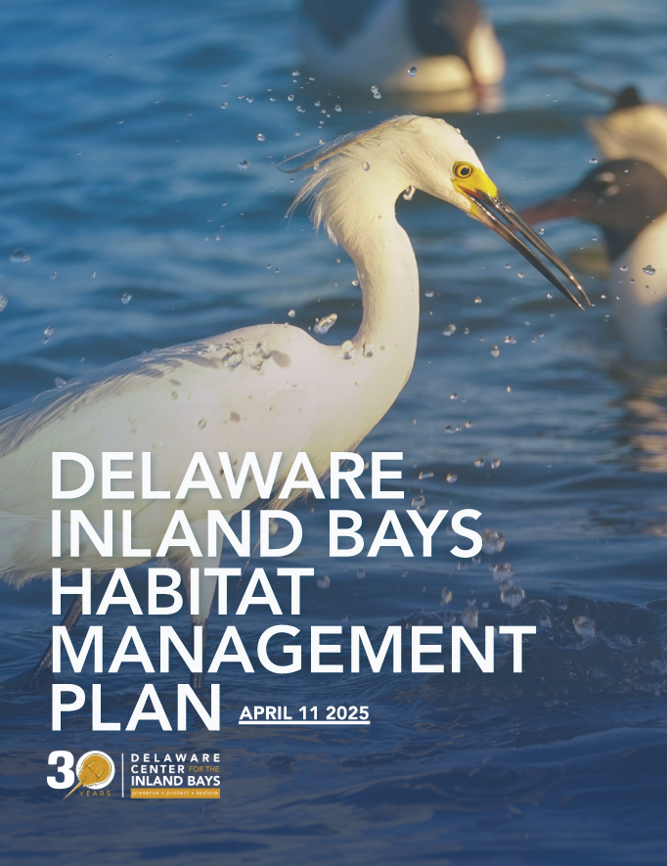
A diverse network of connected natural lands
Soaks up water
Processes nutrients and contaminants
Stores carbon
Regulates temperatures
Buffers shorelines
Supports diverse plant and animal communities
Adapts to climactic variables
Notes:
These are all benefits to society

Slide 25
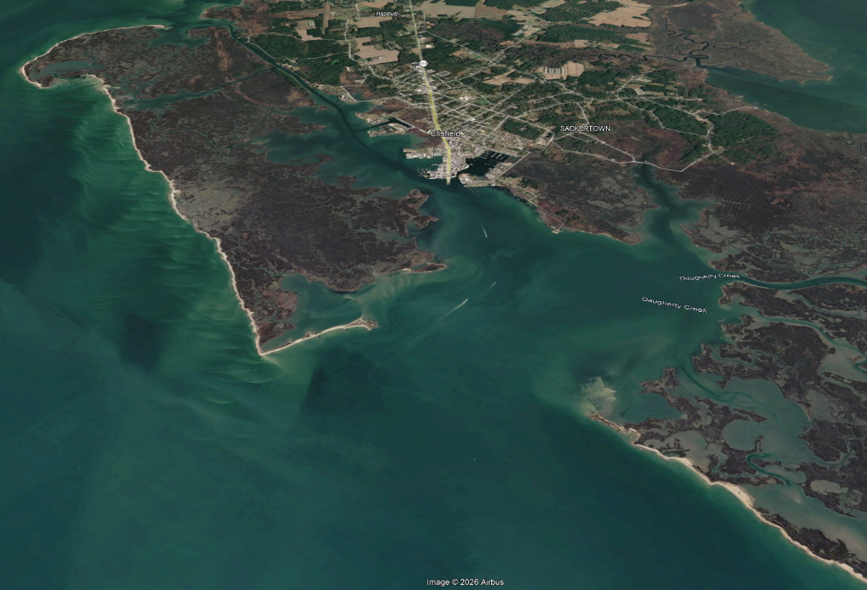
Nature can protect our communities…
“Nature-based solutions (NbS) are actions that protect, sustainably manage, and restore ecosystems to address societal challenges like climate change, biodiversity loss, and disaster risk.” (Google AI)
Image: Google Earth
Notes:
Nature can also more directly provide protection for our communities. The expansive marsh network buffers this coastal community from the waves and tides and it can be restored to benefit our communities and nature.

Slide 26
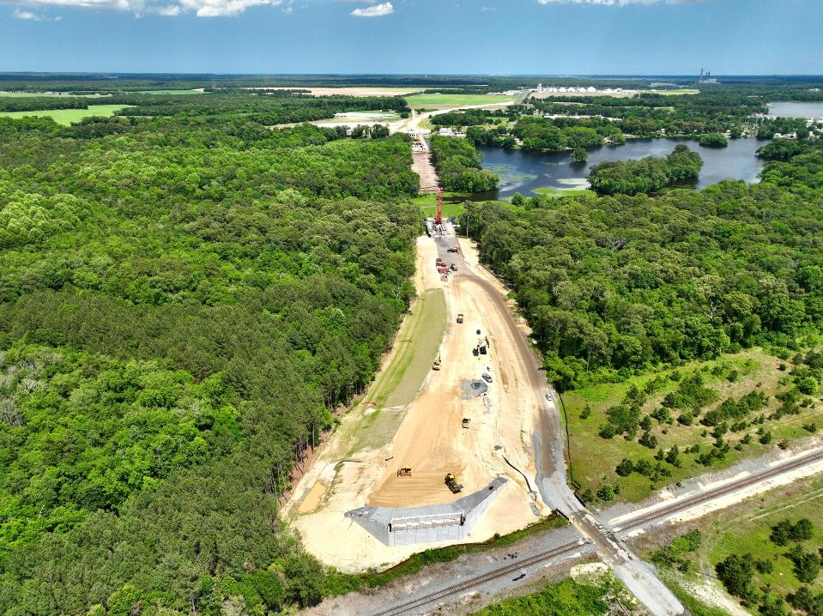
…but natural communities also need our protection
Image: Driscoll Drones
Notes:
Our actions, even well intended ones have actions.

Slide 27
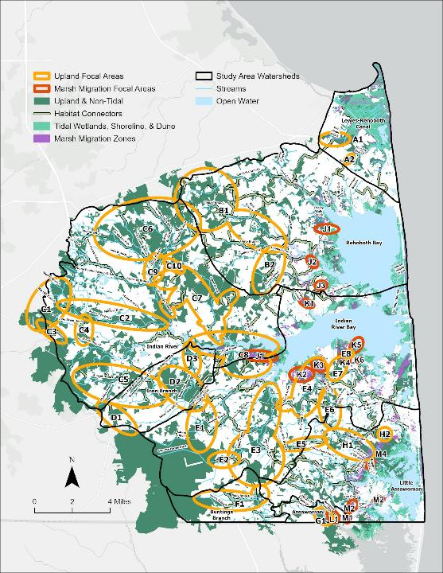
Layering in natural lands conservation & stewardship into resilience planning adds value & benefits all life
Notes:
We need to make space for nature. … The map to the right highlights a network of ecologically significant focal areas that will provide for nature. The habitat plan identifies conservation, stewardship, restoration and policy actions to support and build this network.

Slide 28
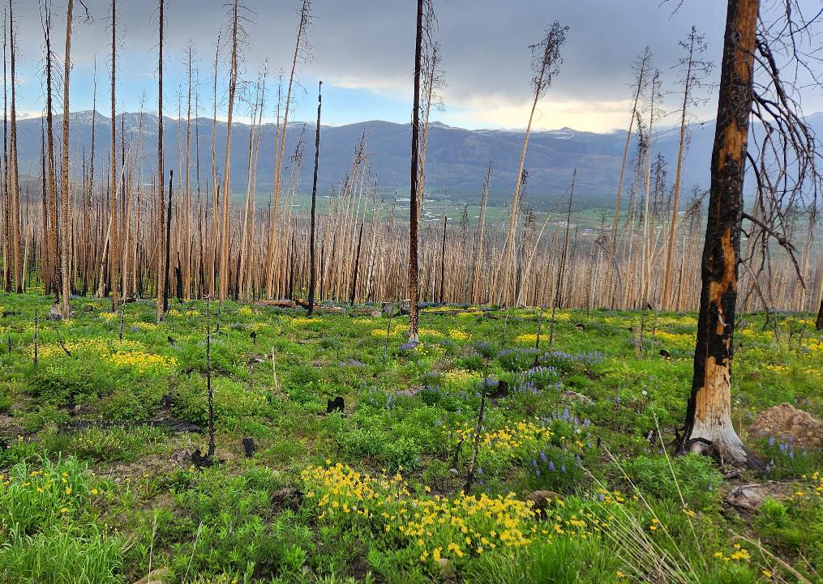
With our help, Nature will not just endure the Anthropocene, but it will thrive
Natural recovery after East Troublesome Fire, Grand Lake, CO

Slide 29
With our help, Nature will not just endure the Anthropocene, but it will thrive
Questions?
Mike Trumbauer, CERP
Principal Restoration Ecologist
Biohabitats, Inc.
mtrumbauer@biohabitats.com

