Slide 1
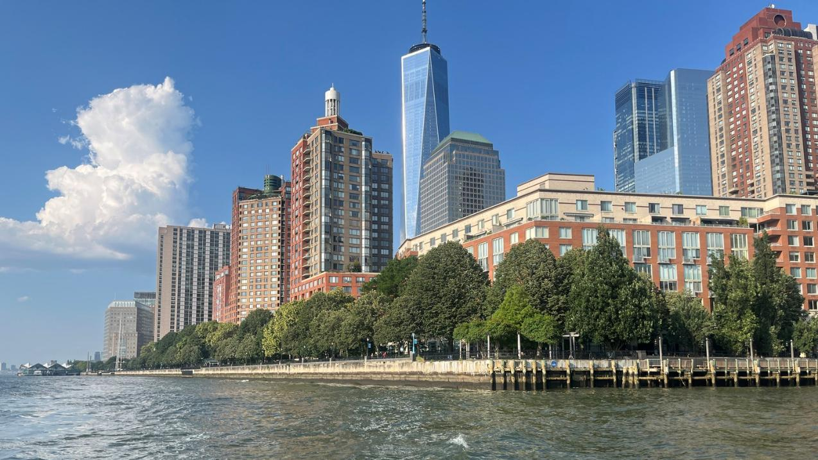
Monitoring & Adaptive Management of NBS along Urban Waterfronts
Kevin Dahms, PE – Biohabitats
NJ Coastal and Climate Resilience Conference
March 10, 2026

Slide 2


Restore the Earth and
Inspire Ecological Stewardship.

Slide 3
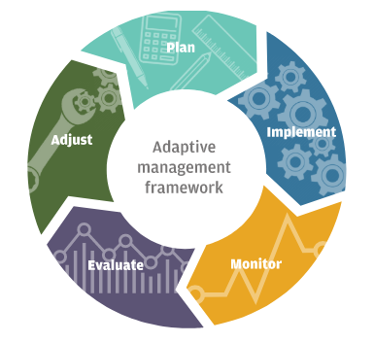

Monitoring & Adaptive Management
Opportunities
Adaptive management
Improved design
Education & stewardship
Financial justification
Proof of innovative strategies
Regulatory improvement

Slide 4
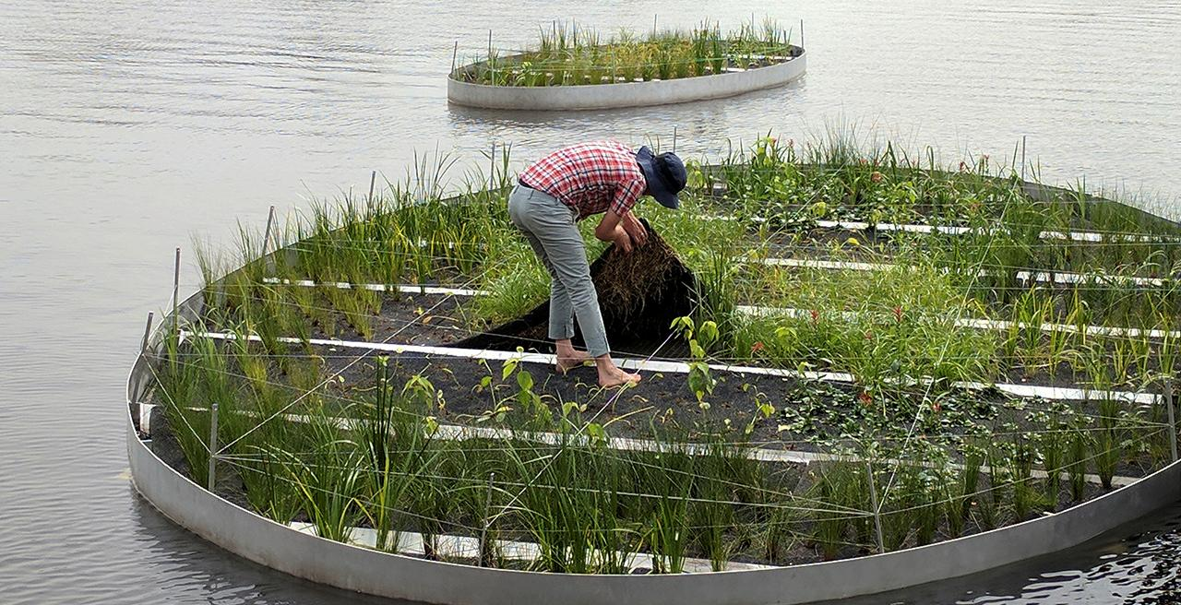
Monitoring & Adaptive Management
Challenges
Underfunded
Long timeframes
Geographic reach
Permits requirements vs. design and management needs
Owner capacity

Slide 5
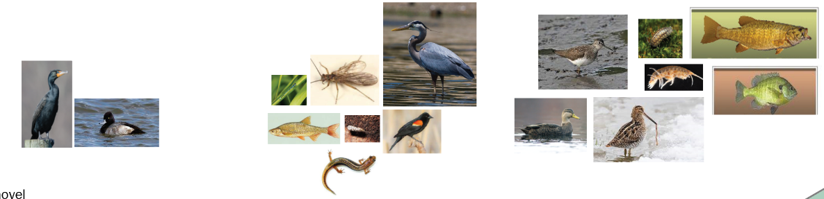

Biodiversity Trajectory
Great Blue Heron
Ardea herodias
Solitary Sandpiper
Tringa solitaria
Isopod (Caecidotea)
Small Mouth Bass
Micropterus dolomieu
Caddisfly
(Neophylax)​
Lesser Scaup
Aythya affinis
Damselfly
(Calopteryx)​
Golden shiner
Notemigonus crysoleucas
Bluegill Sunfish
Lepomis macrochirus
Double crested Cormorant
Phalacrocorax auritus
Northern Two-Lined Salamander
Eurycea bislineata
Red winged
Blackbird
Agelaius phoeniceus
American Black Duck
Anas rubripes
Wilson's Snipe
Gallinago delicata
Amphipod (Crangonyx)
Spring Stonefly
(Amphinemura)
PHASES 2 - 3
PHASE 0 -1
Notes:
If you build it they will come – we provide the structure and the function for target species to thrive.
A restoration or ecological enhancement project will build complexity over time to support a more diverse array of species as the ecological processes build on each other.

Slide 6
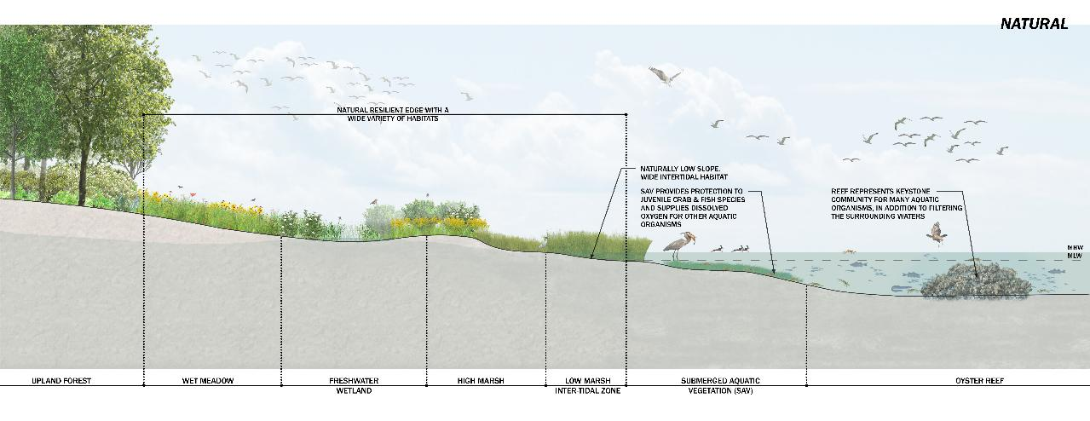
Notes:
The Battery Park City shoreline is very different from a natural shoreline
Might consist of shellfish reef, SAV bed, gradual slope of low marsh to high marsh up to coastal grassland and forest

Slide 7
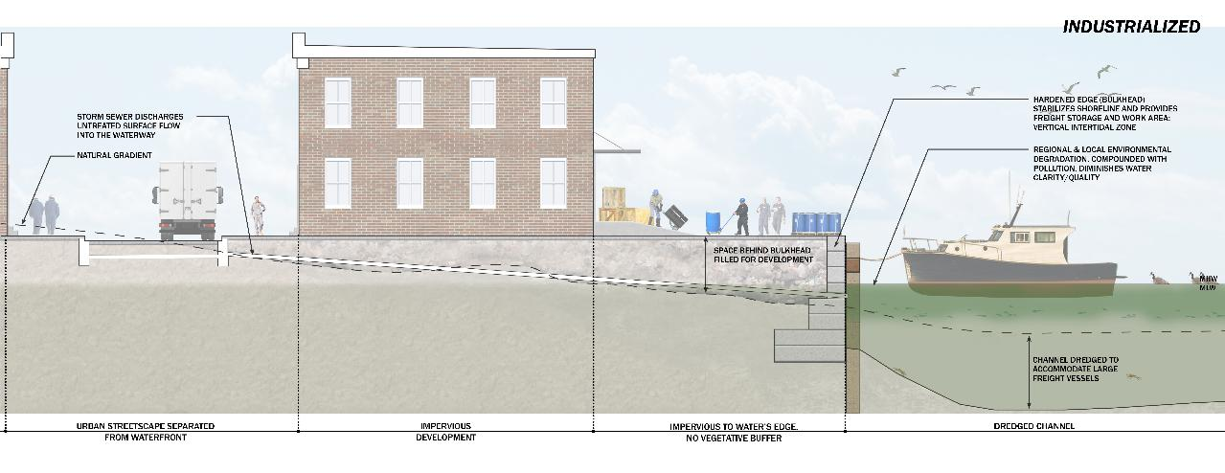
Notes:
Urban waterfronts are totally transformed from the natural shoreline
Infrastrucure immediately to the water’s edge, maritime activity in the waterway, hardened edges, infrastructure immediately adjacent

Slide 8
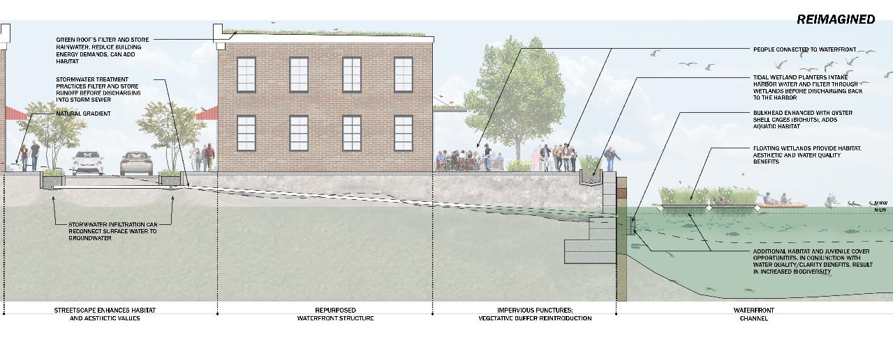
Notes:
Restoration is a misnomer, not restoring it to pristine system, but reintroducing ecosystem function

Slide 9
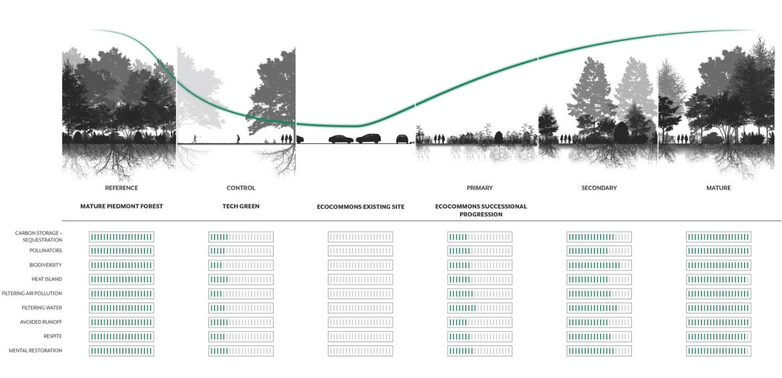
Ecosystem Services Trajectory
Notes:
Rather than consider a biodiversity trajectory we might consider an ecosystem services trajectory to understand how a sites ecosystem services evolve over time
Compare reference site to control, existing conditions, and immediate post restoration conditions where ES might be fairly low, but ideally they are improving over time like we would see with biodiversity trajectory.

Slide 10
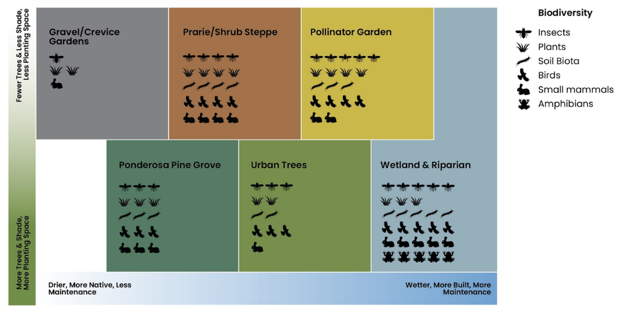
Ecosystem Services Spectrum
Notes:
Ultimately end ES might be limited by site constraints and it is important to understand the potential of the site that you have to work

Slide 11
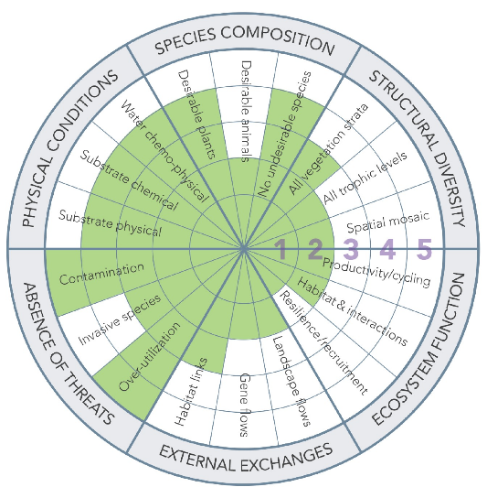
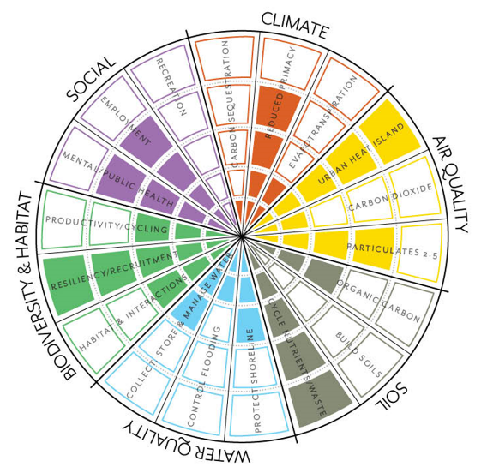
Ecosystem Services: Opportunities
Notes:
We don’t have to improve all ecosystem services to improve the site conditions – we can enhance once without enhancing the other

Slide 12
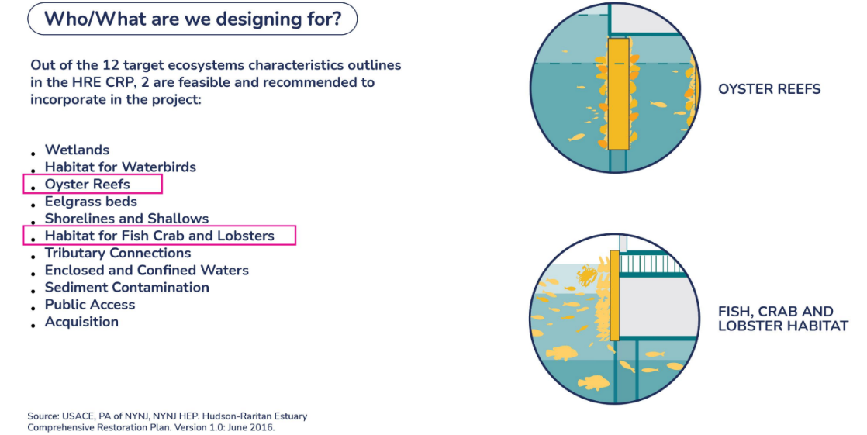
Realistic Targets & Goals
Credit: BPCA, SCAPE
Notes:
Based on site specific needs, we can establish the targets and goals we design for
The species specific needs guide you in what to monitor

Slide 13
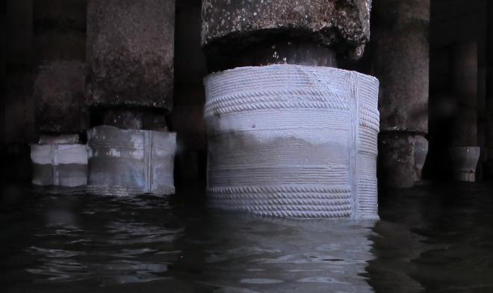
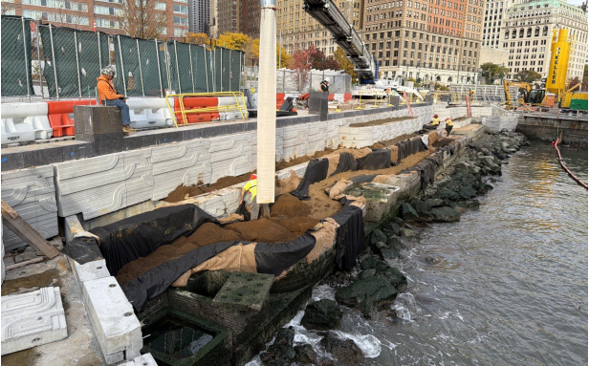
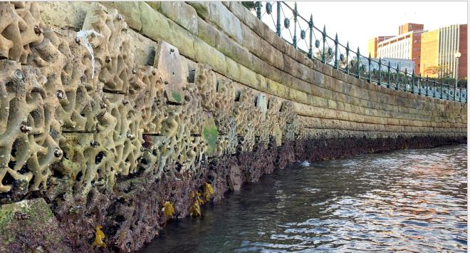
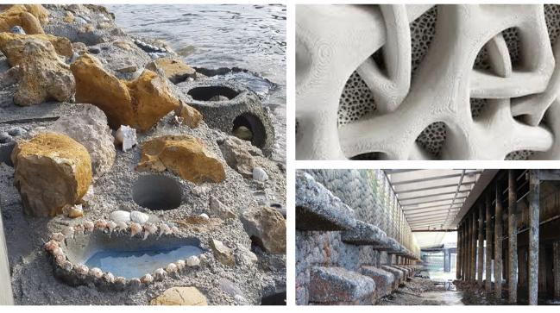
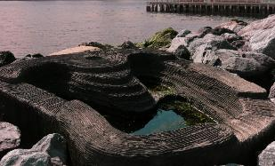
BPC Resilience – Habitat Enhancements
Ecologically Enhanced Piles
Photo credit: ECOncrete
Marsh Terrace
Photo credit: BPCA
Ecologically Enhanced Sea Wall
Photo credit: Inland and Coastal Marina Systems
Rocky Intertidal Habitat
Photo credit: ECOncrete (top), Wetland Ecosystem Team (bottom)

Slide 14

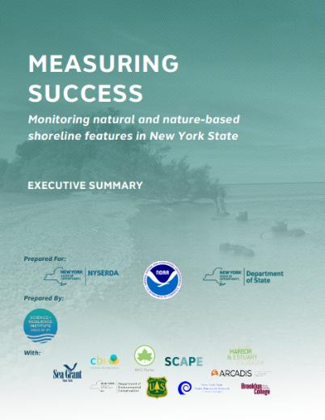
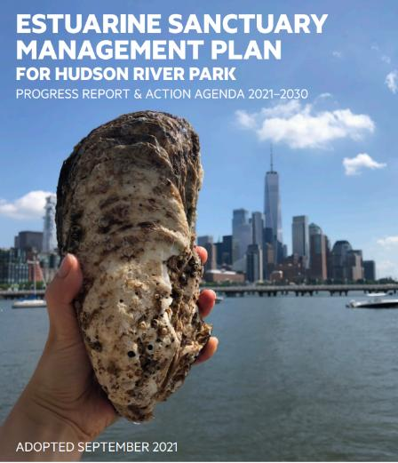
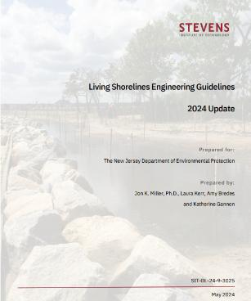
Don’t Reinvent the Wheel…
HEP State of the Estuary
Stevens Institute of Technology
Living Shorelines Engineering Guidelines
NYS Shoreline Monitoring Framework
Hudson River Park Trust ESMP
Notes:
For BPCA we did not start from scratch and borrowed heavily from existing documentation:
NYS DOS Shoreline Monitoring Framework provided a structure to identify parameters and protocols that might be suitable
HRPT ESMP – HRPT is doing enhancement and restoration work immediately upriver from BPC and monitoring those activities
Integrating data collection with HEP’s State of the Estuary
In NJ folks may be able to reference the monitoring guidelines in the Stevens Institute Living Shoreline design guidelines

Slide 15
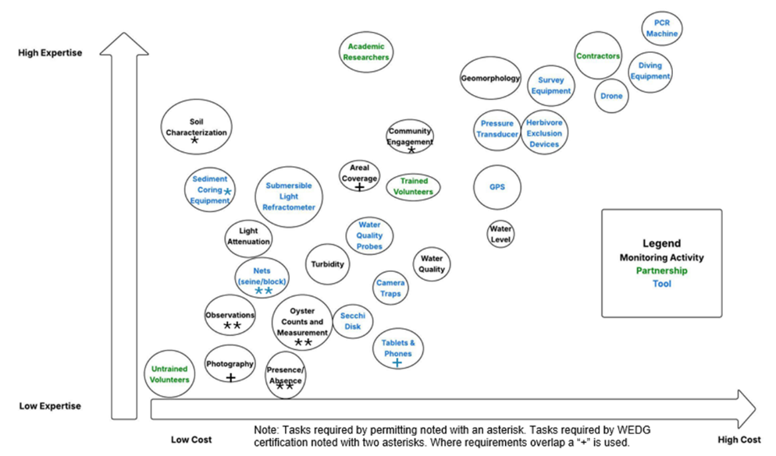
Refine Parameters & Methods
Notes:
Provided BPC with this diagram to help refine
Monitoring activities
Monitoring tools
Potential partners who might complete the work

Slide 16
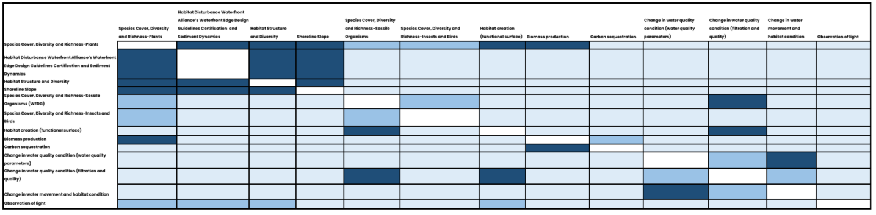
Refine Parameters & Methods
Monitoring Activities 2
Monitoring Activities 1
Notes:
We began refining the tasks with BPC – table is not meant to be read but shows one way of how we thought about and presented the tasks - table shows all potential monitoring activities on both axes
Darker blue shows overlap in tasks, which means there is a cost saving in performing those tasks together

Slide 17
Connecting Monitoring & Management
Not just tied to regulatory requirements…
Goal
Establish Marsh Vegetation on Terraces
Strategy
Restore and revegetate with native marsh species
Indicators
Diversity of Marsh Habitat
Native Cover %
NNI Cover %
Native Species #
Survival Rate %
Thresholds
High and Low Marsh Communities Present
85% Native Species
85% Cover
Causes
Response Actions
Undesirable hydrology
NNI Infestation
Adjust elevations
NNI management
Undesirable hydrology
NNI Infestation
Erosion
NNI mgmt & replant
Adjust elevations
Wave mitigation
Sunlight availabity
Undesirable hydrology & WQ
Erosion
Adjust elevation
Wave mitigation
Retrofit to tide pools
Notes:
Don’t keep your blinders on and ignore other signs/indicators (e.g. birds present might indicate successful outcome
Could also be applied to Oyster Growth
Strategy: Grow Oysters on Ecologically Enhanced Substrate
Indicators: % cover of oyster, # oysters
Thresholds: X number of oyster per feature
Causes: Disease, lack of larvae in water column, undesirable hydrodynamic conditions
Response Actions: Seed substrate, change hydrology, promote substrate for other organisms

Slide 18
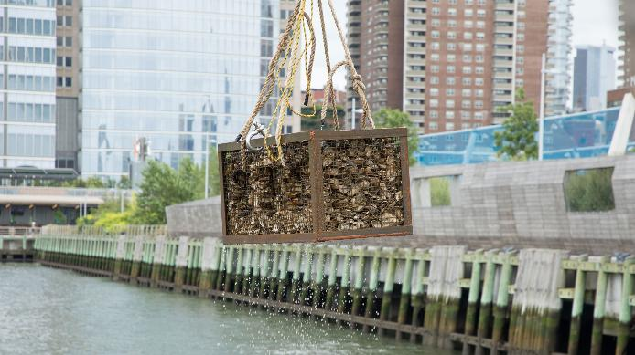
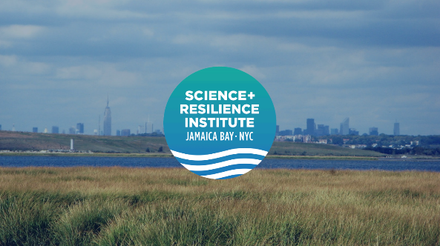
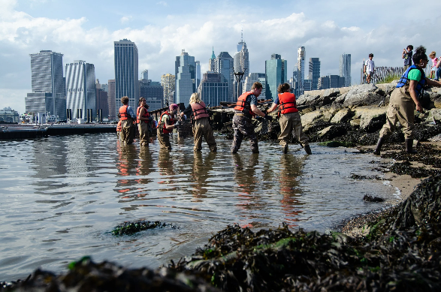
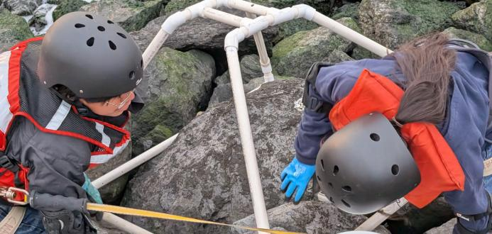

Collaboration – Potential Partners
Hudson River Park Trust
Photo credit: HRPT
New York Harbor School
Photo credit: Mauricio Gonzalez
Billion Oyster Project
Photo credit: Billion Oyster Project

Slide 19
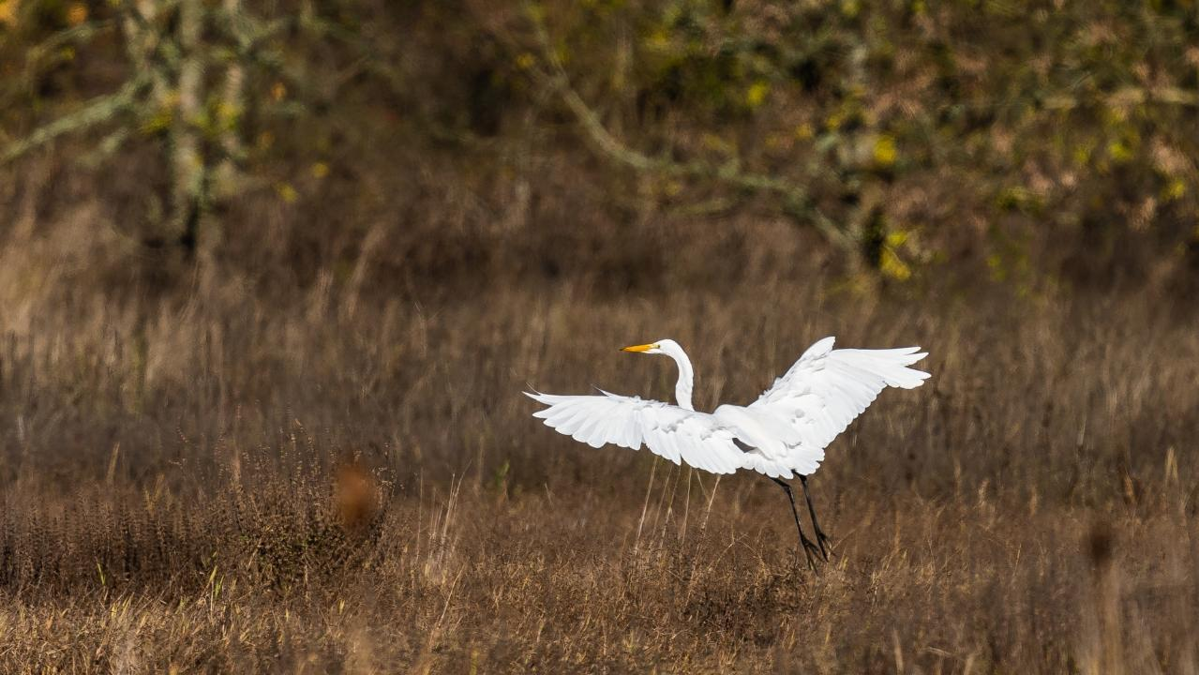

Kevin Dahms, PE
Biohabitats
Hudson River Bioregion Team Leader
Water Resources Engineer
kdahms@biohabitats.com
Thank you!
Questions?

