Slide 1


Building Resilience Across Scales:
State Planning, Municipal Challenges, & Economic Risks
March 11, 2026
Photo: Liberty State Park, NJ​

Slide 2






Our Speakers
Speaker bios
Speaker Bios
Steven Simone
AICP, PP
Nathaly Agosto Filión
Dr. Michael Russell
Dr. Qian He AICP
Stan Slachetka FAICP, PP
Senior Planner Office of Planning Advocacy
NJ Department of State
Deputy Chief Climate Resilience Officer
NJ Department of Environmental Protection
Chief Economist
NJ Department of Environmental Protection
Assistant Professor
Rowan University
Special Projects Planning Leader
Pennoni

Slide 3



Session Outline
Intro/welcome - (5 minutes)
Introducing the Climate Change Goal of New Jersey’s 2025 State Development and Redevelopment Plan - (10 minutes)
Statewide Climate Resilience Action: Engage, Share, and Shape - (10 minutes)
Economic Risks of Climate Change, Municipal Fiscal Risk from Coastal Flooding, & Planning Under Pressure: Municipal Resilience Planning, Redevelopment and Investment - (25 minutes)
Questions - (10 minutes)

Slide 4
“Introducing the Climate Change Goal of New Jersey’s 2025 State Development and Redevelopment Plan”
How the updated State Plan integrates climate adaptation, equity, and flood-prone area designations to guide future development.
Steven Simone
AICP, PP
Senior Planner Office of Planning Advocacy
NJ Department of State

Slide 5
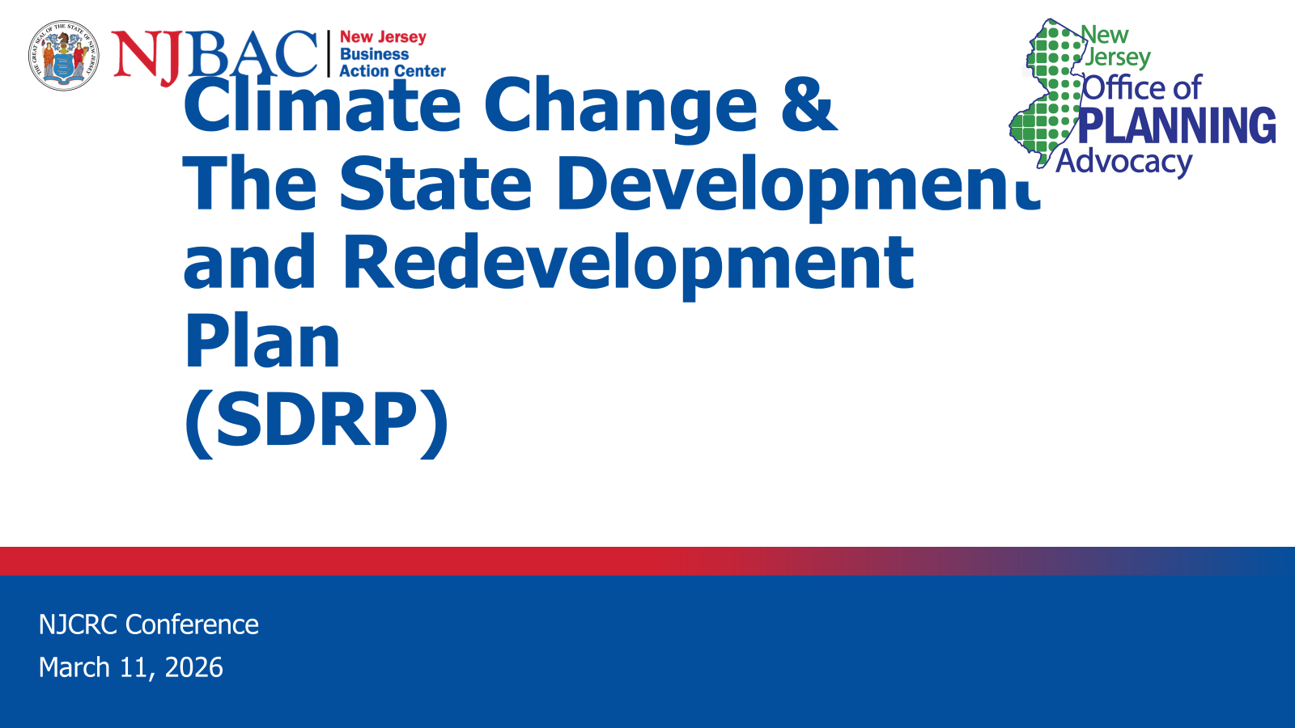
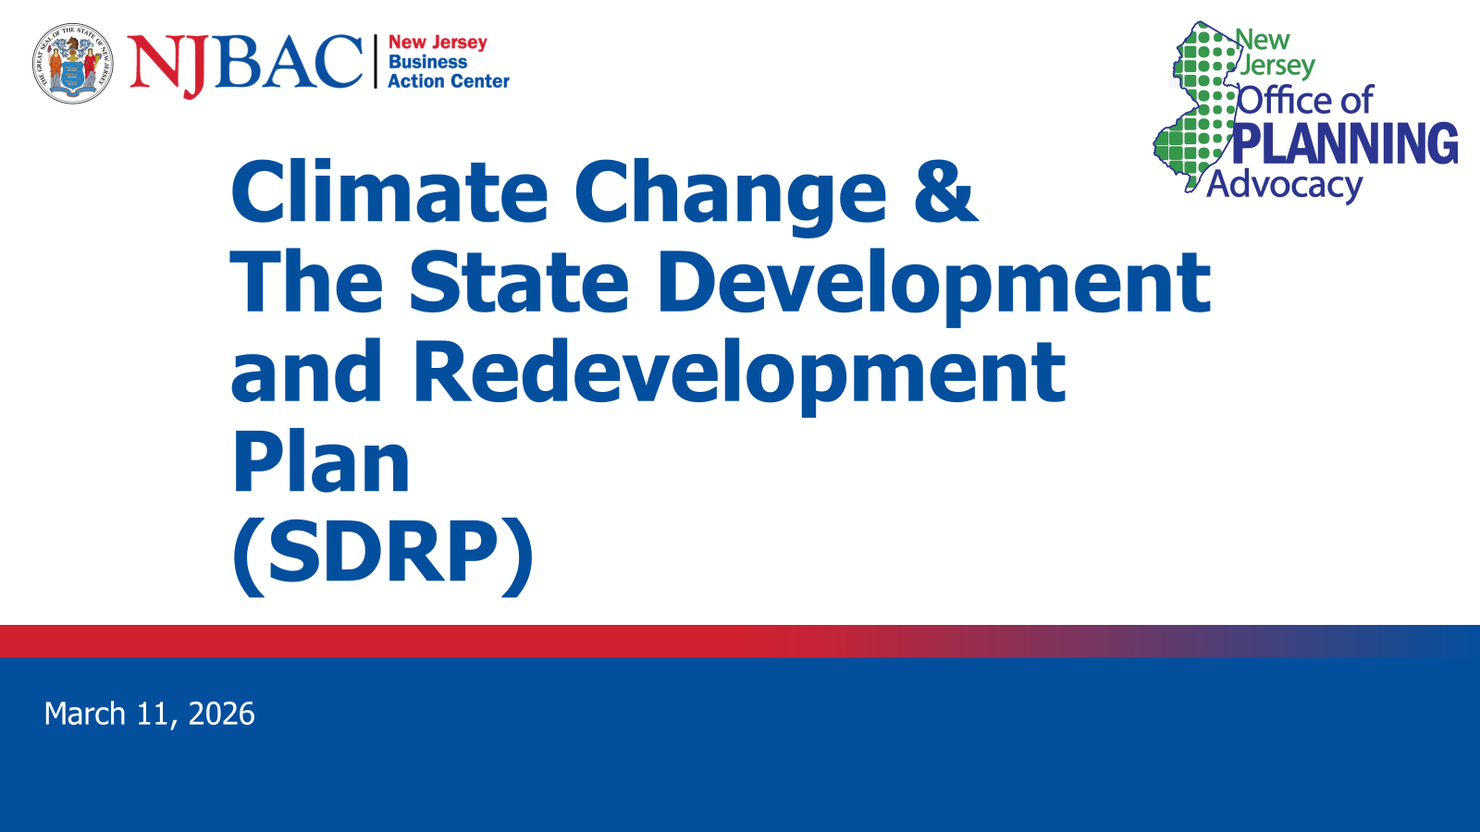

Slide 6


Slide 7
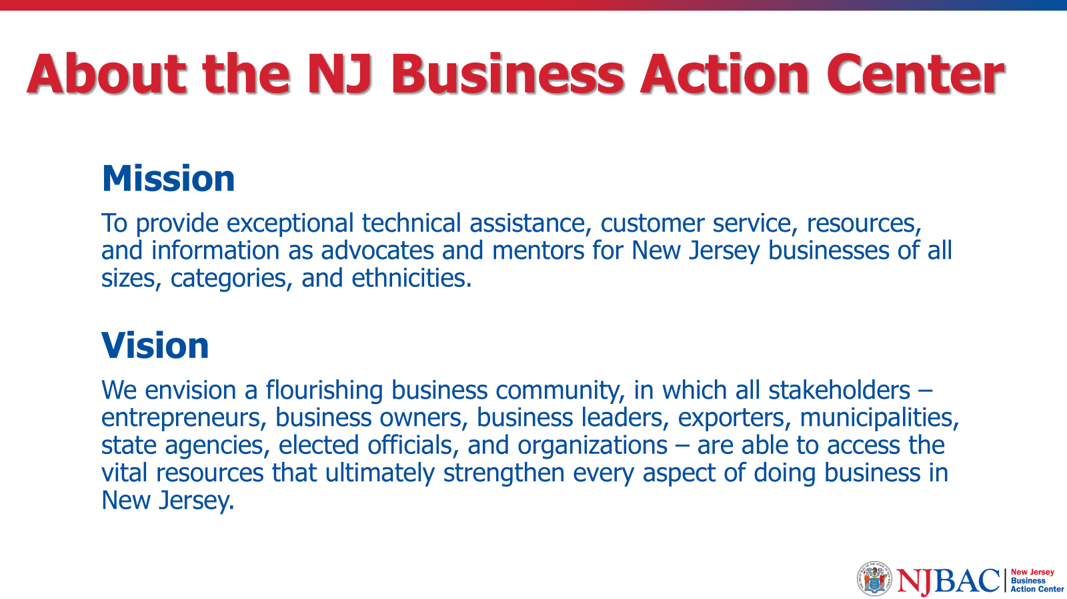

Slide 8
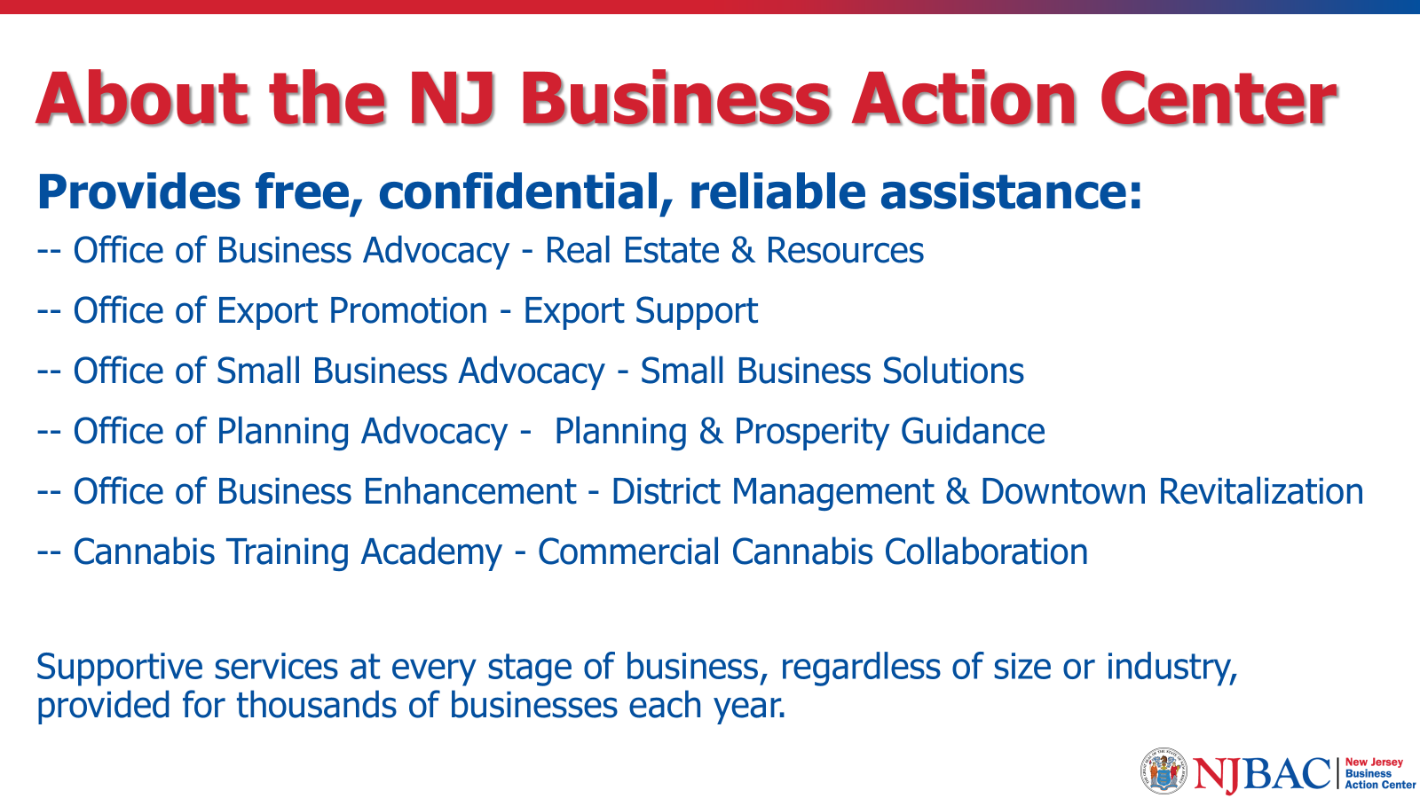

Slide 9
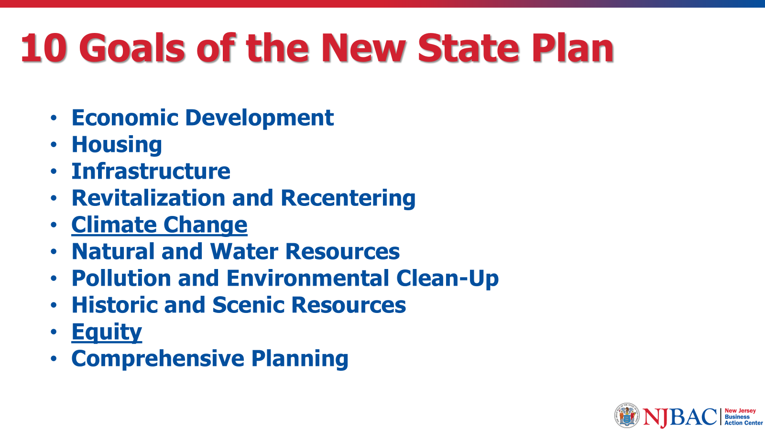

Slide 10
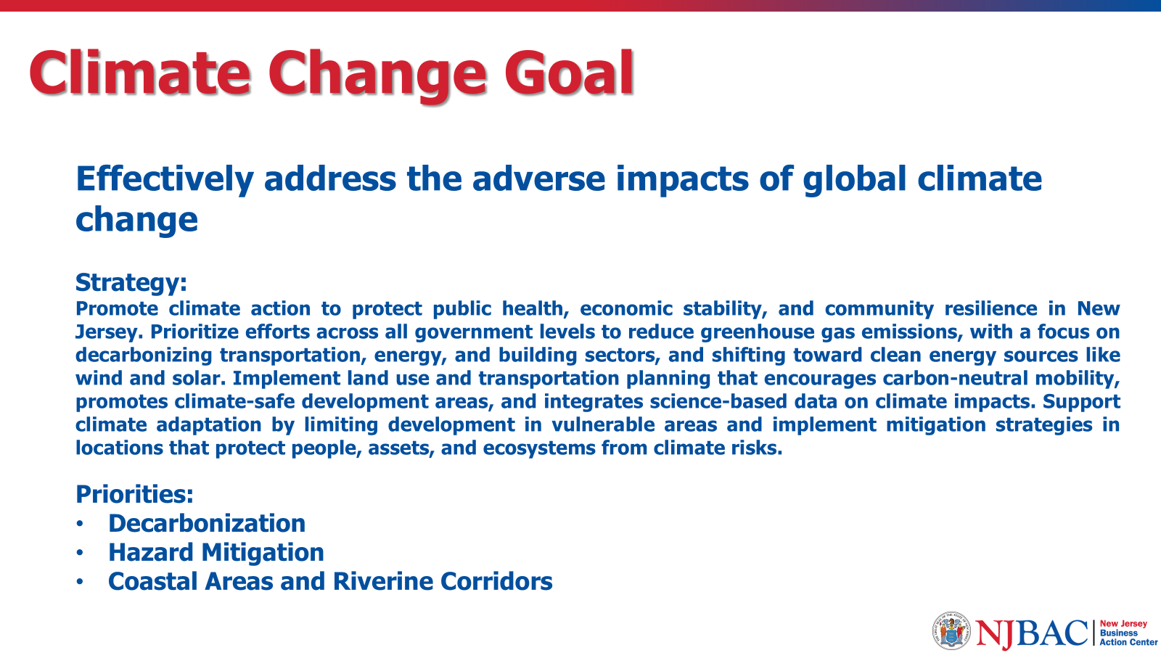

Slide 11
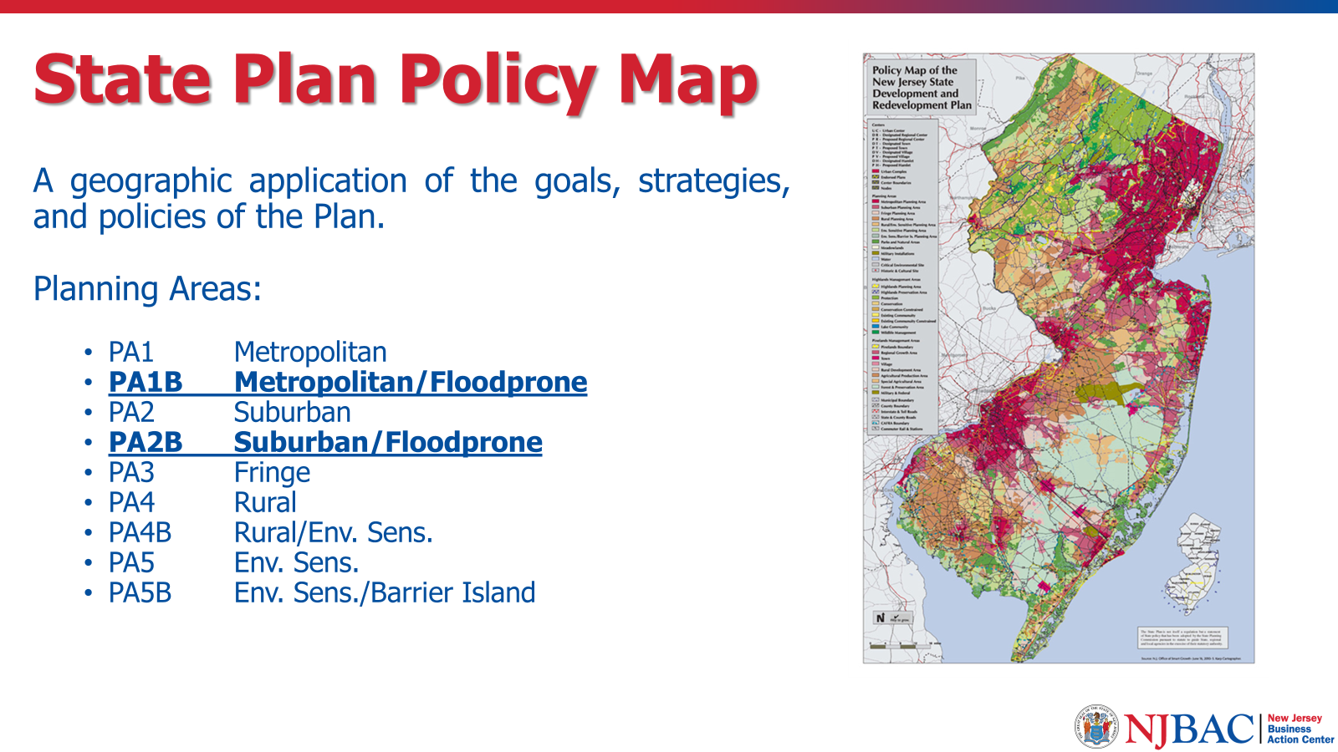

Slide 12
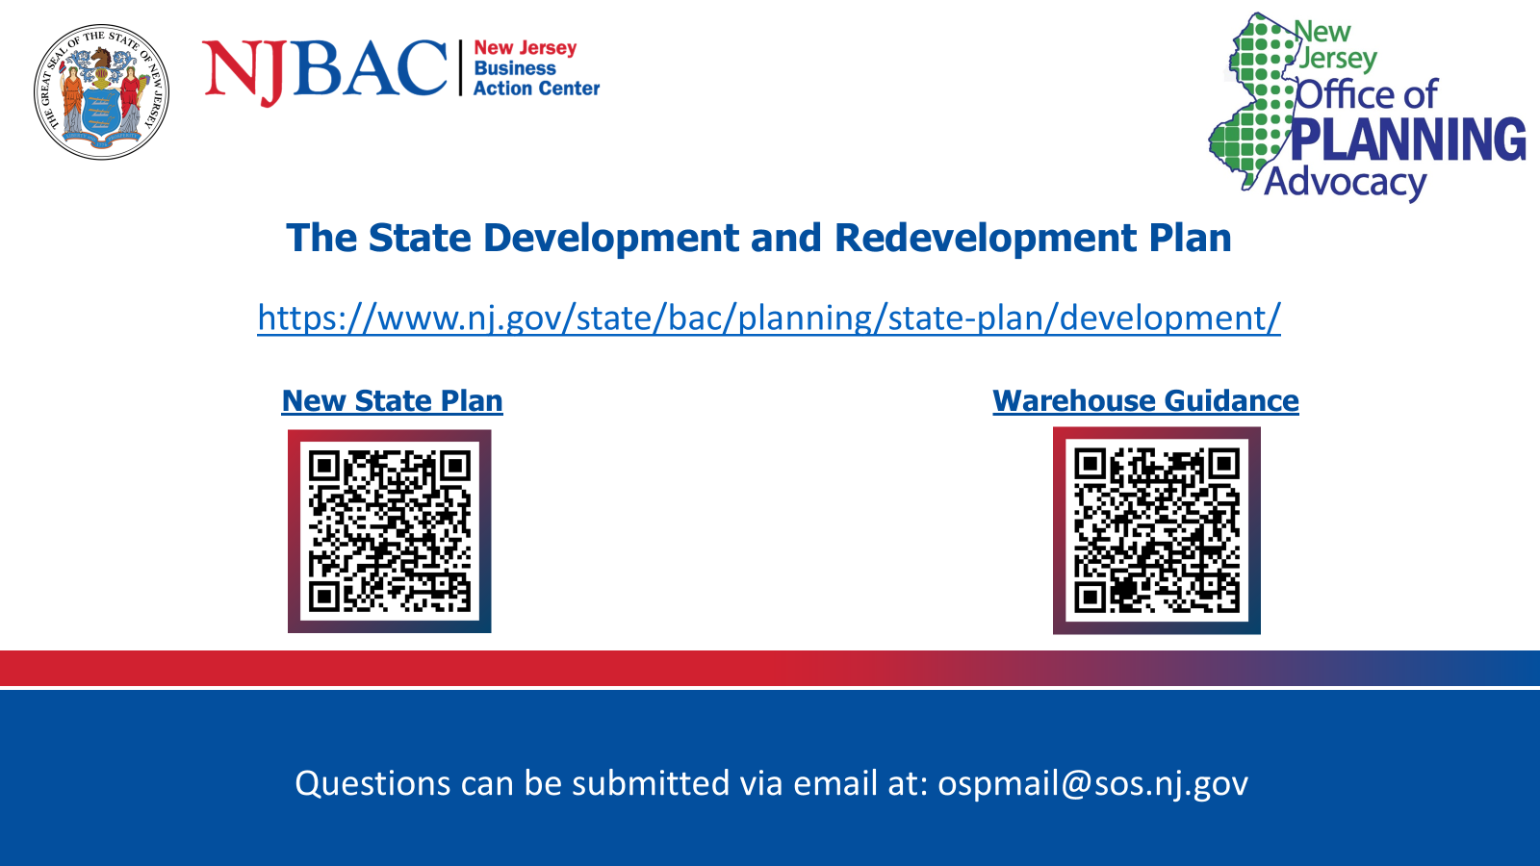

Slide 13
“Statewide Climate Resilience Action: Engage, Share, and Shape”
Insights from five years of public feedback and interagency initiatives shaping New Jersey’s resilience priorities.
Nathaly Agosto Filión
Deputy Chief Climate Resilience Officer
NJ Department of Environmental Protection

Slide 14
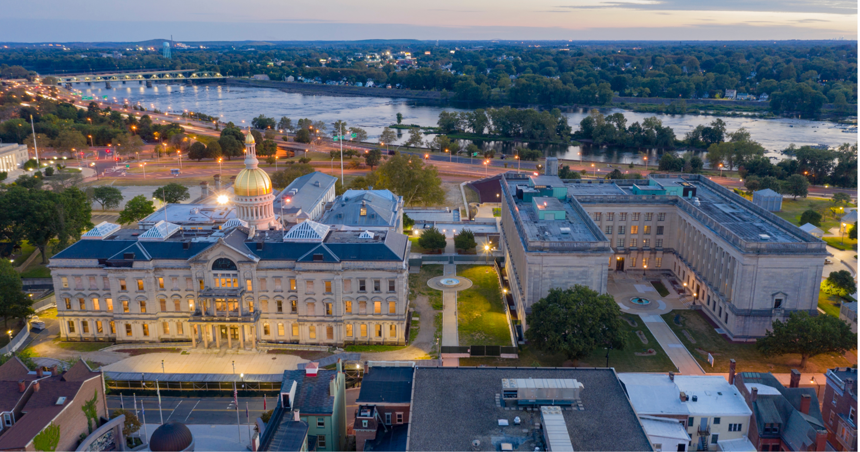
Trenton, NJ
Statewide Climate Resilience Action: Engage, Share, and Shape
New Brunswick, NJ
Nathaly Agosto Filión
Deputy Chief Climate Resilience Officer
Office of Climate Resilience

Slide 15
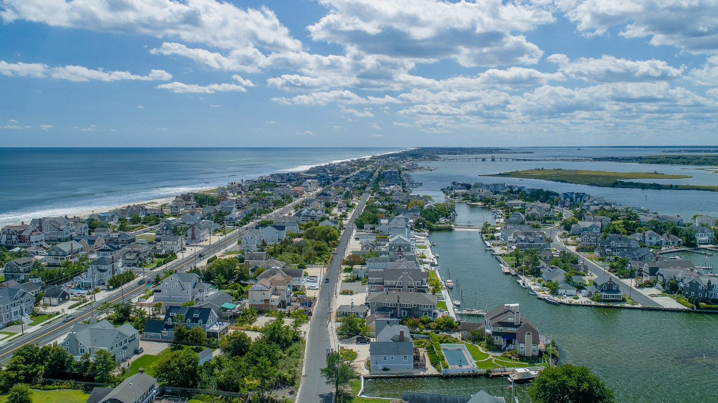

EXECUTIVE ORDER 89
“It is the policy of this State that Executive Branch departments and agencies shall take proactive and coordinated efforts, where appropriate, to protect public health and safety and to promote and protect the physical, economic, and social vitality and resilience of New Jersey’s communities from the current and anticipated impacts of climate change.”

Slide 16


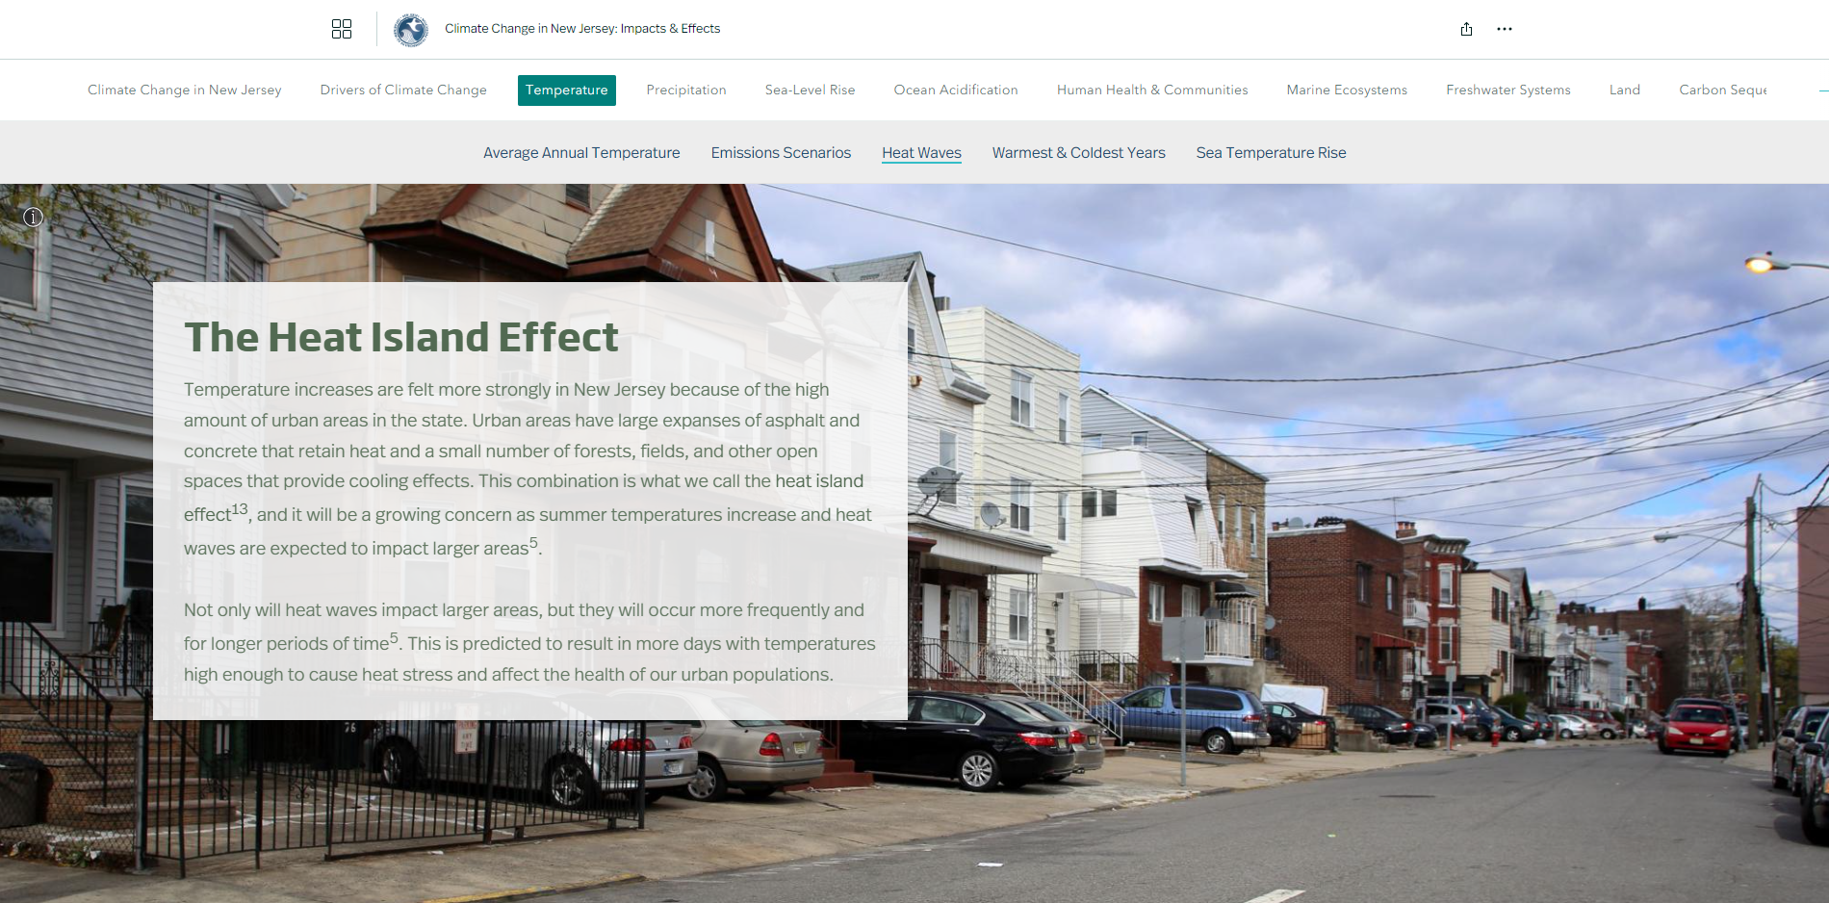

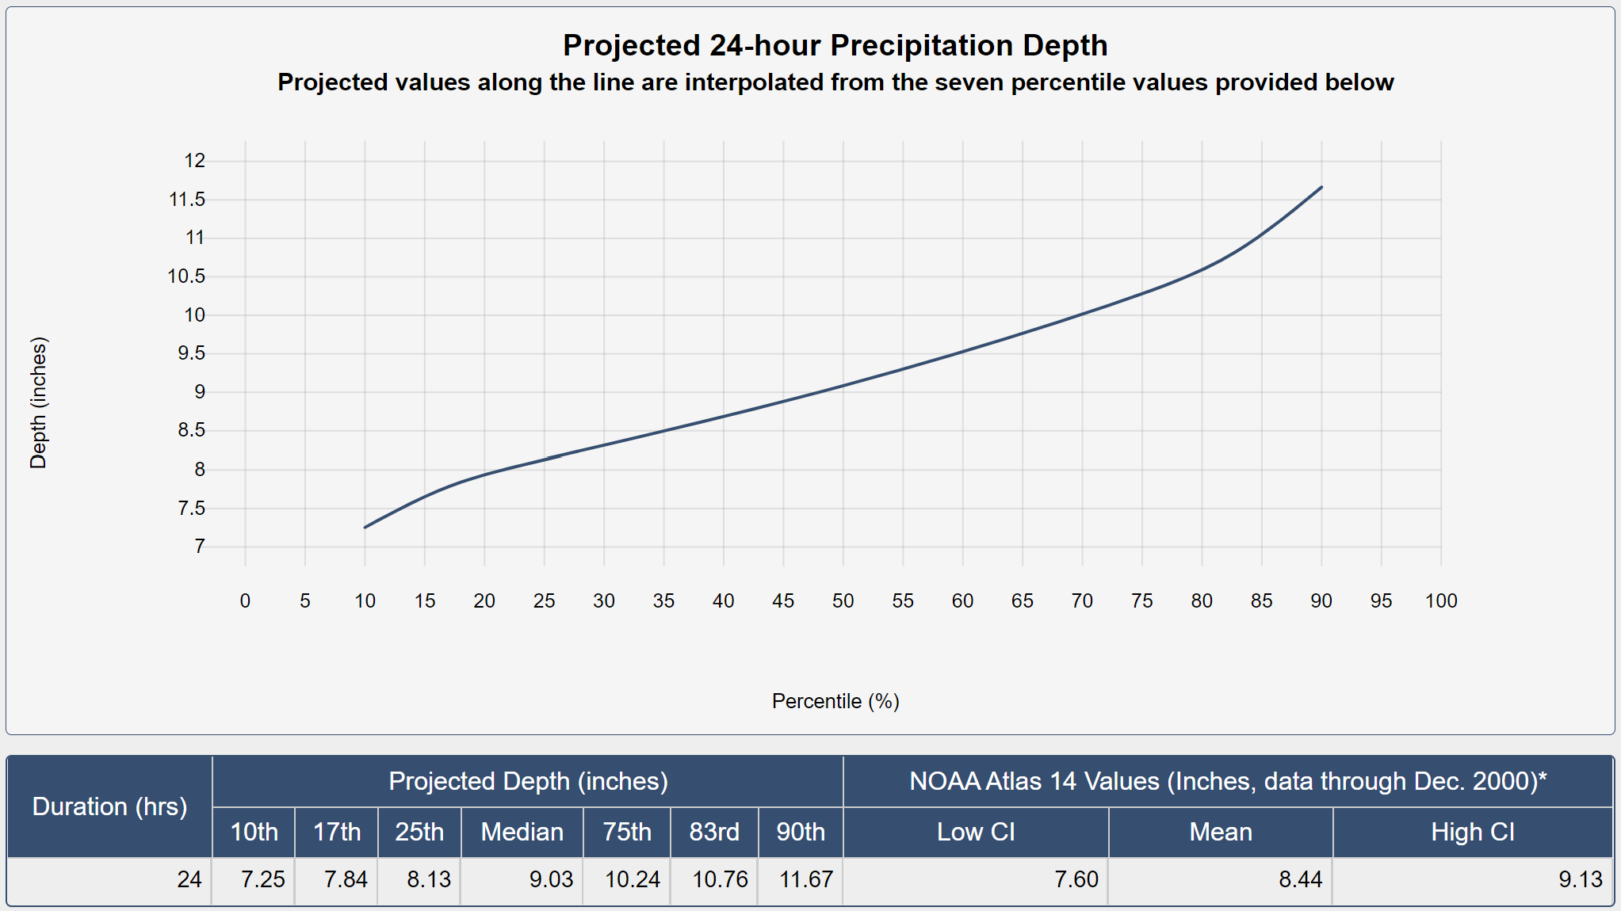

SCIENTIFIC REPORT
on Climate Change
climatechange.nj.gov
Sept. 2023: Climate Change in New Jersey StoryMap
Overview
Comprehensive effort to synthesize the latest and most reliable scientific information on the current and predicted future impacts of climate change.
The report is one component of the State’s comprehensive strategy to both reduce emissions of climate pollutants that fuel global warming, and proactively plan and prepare for the climate impacts that New Jersey cannot avoid.
Released June 30, 2020
Nov. 2021: Updated Atlas 14 data; Extreme Event Precipitation Projections & Projection Tool
Sept. 2022: Climate Change Impacts on Human Health & Communities Addendum

Slide 17


INTERAGENCY COUNCIL
on Climate Resilience
Overview
Established by Executive Order to coordinate the State’s climate resilience policy
Includes 26 member agencies and departments, with Chief Resilience Officer serving at vice chair
Tasked with developing and implementing the Statewide Climate Change Resilience Strategy
Released July 2024
Released October 2021
resiliencecouncil.nj.gov

Slide 18







PRIORITY 1. BUILD RESILIENT AND HEALTHY COMMUNITIES
PRIORITY 2. STRENGTHEN THE RESILIENCE
OF NEW JERSEY’S ECOSYSTEMS
PRIORITY 3. PROMOTE COORDINATED GOVERNANCE
PRIORITY 4. INVEST IN INFORMATION
AND INCREASE PUBLIC UNDERSTANDING
PRIORITY 5. PROMOTE CLIMATE-INFORMED INVESTMENTS AND INNOVATIVE FINANCING
PRIORITY 6: COASTAL RESILIENCE PLAN

Slide 19

THREE QUESTIONS
From 2020-2025 Listening Sessions
What would you like to see the Interagency Council do more/less?
How can the Interagency Council best support municipal and local-level climate resilience action?
What one action do you think the Interagency Council needs to take in the next five years to increase New Jersey’s overall resilience to climate change?

Slide 20
 |  | Themes, Grouped by Similarities
 |  | State-led Resilience Policy, Planning & Practices
 |  | Legislation, Rules and Regulatory Intervention
 |  | Coordinated Governance/Interagency Operations
 |  | Funding
 |  | Technical Assistance & Guidance/Support
 |  | Climate-Informed Investments & Innovative Financing
 |  | Natured-Based/Ecological Intervention
 |  | Climate Resilience Education, Communications & Outreach
 |  | Infrastructure Intervention

Slide 21
 |  | Themes, Grouped by Similarities
151 | 89 | State-led Resilience Policy, Planning & Practices
 | 44 | Legislation, Rules and Regulatory Intervention
 | 18 | Coordinated Governance/Interagency Operations
79 | 39 | Funding
 | 31 | Technical Assistance & Guidance/Support
 | 9 | Climate-Informed Investments & Innovative Financing
46 | 36 | Natured-Based/Ecological Intervention
 | 28 | Climate Resilience Education, Communications & Outreach
 | 18 | Infrastructure Intervention

Slide 22
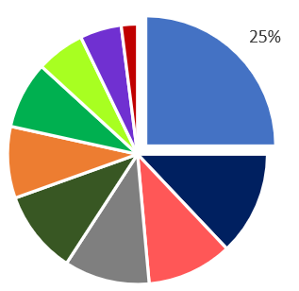
State-led Resilience Policy, Planning & Practices
Requesting State leadership for advancing climate resilience through state-level policy, planning, and practices (including prioritization principles).
“Dis-incentivize new development in risky/hazardous areas.”
"Less talk, more walk"
"Develop a well-conceived plan on how all sectors should address climate change in the coming years and decades."
"Issue a state policy that requires resiliency to be considered as an evaluation factor in all planning and infrastructure projects."

Slide 23
State-led Resilience Policy, Planning & Practices (Cont’D)
"Adopt a longer-term planning horizon for adaptation – focusing on what needs to be done over the next 50 years, not the next 5"
"Prioritize resilience measures that protect and invest in the most vulnerable communities in terms of regulatory, permitting, spending and planning assistance by state agencies."
"Stronger focus on urban coastal issues"
"Set tangible, objective targets for adaptation, like we have done with greenhouse gas emissions."
"Develop a statewide assessment for coastal flooding and impacts from sea level rise as well as a planned approach to mitigate and adapt to those changes”
"Emphasize/encourage the prioritization of the Interagency Council’s resilience actions at the local level with the local departmental equivalents"

Slide 24
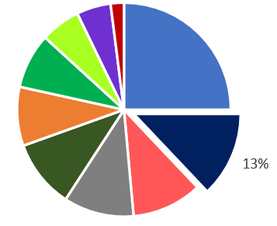
Legislation, Rules and Regulatory Intervention
Requesting State action in the form of regulatory, legislative or other state-led rule-making processed. Note: these comments differ from “policy” theme based on enforceability.
“Aggressive legislation providing for funding of Resilience actions”
"The NJ building code & zoning ordinances should be updated to help deal w/ these climate issues ASAP."
"Update land use regulations to incorporate climate change impacts (sea level rise /increase precipitation). Development needs to be discouraged from high-risk areas"
"Legislate funding and process for assisting with moving communities to safer areas.”

Slide 25
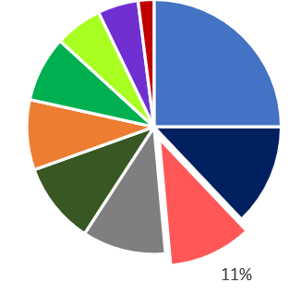
Funding
“Money"
Requests for assistance (grants, money, financing) as well as guidance and technical assistance for implementing or advancing climate resilience goals, projects and initiatives including covering damage expenses and managing financial obligations, as well as support for specific projects or campaigns.
Note: Funding recipients and project needs/focus areas varied.
"establish dedicated funding for adaptation and planned retreat”
"Search for more funding opportunities and provide clarity to other state agencies and on a local level."
"Funding for resilience planning and implementation at the local level"

Slide 26
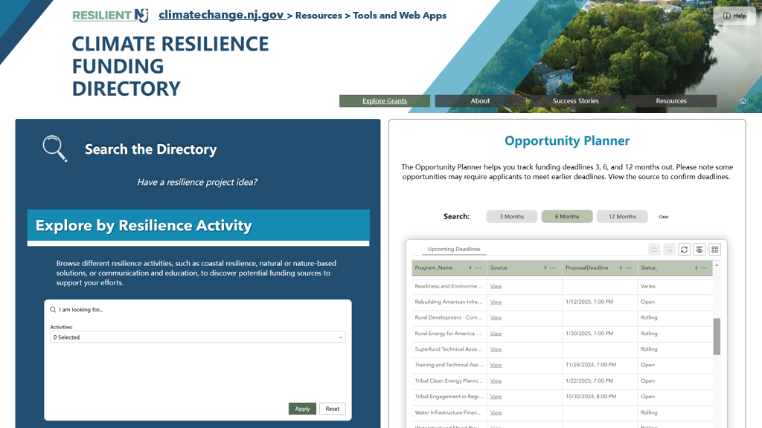

Slide 27



Contact
Edwin B. Forsythe National Wildlife Refuge, Galloway, NJ
@newjerseydep
@nj.dep
Nathaly Agosto Filión
Nathaly.AgostoFilion@dep.nj.gov

Slide 28

From Climate Exposure to Fiscal Transmission
Michael C. Russell, Ph.D.
Chief Economist
Office of Economic Analysis
Community Investment and Economic Revitalization
Notes:
The State Plan identifies where risk is concentrated. My focus is how that risk moves through markets and fiscal systems.

Slide 29
Climate Risk Propagates Through Economic Systems
Persistent flood exposure
Market responses
Insurance & financing repricing
Property market adjustment
Municipal revenue base pressure
Revenue channel
Borrowing & capital constraints
Balance-sheet channel
Notes:
Insurance and mortgage markets respond to forward-looking risk models. Property markets adjust through expectations. Municipal revenue responds with lag. Borrowing constraints often surface only after credit reassessment.
These channels can reinforce each other and operate at different speeds.

Slide 30
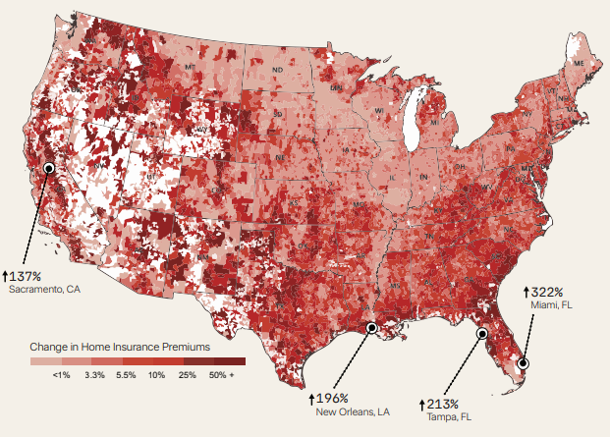
Markets respond before planning cycles
Insurance repricing is model-driven and updates frequently.
Mortgage markets incorporate risk through underwriting and capital requirements.
Property markets reflect expectations, not just realized loss.
Visual from Street, F. (2025). The 12th National Risk Assessment: Property Prices in Peril.

Slide 31
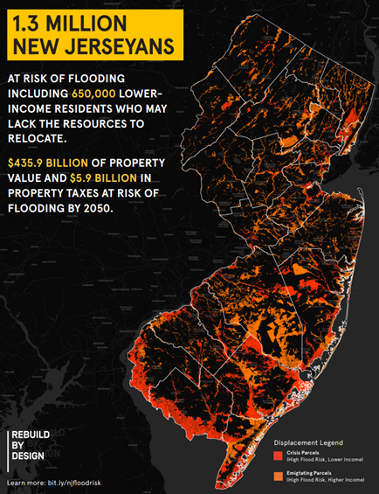
Revenue concentration amplifies small shocks
Heavy reliance on property taxation and tourism spending
Limited revenue diversification
Fixed infrastructure and service costs
Visual from https://rebuildbydesign.org/nj-flood-risk/

Slide 32
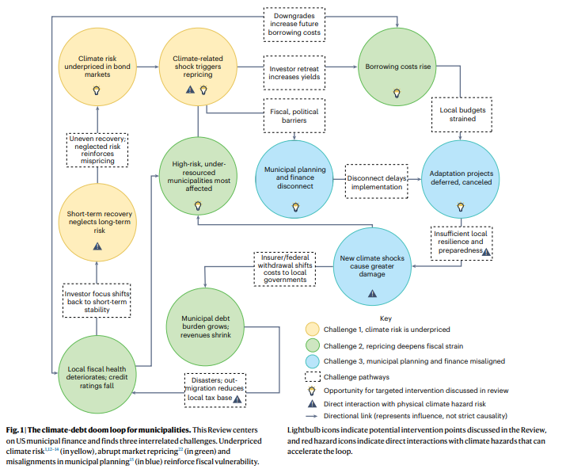
Municipal fiscal stability is a resilience issue
Fiscal heterogeneity impacts statewide outcomes
Local balance-sheet stress influences long-term investment
Preventative coordination reduces compounding losses
Visual Mishra et al. (2026), Physical climate risk creates challenges and opportunities in U.S. municipal finance.

Slide 33

“Municipal Fiscal Risk From Coastal Flooding”
Research Evidence On How Sea-Level Rise And Road Network Disruptions Affect Local Budgets And Planning Capacity
Dr. Qian He AICP
Assistant Professor
Department of Geography, Planning, and Sustainability
Rowan University

Slide 34
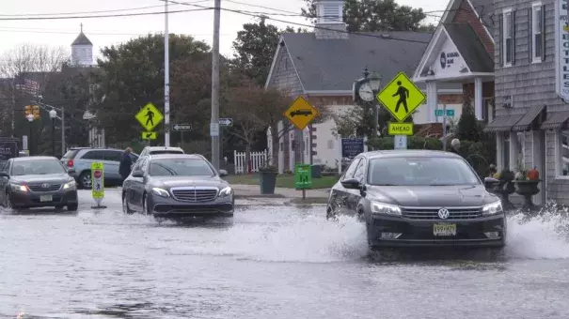
Fiscal capacity shapes what and where adaptation is possible. If municipal revenue weakens while infrastructure costs rise, even good plans become hard to implement.
Sunny day flooding in Bay Head, NJ, photo credit: AP Photo/ Wayne Parry
Notes:
https://apnews.com/article/climate-floods-rising-sea-levels-tides-environment-c452192c9995ccd298ca9f5c5dfc9716

Slide 35



Why municipal finance belongs in SLR resilience planning ?
31%
Key points:
of local government general revenue comes from property taxes (U.S.). Urban-Brookings Tax Policy Center, 2024
Local fiscal capacity shapes what communities can maintain, retrofit, and deliver as hazards intensify.
Sea-level rise can erode the tax base through flooding property parcels. (Hino & Berke, 2021; Shi & Varuzzo, 2020; Shi et al., 2024
Higher climate risk will translate into higher mitigation costs and greater difficulty in municipal bond and financing. (Butler & Yi, 2022; Gao et al., 2019; Jerch et al., 2023; Painter, 2020)
45%
of city finance officers feel optimistic about meeting FY2026 fiscal needs
National League of Cities Report, 2025
7.5%
real (inflation-adjusted) increase in average general fund spending in FY24; National League of Cities Report, 2025
Study funded by the National Science Foundation (NSF), Directorate for Engineering, CMMI (Award No. 2427242)
Notes:
Key message: If fiscal exposure is understated, resilience plans can misjudge timing, priorities, and feasible financing.
- Urban-Brookings Tax Policy Center (Briefing Book): “Local governments collected $609 billion in property taxes in 2021, or 30 percent of local general revenue.” https://taxpolicycenter.org/briefing-book/how-do-state-and-local-property-taxes-work - National League of Cities. City Fiscal Conditions 2025 (PDF). Stats used: 45% optimism for FY2026; 7.5% real increase in FY2024 spending. https://www.nlc.org/wp-content/uploads/2025/11/2025-City-Fiscal-Conditions-ReportwebA.pdf - Painter, M. (2020). An inconvenient cost: The effects of climate change on municipal bonds. Journal of Financial Economics. (Claim about climate risk increasing municipal borrowing costs.) https://www.sciencedirect.com/science/article/abs/pii/S0304405X19301631 - Goldsmith-Pinkham, P. S., et al. (2023). Sea-level rise exposure and municipal bond yields. Review of Financial Studies. (Supporting claim about SLR exposure and borrowing costs.) https://academic.oup.com/rfs/article-abstract/36/11/4588/7156853 [/Sources]

Slide 36
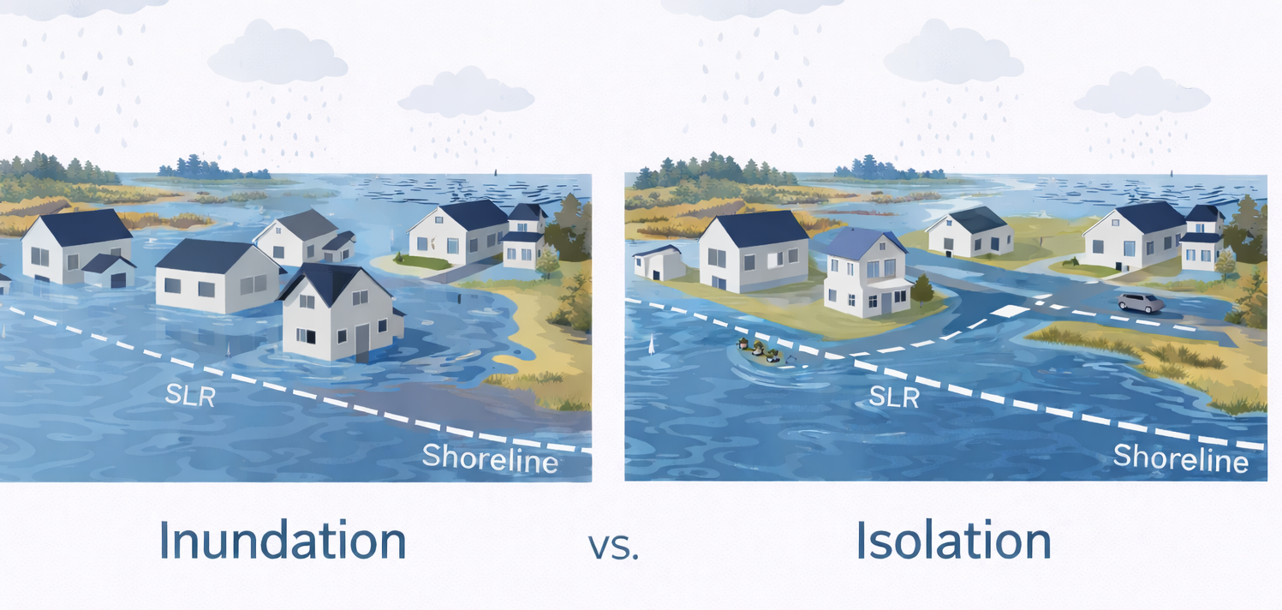
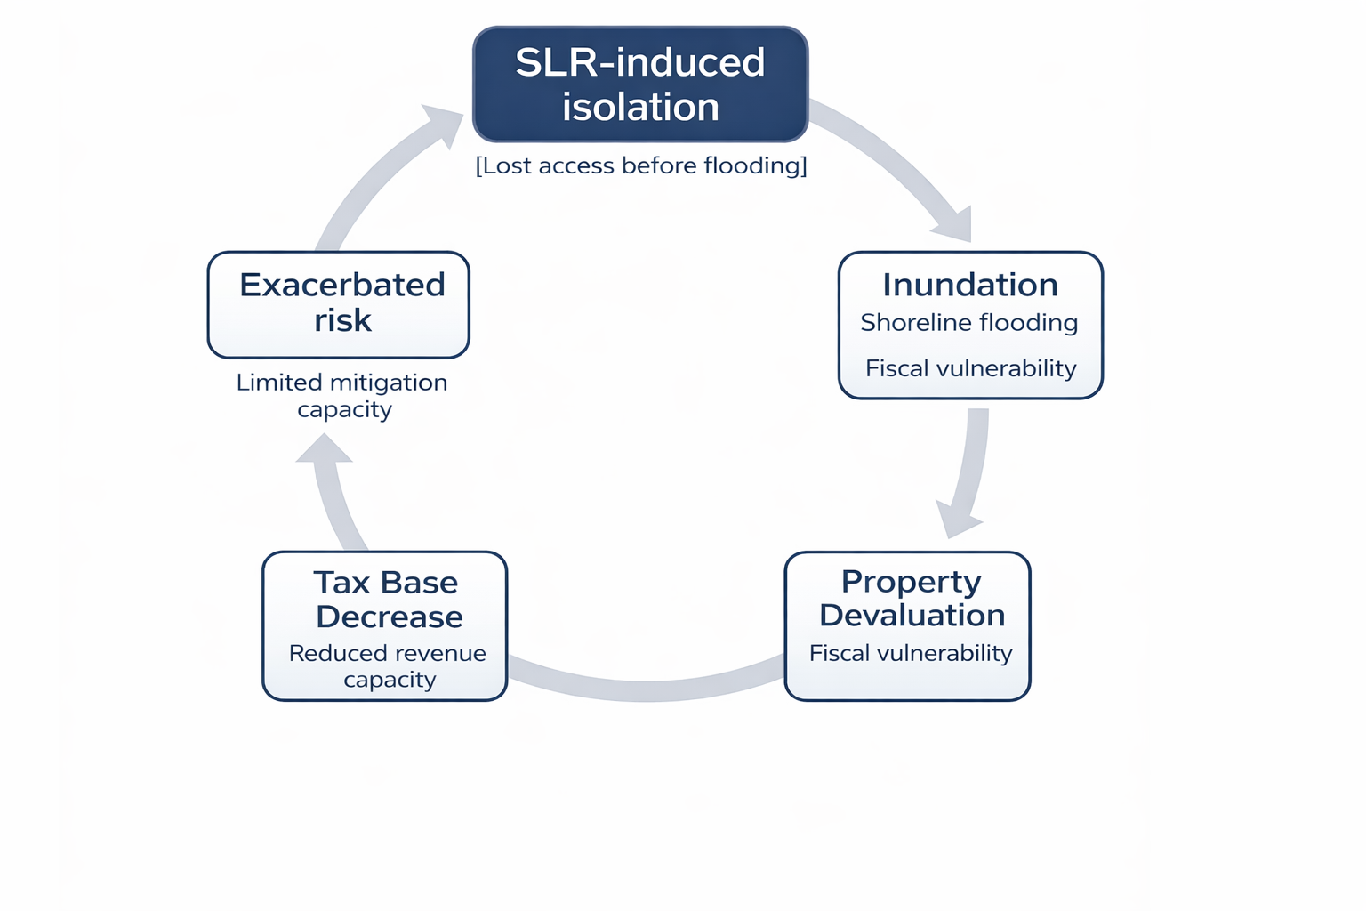
Pathways to fiscal exposure under SLR
(He, Namadi, Olcese, in progress)
Study funded by the National Science Foundation (NSF), Directorate for Engineering, CMMI (Award No. 2427242)
Notes:
Setup for discussion: which places shift from 'safe' to 'at risk' once access disruption is included?
Existing research evidence on SLR’s impact on the local tax base primarily rely on inundation, i.e., direct flooding (Shi & Varuzzo, 2020; Shi et al., 2023) and lacks linkage to fine-scale land use specification on parcel level.
[Sources] - NOAA Office for Coastal Management Sea Level Rise inundation data: 0.5–10 ft above Mean Higher High Water (MHHW). https://www.fisheries.noaa.gov/inport/item/48106 - NOAA Digital Coast Sea Level Rise Viewer (context: inundation up to 10 ft above average high tides). https://coast.noaa.gov/digitalcoast/tools/slr.html - Painter, M. (2020). An inconvenient cost: The effects of climate change on municipal bonds. Journal of Financial Economics. https://www.sciencedirect.com/science/article/abs/pii/S0304405X19301631 - Goldsmith-Pinkham, P. S., Gustafson, M. T., Lewis, R. C., Matvos, G., & Schwert, M. (2023). Sea-level rise exposure and municipal bond yields. Review of Financial Studies. https://academic.oup.com/rfs/article-abstract/36/11/4588/7156853 [/Sources]

Slide 37
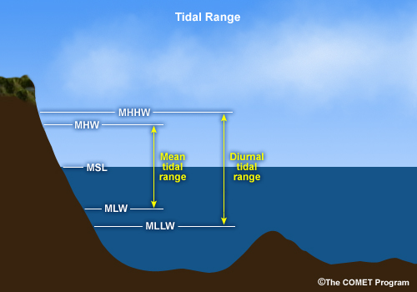
Data & Methodology
Isolation method developed by Logan et al. (2022) and Best et al. (2023)
OpenStreetMap (OSM) road network
NOAA’s mean higher high water (MHHW) for global sea-level rise scenarios (1-10ft)
Parcel data containing year built and property values retrieved from local municipalities
A parcel is considered isolated if it lacks an unflooded route between the centroid and any fire stations or primary schools.
Study funded by the National Science Foundation (NSF), Directorate for Engineering, CMMI (Award No. 2427242)
Notes:
In this work, we investigate municipal fiscal risk&#39;s spatial and temporal pattern based on direct inundation and indirect isolation risk. Based on the National Oceanic and Atmospheric
Administration (NOAA) projection, we examine how SLR scenarios can affect municipal fiscal stress using parcel-level contemporary and historical housing data from Dorchester County, Maryland. We consider property at risk for inundation if the centroid of a parcel is inundated and isolated if a property loses road network access to essential services (Logan et al., 2023; Best et al., 2023).

Slide 38
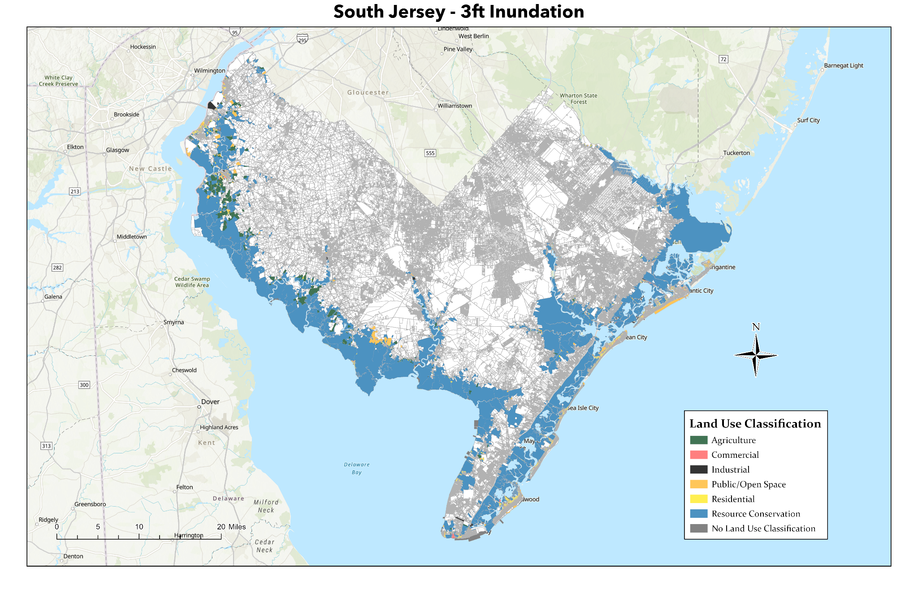
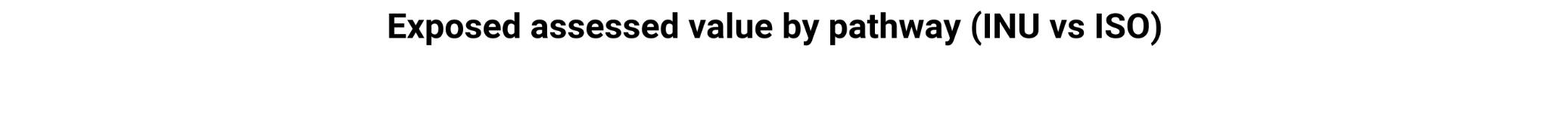
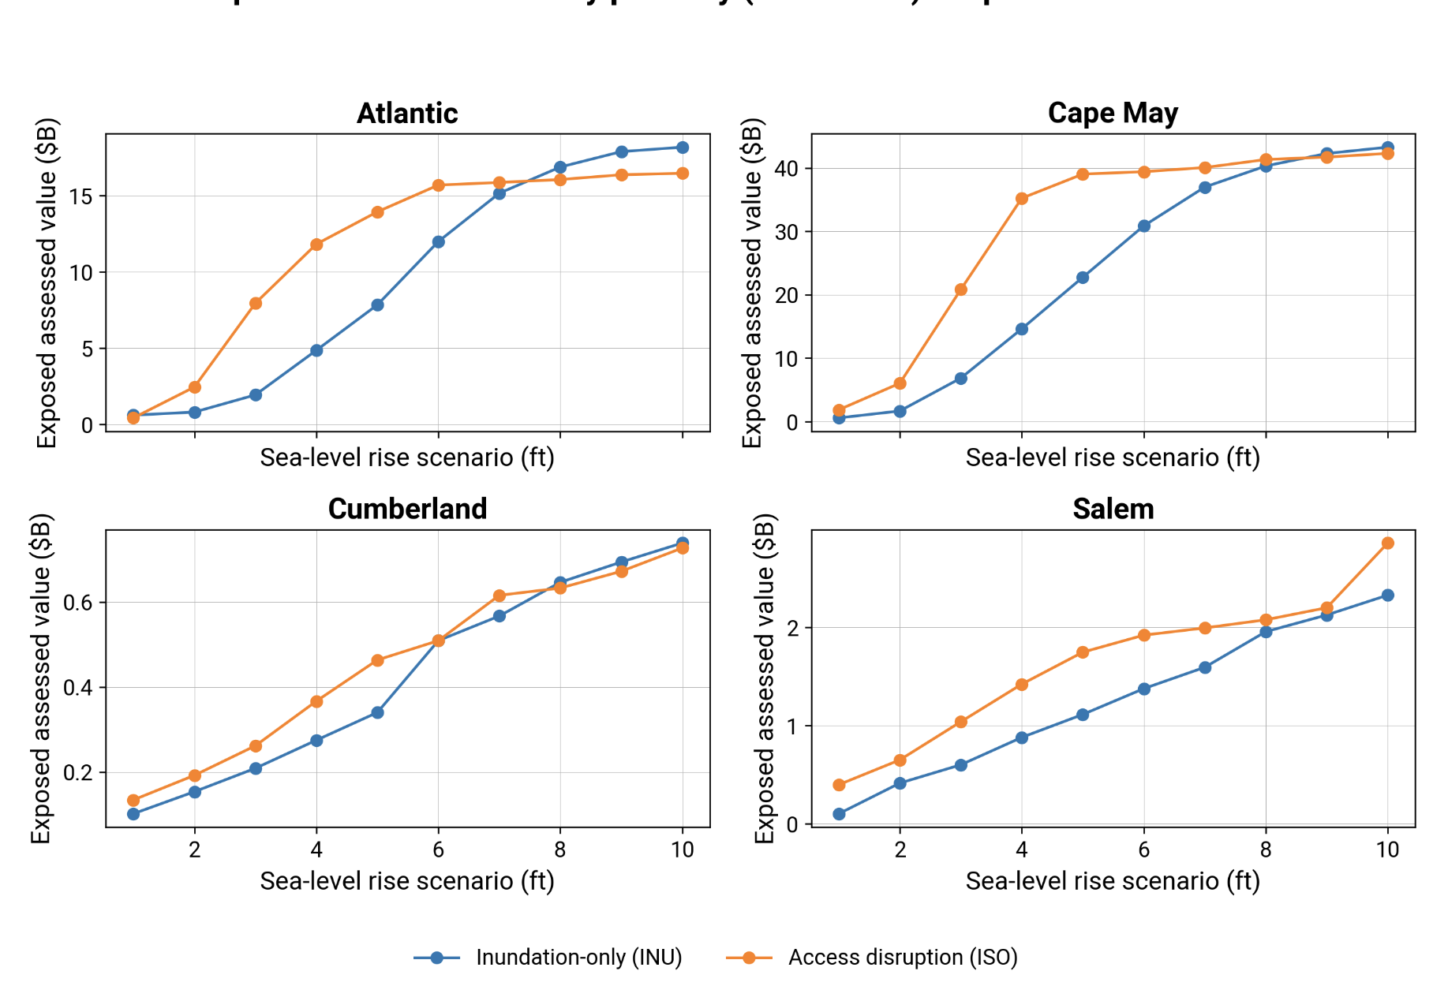
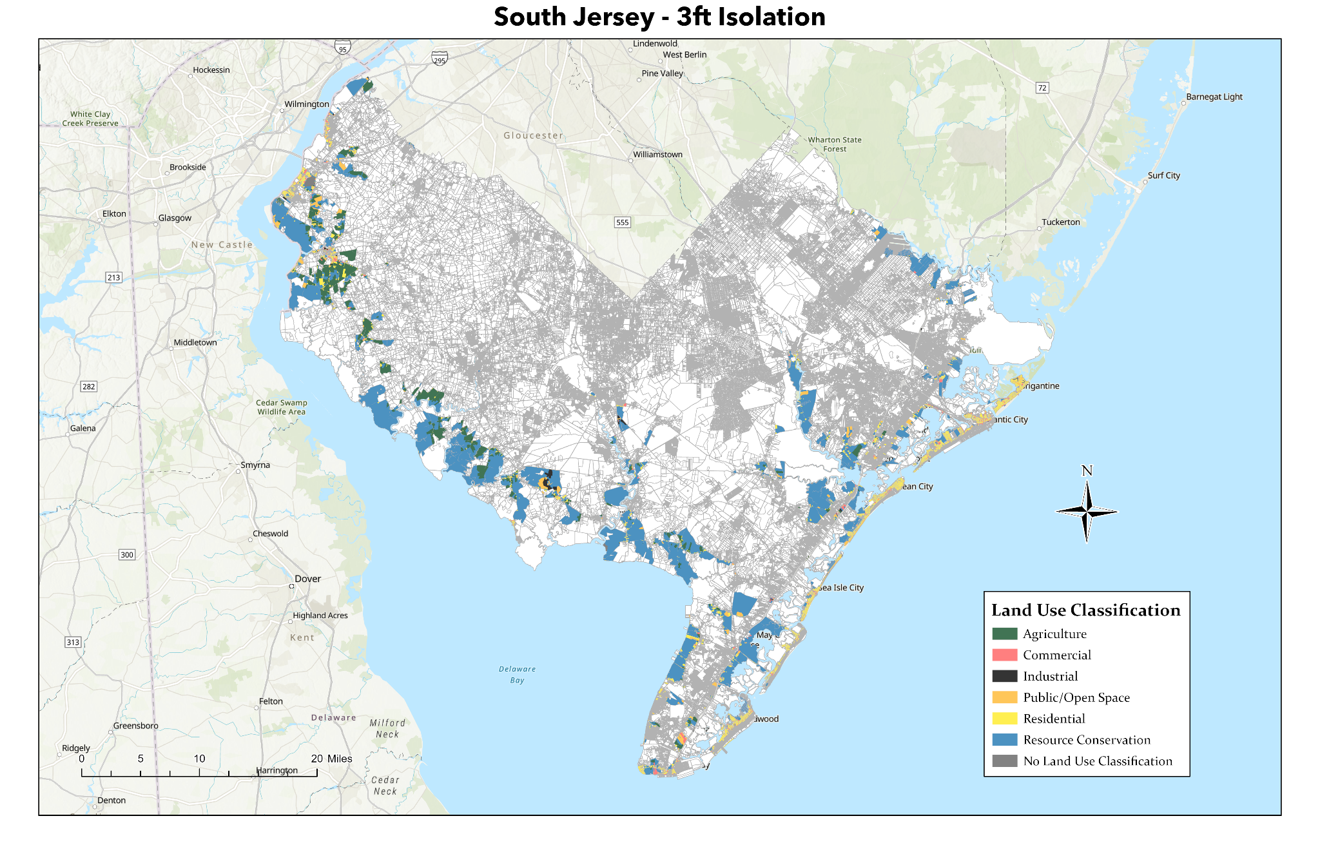
(Olcese & He, in progress)
Study funded by the National Science Foundation (NSF), Directorate for Engineering, CMMI (Award No. 2427242)

Slide 39
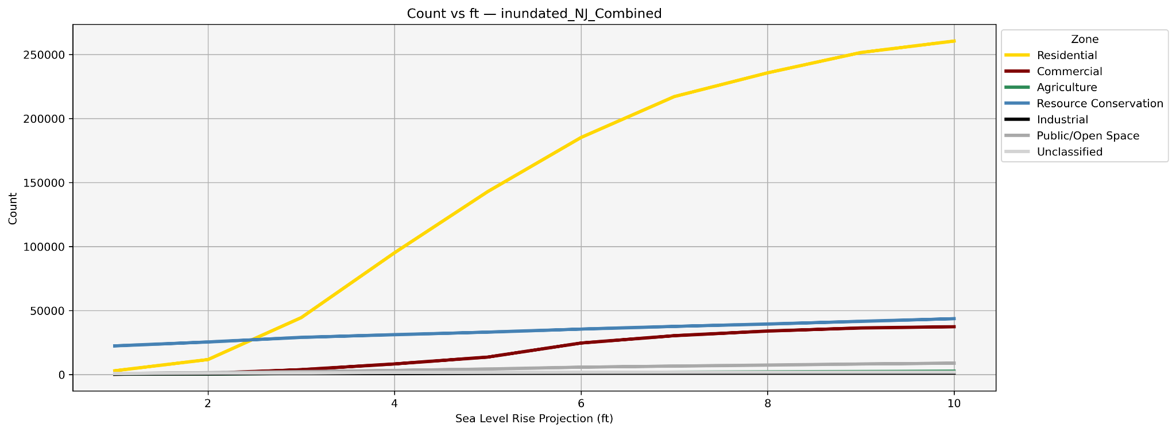


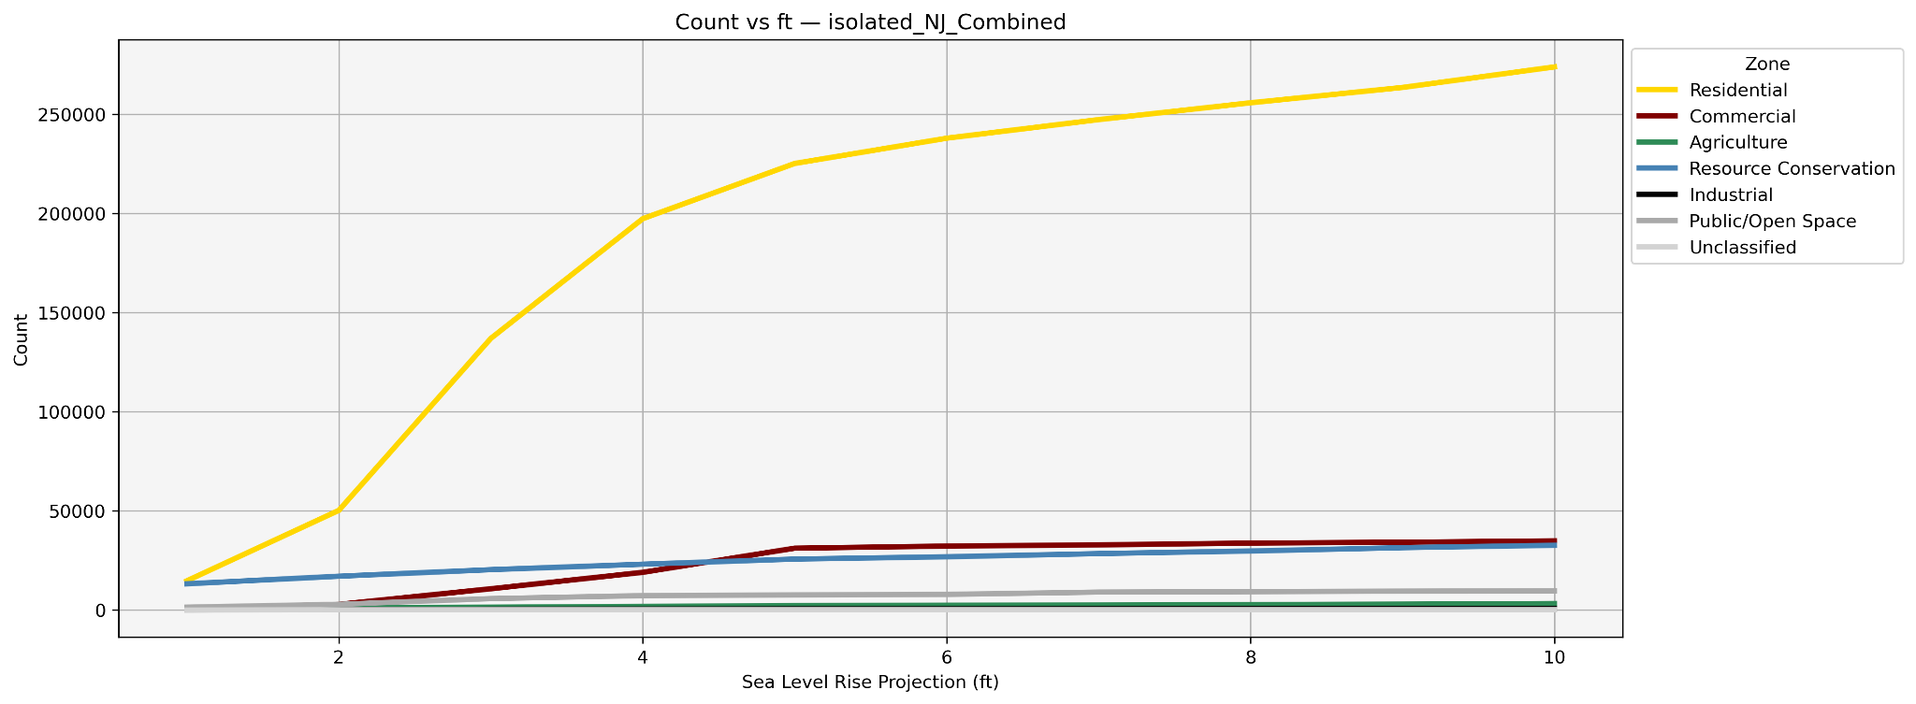
Across South Jersey, road-access failures can drive fiscal risk earlier than parcel flooding. At low sea-level rise thresholds, isolation expands quickly, especially for residential parcels where tax base depends heavily upon.
Planners should pair inundation maps with road-network choke-point analysis to target land-use, zoning, and capital investments that maintain essential connectivity.
(Olcese & He, in progress)
Study funded by the National Science Foundation (NSF), Directorate for Engineering, CMMI (Award No. 2427242)

Slide 40
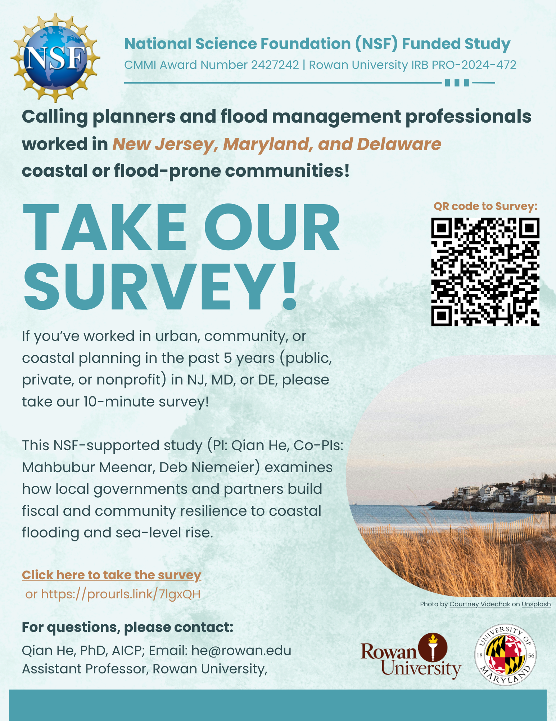
We want to learn from your experience (anonymous) on how local planning efforts build fiscal and community resilience to Sea-level rise flooding impacts. If you are eligible, please consider taking our survey after this session.
Rowan University IRB: #PRO-2024-472

Slide 41
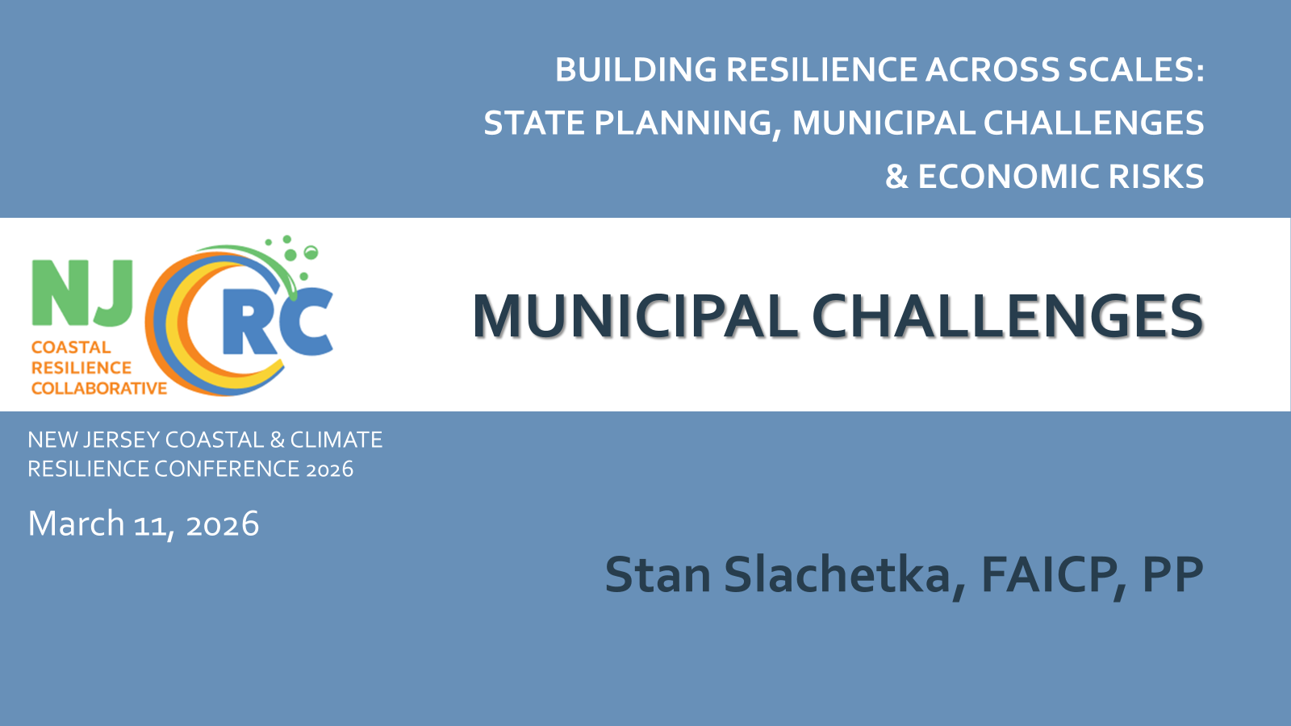


Across South Jersey, road-access failures can drive fiscal risk earlier than parcel flooding. At low sea-level rise thresholds, isolation expands quickly, especially for residential parcels where tax base depends heavily upon.
Policy takeaway: capital plans should prioritize protecting key connectors and adding route redundancy to safeguard services and the tax base.
(Olcese & He, in progress)
Study funded by the National Science Foundation (NSF), Directorate for Engineering, CMMI (Award No. 2427242)
Notes:
A practical coordination barrier is accessing updated zoning shapefiles. Zoning updates sit with municipalities with varying staff capacity under home rule, not everyone maintains an updated dataset, which can slow regional risk assessment and limits comparability.

Slide 42
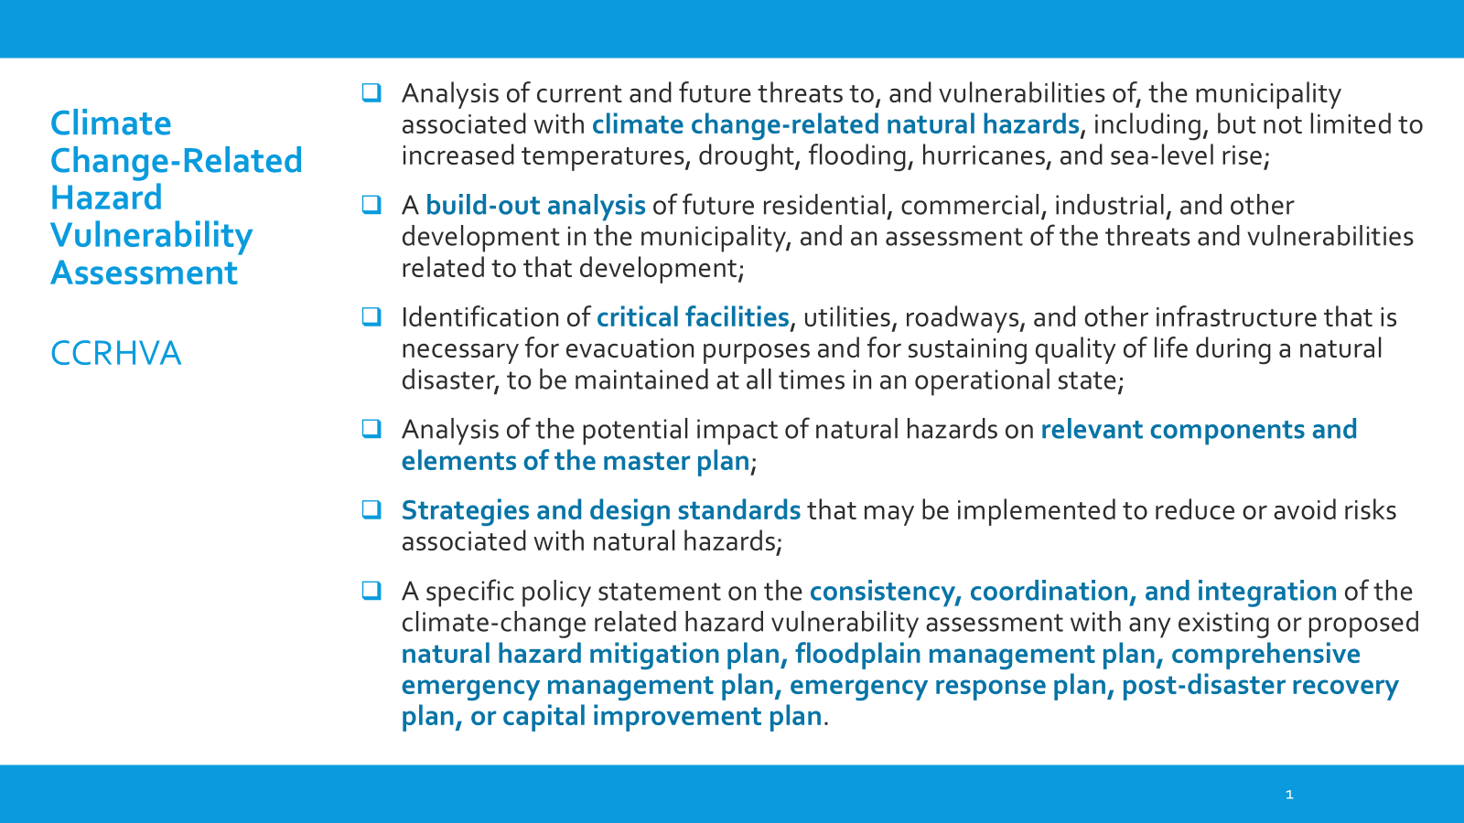

Slide 43
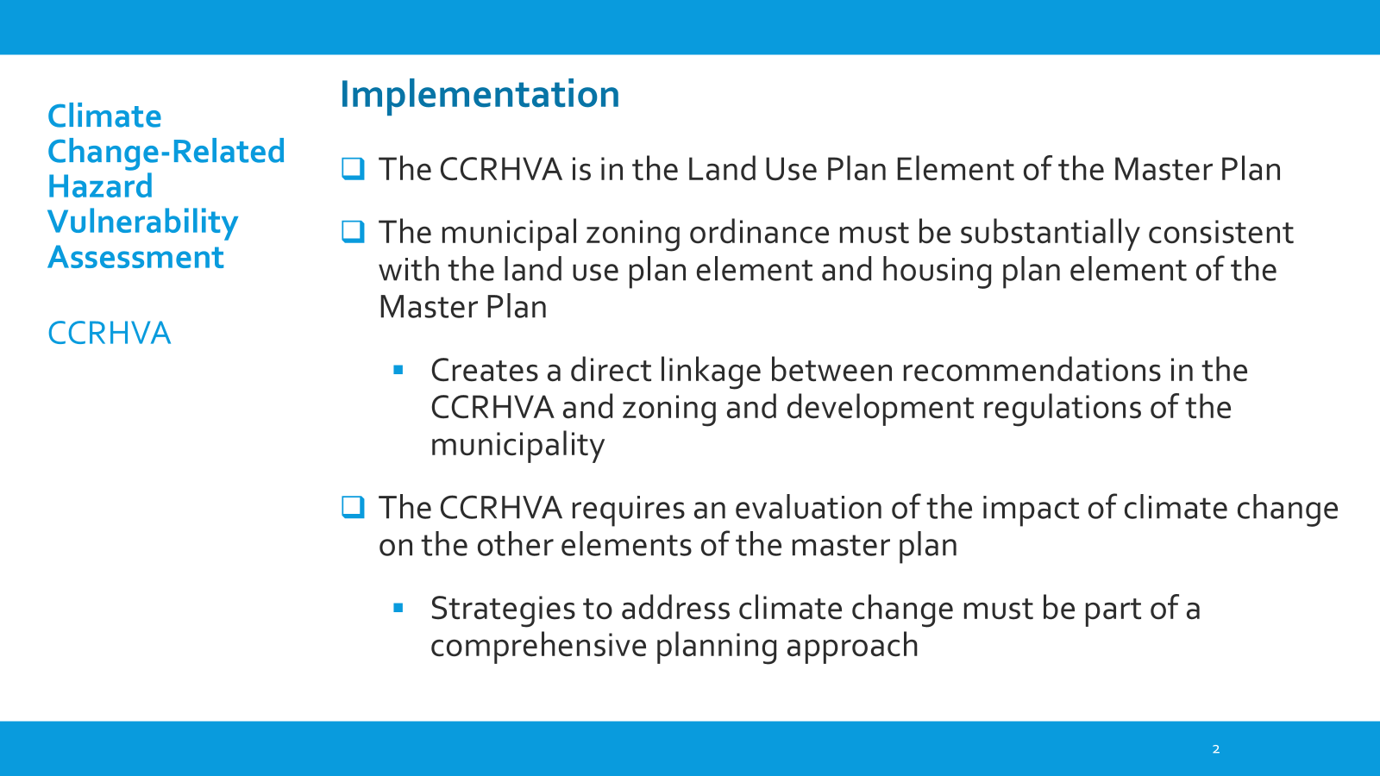

Slide 44
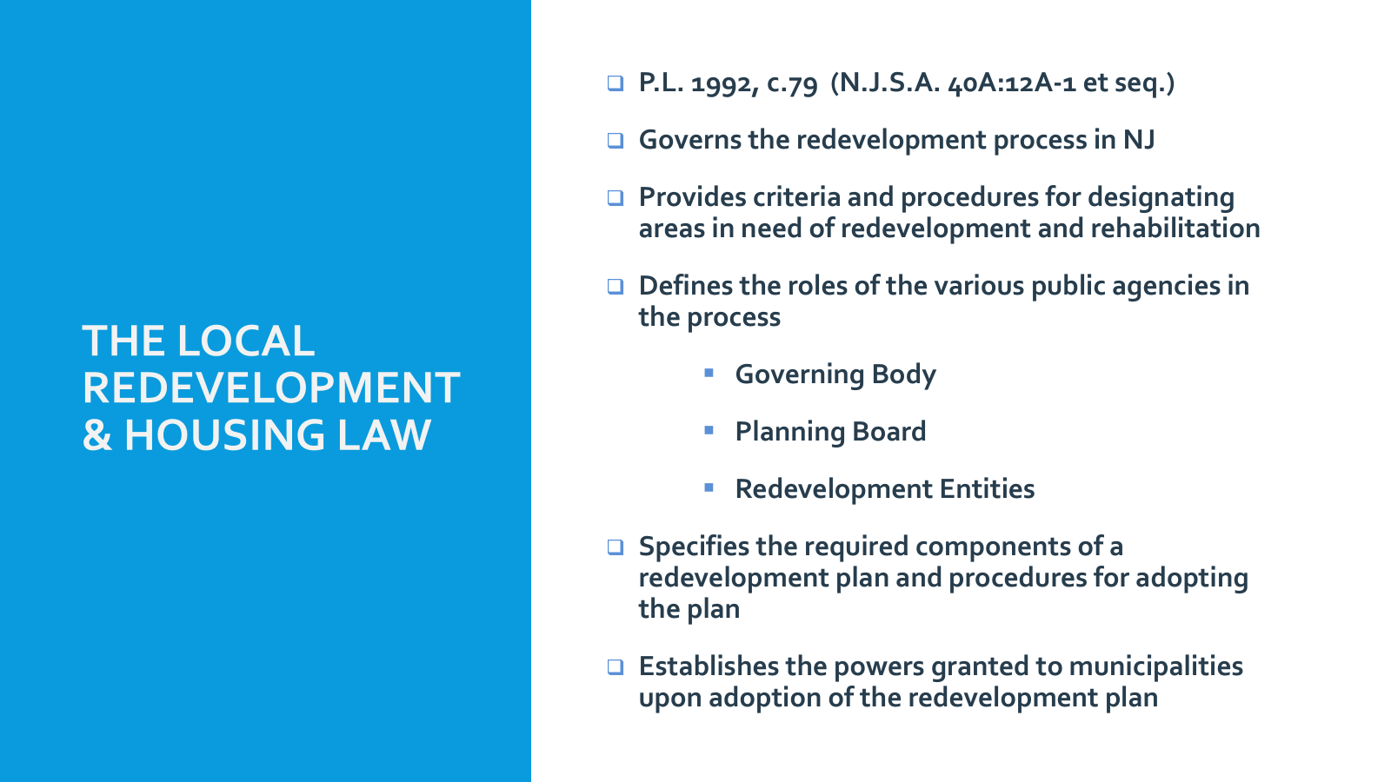

Slide 45
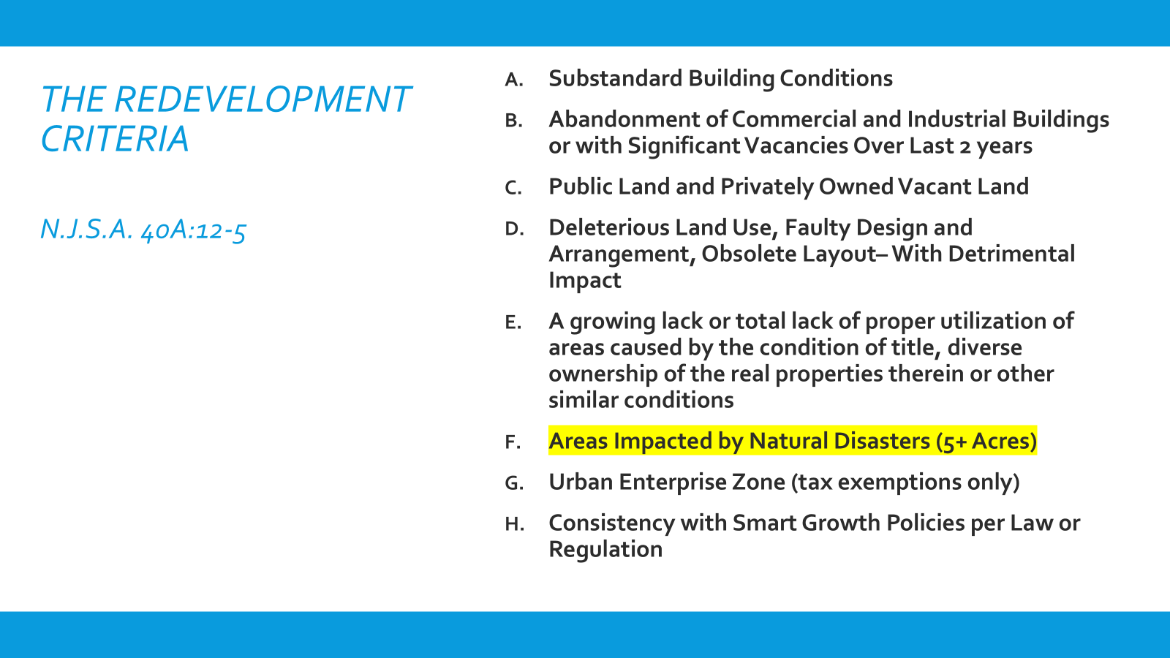

Slide 46
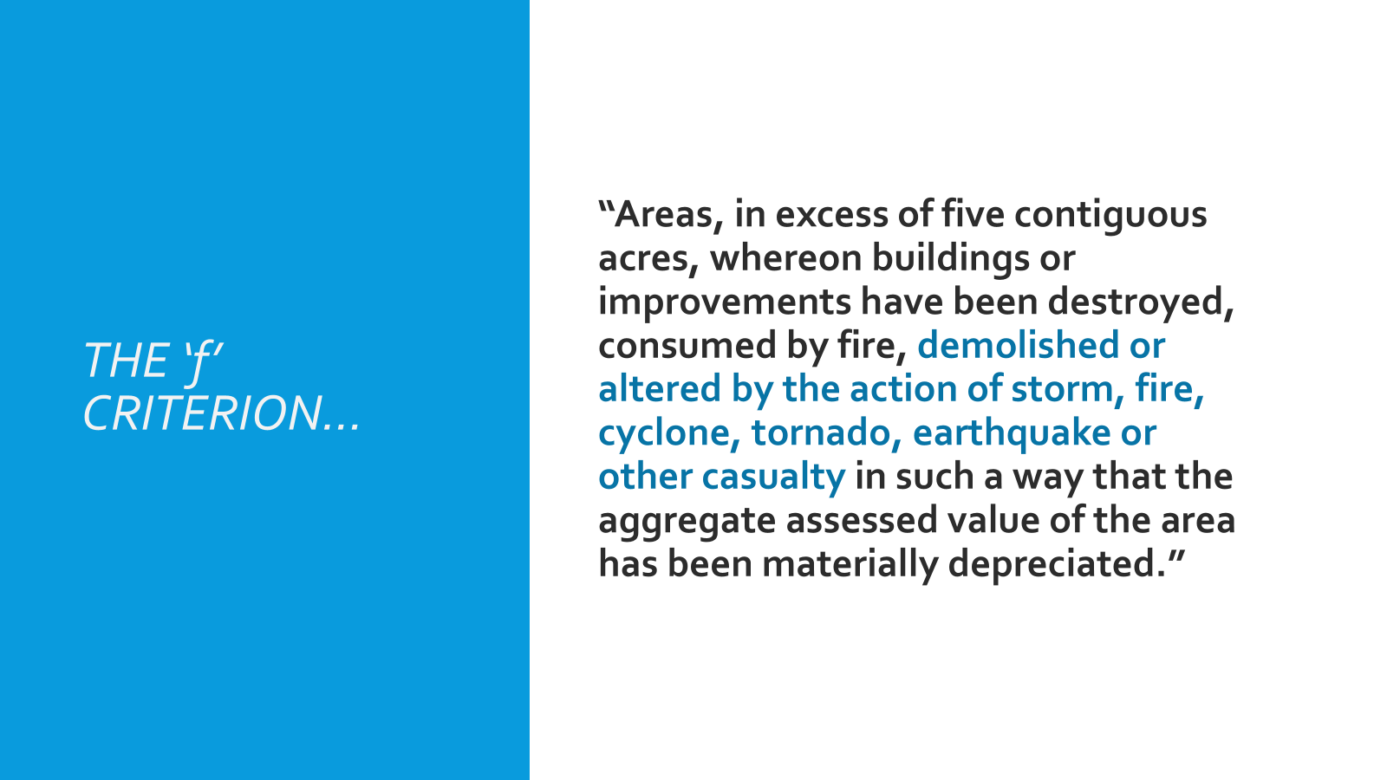
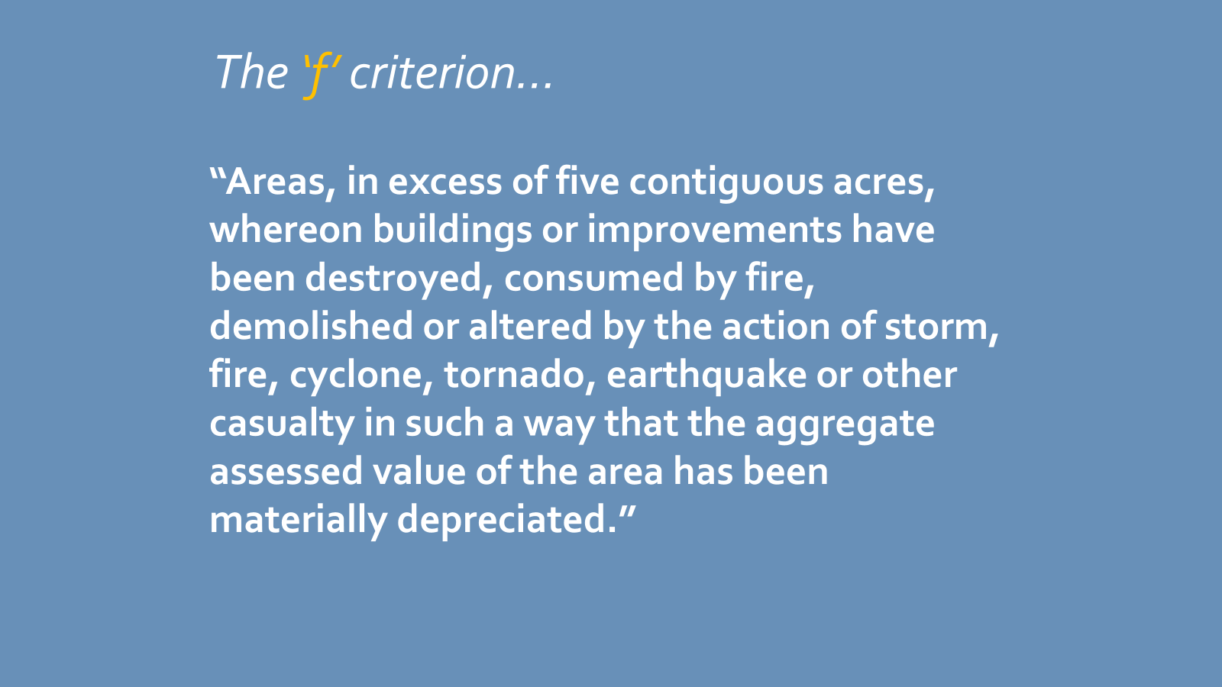

Slide 47
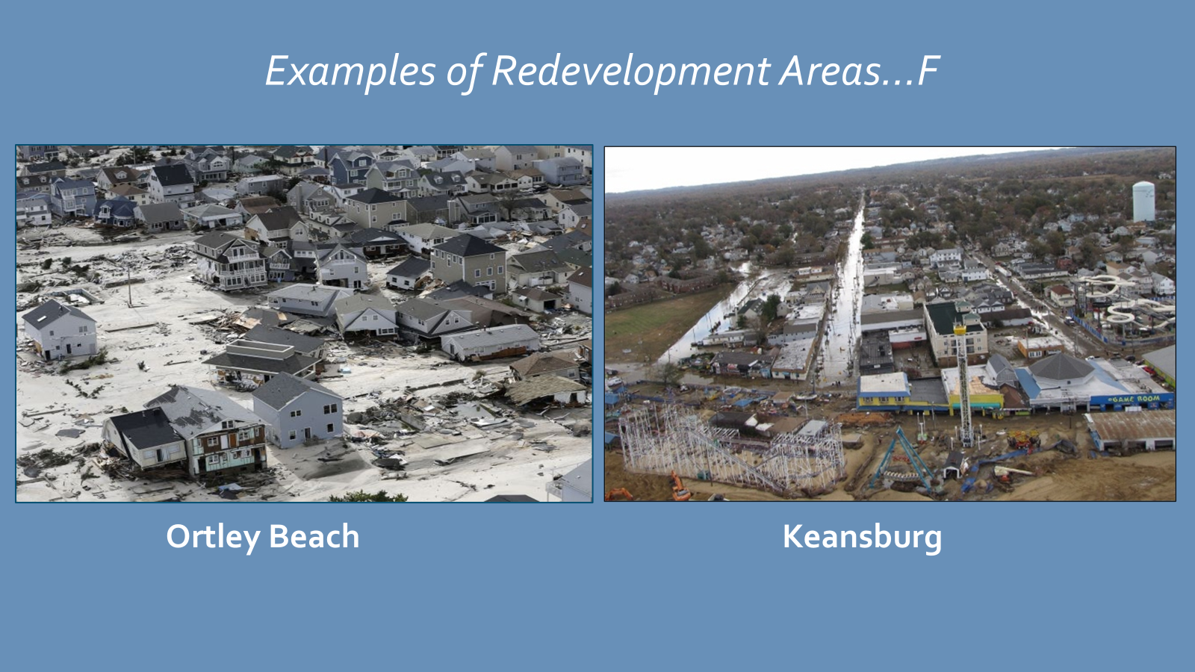

Slide 48
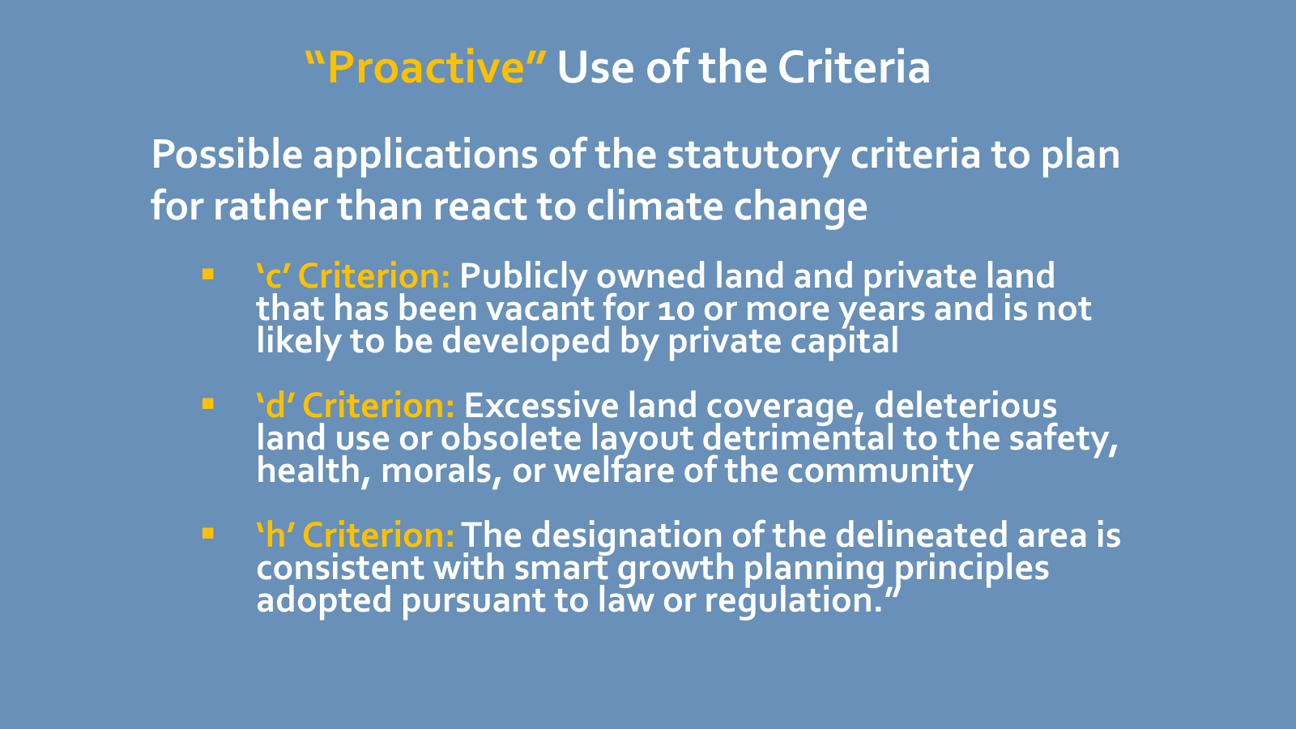
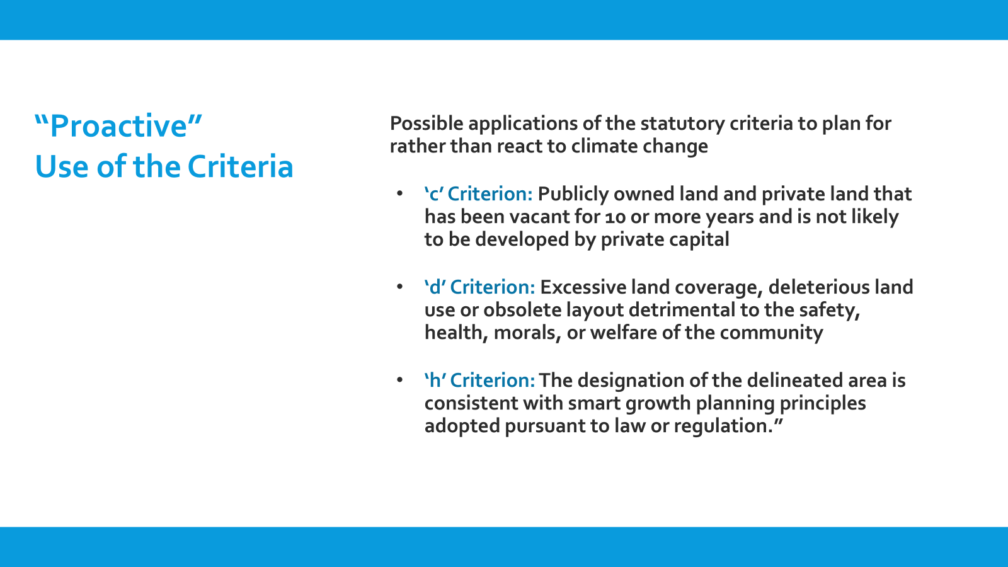

Slide 49
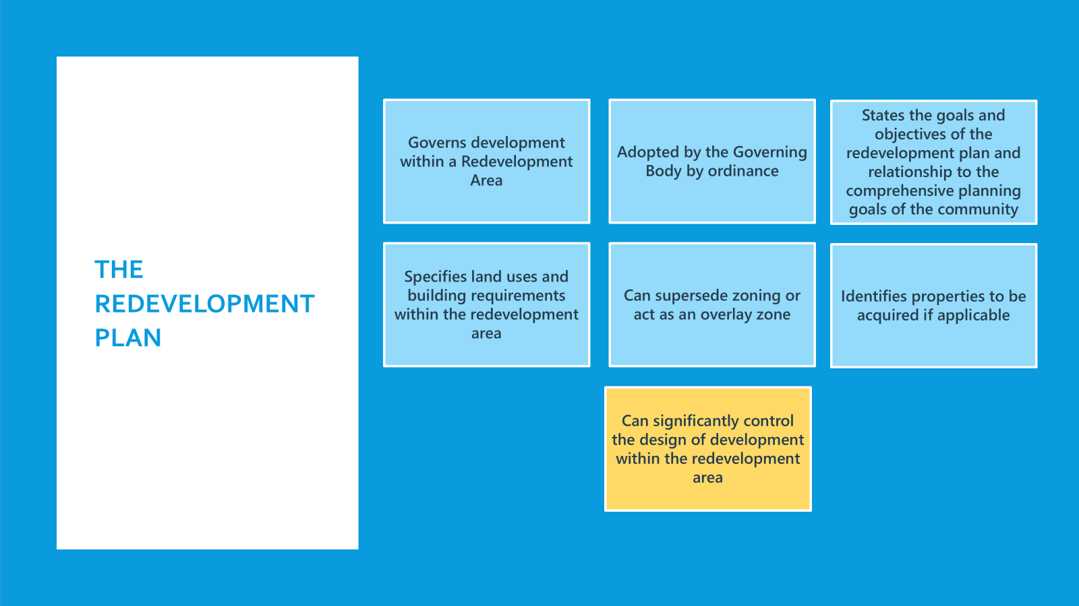

Slide 50
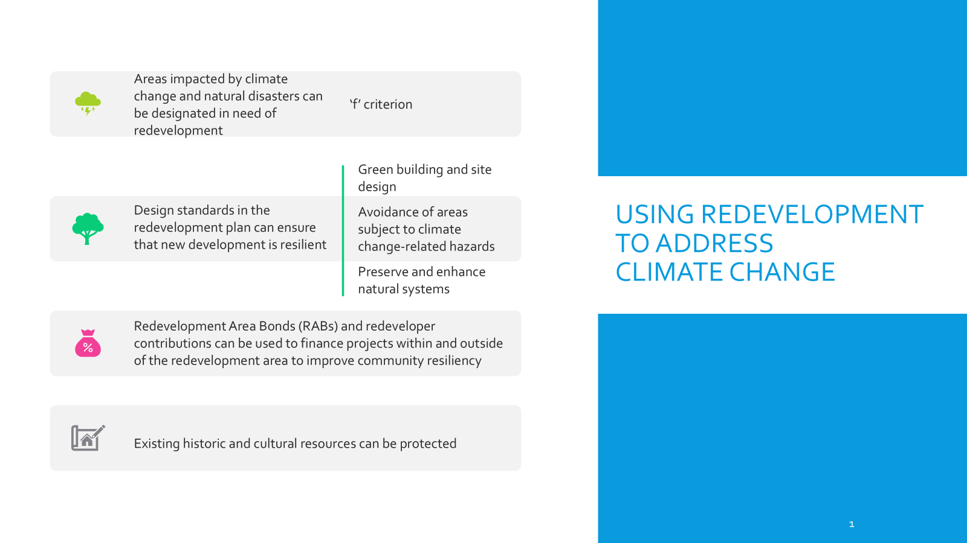

Slide 51

Any questions?
Ask away!
Photo: Princeton, NJ

