Slide 1
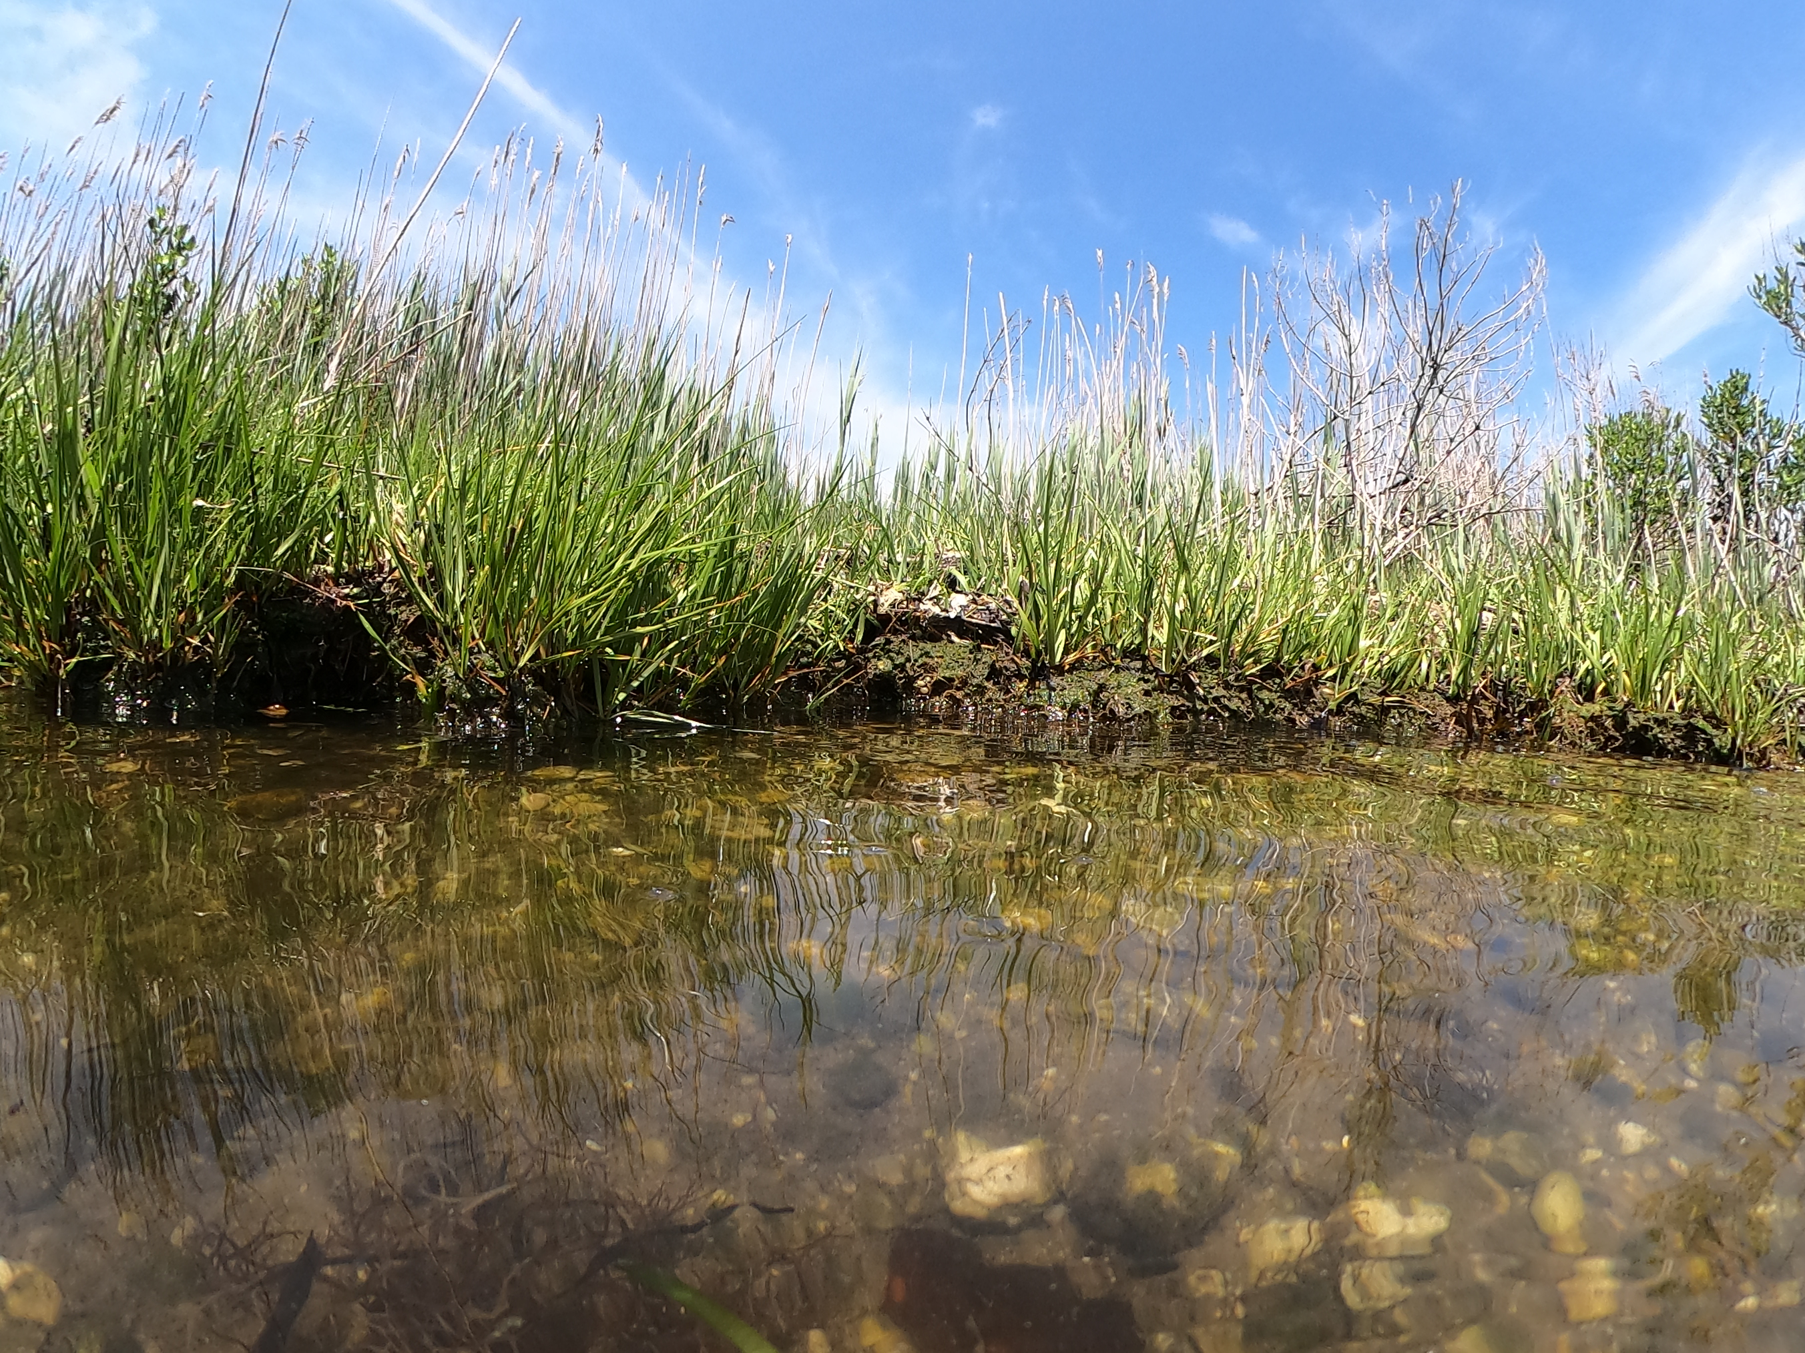


Hydrologic Variability in NJ Salt Marshes and Implications for Restoration Planning
Ceili Pestalozzi, LeeAnn Haaf, Martha Maxwell-Doyle, March 9, 2026
Notes:
This study was a joint effort between Partnership for the Delaware Estuary and the Barnegat Bay Partnership
The study was designed and carried out by BBP and PDE staff, and I came in during the data analysis stage. I’m here to tell a piece of the larger story.
We looked into drivers of hydrologic variability in salt marshes in two different systems, Barnegat Bay and Delaware Bay
Goal for today is to connect some of the results from this preliminary study to restoration planning

Slide 2
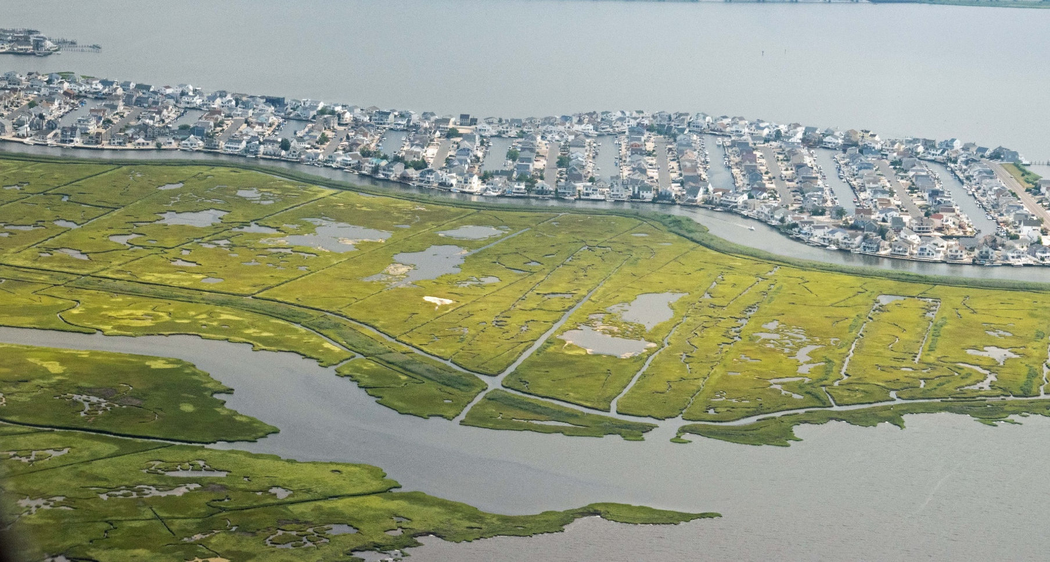
NJ has experienced a decline in wetland acreage due to:
Salt marshes provide many ecosystem services
Historic and recent alteration
Development
Sea-level rise
We need studies that allow us to:
Understand threats and trajectories
Prioritize areas for restoration
Select restoration techniques and evaluate outcomes
Notes:
Ecosystem services: storm protection, filtering of pollutants, C sequestration
Restoration is ongoing, Value of restoration projects is evident, but in order to be more efficient and successful, we need studies that

Slide 3
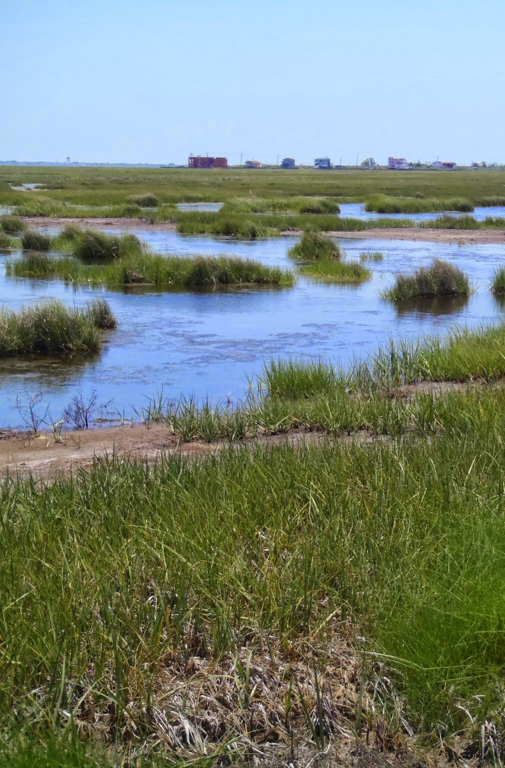
Hydrology is Key
Plant physiology and competition (zonation)
Nutrients and water quality (biogeochemistry)
Sediment delivery
Accretion
Notes:
Hydrology is the main determinant of wetland structure and function
When we are thinking about restoration projects, the pre-restoration hydrology at the site is going to shed light on why the wetland is in need of restoration, which techniques are most appropriate, and the outcomes of those techniques

Slide 4
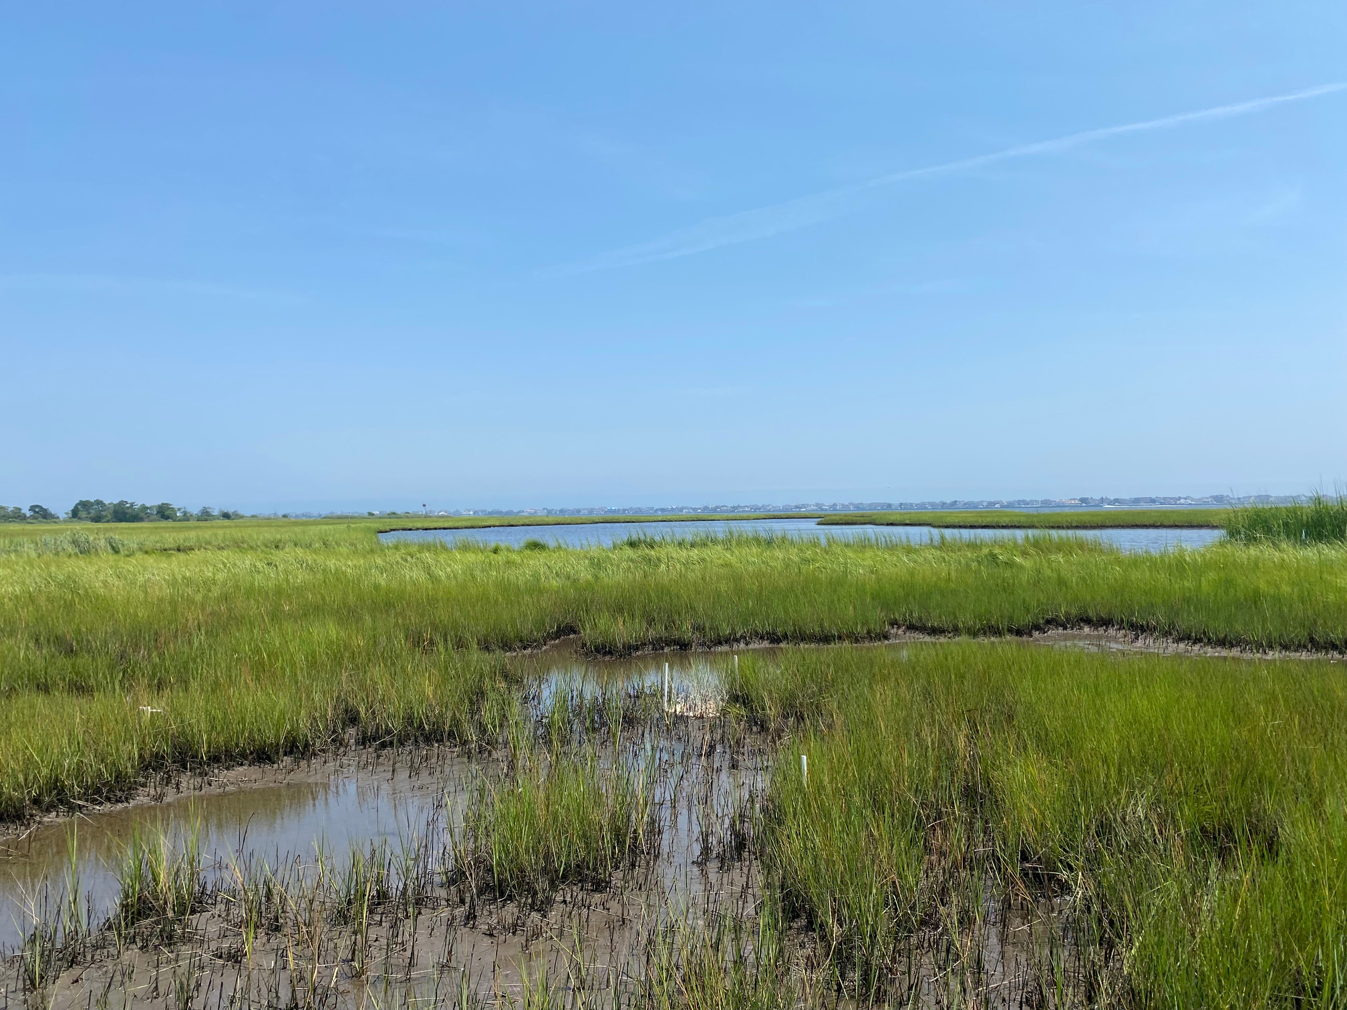
Local Water-Level data are sparse
Challenges Include:
Time
Expertise
Infrastructure/access
WL monitoring at long-term SET-MH monitoring sites:
What meteorological variables are driving water levels at individual sites?
How is this related to elevation and condition/vulnerability?
Are USGS gauges a good substitute for on-site data?
Notes:
Despite the importance of hydrology, water level data are sparse due to various challenges, availability of regional data
regional data (USGS gauges) are an easy substitute, or NOAA Vdatum or NOAA datums (NTDE is 25 to 45 years old).
This study was a preliminary investigation into what is driving water levels at individual sites (long-term monitoring sites)
Long term monitoring sites are SET-MH sites, which allow us to calculate, elevation change rate, accretion rate, and shallow subsidence
Study design allowed us to look into water levels related to elevation and elevation dynamics, and it also allowed us to compare the USGS gauges with local data to see if these were good substitutes for local data.

Slide 5
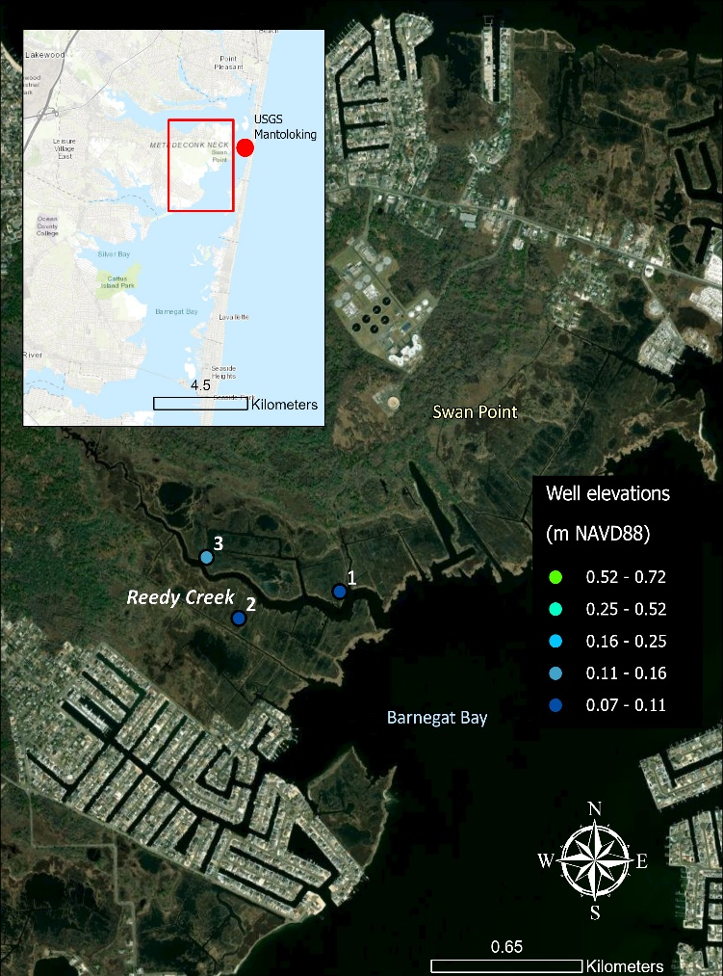
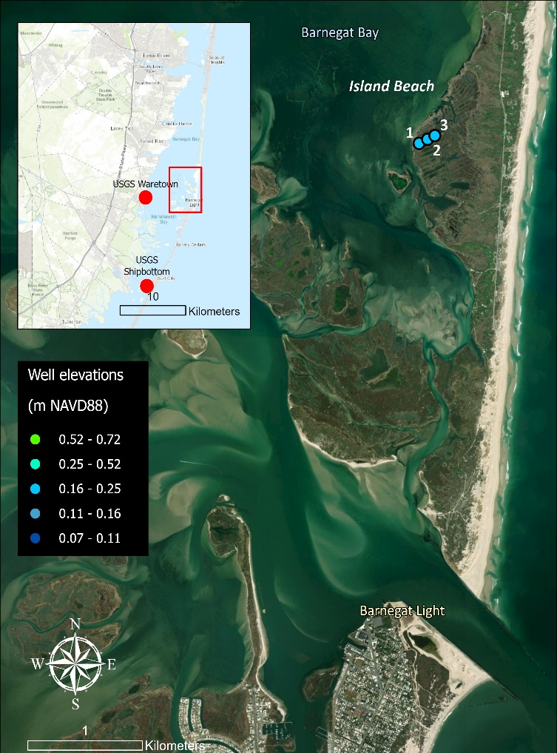
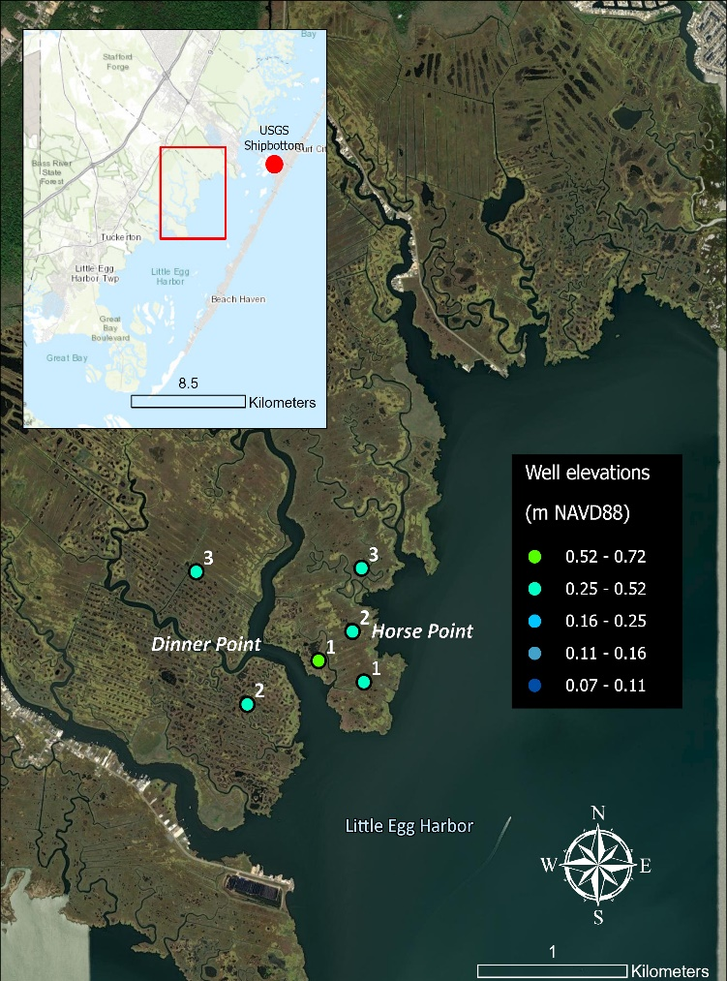
Long-term monitoring sites in Barnegat Bay
A
B
C
Notes:
Taking a closer look at our sites, only focusing on BB today
These are all sites that have SET-MH monitoring ongoing. This measures elevation change and accretion so we have an idea of elevation change rate and accretion and shallow subsidence
three SETs in each array.
Notice USGS gauges (red dots), within 4-8 km of SET sites
All BB sites are microtidal, Reedy creek has lowest range close to 1 ft, and southern BB at the Horse Point site is about 2 ft. This is generally a sediment-poor system

Slide 6
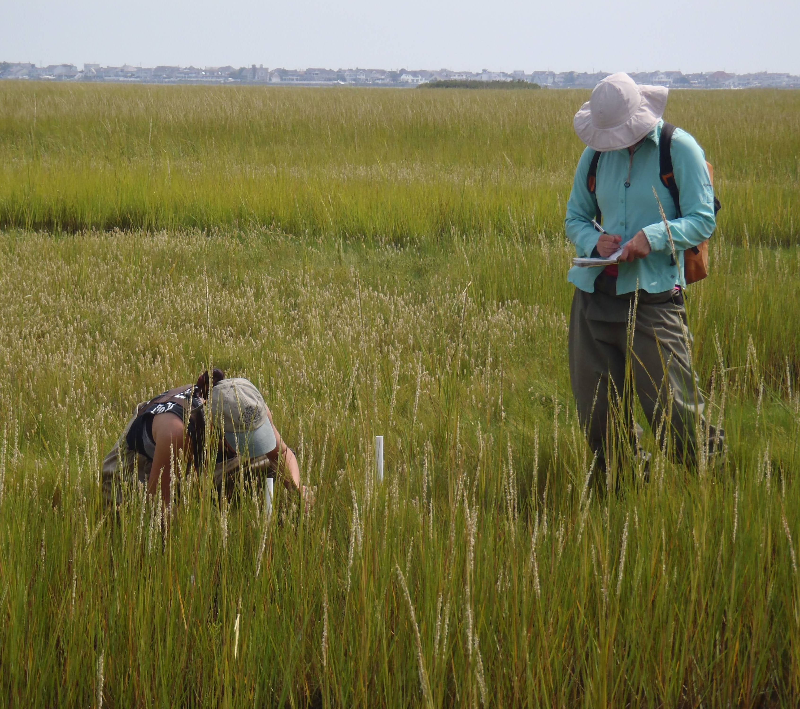
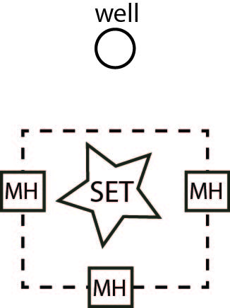
Data Collection
SET-MH: elevation change (accretion/subsidence, long term)
Groundwater wells: local groundwater/surface water level (15-min logging interval)
Weather: wind direction, wind speed, precipitation, season

Slide 7

Analysis
On-site to gauge water level comparison: tidal signatures removed from data with oce package in R (observed-predicted), then gauges and on-site levels compared using z-scores
PLS regression used to identify relationships between meteorological factors and water levels (gw & sw)
Surface flooding frequency, duration, and depth calculating using Vulntoolkit package in R
Notes:
We made the on-site to gauge water level comparison by removing the tidal signature from both datasets. We wanted to look at the variations outside the predicted tidal variation, as these are hypothesized to show the greatest differences between sites (tidal influence is expected to be similar over a larger area, but water level may, or may not be, depending on meteorological and other factors)

Slide 8
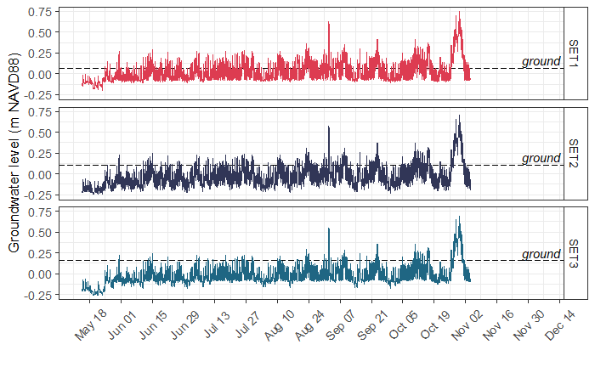
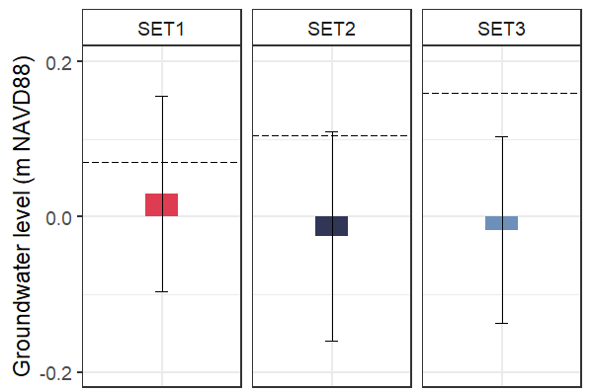
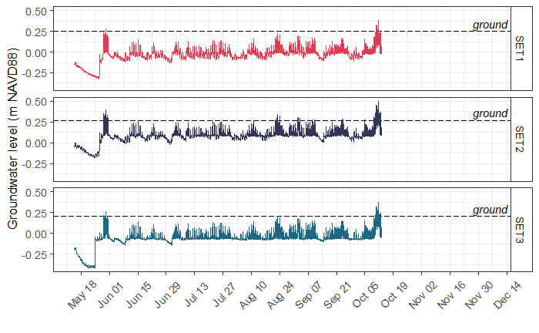
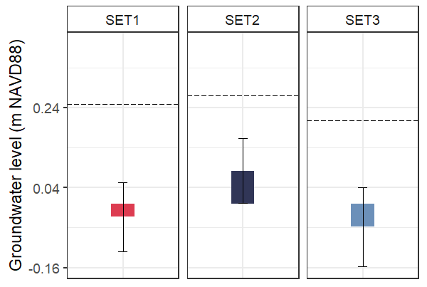
Reedy Creek groundwater
A
B
Lowest elevation
Frequently flooded, longer duration
Surface elevations close to MTL
Island Beach groundwater
A
B
Low elevation
Infrequently flooded
Surface elevations close to MHW
Notes:
Both Reedy Creek and Island Beach are considered very vulnerable, not keeping up with SLR, losing vegetated area, in need of restoration
Reedy Creek is very low elevation, frequently flooded, and surface elevations are close to MTL (as determined at nearest gage)
Island Beach is infrequently flooded, and surface elevations are low, close to MHW
Different techniques would be needed for restoration at each, based on water levels and ground surface interaction. Reedy Creek is a good candidate for sediment placement, Island Beach probably is not (might be risking acid sulfates). If you’re just looking at gage, you might think you could add some elevation to Island Beach and still have it flood daily, when in fact, hydrologic alteration in the form of ditch remediation plus improved drainage might be more appropriate (we need to change the way the marsh floods and drains).

Slide 9
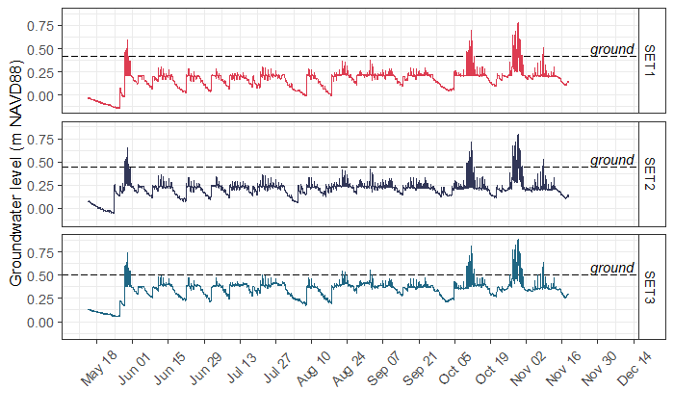
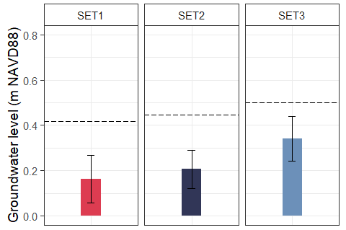
Horse Point groundwater
A
B
Highest elevation (+20-30cm)
Infrequently flooded
Surface elevations above MHHW
Notes:
Horse point

Slide 10
Frequency, duration, and depth of flooding at ground elevations.
Site | SET # | Ground surface (m NAVD88) | Mean frequency (%) | Mean duration (%) | Mean depth of flooding (m)
Reedy Creek | 1 | 0.0701 | 65.0% | 35.7% | 0.103
 | 2 | 0.1051 | 41.8% | 22.3% | 0.068
 | 3 | 0.1599 | 19.7% | 11.2% | 0.058
Island Beach | 1 | 0.2493 | 1.17% | 0.62% | 0.073
 | 2 | 0.2696 | 6.36% | 3.34% | 0.045
 | 3 | 0.2082 | 2.14% | 1.12% | 0.054
Horse Point | 1 | 0.4174 | 3.72% | 2.06% | 0.112
 | 2 | 0.4458 | 3.82% | 2.08% | 0.113
 | 3 | 0.5007 | 5.31% | 3.03% | 0.135
West Creek | 1 | 0.7168 | 0.39% | 0.51% | 0.06
 | 2 | 0.5177 | 3.92% | 2.06% | 0.105
 | 3 | 0.4463 | 2.22% | 1.34% | 0.104
Notes:
Surface flooding frequency, duration, and depth calculating using Vulntoolkit package in R
surface flooding was more frequent, of longer duration, and deeper in sites that had groundwater tables closer to the ground surface, but this did not always follow the same pattern as ground surface elevations, highlighting the importance of local conditions on groundwater and surface water levels. Accretion rates were also higher where groundwater was closer to the surface, likely due to sediment delivery onto the marsh via floods (Fig. 53A, C).
In Barnegat Bay, where tidal ranges are much lower, flood frequency and duration above the ground surface were more similar to each other for most of the sites. This is expected because the Barnegat Bay marsh sites were closer to MHHW (some above and some below, Table 4 and Table 6) meaning that the marshes may only flood infrequently or at low depths during a typical tidal cycle. Flood frequency and duration were similar among sites at Island Beach, Horse Point, and West Creek, despite ~40 cm in elevation difference between these sites (Fig. 44-46). Flood frequency and duration was much higher at Reedy Creek than at the other Barnegat Bay sites and flood frequency at the marsh surface was also substantially higher than duration at this site only (Fig 43). Flood depths were highest at Reedy Creek (Fig 43) and lowest at Island Beach (Fig 44), even though these are the two lowest elevation sites (both close to MTL and below MHHW) and Island Beach is only about 10cm higher in elevation than Reedy Creek (relative to NAVD88 or MHW).

Slide 11
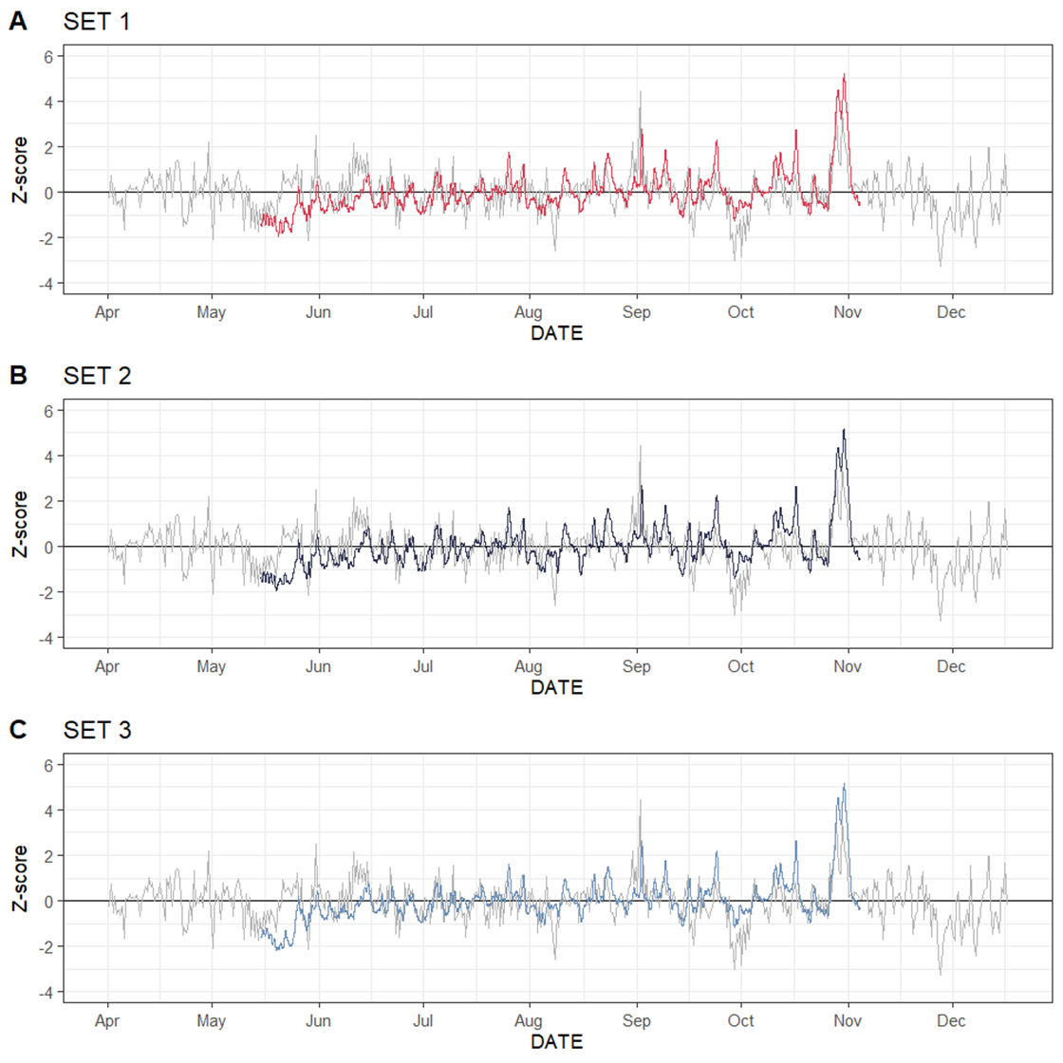
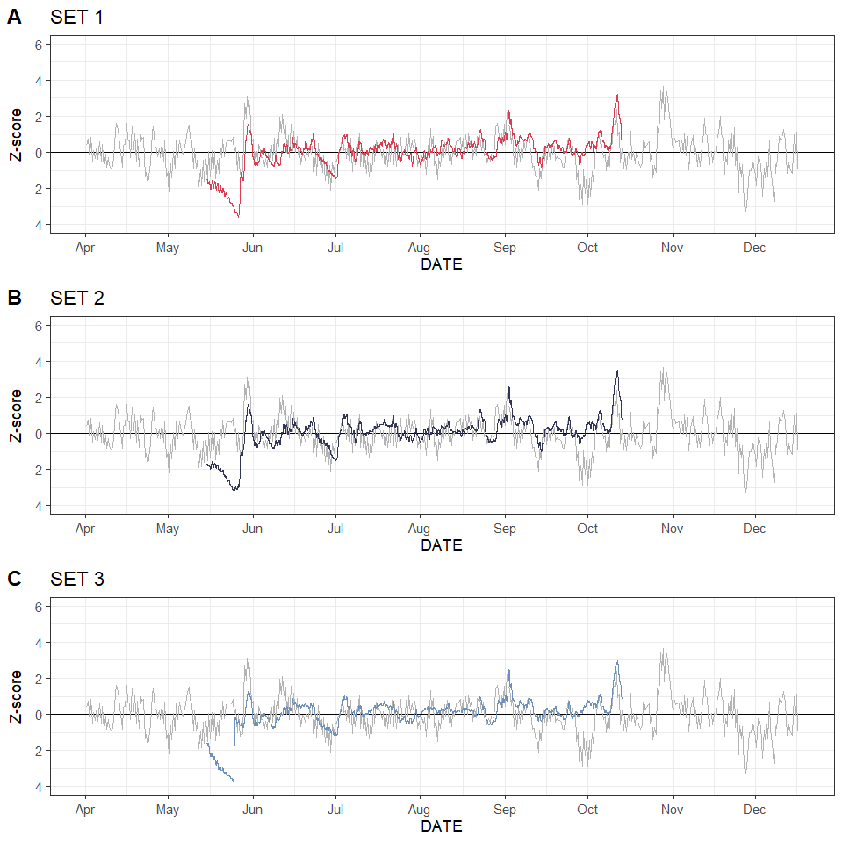
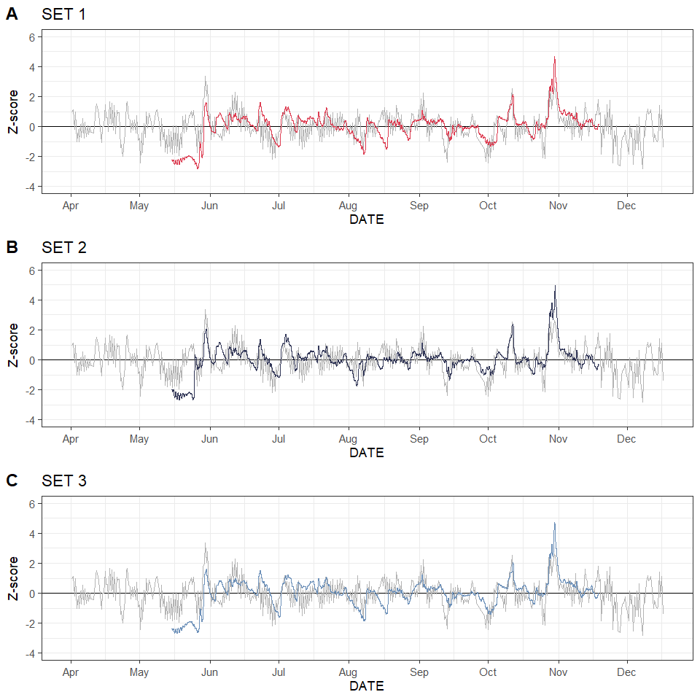
Reedy Creek
The nearest USGS gauges generally did not provide an accurate picture of hydrologic regimes at the marsh sites
Island Beach
Similar patterns with notable differences
Magnitude of anomalies and even direction of anomalies is sometimes different
Horse Point
Time lags around 0.25 to 1.25 hrs for WL
Tidal WLs were reaching high and low relatively close together
Notes:
On-site to gauge water level comparison: tidal signatures removed from data with oce package in R (observed-predicted), then gauges and on-site levels compared using z-scores
Groundwater levels at each site compared, via Z-score, to the water levels at the nearest USGS gage
Generally a similar pattern, but magnitude of anomalies and sometimes even direction of anomalies is different
This site is low in elevation, generally close to MTL, and flooded often

Slide 12
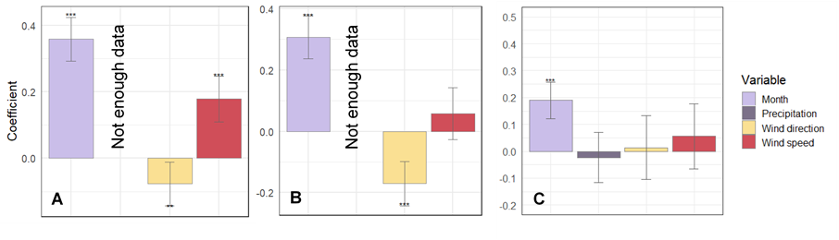
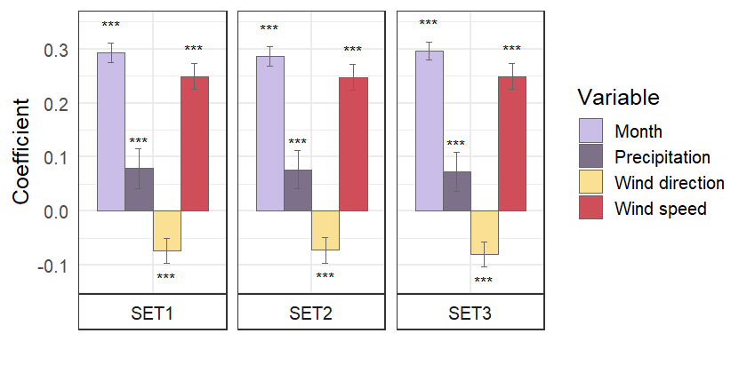
USGS Mantoloking
PLS regression coefficients of the model to predict water level anomalies (i.e., with tidal signal removed). Asterisks represent significance (* p<0.07, ** p<0.05, ***p<0.001).
Reedy Creek
Month (season)
Wind speed
Reedy
Notes:
PLS regression used to identify relationships between meteorological factors and water levels (gw & sw)
Coefficient speaks to strength of relationship and asterisks indicate significance
Month was a strong predictor of water level anomalies, at both the gage and at Reedy Creek, along with wind speed

Slide 13
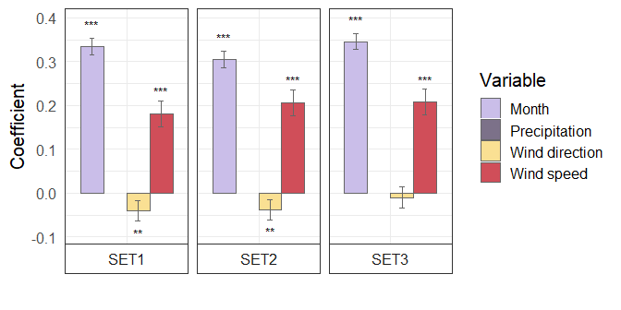
USGS Waretown
PLS regression coefficients of the model to predict water level anomalies (i.e., with tidal signal removed). Asterisks represent significance (* p<0.07, ** p<0.05, ***p<0.001).
Island Beach
Month (season)
Wind speed
Island Beach
Notes:
Month was a strong predictor of water level anomalies, at both the gage and at Island Beach
Notably, wind speed was a strong predictor at Island Beach but not at the Waretown gage

Slide 14
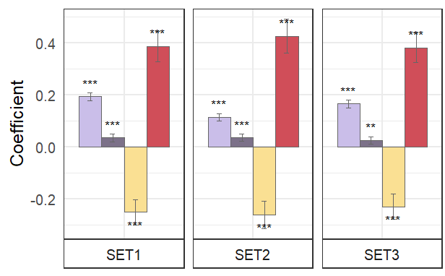
USGS Shipbottom
PLS regression coefficients of the model to predict water level anomalies (i.e., with tidal signal removed). Asterisks represent significance (* p<0.07, ** p<0.05, ***p<0.001).
Horse Point
Month (season)
Wind speed
Wind direction

Slide 15
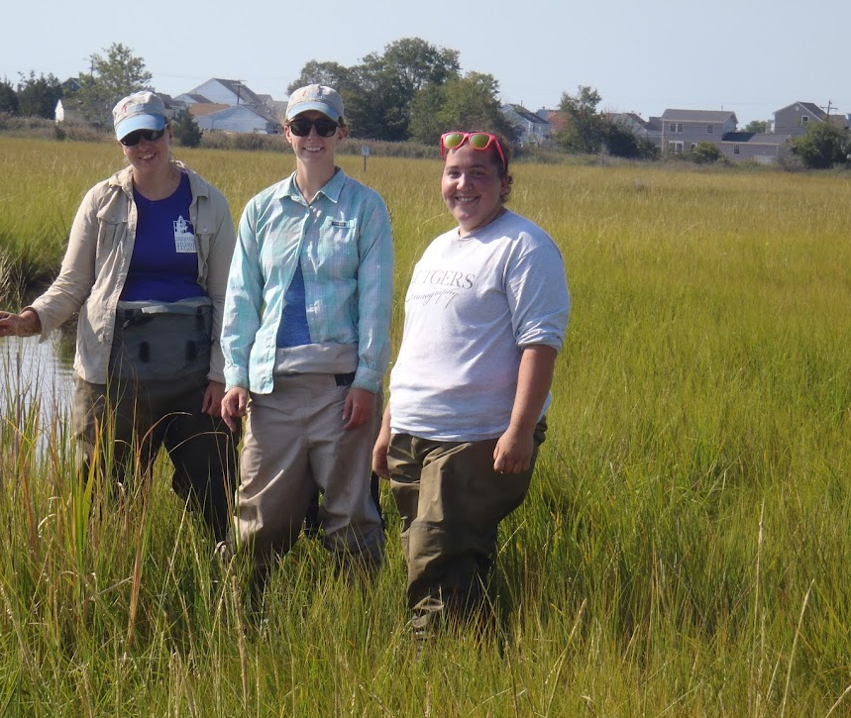
Summary
Unique inundation patterns, even at low elevations/vulnerable sites
Wind is a major player (exact location is important)
Tide gages generally did not provide an accurate picture of hydrologic regime at the wetland sites
Source: MACWA Umbrella QAPP, 2023
Notes:
These unique inundation patterns coupled with the results of the PLS regressions for groundwater and surface water level anomalies highlight how salt marshes in different areas of the bay experience flooding differently. Tidal range and elevation relative to tidal datums play a part in the hydrologic regime, but also interact with other factors such as seasonality and wind, and potentially unstudied factors like soil characteristics, atmospheric pressure, or individual factors affecting seasonality in water levels (river runoff, long-term wind patterns, long-term precipitation patterns, etc.). Haaf et al. (2022) concluded that marshes with smaller tidal ranges like those in Barnegat Bay are more vulnerable to RSLC, and results from that study specifically showed that Island Beach and Reedy Creek had especially short time-to-submergence compared to other Barnegat Bay and Delaware Bay sites. Both of these sites are failing to build elevation at a pace that can keep up with RSLC, but they have very different patterns of inundation, highlighting the complexity of these systems and the mechanisms of vulnerability to sea level change.
Different restoration techniques might be appropriate for each, for example, BUDM may not be appropriate at Island Beach because it floods so infrequently, even at this low elevation
In conclusion, seasonality, wind direction and wind speed were important drivers of groundwater and surface water level anomalies in both Delaware Bay and Barnegat Bay salt marshes, and drivers were expectedly site-specific. Seasonality was an important driver of bay-wide water levels in both Barnegat Bay and Delaware Bay, and also appeared to have a greater influence on marshes below MHHW. Water level monitoring at the nearest tide gauges generally did not provide an accurate picture of hydrologic regimes at the individual marsh sites and differences in water levels varied with gauge-site pair and with time. This is an important consideration for evaluating vulnerability to RSLC as well as designing and employing restoration techniques, which often rely on accurate evaluation of tidal range and accurate determination of elevations relative to local tidal datums.

Slide 16
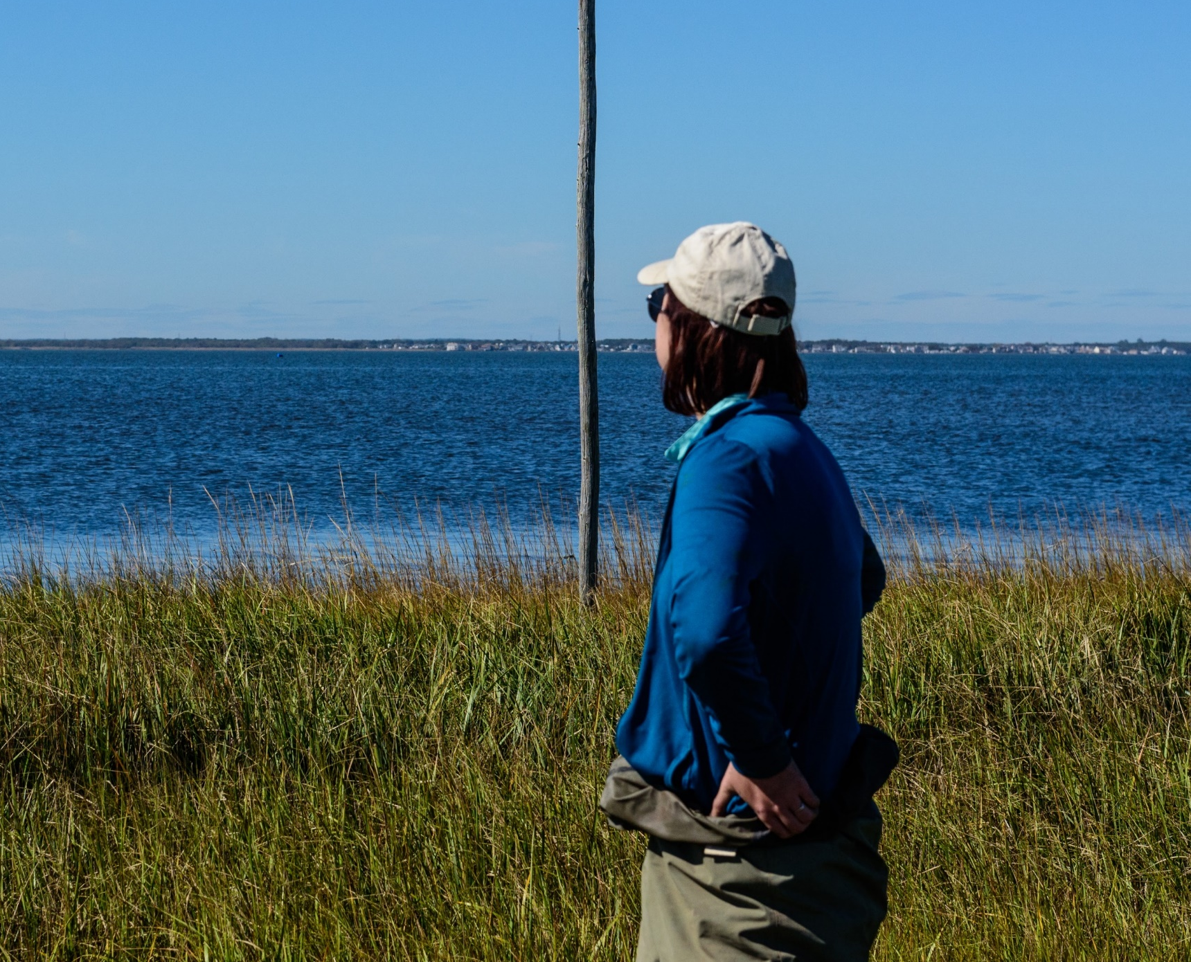
Looking Forward
Expanded water level monitoring
Moving-average for precipitation
Circular regression for wind

Slide 17
THANK YOU
Ceili Pestalozzi
cpestalozzi@ocean.edu
Special thanks to Dr. LeeAnn Haaf, Martha Maxwell-Doyle, Dr. Danielle Kreeger, and Emily Pirl who designed this study and secured funding for its completion. We would like to acknowledge the many hours spent in the field installing wells and completing monitoring by LeeAnn Haaf, Emily Pirl, Martha Maxwell-Doyle, and many field technicians at the Barnegat Bay Partnership and Partnership for the Delaware Estuary.
Many thanks to USEPA for funding this work.
Although the information in this document has been funded wholly or in part by the U.S. Environmental Protection Agency under award # CD96265200 to Ocean County College, it has not undergone the Agency’s publications review process and, therefore, may not necessarily reflect the views of the Agency. No official EPA endorsement should be inferred.

