Slide 1
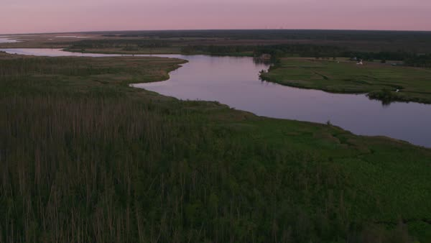

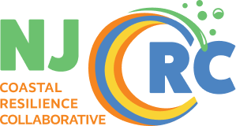
Urban climate adaptation - a rush to resilience?
Leveraging Nature Based Solutions to Enhance Future readiness for Coastal Assets and Communities
New Jersey Coastal Resilience Conference, March 10, 2026
Edgar Westerhof, Arcadis
Edgar J. Westerhof | October 19, 2016
NAREIM Architectural & Engineering Conference
NJAFM, October 24 2018, Atlantic City
Edgar J. Westerhof, Arcadis U.S., Inc
Mullica River – Great Bay
Image Credit Rebuild by Design

Slide 2
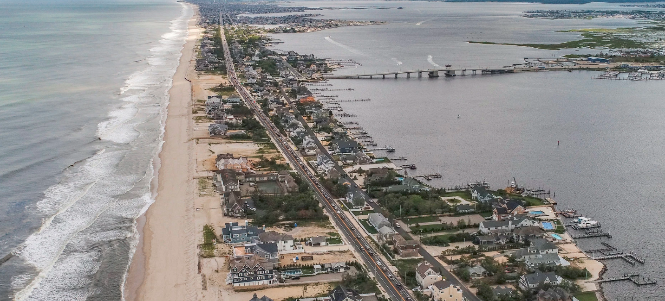
Urban climate adaptation - a rush to resilience?
Edgar J. Westerhof | October 19, 2016
NAREIM Architectural & Engineering Conference
Mullica River – Great Bay
NJAFM, October 24 2018, Atlantic City
Edgar J. Westerhof, Arcadis U.S., Inc
NJAFM, October 24 2018, Atlantic City
Edgar J. Westerhof, Arcadis U.S., Inc
Mantaloking, NJ
Image Credit Rebuild by Design

Slide 3
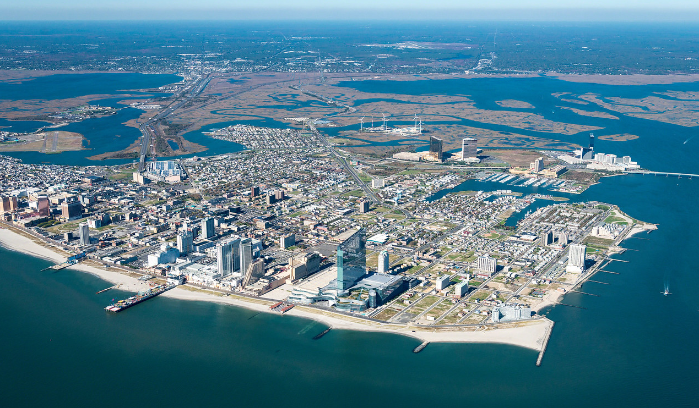
“DUTCH FLOOD CONTROL EXPERT HAS TOUGH LOVE FOR ATLANTIC CITY”
Press Of Atlantic City

Slide 4
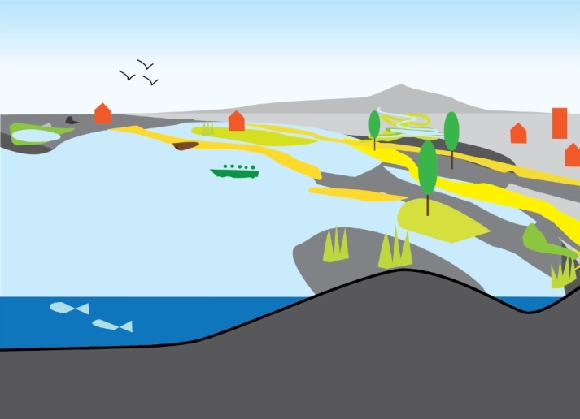
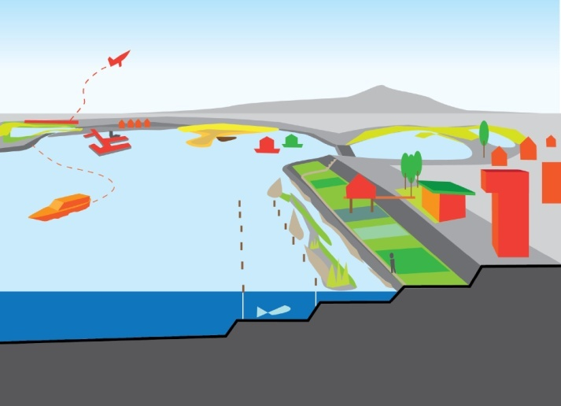
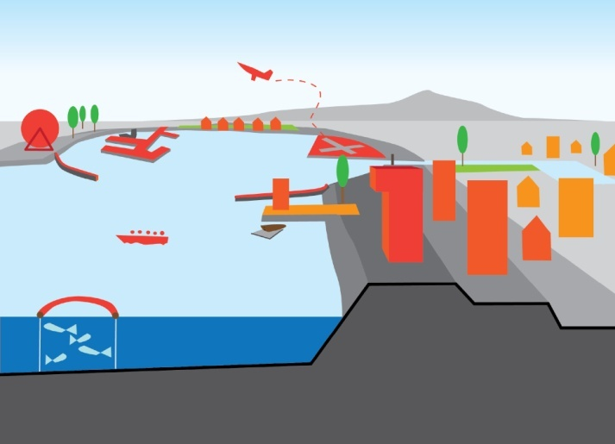
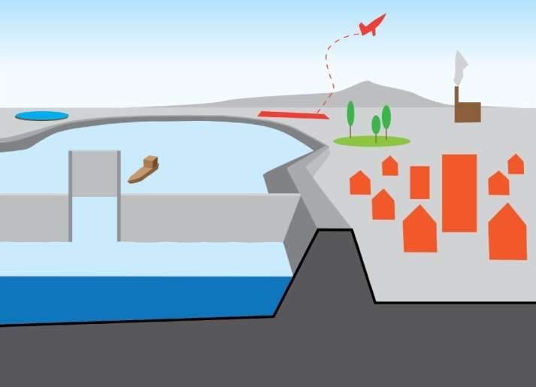
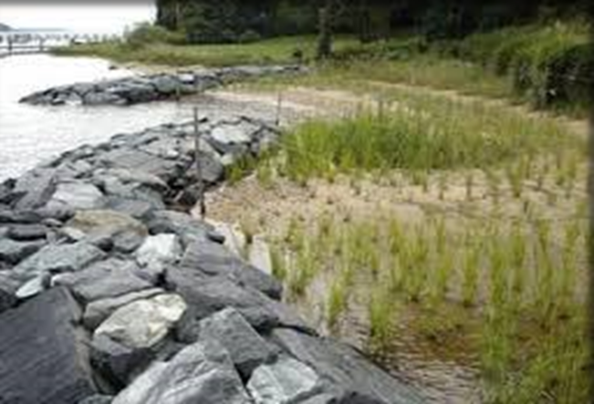
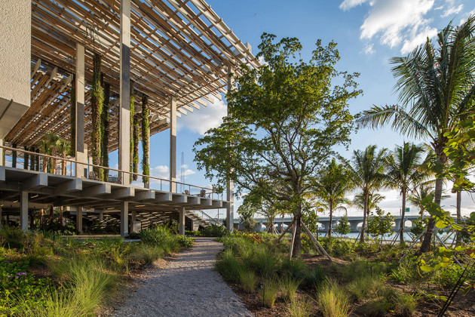
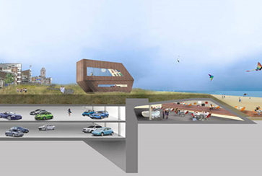
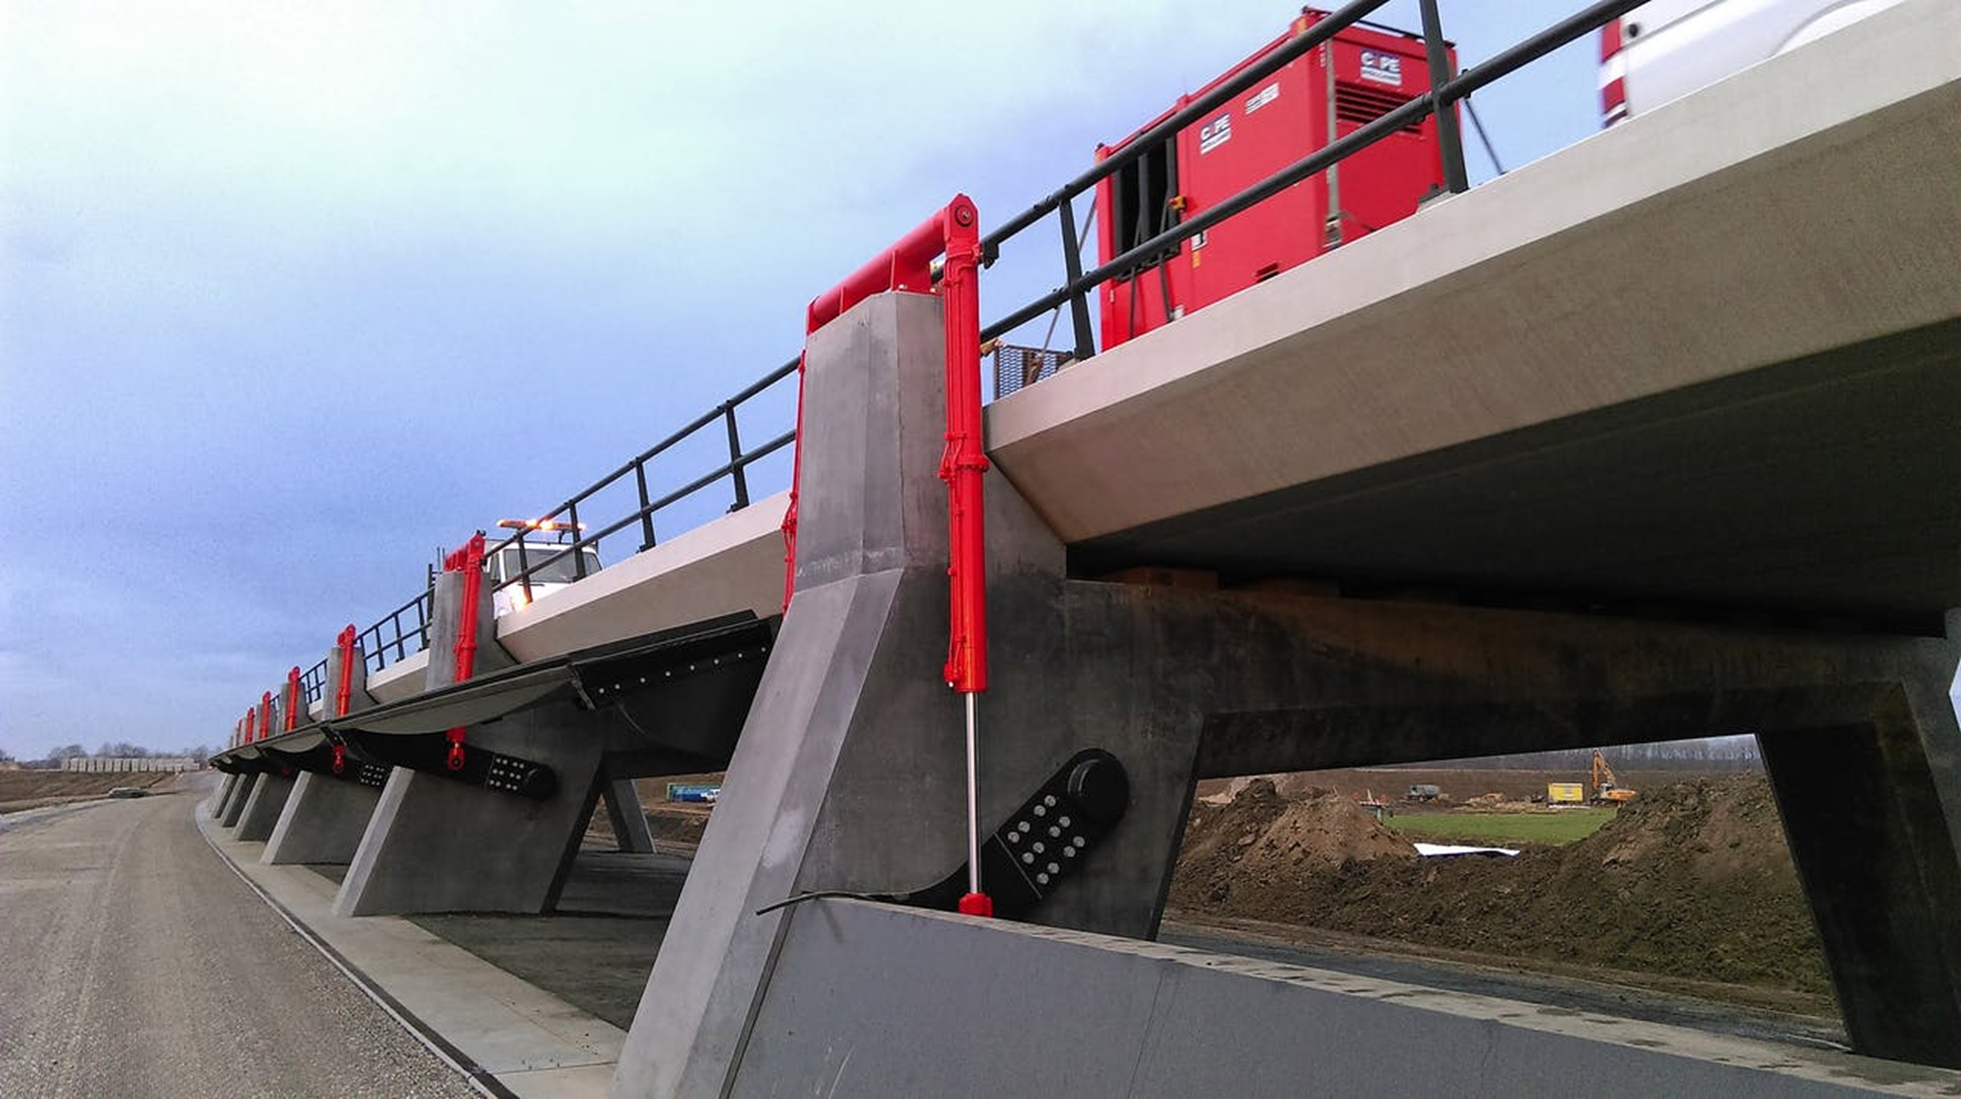
Ecology Driven
Community Driven
Economy Driven
Defense Driven

Slide 5
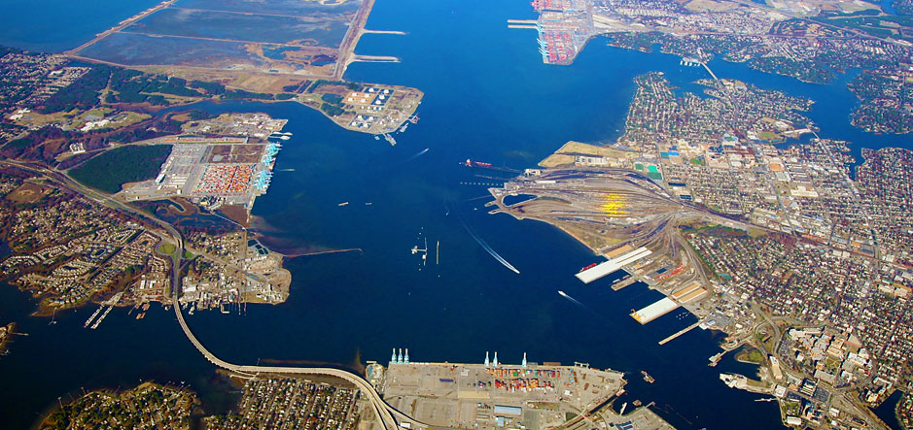
A systems approach to water management
Case Study – Norfolk, Ohio Creek

Slide 6
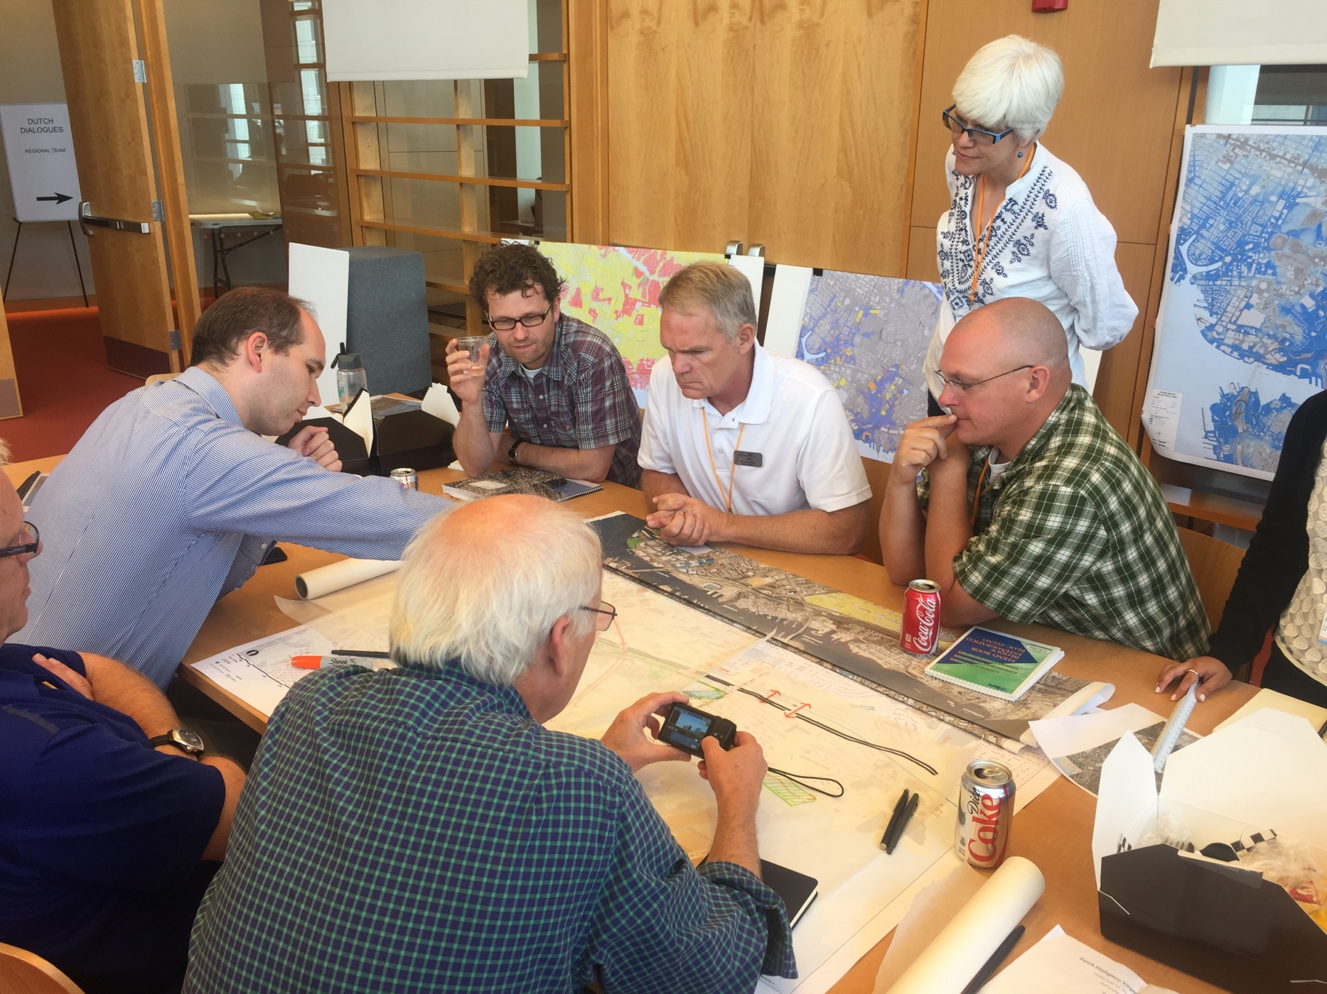



Slide 7
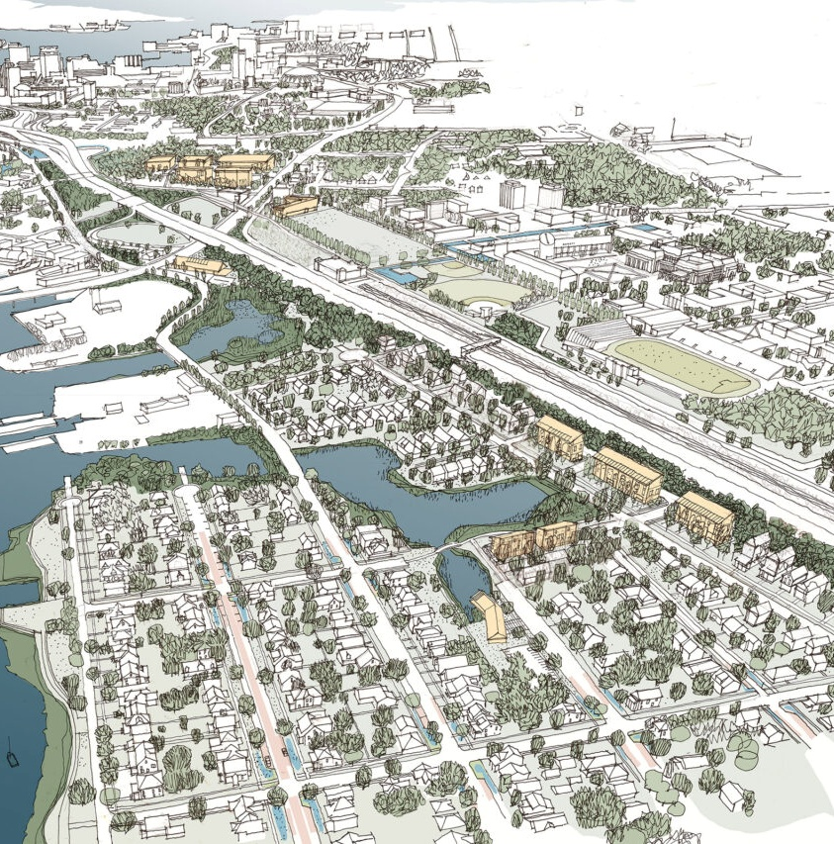
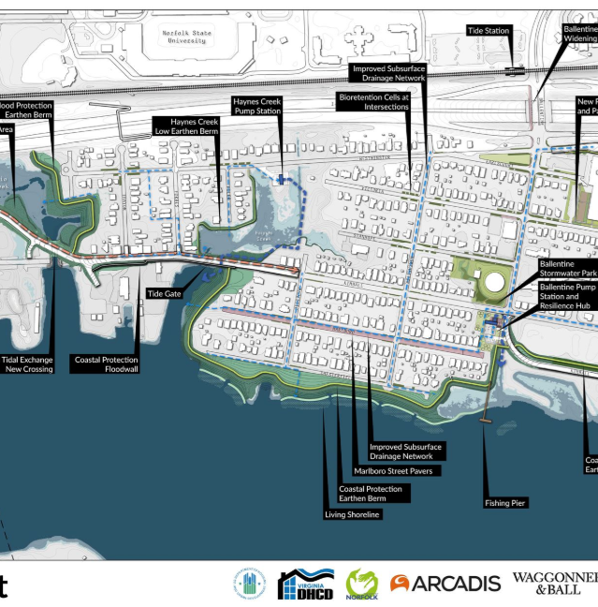

Slide 8
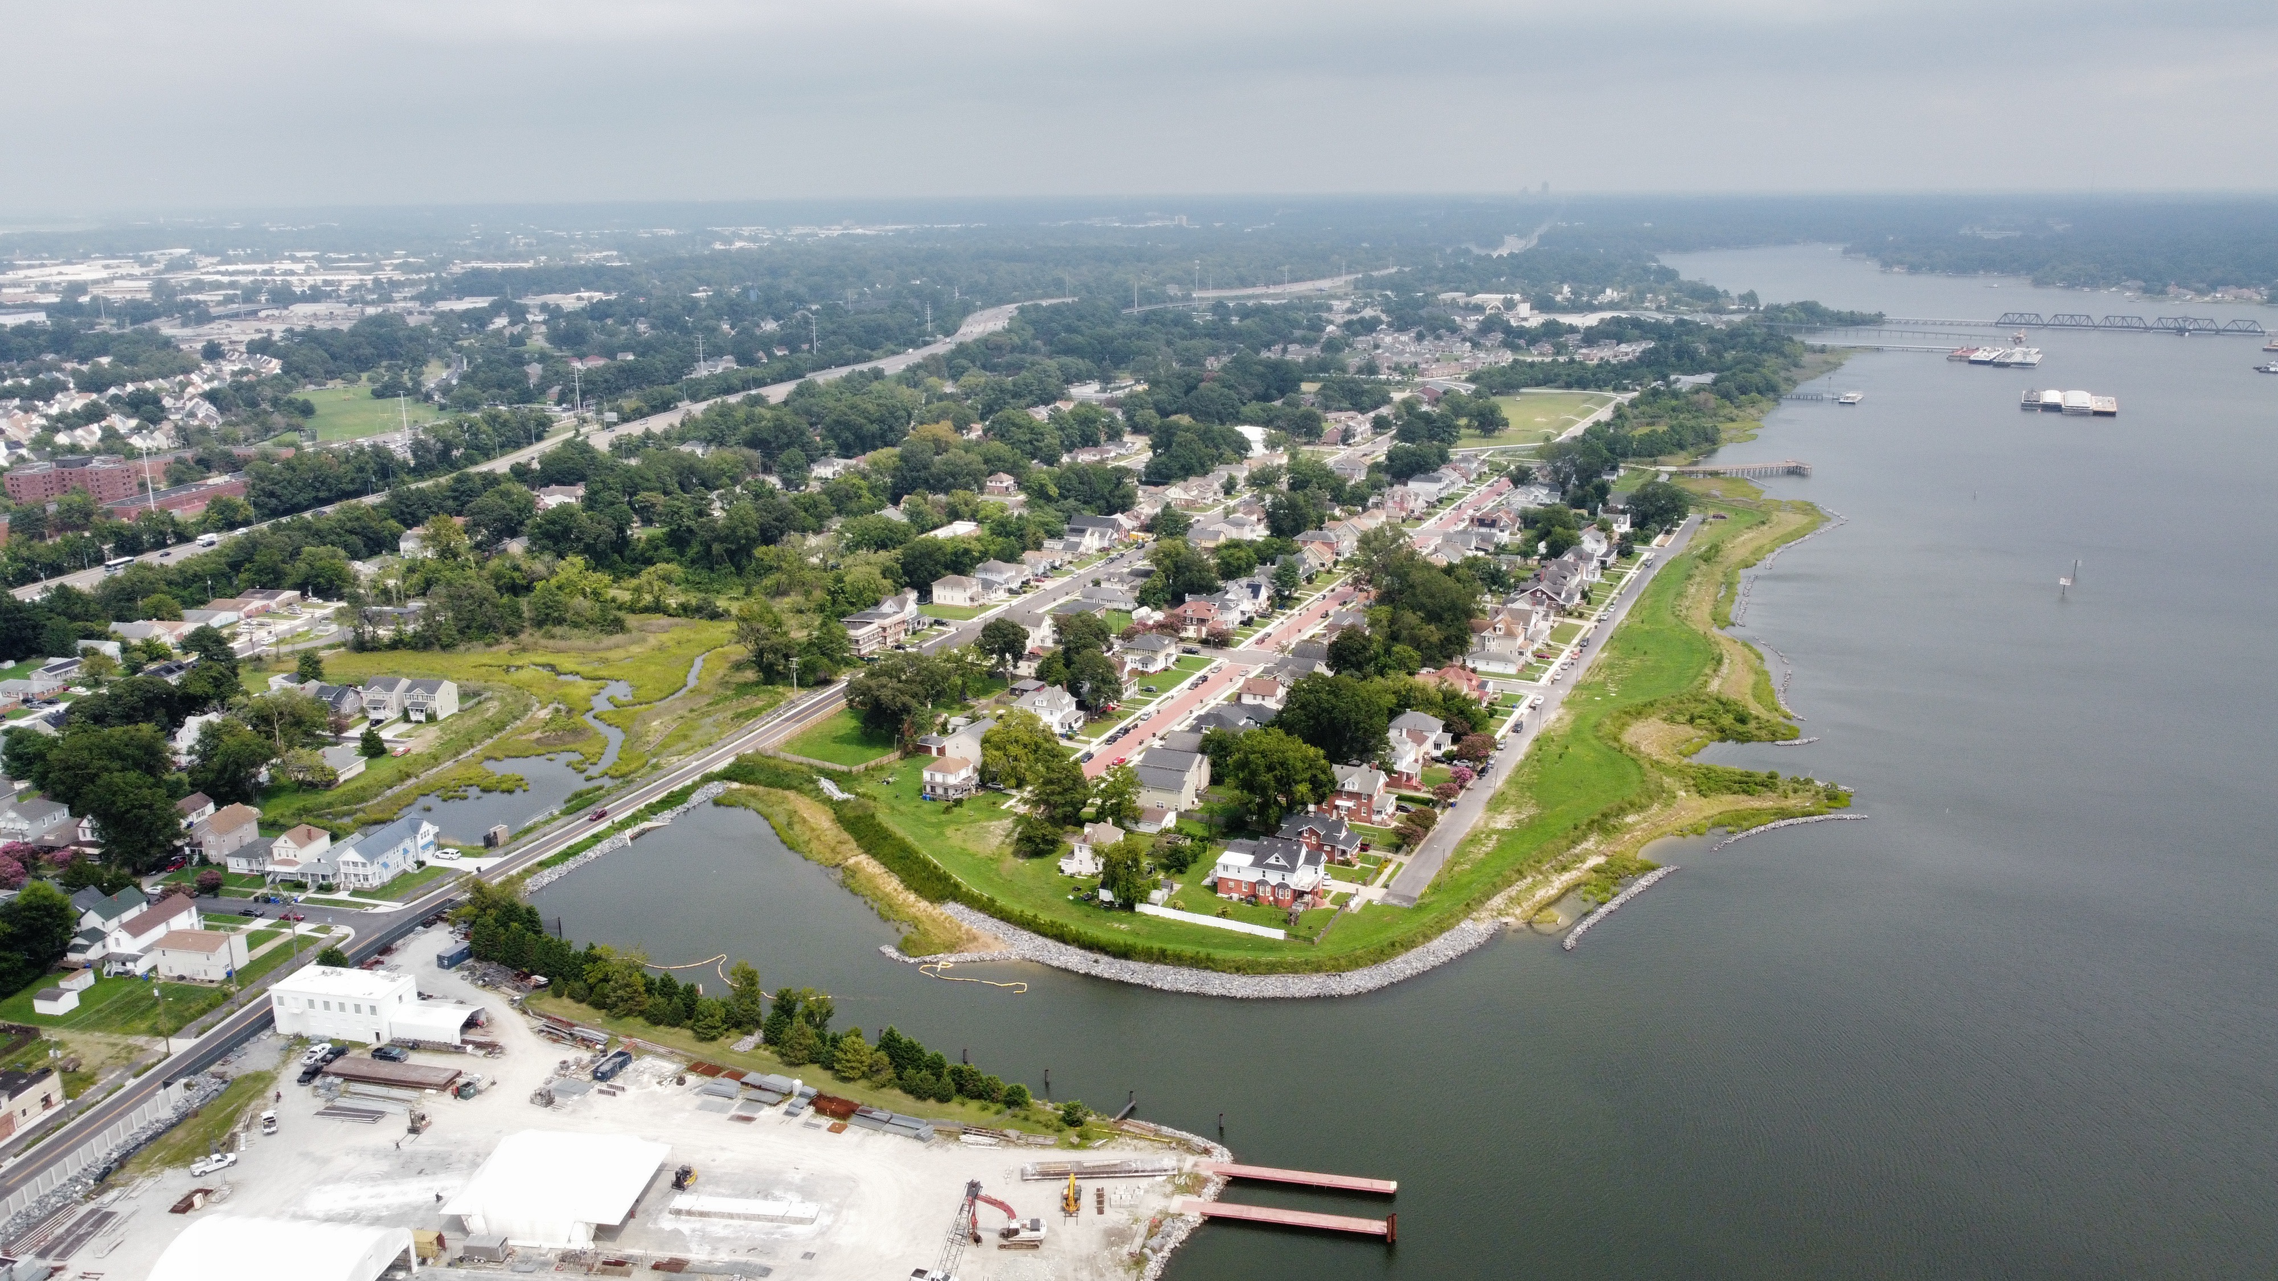


Ohio Creek Flood Resilience
Norfolk, VA
Stormwater Pump Station
Berm with Public Stormwater Resilience Park
Raised Road
Public Fishing Pier
Stormwater Pump Station
Improved Drainage & WW Infrastructure
Green Infrastructure
Living Shorelines/Shoreline Stabilization
Flood Protection Berm
Flood Storage
Stream & Wetlands
Tide Gate
Flood Protection Wall
Notes:
Ohio Creek:
Incorporates habitat restoration design into coastal and pluvial risk management practices blending built and natural solutions
Won multiple awards throughout the industry including the Association of State Floodplain Managers award in 2023.
Served as the lead designer on Ohio Creek Project for the City of Norfolk. Ohio Creek set the standard for flood risk and resilience projects in the Hampton Roads area. This is evident by the project winning multiple awards throughout the industry including the Association of State Floodplain Managers award in 2023.
For this project, the Arcadis team designed 2 large stormwater pumpstations, tide gates, flood barriers/berms, living shoreline and green infrastructure.
Integrated coastal and inland stormwater resilience with ecosystem restoration
Suite of nature-based and engineered solutions
4 ac of new tidal marsh, bioswales, and shoreline vegetation
Extensive community engagement provided meaningful input for key design decisions

Slide 9
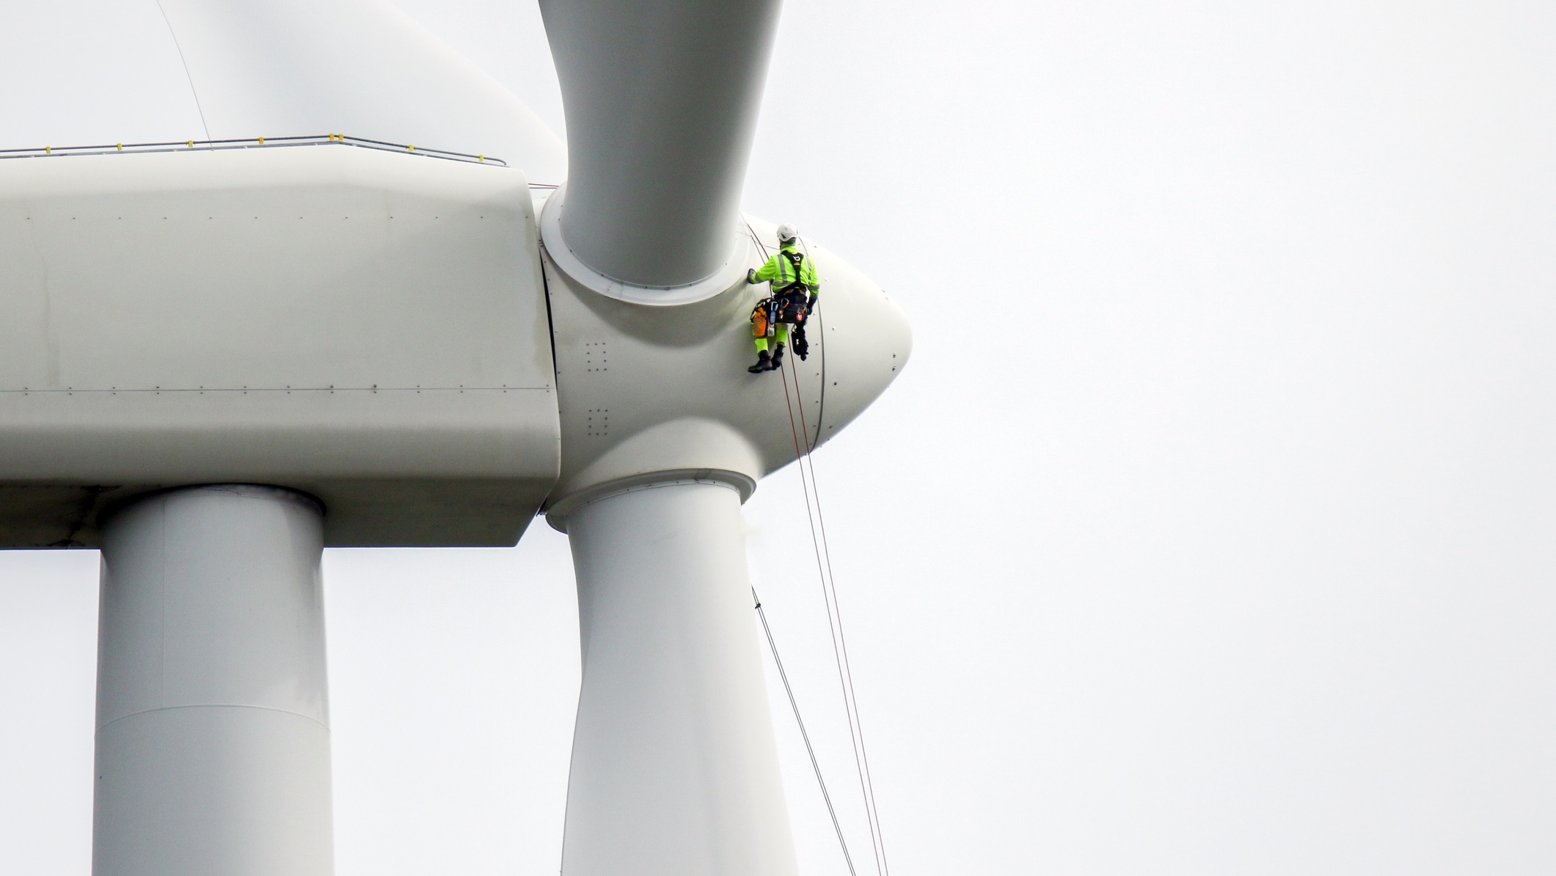
Thank you
Edgar Westerhof
Sr. Vice President – US Director for Climate Adaptation
c 646.246.0144
e edgar.westerhof@arcadis.com
Arcadis. Improving quality of life.

